Slide 3
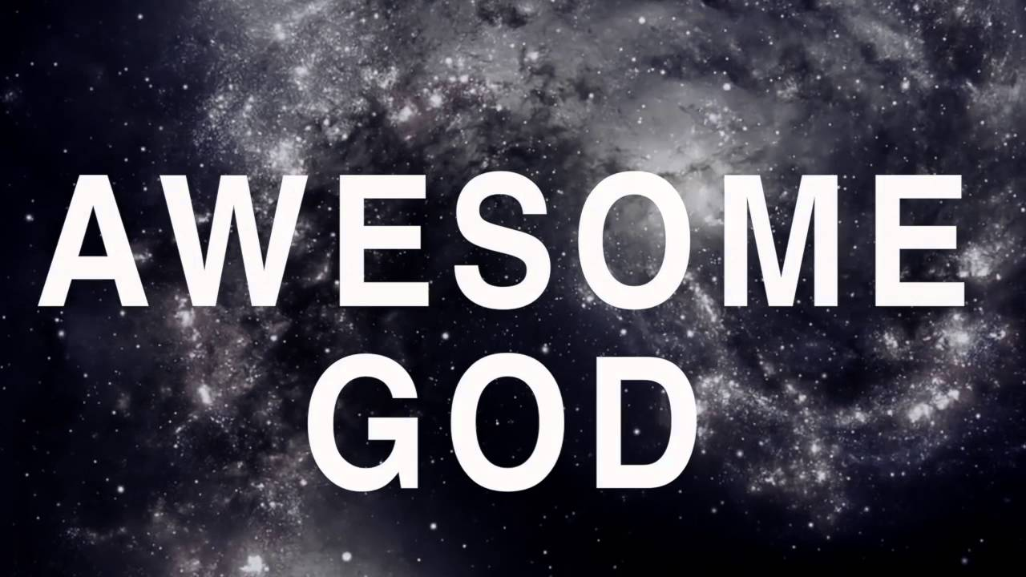
You Are Awesome Lord
By Pastor Fee Soliven
Deuteronomy 7:8-11
Sunday Morning
May 27, 2018

Slide 4
Deuteronomy 7:8-11
8 but because the LORD loves you, and because He would keep the oath which He swore to your fathers, the LORD has brought you out with a mighty hand, and redeemed you from the house of bondage, from the hand of Pharaoh king of Egypt. 9 Therefore know that the LORD your God, He is God, the faithful God who keeps covenant and mercy for a thousand generations with those who love Him and keep His commandments;

Slide 5
10 and He repays those who hate Him to their face, to destroy them. He will not be slack with him who hates Him; He will repay him to his face. 11 Therefore you shall keep the commandment, the statutes, and the judgments which I command you today, to observe them.

Slide 6
How well do you know God?

Slide 7
Isaiah 55:8-9
8 "For My thoughts are not your thoughts, Nor are your ways My ways," says the LORD. 9 "For as the heavens are higher than the earth, So are My ways higher than your ways, And My thoughts than your thoughts.

Slide 8
Deuteronomy 7:9-10
“Know therefore that the Lord your God, He is God, the faithful God, who keeps His covenant and His lovingkindness to a thousandth generation with those who love Him and keep His commandments; but repays those who hate Him to their faces, to destroy them; He will not delay with him who hates Him”

Slide 9
To be Faithful means to be Reliable

Slide 10
Ephesians 2:12-15
(Living Bible)
12 Remember that in those days you were living utterly apart from Christ; you were enemies of God's children, and he had promised you no help. You were lost, without God, without hope.

Slide 11
13 But now you belong to Christ Jesus, and though you once were far away from God, now you have been brought very near to him because of what Jesus Christ has done for you with his blood. 14 For Christ himself is our way of peace. He has made peace between us Jews and you Gentiles by making us all one family, breaking down the wall of contempt that used to separate us.

Slide 12
15 By his death he ended the angry resentment between us, caused by the Jewish laws that favored the Jews and excluded the Gentiles, for he died to annul that whole system of Jewish laws. Then he took the two groups that had been opposed to each other and made them parts of himself; thus he fused us together to become one new person, and at last there was peace.

Slide 13
God’s Faithfulness is Grounded in His Unchanging Nature

Slide 14
Malachi 3:6
“For I the Lord do not change; therefore you, O children of Jacob, are not consumed.

Slide 15
Numbers 23:19
God is not man, that he should lie, or a son of man, that he should change his mind. Has he said, and will he not do it? Or has he spoken, and will he not fulfill it?

Slide 16
Hebrews 13:8
“Jesus Christ is the same yesterday, today, and forever”

Slide 17
Yet so Many People have a Lesser View of God

Slide 18
1. They think they are free to live as they please, but when trouble comes, God will bail them out.

Slide 19
2. They believe God doesn’t pay attention to sin unless it’s something really bad like murder.

Slide 20
3. They are confident that God understands their faults and failures and will overlook their sin.

Slide 21
Matthew 12:35-37
35 The good man brings good things out of the good stored up in him, and the evil man brings evil things out of the evil stored up in him. 36 But I tell you that men will have to give account on the day of judgment for every careless word they have spoken. 37 For by your words you will be acquitted, and by your words you will be condemned."

Slide 22
Numbers 32:23
“Be sure your sin will find you out”

Slide 23
John 15:13
“Greater love has no one than this, that someone lay down his life for his friends.”

Slide 24
How does God display His faithfulness?

Slide 25
1. He always does what He has said and fulfills every promise He’s made

Slide 26
2. He never forgets, falters, or fails to keep His Word

Slide 27
3. He is reliable, trustworthy, unfailing, unwavering, constant, and steadfast

Slide 28
God’s Attributes are the Foundation for His Faithfulness

Slide 29
Omniscient - (All Knowing)

Slide 30
Psalm 139:1-4
1 O LORD, You have searched me and known me. 2 You know my sitting down and my rising up; You understand my thought afar off. 3 You comprehend my path and my lying down, And are acquainted with all my ways. 4 For there is not a word on my tongue, But behold, O LORD, You know it altogether.

Slide 31
Omnipotent – (All Powerful)

Slide 32
Jeremiah 32:17
“Ah, Sovereign LORD, you have made the heavens and the earth by your great power and outstretched arm. Nothing is too hard for you.”

Slide 33
Omnipresent – (God Fills All Space)

Slide 34
Jeremiah 23:23-24
23 "Can a man hide himself in hiding places So I do not see him?" declares the LORD "Do I not fill the heavens and the earth?" declares the LORD. 24 "Am I a God who is near," declares the LORD, "And not a God far off?

Slide 35
Truthful – (Jesus is The Truth)

Slide 36
John 14:6
Jesus said to him, "I am the way, the truth, and the life. No one comes to the Father except through Me.

Slide 37
Unchanging – (God is Steadfast)

Slide 38
Malachi 3:6
“For I the Lord do not change; therefore you, O children of Jacob, are not consumed.

Slide 39
God’s Word testifies that the Lord is Faithful and Trustworthy

Slide 40
Psalm 56:3
“Whenever I am afraid, I will trust in You”

Slide 41
Psalm 62:8
“Trust in Him at all times, you people; Pour out your heart before Him; God is a refuge for us”

Slide 42
Psalm 36:5
“Your mercy, O LORD, is in the heavens; Your faithfulness reaches to the clouds”

Slide 43
Psalm 119:90
“Your faithfulness endures to all generations; You established the earth, and it abides”

Slide 44
1. How closely does your perception of God align with who He reveals Himself to be in His Word?

Slide 45
2. Are you more likely to view God according to your circumstances and experiences, others’ ideas, or Scripture?

Slide 46
3. Do you truly believe that God is faithful all the time?
.

Slide 47
4. How do your responses to problems, suffering, or trouble affirm or deny this truth?

