Slide 3
Now is the Time to Repent
By Pastor Fee Soliven
Mark 1:9-15
Wednesday Evening
July 25, 2018

Slide 4
9 It came to pass in those days that Jesus came from Nazareth of Galilee, and was baptized by John in the Jordan.

Slide 5
10 And immediately, coming up from the water, He saw the heavens parting and the Spirit descending upon Him like a dove.

Slide 6
11 Then a voice came from heaven, "You are My beloved Son, in whom I am well pleased."

Slide 7
12 And immediately the Spirit drove Him into the wilderness.

Slide 8
13 And He was there in the wilderness forty days, tempted by Satan, and was with the wild beasts; and the angels ministered to Him.

Slide 9
14 Now after John was put in prison, Jesus came to Galilee, preaching the gospel of the kingdom of God,

Slide 10
15 and saying, "The time is fulfilled, and the kingdom of God is at hand. Repent, and believe in the gospel."

Slide 11
9 It came to pass in those days that Jesus came from Nazareth of Galilee, and was baptized by John in the Jordan.

Slide 12
Matthew 2:22-23
22 But when he heard that Archelaus was reigning over Judea instead of his father Herod, he was afraid to go there. And being warned by God in a dream, he turned aside into the region of Galilee. 23 And he came and dwelt in a city called Nazareth, that it might be fulfilled which was spoken by the prophets, "He shall be called a Nazarene."

Slide 13
If John’s baptism was for repentance from sin, why was Jesus baptized?

Slide 14
John 8:46
“Which of you convicts Me of sin? And if I tell the truth, why do you not believe Me?

Slide 15
2 Corinthians 5:21
“For He made Him who knew no sin to be sin for us, that we might become the righteousness of God in Him”

Slide 16
Hebrews 4:15
“For we do not have a High Priest who cannot sympathize with our weaknesses, but was in all points tempted as we are, yet without sin”

Slide 17
1 John 3:5-6
5 And you know that He was manifested to take away our sins, and in Him there is no sin. 6 Whoever abides in Him does not sin. Whoever sins has neither seen Him nor known Him.

Slide 18
(1) to confess sin on behalf of the nation

Slide 19
Isaiah 6:5
“So I said: "Woe is me, for I am undone! Because I am a man of unclean lips, And I dwell in the midst of a people of unclean lips; For my eyes have seen the King, The LORD of hosts."

Slide 20
Nehemiah 1:6
“please let Your ear be attentive and Your eyes open, that You may hear the prayer of Your servant which I pray before You now, day and night, for the children of Israel Your servants, and confess the sins of the children of Israel which we have sinned against You. Both my father's house and I have sinned.”

Slide 21
Ezra 9:2
“For they have taken some of their daughters as wives for themselves and their sons, so that the holy seed is mixed with the peoples of those lands. Indeed, the hand of the leaders and rulers has been foremost in this trespass."

Slide 22
(2) to fulfill all righteousness in order to accomplish God’s mission and advance God’s work in the world;

Slide 23
Matthew 3:15
“But Jesus answered and said to him, "Permit it to be so now, for thus it is fitting for us to fulfill all righteousness…”

Slide 24
(3) to inaugurate his public ministry to bring the message of salvation to all people;

Slide 25
(4) to show support for John’s ministry

Slide 26
(5) to give us an example to follow

Slide 27
10 And immediately, coming up from the water, He saw the heavens parting and the Spirit descending upon Him like a dove.

Slide 28
Isaiah 64:2
“The consuming fire of your glory would burn down the forests and boil the oceans dry. The nations would tremble before you; then your enemies would learn the reason for your fame”

Slide 29
11 Then a voice came from heaven, "You are My beloved Son, in whom I am well pleased."

Slide 30
“You are my beloved Son.”

Slide 31
Luke 1:35
And the angel answered and said to her, "The Holy Spirit will come upon you, and the power of the Highest will overshadow you; therefore, also, that Holy One who is to be born will be called the Son of God”

Slide 32
John 15:26
“But when the Helper comes, whom I shall send to you from the Father, the Spirit of truth who proceeds from the Father, He will testify of Me”

Slide 33
1 Peter 1:1-2
“elect according to the foreknowledge of God the Father, in sanctification of the Spirit, for obedience and sprinkling of the blood of Jesus Christ: Grace to you and peace be multiplied”

Slide 34
12 And immediately the Spirit drove Him into the wilderness.

Slide 35
13 And He was there in the wilderness forty days, tempted by Satan, and was with the wild beasts; and the angels ministered to Him.

Slide 36
announcing Jesus’ birth to Mary
reassuring Joseph
naming Jesus
(4) announcing Jesus’ birth to the shepherds
(5) protecting Jesus by sending his family to Egypt
(6) ministering to Jesus in Gethsemane

Slide 37
14 Now after John was put in prison, Jesus came to Galilee, preaching the gospel of the kingdom of God,

Slide 38
Matthew 14:1-12
1 At that time Herod the tetrarch heard the report about Jesus 2 and said to his servants, "This is John the Baptist; he is risen from the dead, and therefore these powers are at work in him." 3 For Herod had laid hold of John and bound him, and put him in prison for the sake of Herodias, his brother Philip's wife.

Slide 39
4 Because John had said to him, "It is not lawful for you to have her." 5 And although he wanted to put him to death, he feared the multitude, because they counted him as a prophet. 6 But when Herod's birthday was celebrated, the daughter of Herodias danced before them and pleased Herod. 7 Therefore he promised with an oath to give her whatever she might ask. 8 So she, having been prompted by her mother, said, "Give me John the Baptist's head here on a platter."

Slide 40
9 And the king was sorry; nevertheless, because of the oaths and because of those who sat with him, he commanded it to be given to her. 10 So he sent and had John beheaded in prison. 11 And his head was brought on a platter and given to the girl, and she brought it to her mother. 12 Then his disciples came and took away the body and buried it, and went and told Jesus.

Slide 41
15 and saying, "The time is fulfilled, and the kingdom of God is at hand. Repent, and believe in the gospel."

Slide 42
Matthew 3:2
and saying, "Repent, for the kingdom of heaven is near."

Slide 43
Matthew 4:17
From that time on Jesus began to preach, "Repent, for the kingdom of heaven is near."

Slide 44
Acts 2:38
Peter replied, "Repent and be baptized, every one of you, in the name of Jesus Christ for the forgiveness of your sins, and you will receive the gift of the Holy Spirit.

Slide 45
Acts 20:21
testifying to Jews and Greeks alike about repentance to God and faith in our Lord Jesus.

Slide 46
Galatians 4:4
But when the time had fully come, God sent His Son, born of a woman, born under the Law,

Slide 47
Ephesians 1:10
as a plan for the fullness of time, to bring all things in heaven and on earth together in Christ.

Slide 48
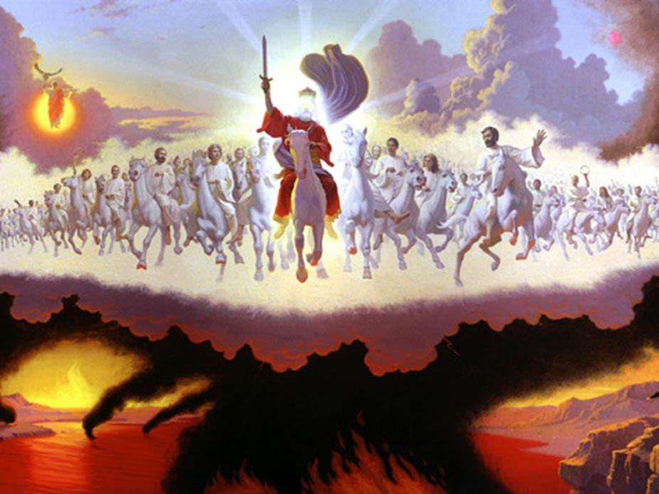
13 And He was there in the wilderness forty days, tempted by Satan, and was with the wild beasts; and the angels ministered to Him.

