Slide 3
Has Heaven Indicted America?
Part 1 of 4
by Pastor Fee Soliven
Proverbs 14:32-35
Sunday Morning
August 12, 2018

Slide 4
32 The wicked is banished in his wickedness, But the righteous has a refuge in his death. 33 Wisdom rests in the heart of him who has understanding, But what is in the heart of fools is made known. 34 Righteousness exalts a nation, But sin is a reproach to any people. 35 The king's favor is toward a wise servant, But his wrath is against him who causes shame.

Slide 5
The Death of America

Slide 6
Our Rejection of God

Slide 7
Psalm 9:15-17
15 The nations have sunk down in the pit which they made; In the net which they hid, their own foot is caught. 16 The LORD is known by the judgment He executes; The wicked is snared in the work of his own hands. Meditation. Selah 17 The wicked shall be turned into hell, And all the nations that forget God.

Slide 8
1. Since 1973 we have murdered our babies in their mothers’ wombs at the rate of 4,000 per day, totaling nearly 60 million, and their blood cries out for vengeance.

Slide 9
2. We consume more than one-half of all the illegal drugs produced in the world, yet we constitute only 4.4% of the world’s population.

Slide 10
3. We spend $13.3 billion dollars per year on pornography, and 60% of all the Internet porn websites are hosted in our nation.

Slide 11
4. Our total of cohabiting partners has increased from 500,000 in 1960 to over 14 million in 2018.

Slide 12
5. Our divorce rate in 2018 was the fifth highest in the world, at 46%.

Slide 13
6. Forty percent of all our children are born to unmarried women.

Slide 14
7. We lost $119.6 billion in various forms of gambling during 2016.

Slide 15
8. Our number one drug problem is alcohol, producing over 30 million adults who are either alcoholics or who are abusing alcohol.

Slide 16
9. Our nation has become a debt junkie, leading the world in both government debt and personal debt.

Slide 17
10. Blasphemy of God’s name, His Word, and His Son has become commonplace in our media.

Slide 18
11. We are the moral polluter of planet earth through the distribution of our immoral, violent and blasphemous television programs and movies.

Slide 19
12. We have wavered back and forth in our support of Israel, and in the process, we have forced them into the self-destructive appeasement policy of trading land for peace.

Slide 20
The Consequences of Rebellion

Slide 21
Isaiah 5:20
“Woe to those who call evil good, and good evil; Who put darkness for light, and light for darkness; Who put bitter for sweet, and sweet for bitter”

Slide 22
1. Our schools have become arenas of deadly violence.

Slide 23
2. Our prison population is increasing exponentially, from 500,000 in 1980 to over 2.3 million in 2018. We have the highest incarceration rate in the world.

Slide 24
3. Over 1.5 million of our women are reported victims of domestic violence each year, and it is estimated that the majority of cases are never reported.

Slide 25
4. We are currently averaging over 4 million child abuse cases each year, involving 7.2 million children.

Slide 26
5. We experienced more than 1.2 million violent crimes during 2016, with more than 17,000 people murdered.

Slide 27
6. Teen violence has increased exponentially, with youngsters killing each other over tennis shoes.

Slide 28
7. Gangs are terrorizing our cities.

Slide 29
8. Even the nicest of our neighborhoods are no longer safe, requiring us to protect our homes with security systems and weapons.

Slide 30
9. Our money is becoming increasingly worthless.

Slide 31
10. Our economy is being choked to death by a pile of debt that is beyond comprehension.

Slide 32
11. Our major corporations and labor unions are in bondage to greed.

Slide 33
12. Our society has become deeply divided, splintered among competing groups defined by racial, religious and economic factors.

Slide 34
13. Our families are being destroyed by an epidemic of divorce.

Slide 35
14. Our entertainment industry consists of vulgarians amusing barbarians.

Slide 36
15. One of our fastest growing businesses is the pagan practice of tattooing and body piercing.

Slide 37
16. Our universities and media outlets are controlled by radical leftists who hold Capitalism and Christianity in contempt and who scoff at God and His Word.

Slide 38
17. Our federal government has become top-heavy with bureaucrats who are insensitive to taxpayers.

Slide 39
18. Our politicians have become more concerned with power than service.

Slide 40
19. All levels of government have become increasingly oppressive, seeking to regulate every aspect of our lives.

Slide 41
20. Our legal system has been hijacked by activists who desire to impose their will on the people, regardless of what the people desire.

Slide 42
21. Our freedom of speech is being threatened by “hate crime” legislation.

Slide 43
22. Our forms of sports are becoming increasingly violent, reminiscent of the gladiators of ancient Rome.

Slide 44
23. Our society has become star-stuck, more interested in celebrities than people of integrity.

Slide 45
24. Our churches are caught up in an epidemic of apostasy as they set aside the Word of God in an effort to cozy up to the world and gain its approval.

Slide 46
25. We are experiencing one major natural disaster after another in unprecedented volume and ferocity.

Slide 47
26. We have become afflicted with a plague of sexual perversion, producing an army of hard core militant homosexuals.

Slide 48
Jeremiah 6:15
Were they ashamed when they had committed abomination? No! They were not at all ashamed; Nor did they know how to blush. Therefore they shall fall among those who fall; At the time I punish them, They shall be cast down," says the LORD.

Slide 49
Cultural Christianity

Slide 50
According to Gallup polling, as of December 2017, 72% of Americans claimed to be Christians, as compared to 85% in 1990.
Not only has the percentage dropped dramatically, but the evidence of Christianity in the lives of those who claim to be Christians is almost nil.

Slide 51
Evangelical Christianity

Slide 52
19% are living with a partner outside of marriage.
37% do not believe the Bible to be totally accurate.
45% do not believe Jesus was sinless.
52% do not believe Satan is real.
57% do not believe Jesus is the only way to eternal life.
57% believe that good works play a part in gaining eternal life.

Slide 53
Christian Confusion

Slide 54
2 Thessalonians 2:9-12
9 The coming of the lawless one will be in accordance with the work of Satan displayed in all kinds of counterfeit miracles, signs and wonders, 10 and in every sort of evil that deceives those who are perishing. They perish because they refused to love the truth and so be saved.

Slide 55
11 For this reason God sends them a powerful delusion so that they will believe the lie 12 and so that all will be condemned who have not believed the truth but have delighted in wickedness.

Slide 56
Nahum 1:2-5
(Living Bible Translation)
2 God is jealous over those he loves; that is why he takes vengeance on those who hurt them. He furiously destroys their enemies. 3 He is slow in getting angry, but when aroused, his power is incredible, and he does not easily forgive. He shows his power in the terrors of the cyclone and the raging storms; clouds are billowing dust beneath his feet!

Slide 57
4 At his command the oceans and rivers become dry sand; the lush pastures of Bashan and Carmel fade away; the green forests of Lebanon wilt. 5 In his presence mountains quake and hills melt; the earth crumbles, and its people are destroyed.

Slide 58
The Steps to Destruction

Slide 59
Romans 1:24-25
24 So God let them go ahead into every sort of sex sin, and do whatever they wanted to-yes, vile and sinful things with each other's bodies. 25 Instead of believing what they knew was the truth about God, they deliberately chose to believe lies. So they prayed to the things God made, but wouldn't obey the blessed God who made these things.

Slide 60
Romans 1:26-27
26 That is why God let go of them and let them do all these evil things, so that even their women turned against God's natural plan for them and indulged in sex sin with each other. 27 And the men, instead of having normal sex relationships with women, burned with lust for each other, men doing shameful things with other men and, as a result, getting paid within their own souls with the penalty they so richly deserved.

Slide 61
Romans 1:28-32
28 Furthermore, since they did not think it worthwhile to retain the knowledge of God, he gave them over to a depraved mind, to do what ought not to be done. 29 They have become filled with every kind of wickedness, evil, greed and depravity. They are full of envy, murder, strife, deceit and malice. They are gossips,

Slide 62
30 slanderers, God-haters, insolent, arrogant and boastful; they invent ways of doing evil; they disobey their parents; 31 they are senseless, faithless, heartless, ruthless. 32 Although they know God's righteous decree that those who do such things deserve death, they not only continue to do these very things but also approve of those who practice them.

Slide 63
Jeremiah 30:12-14
12 "This is what the LORD says: "'Your wound is incurable, your injury beyond healing. 13 There is no one to plead your cause, no remedy for your sore, no healing for you. 14 All your allies have forgotten you; they care nothing for you. I have struck you as an enemy would and punished you as would the cruel, because your guilt is so great and your sins so many.

Slide 64
Our Prophetic Type

Slide 65
2 Chronicles 36:15-16
15 The LORD, the God of their fathers, sent word to them again and again by His messengers, because He had compassion on His people and on His dwelling place; 16 but they continually mocked the messengers of God, despised His words and scoffed at His prophets, until the wrath of the LORD arose against His people,

Slide 66
Our Destiny

Slide 67
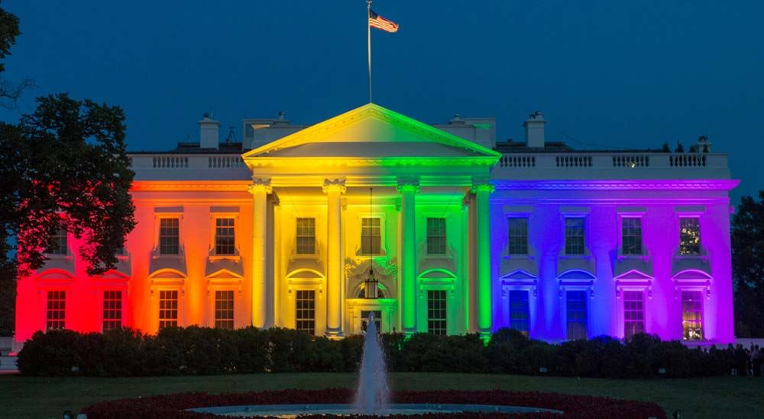
11. Our major corporations and labor unions are in bondage to greed.

Slide 68
1. President Obama left office with a 60% approval rating.
2. Obama’s designated heir, Hillary Clinton, received three million more votes than Donald Trump.
3. The future of our nation, the Millennials (ages 18-28), supported an out-and-out Socialist, and when he failed to get the Democratic nomination, they supported Clinton overwhelmingly.

Slide 69
There is a famine of the Word of God in our Nation
Amos 8:11
"Behold, the days are coming," says the Lord GOD, "That I will send a famine on the land, Not a famine of bread, Nor a thirst for water, But of hearing the words of the LORD.

