Slide 3
End of Days
By Pastor Fee Soliven
Mark 13:1-12
Wednesday Evening
July 31, 2019

Slide 4
1 Then as He went out of the temple, one of His disciples said to Him, "Teacher, see what manner of stones and what buildings are here!“2 And Jesus answered and said to him, "Do you see these great buildings? Not one stone shall be left upon another, that shall not be thrown down."

Slide 5
3 Now as He sat on the Mount of Olives opposite the temple, Peter, James, John, and Andrew asked Him privately, 4 Tell us, when will these things be? And what will be the sign when all these things will be fulfilled?" 5 And Jesus, answering them, began to say: "Take heed that no one deceives you. 6 For many will come in My name, saying, 'I am He,' and will deceive many.

Slide 6
7 But when you hear of wars and rumors of wars, do not be troubled; for such things must happen, but the end is not yet. 8 For nation will rise against nation, and kingdom against kingdom. And there will be earthquakes in various places, and there will be famines and troubles. These are the beginnings of sorrows.

Slide 7
9 But watch out for yourselves, for they will deliver you up to councils, and you will be beaten in the synagogues. You will be brought before rulers and kings for My sake, for a testimony to them. 10 And the gospel must first be preached to all the nations. 11 But when they arrest you and deliver you up, do not worry beforehand, or premeditate what you will speak. But whatever is given you in that hour, speak that; for it is not you who speak, but the Holy Spirit.

Slide 8
1 Then as He went out of the temple, one of His disciples said to Him, "Teacher, see what manner of stones and what buildings are here!"

Slide 9
2 Kings 25:8-10
8 And in the fifth month, on the seventh day of the month (which was the nineteenth year of King Nebuchadnezzar king of Babylon), Nebuzaradan the captain of the guard, a servant of the king of Babylon, came to Jerusalem.

Slide 10
9 He burned the house of the LORD and the king's house; all the houses of Jerusalem, that is, all the houses of the great, he burned with fire. 10 And all the army of the Chaldeans who were with the captain of the guard broke down the walls of Jerusalem all around.

Slide 11
Ezra 6:14-17
14 So the elders of the Jews built, and they prospered through the prophesying of Haggai the prophet and Zechariah the son of Iddo. And they built and finished it, according to the commandment of the God of Israel, and according to the command of Cyrus, Darius, and Artaxerxes king of Persia.

Slide 12
15 Now the temple was finished on the third day of the month of Adar, which was in the sixth year of the reign of King Darius. 16 Then the children of Israel, the priests and the Levites and the rest of the descendants of the captivity, celebrated the dedication of this house of God with joy.

Slide 13
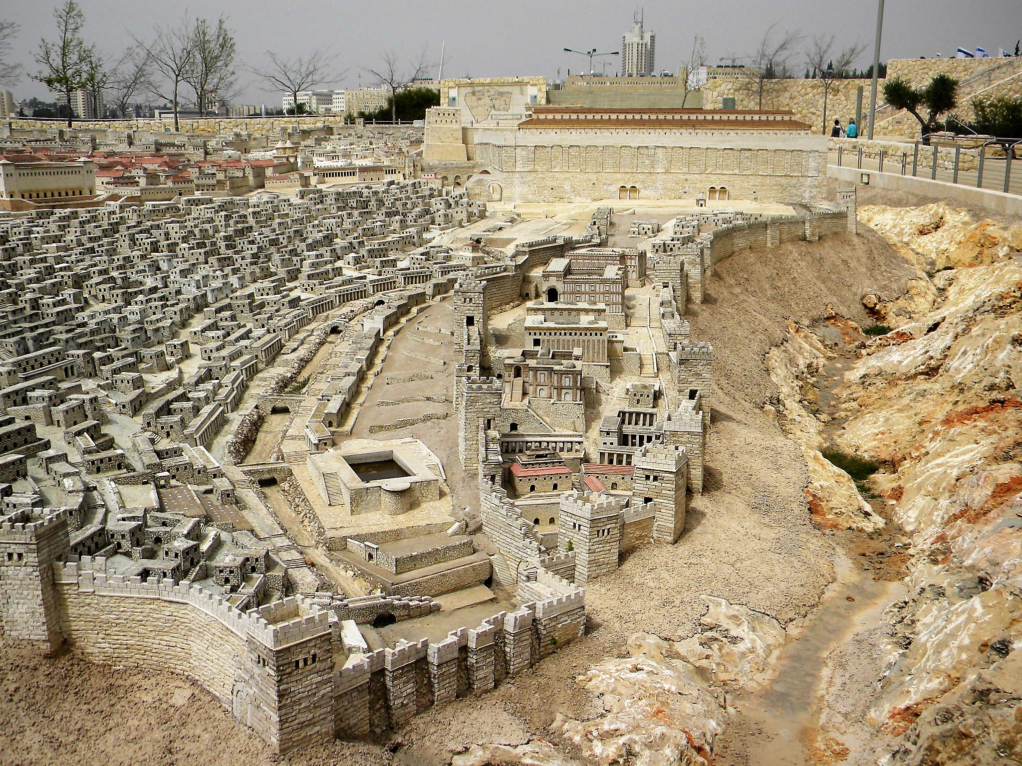
Romans 13:1-7
1 Let every soul be subject to the governing authorities. For there is no authority except from God, and the authorities that exist are appointed by God. 2 Therefore whoever resists the authority resists the ordinance of God, and those who resist will bring judgment on themselves.

Slide 14
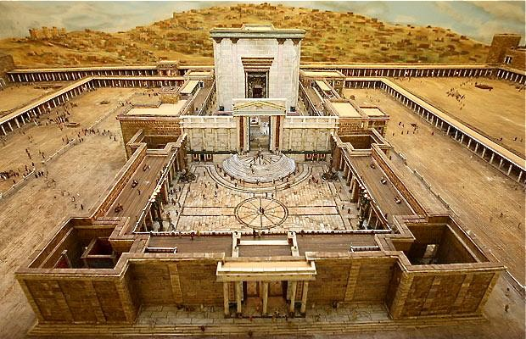
3 For rulers are not a terror to good works, but to evil. Do you want to be unafraid of the authority? Do what is good, and you will have praise from the same. 4 For he is God's minister to you for good. But if you do evil, be afraid; for he does not bear the sword in vain; for he is God's minister, an avenger to execute wrath on him who practices evil.

Slide 15
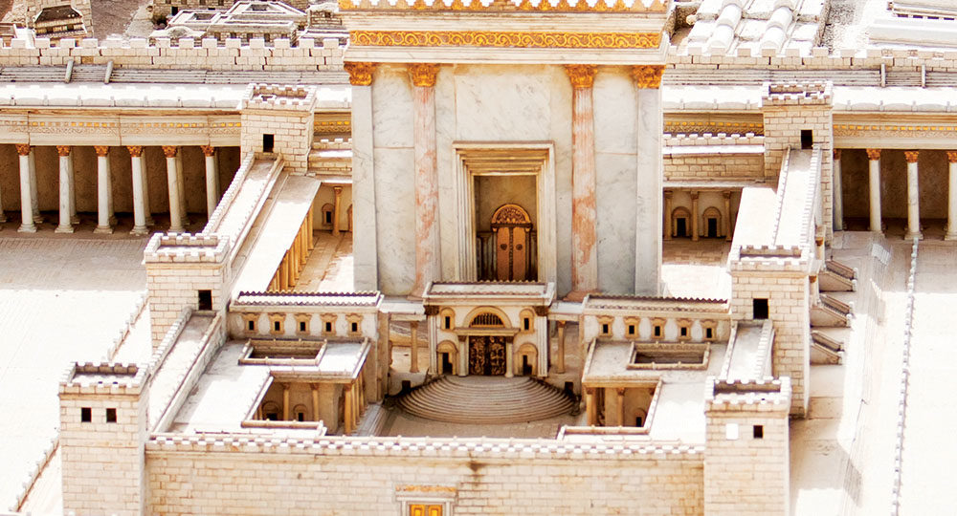
5 Therefore you must be subject, not only because of wrath but also for conscience' sake. 6 For because of this you also pay taxes, for they are God's ministers attending continually to this very thing. 7 Render therefore to all their due: taxes to whom taxes are due, customs to whom customs, fear to whom fear, honor to whom honor.

Slide 16
2 And Jesus answered and said to him, "Do you see these great buildings? Not one stone shall be left upon another, that shall not be thrown down."

Slide 17
Micah 3:8-12
8 But truly I am full of power by the Spirit of the LORD, And of justice and might, To declare to Jacob his transgression And to Israel his sin. 9 Now hear this, you heads of the house of Jacob And rulers of the house of Israel, Who abhor justice And pervert all equity, 10 Who build up Zion with bloodshed And Jerusalem with iniquity:

Slide 18
11 Her heads judge for a bribe, Her priests teach for pay, And her prophets divine for money. Yet they lean on the LORD, and say, "Is not the LORD among us? No harm can come upon us." 12 Therefore because of you Zion shall be plowed like a field, Jerusalem shall become heaps of ruins, And the mountain of the temple Like the bare hills of the forest.

Slide 19
Jeremiah 26:6-9
6 then I will make this house like Shiloh, and will make this city a curse to all the nations of the earth." ' " 7 So the priests and the prophets and all the people heard Jeremiah speaking these words in the house of the LORD. 8 Now it happened, when Jeremiah had made an end of speaking all that the LORD had commanded him to speak to all the people, that the priests and the prophets and all the people seized him, saying, "You will surely die!

Slide 20
9 Why have you prophesied in the name of the LORD, saying, 'This house shall be like Shiloh, and this city shall be desolate, without an inhabitant'?" And all the people were gathered against Jeremiah in the house of the LORD.

Slide 21
3 Now as He sat on the Mount of Olives opposite the temple, Peter, James, John, and Andrew asked Him privately, 4 Tell us, when will these things be? And what will be the sign when all these things will be fulfilled?"

Slide 22
1. They wanted to know when this would happen especially the destruction of the Temple

Slide 23
2. What sign would show that Jesus’ words will be fulfilled

Slide 24
5 And Jesus, answering them, began to say: "Take heed that no one deceives you. 6 For many will come in My name, saying, 'I am He,' and will deceive many.

Slide 25
“Don’t let anyone mislead you”

Slide 26
Revelation 1:7-8
7 Behold, He is coming with clouds, and every eye will see Him, even they who pierced Him. And all the tribes of the earth will mourn because of Him. Even so, Amen. 8 I am the Alpha and the Omega, the Beginning and the End," says the Lord, "who is and who was and who is to come, the Almighty."

Slide 27
7 But when you hear of wars and rumors of wars, do not be troubled; for such things must happen, but the end is not yet. 8 For nation will rise against nation, and kingdom against kingdom. And there will be earthquakes in various places, and there will be famines and troubles. These are the beginnings of sorrows.

Slide 28
“Do Not Be Troubled.”

Slide 29
New York Times Reports:
What is a war? War is defined as an active conflict that has claimed more than 1,000 lives. Has the world ever been at peace?

Slide 30
Of the past 3,400 years, humans have been entirely at peace for 268 of them, or just 8 percent of recorded history. How many people have died in war? At least 108 million people were killed in wars in the twentieth century. Estimates for the total number killed in wars throughout all of human history range from 150 million to 1 billion.

Slide 31
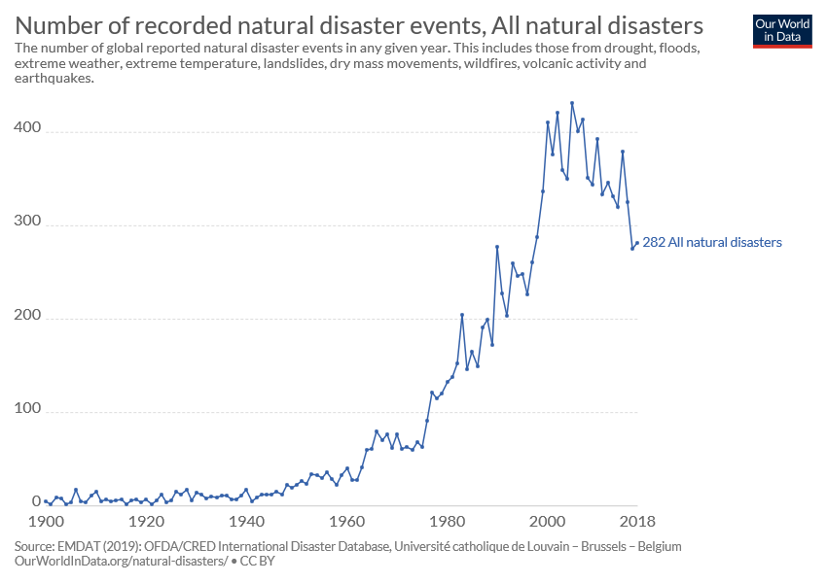

Slide 32
New York Times:
The annual number of “great” earthquakes nearly tripled over the last decade, providing a reminder to Americans that unruptured faults like those in the northwest United States might be due for a Big One. Between 2004 and 2014, 18 earthquakes with magnitudes of 8.0 or more rattled subduction zones around the globe.

Slide 33
That's an increase of 265 percent over the average rate of the previous century, which saw 71 great quakes, according to a report to the annual meeting of the Geological Society of America this week in Vancouver, British Columbia.

Slide 34
Revelation 21:1-4
1 Now I saw a new heaven and a new earth, for the first heaven and the first earth had passed away. Also there was no more sea. 2 Then I, John, saw the holy city, New Jerusalem, coming down out of heaven from God, prepared as a bride adorned for her husband.

Slide 35
3 And I heard a loud voice from heaven saying, "Behold, the tabernacle of God is with men, and He will dwell with them, and they shall be His people. God Himself will be with them and be their God. 4 And God will wipe away every tear from their eyes; there shall be no more death, nor sorrow, nor crying. There shall be no more pain, for the former things have passed away."

Slide 36
9 But watch out for yourselves, for they will deliver you up to councils, and you will be beaten in the synagogues. You will be brought before rulers and kings for My sake, for a testimony to them.

Slide 37
10 And the gospel must first be preached to all the nations.

Slide 38
Acts 2:38-42
38 Then Peter said to them, "Repent, and let every one of you be baptized in the name of Jesus Christ for the remission of sins; and you shall receive the gift of the Holy Spirit. 39 For the promise is to you and to your children, and to all who are afar off, as many as the Lord our God will call."

Slide 39
40 And with many other words he testified and exhorted them, saying, "Be saved from this perverse generation." 41 Then those who gladly received his word were baptized; and that day about three thousand souls were added to them. 42 And they continued steadfastly in the apostles' doctrine and fellowship, in the breaking of bread, and in prayers.

Slide 40
11 But when they arrest you and deliver you up, do not worry beforehand, or premeditate what you will speak. But whatever is given you in that hour, speak that; for it is not you who speak, but the Holy Spirit.

Slide 41
Acts 7:59-60
59 And they stoned Stephen as he was calling on God and saying, "Lord Jesus, receive my spirit." 60 Then he knelt down and cried out with a loud voice, "Lord, do not charge them with this sin." And when he had said this, he fell asleep.

Slide 42
Acts 12:1-2
1 Now about that time Herod the king stretched out his hand to harass some from the church. 2 Then he killed James the brother of John with the sword.

