Slide 3
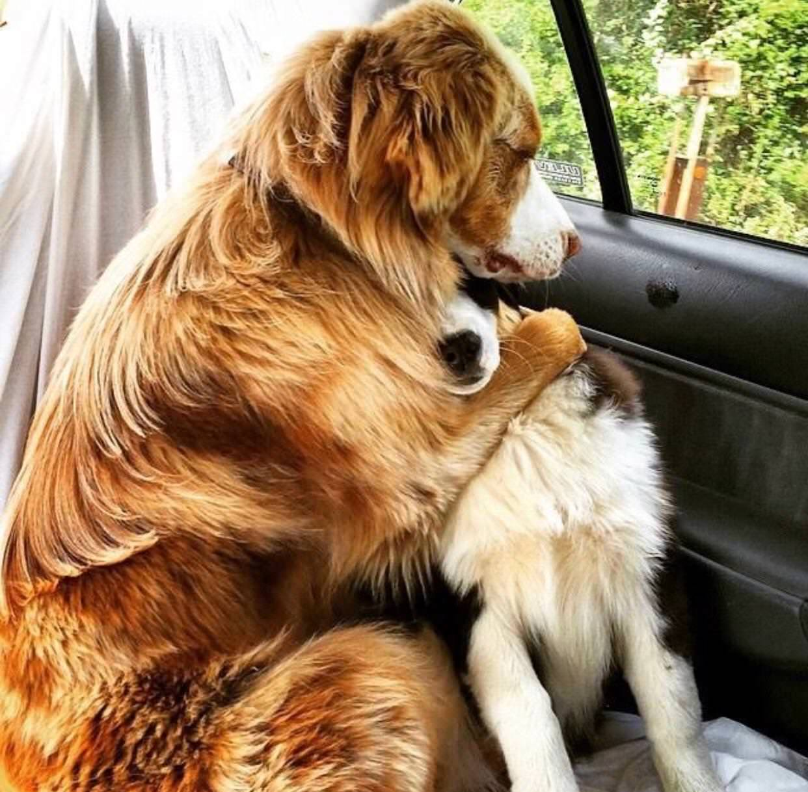
When Someone Hurts You
By Pastor Fee Soliven
Romans 12:19-21
Sunday Morning
July 21, 2019

Slide 4
Romans 12:19-21
19 Beloved do not avenge yourselves, but rather give place to wrath; for it is written, "Vengeance is Mine, I will repay," says the Lord. 20 Therefore "If your enemy is hungry, feed him; If he is thirsty, give him a drink; For in so doing you will heap coals of fire on his head." 21 Do not be overcome by evil, but overcome evil with good.

Slide 5
1 Samuel 24:1-7
1 Now it happened, when Saul had returned from following the Philistines, that it was told him, saying, "Take note! David is in the Wilderness of En Gedi." 2 Then Saul took three thousand chosen men from all Israel, and went to seek David and his men on the Rocks of the Wild Goats. 3 So he came to the sheepfolds by the road, where there was a cave; and Saul went in to attend to his needs. (David and his men were staying in the recesses of the cave.)

Slide 6
4 Then the men of David said to him, "This is the day of which the LORD said to you, 'Behold, I will deliver your enemy into your hand, that you may do to him as it seems good to you.' " And David arose and secretly cut off a corner of Saul's robe. 5 Now it happened afterward that David's heart troubled him because he had cut Saul's robe.

Slide 7
6 And he said to his men, "The LORD forbid that I should do this thing to my master, the LORD's anointed, to stretch out my hand against him, seeing he is the anointed of the LORD." 7 So David restrained his servants with these words, and did not allow them to rise against Saul. And Saul got up from the cave and went on his way.

Slide 8
How do you handle and get a grip on types of negative feelings and emotions when they happen?

Slide 9
1. Some drunk driver has just killed your son or your spouse

Slide 10
2. Someone has just abducted and killed your daughter or son

Slide 11
3. Your husband has been physically abusing you for years in your marriage

Slide 12
4. Some scam artist has just stolen all of your life’s savings

Slide 13
5. You have just found out that your spouse has been cheating on
You

Slide 14
6. Someone slanders you and your family and tries to destroy your character

Slide 15
1. They get mad at God

Slide 16
2. They start questioning God

Slide 17
3. How could He allow this wrong to occur?

Slide 18
4. Why didn’t He protect them?

Slide 19
Romans 12:19
“Beloved do not avenge yourselves, but rather give place to wrath; for it is written, "Vengeance is Mine, I will repay," says the Lord.”

Slide 20
1. Seek God’s Counsel

Slide 21
Proverbs 24:6
“For by wise guidance you can wage your war, and in abundance of counselors there is victory.”

Slide 22
Proverbs 13:10
“By insolence comes nothing but strife, but with those who take advice is wisdom.”

Slide 23
Proverbs 12:15
“The way of a fool is right in his own eyes, but a wise man listens to advice.”

Slide 24
Psalm 73:24
“You guide me with your counsel, and afterward you will receive me to glory.”

Slide 25
1 Chronicles 16:11
“Seek the Lord and his strength; seek his presence continually!”

Slide 26
2. Seek God’s Wisdom

Slide 27
James 1:5
“If any of you lacks wisdom, let him ask God, who gives generously to all without reproach, and it will be given him.”

Slide 28
Proverbs 1:7
“The fear of the Lord is the beginning of knowledge; fools despise wisdom and instruction.”

Slide 29
Proverbs 2:6
“For the Lord gives wisdom; from his mouth come knowledge and understanding;”

Slide 30
James 3:17
But the wisdom from above is first pure, then peaceable, gentle, open to reason, full of mercy and good fruits, impartial and sincere.

Slide 31
Romans 11:33
“Oh, the depth of the riches and wisdom and knowledge of God! How unsearchable are his judgments and how inscrutable his ways!

Slide 32
3. Seek Humility that only comes From God

Slide 33
James 4:6
“But he gives more grace. Therefore it says, “God opposes the proud, but gives grace to the humble.”

Slide 34
Proverbs 22:4
“The reward for humility and fear of the Lord is riches and honor and life.”

Slide 35
Philippians 2:1-4
1 Therefore if there is any consolation in Christ, if any comfort of love, if any fellowship of the Spirit, if any affection and mercy, 2 fulfill my joy by being like-minded, having the same love, being of one accord, of one mind. 3 Let nothing be done through selfish ambition or conceit, but in lowliness of mind let each esteem others better than himself. 4 Let each of you look out not only for his own interests, but also for the interests of others.

Slide 36
Luke 14:11
“For everyone who exalts himself will be humbled, and he who humbles himself will be exalted.”

Slide 37
4. Don’t Lose Your Faith

Slide 38
1 Corinthians 16:13
“Be watchful, stand firm in the faith, act like men, be strong.”

Slide 39
Ephesians 2:8-9
8 For by grace you have been saved through faith. 9 And this is not your own doing; it is the gift of God, not a result of works, so that no one may boast.

Slide 40
1 John 5:4
“For everyone who has been born of God overcomes the world. And this is the victory that has overcome the world—our faith.”

Slide 41
Romans 10:17
“So faith comes from hearing, and hearing through the word of Christ.”

Slide 42
Mark 10:52
And Jesus said to him, “Go your way; your faith has made you well.” And immediately he recovered his sight and followed him on the way.

Slide 43
Romans 8:28
“And we know that for those who love God all things work together for good, for those who are called according to his purpose.”

Slide 44
Hebrews 11:6
“And without faith it is impossible to please him, for whoever would draw near to God must believe that he exists and that he rewards those who seek him.”

Slide 45
Hebrews 11:1
“Now faith is the assurance of things hoped for, the conviction of things not seen.”

Slide 46
5. Seek God’s Forgiveness

Slide 47
Luke 6:27-36
27 "But I say to you who hear: Love your enemies, do good to those who hate you, 28 bless those who curse you, and pray for those who spitefully use you. 29 To him who strikes you on the one cheek, offer the other also. And from him who takes away your cloak, do not withhold your tunic either.

Slide 48
30 Give to everyone who asks of you. And from him who takes away your goods do not ask them back. 31 And just as you want men to do to you, you also do to them likewise. 32 But if you love those who love you, what credit is that to you? For even sinners love those who love them.

Slide 49
33 And if you do good to those who do good to you, what credit is that to you? For even sinners do the same. 34 And if you lend to those from whom you hope to receive back, what credit is that to you? For even sinners lend to sinners to receive as much back.

Slide 50
35 But love your enemies, do good, and lend, hoping for nothing in return; and your reward will be great, and you will be sons of the Most High. For He is kind to the unthankful and evil. 36 Therefore be merciful, just as your Father also is merciful.

Slide 51
Matthew 6:14
14 "For if you forgive men their trespasses, your heavenly Father will also forgive you. 15 But if you do not forgive men their trespasses, neither will your Father forgive your trespasses.

Slide 52
Ephesians 4:31-32
31 Let all bitterness and wrath and anger and clamor and slander be put away from you, along with all malice. 32 Be kind to one another, tenderhearted, forgiving one another, as God in Christ forgave you.

Slide 53
1 John 1:9
“If we confess our sins, he is faithful and just to forgive us our sins and to cleanse us from all unrighteousness.”

Slide 54
Ephesians 4:32
“Be kind to one another, tenderhearted, forgiving one another, as God in Christ forgave you.”

Slide 55
Luke 17:3-4
3 Take heed to yourselves. If your brother sins against you, rebuke him; and if he repents, forgive him. 4 And if he sins against you seven times in a day, and seven times in a day returns to you, saying, 'I repent,' you shall forgive him."

Slide 56
Colossians 3:13
“Bearing with one another and, if one has a complaint against another, forgiving each other; as the Lord has forgiven you, so you also must forgive.”

Slide 57
6. Keep Pressing Forward to God’s Call in Your Life

Slide 58
Philippians 3:12-16
12 Not that I have already attained, or am already perfected; but I press on, that I may lay hold of that for which Christ Jesus has also laid hold of me. 13 Brethren, I do not count myself to have apprehended; but one thing I do, forgetting those things which are behind and reaching forward to those things which are ahead,

Slide 59
14 I press toward the goal for the prize of the upward call of God in Christ Jesus. 15 Therefore let us, as many as are mature, have this mind; and if in anything you think otherwise, God will reveal even this to you. 16 Nevertheless, to the degree that we have already attained, let us walk by the same rule, let us be of the same mind.

Slide 60
Hebrews 12:1-3
1 Therefore we also, since we are surrounded by so great a cloud of witnesses, let us lay aside every weight, and the sin which so easily ensnares us, and let us run with endurance the race that is set before us,

Slide 61
2 looking unto Jesus, the author and finisher of our faith, who for the joy that was set before Him endured the cross, despising the shame, and has sat down at the right hand of the throne of God. 3 For consider Him who endured such hostility from sinners against Himself, lest you become weary and discouraged in your souls.

