Slide 1
God Tear Down Our Idols
by Pastor Fee Soliven
Psalm 19:12-14
Sunday Morning
July 12, 2020

Slide 2
Deuteronomy 4:23-24
23 Take heed to yourselves, lest you forget the covenant of the LORD your God which He made with you, and make for yourselves a carved image in the form of anything which the LORD your God has forbidden you. 24 For the LORD your God is a consuming fire, a jealous God.

Slide 3
Is God Tearing Down Idols Across our Land Right Before Us?

Slide 4
Prophets like David Wilkerson, Jonathan Cahn, Perry Stone, Jim Bakker and the list goes on……..

Slide 5
Exodus 34:14-17
14 for you shall worship no other god, for the LORD, whose name is Jealous, is a jealous God, 15 lest you make a covenant with the inhabitants of the land, and they play the harlot with their gods and make sacrifice to their gods, and one of them invites you and you eat of his sacrifice,

Slide 6
16 and you take of his daughters for your sons, and his daughters play the harlot with their gods and make your sons play the harlot with their gods. 17 You shall make no molded gods for yourselves.

Slide 7
Unfaithful Israel
Jeremiah 3:1-5
1 If a man divorces his wife, and she goes from him and becomes another man’s, shall he return to her again? Shall not that land be greatly polluted? But you have played the harlot with many lovers; yet return again to Me, says the Lord.

Slide 8
2 Lift up your eyes to the high places and see! Where have you not been ravished? In the roads you have sat for them as the Arabian in the wilderness. And you have polluted the land with your harlotry and with your wickedness. 3 Therefore the showers have been withheld, and there has been no latter rain. And you had a harlot’s forehead; you refused to be ashamed.

Slide 9
4 Shall you not from this time cry to Me, “My Father, you are the guide of my youth? 5 Shall He reserve His anger forever? Shall He keep it to the end?” Indeed, you have spoken and done evil things as you could.

Slide 10
A Call to Repentance
Jeremiah 3:6-10
6 The Lord said also to me in the days of Josiah the king: Have you seen that which backsliding Israel has done? She has gone up on every high mountain and under every green tree, and there has played the harlot. 7 I said after she had done all these things, “Turn to Me.” But she did not return. And her treacherous sister Judah saw it.

Slide 11
8 I saw that for all the adulteries of backsliding Israel, I had put her away and given her a bill of divorce. Yet her treacherous sister Judah did not fear but went and played the harlot also. 9 Through the lightness of her harlotry she defiled the land and committed adultery with stones and with trees. 10 Yet for all this, her treacherous sister Judah has not turned to Me with her whole heart, but feignedly, says the Lord.

Slide 12
Siege of Jerusalem
Jeremiah 6:10-13
10 To whom shall I speak and give warning that they may hear? See, their ears are closed, and they cannot listen. Indeed, the word of the Lord is a reproach to them; they have no delight in it. 11 Therefore I am full of the fury of the Lord; I am weary with holding in. I will pour it out upon the children in the street and upon the assembly of young men together; for even the husband with the wife shall be taken, the aged with him who is full of days.

Slide 13
12 Their houses shall be turned to others, with their fields and wives together; for I will stretch out My hand upon the inhabitants of the land, says the Lord. 13 For from the least of them even to the greatest of them, everyone is given to covetousness. And from the prophet even to the priest, everyone deals falsely.

Slide 14
The Day of Disaster
Jeremiah 16:1-13
1 The word of the Lord came also to me, saying: 2 You shall not take a wife, nor shall you have sons or daughters in this place. 3 For thus says the Lord concerning the sons and concerning the daughters who are born in this place, and concerning their mothers who bore them, and concerning their fathers who fathered them in this land:

Slide 15
4 They will die of deadly diseases. They will not be lamented, nor shall they be buried. But they will be as dung upon the face of the ground. And they will be consumed by the sword and by famine. And their carcasses will be food for the fowl of heaven and for the beasts of the earth. 5 For thus says the Lord: Do not enter a house of mourning, nor go to lament or bemoan them; for I have taken away My peace from this people, says the Lord, even loving­kindness and mercy.

Slide 16
6 Both the great and the small will die in this land. They will not be buried; neither will men lament for them, cut themselves, nor make themselves bald for them. 7 Neither will men tear themselves for them in mourning, to comfort them for the dead; nor will men give them the cup of consolation to drink for their father or for their mother. 8 Also you shall not go into the house of feasting, to sit with them to eat and to drink.

Slide 17
9 For thus says the Lord of Hosts, the God of Israel: I will cause to cease out of this place, before your eyes and in your days, the voice of laughter and the voice of gladness, the voice of the bridegroom and the voice of the bride. 10 And when you tell this people all these words, and they say to you, “Why has the Lord pronounced all this great disaster against us? Or what is our iniquity? Or what is our sin that we have committed against the Lord our God?”

Slide 18
11 then you shall say to them: Because your fathers have forsaken Me, says the Lord, and have walked after other gods and have served them and have worshipped them, but have forsaken Me and have not kept My law. 12 And you have done worse than your fathers, for here you are, each one walking after the imaginations of his evil heart so that they do not listen to Me.

Slide 19
13 Therefore I will cast you out of this land into a land that you do not know, neither you nor your fathers; and there you will serve other gods day and night because I will not show you favor. iniquity and their sin, because they have defiled My land; they have filled My inheritance with the carcasses of their detestable and abominable things.

Slide 20
Idols

Slide 21
1. Sports in America

Slide 22
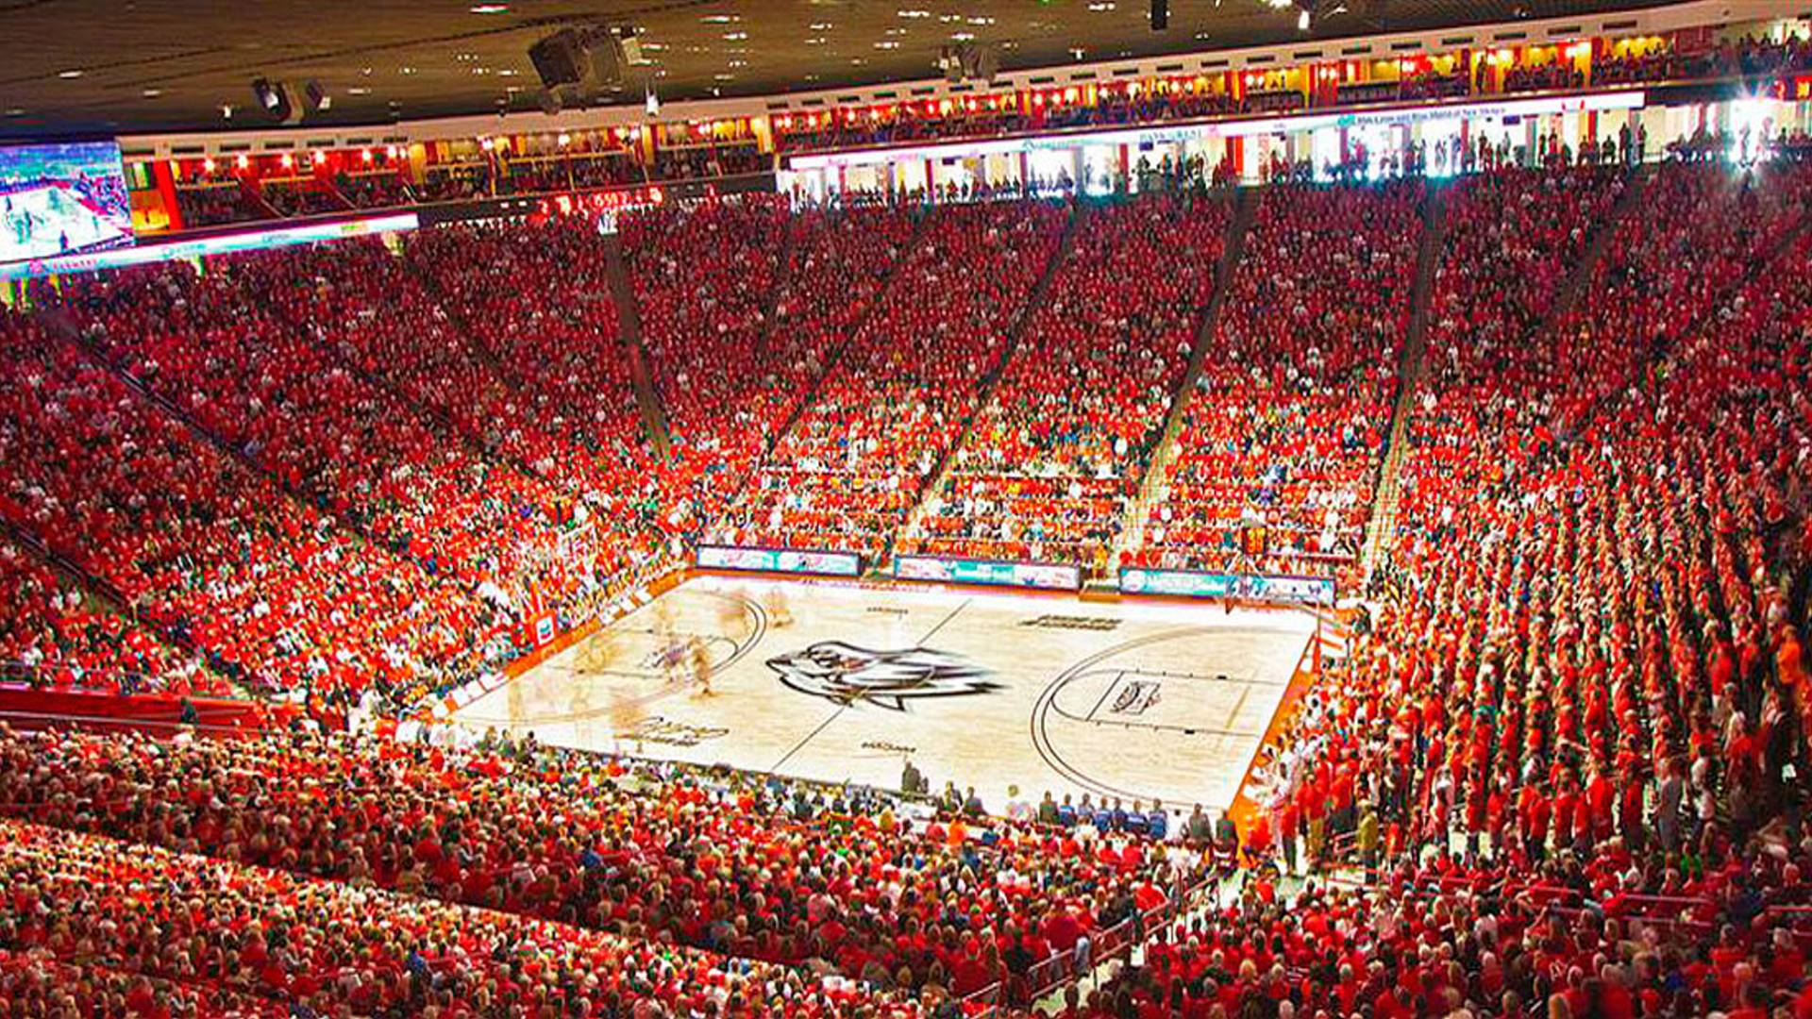
It quiets our spirits

Slide 23
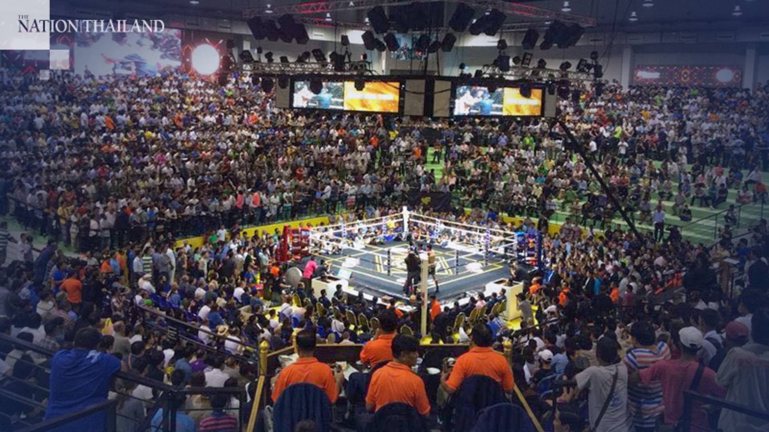
It Enlightens our Minds

Slide 24
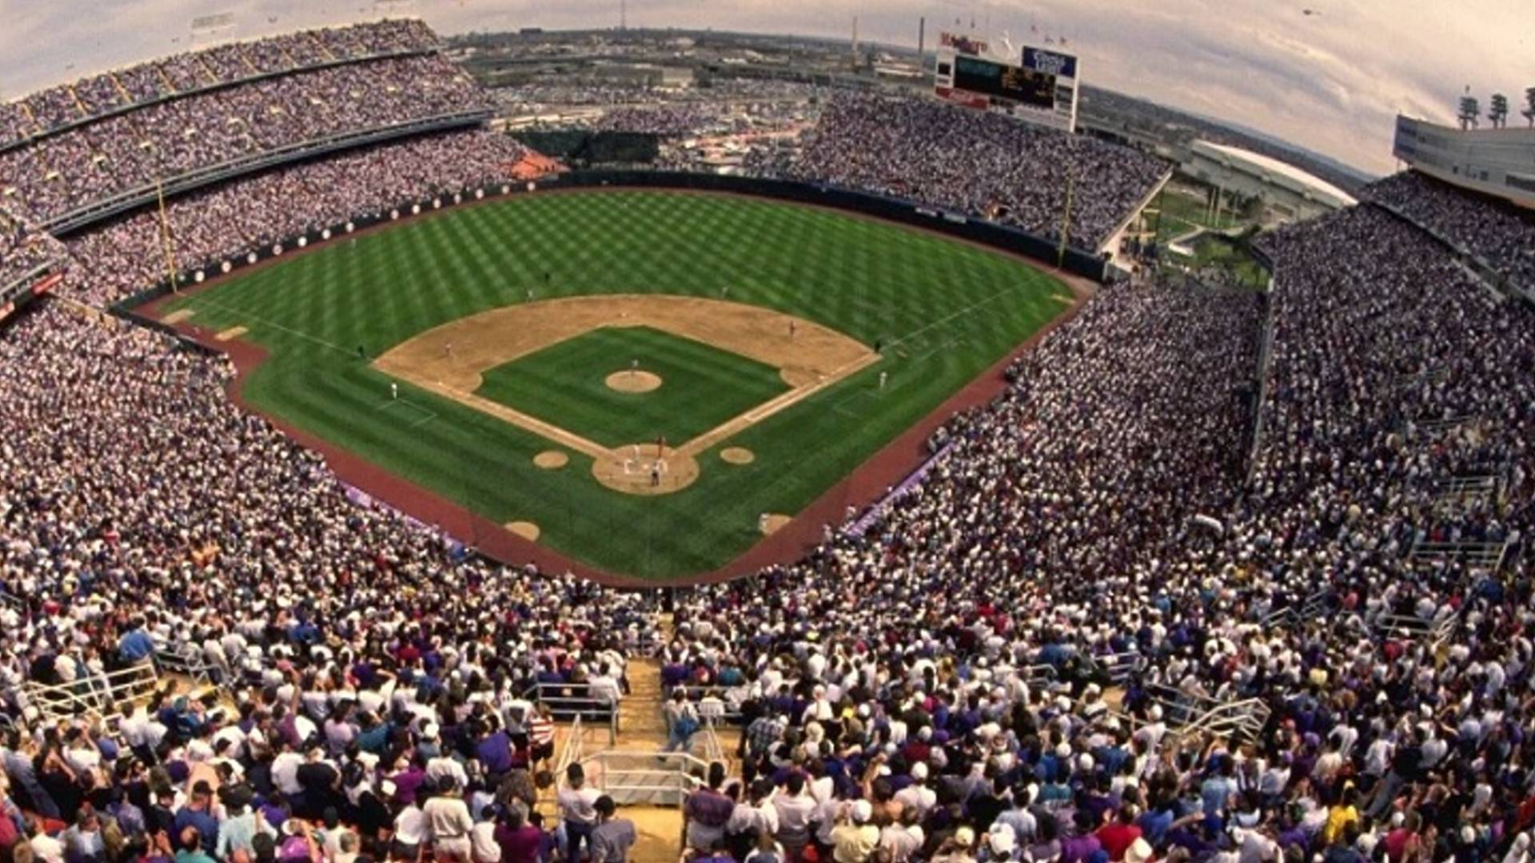
It Increases our Energy

Slide 25
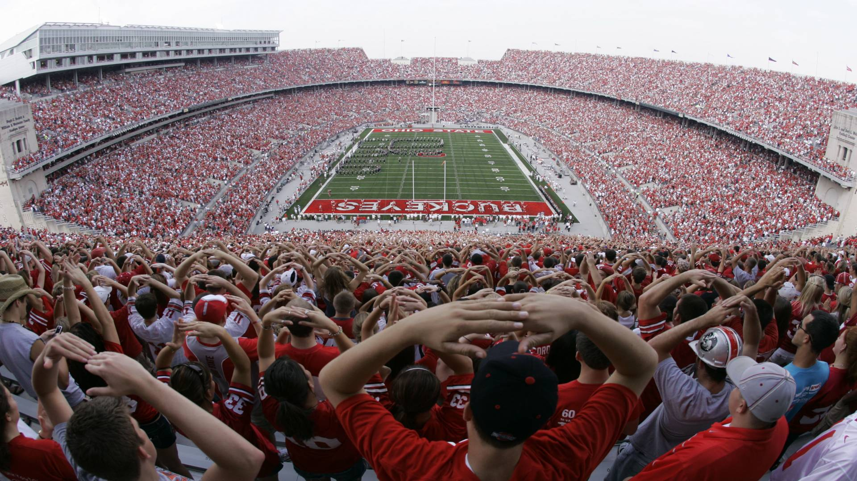
It Purifies our Hearts

Slide 26
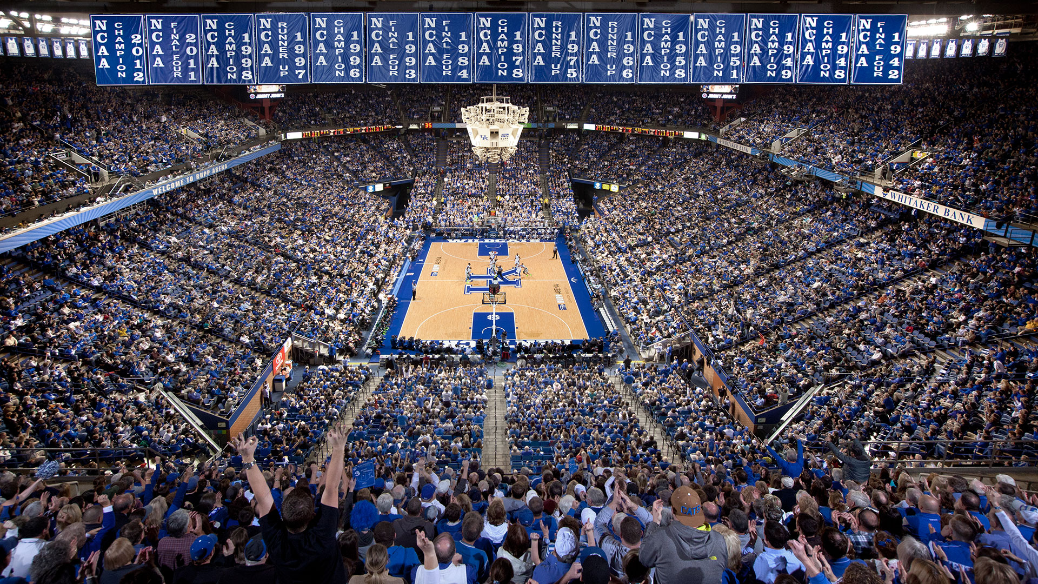
It Purifies our Hearts

Slide 27
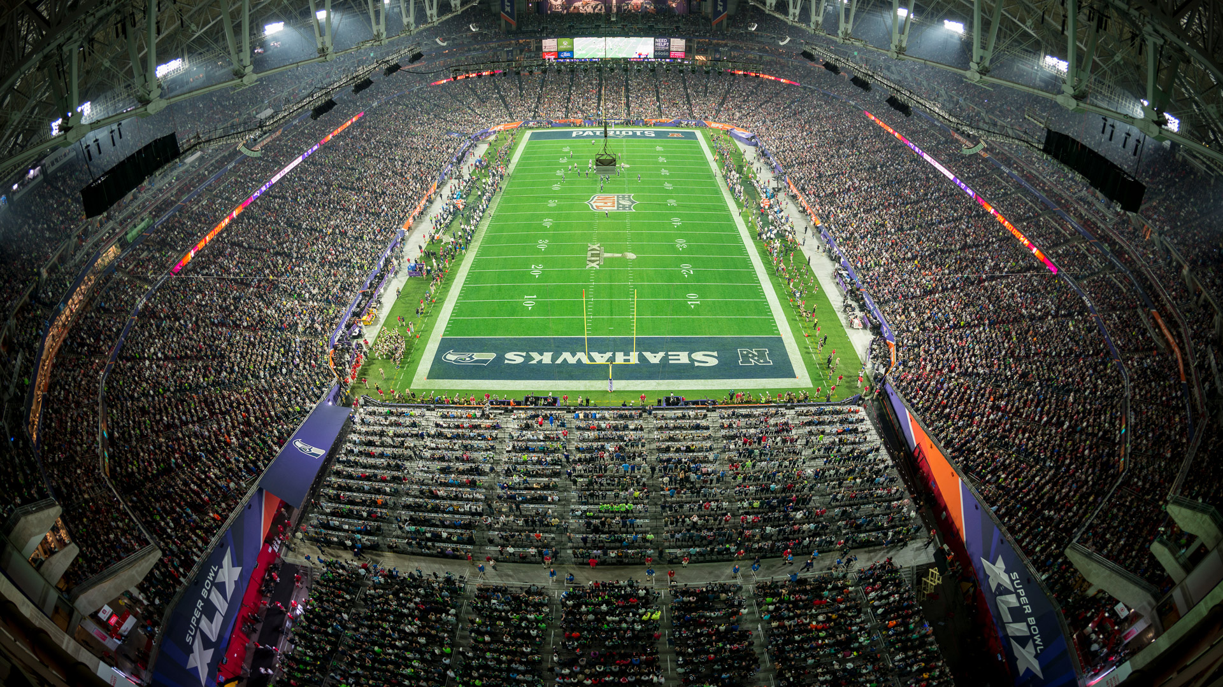
It Purifies our Hearts

Slide 28
2. Religion in America

Slide 29
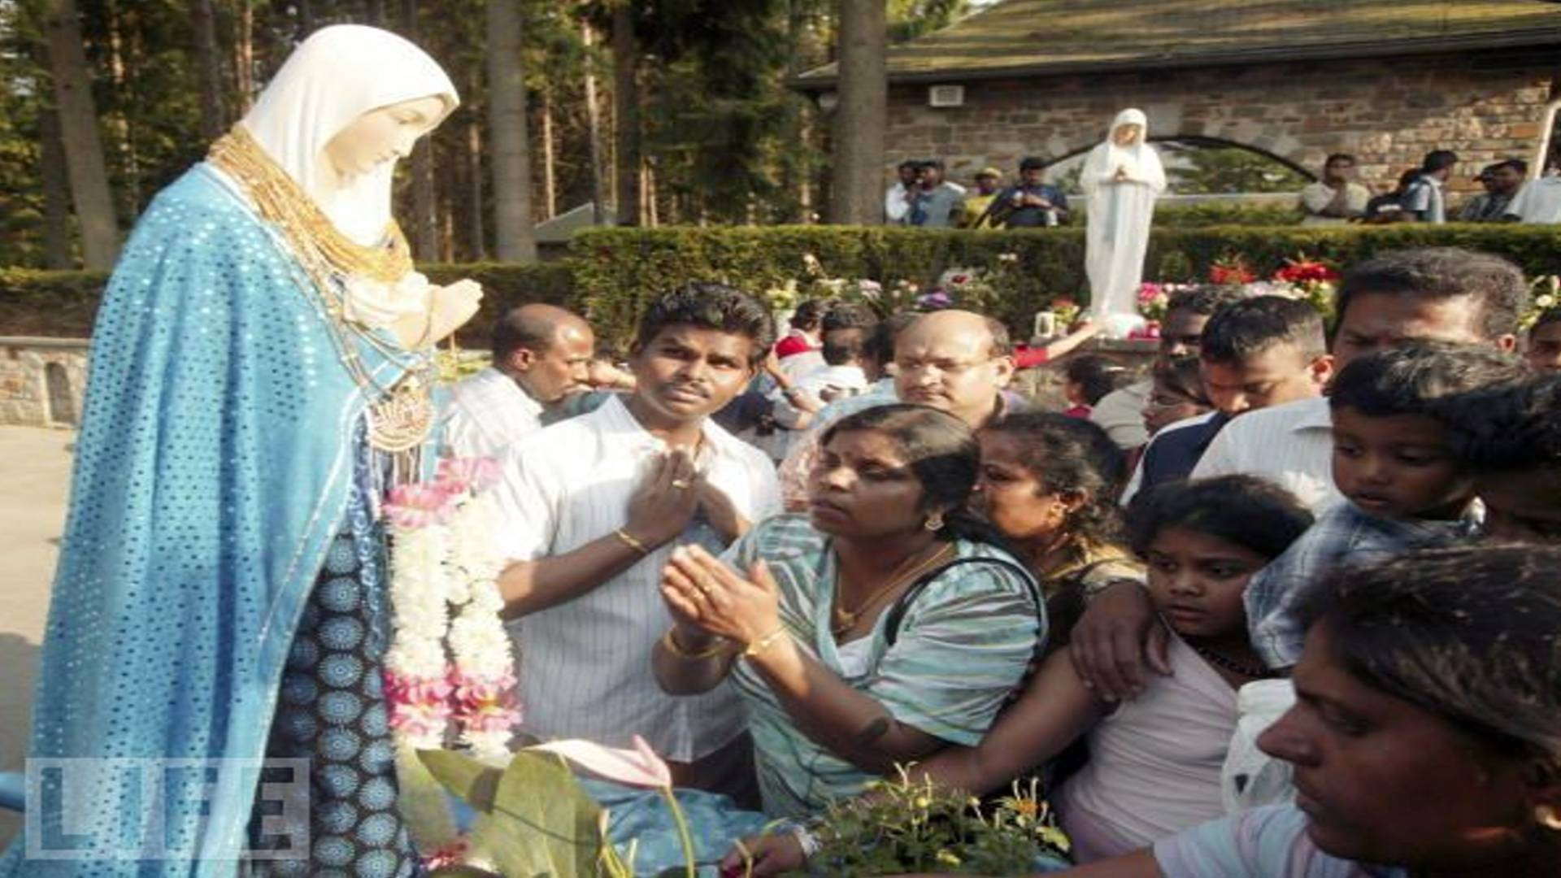
1 John 1:9-10
“If we confess our sins, He is faithful and just to forgive us our sins and to cleanse us from all unrighteousness. 10 If we say that we have not sinned, we make Him a liar, and His word is not in us”

Slide 30
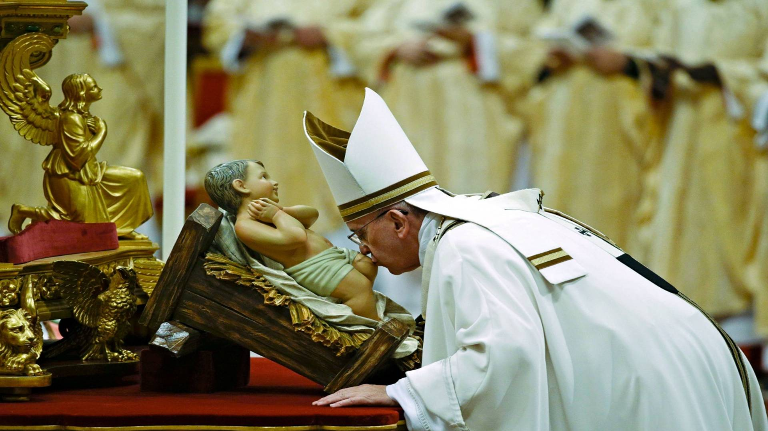
It Enlarges our View of God

Slide 31
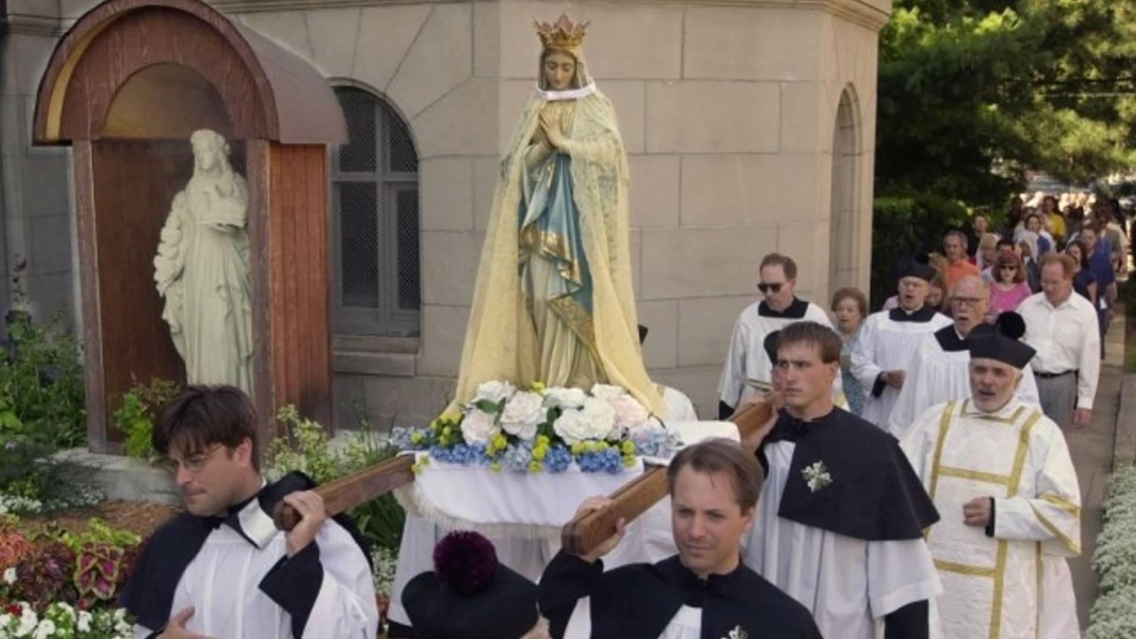
It increases our love for God

Slide 32
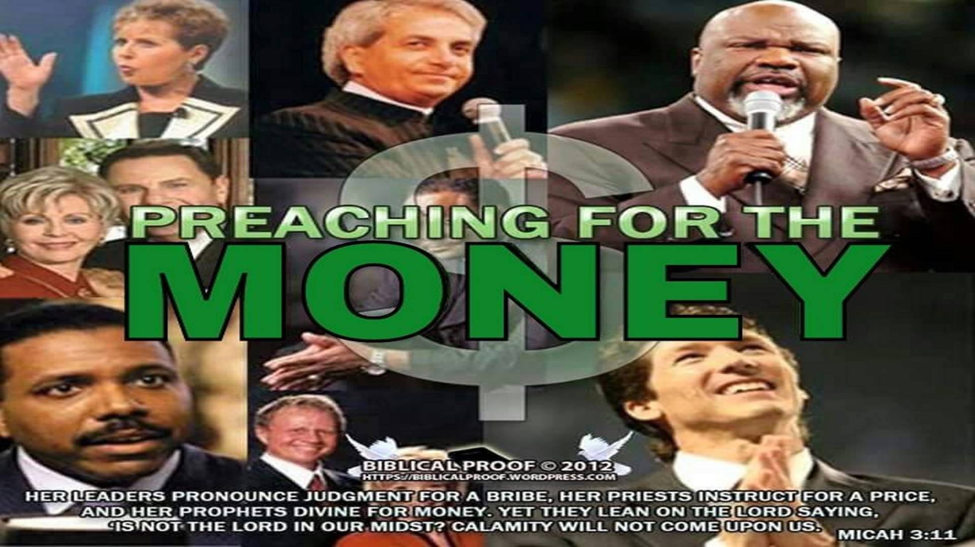
It increases our Sensitivity to the Authority and Power of God

Slide 33
It Strengthens our Faith

Slide 34
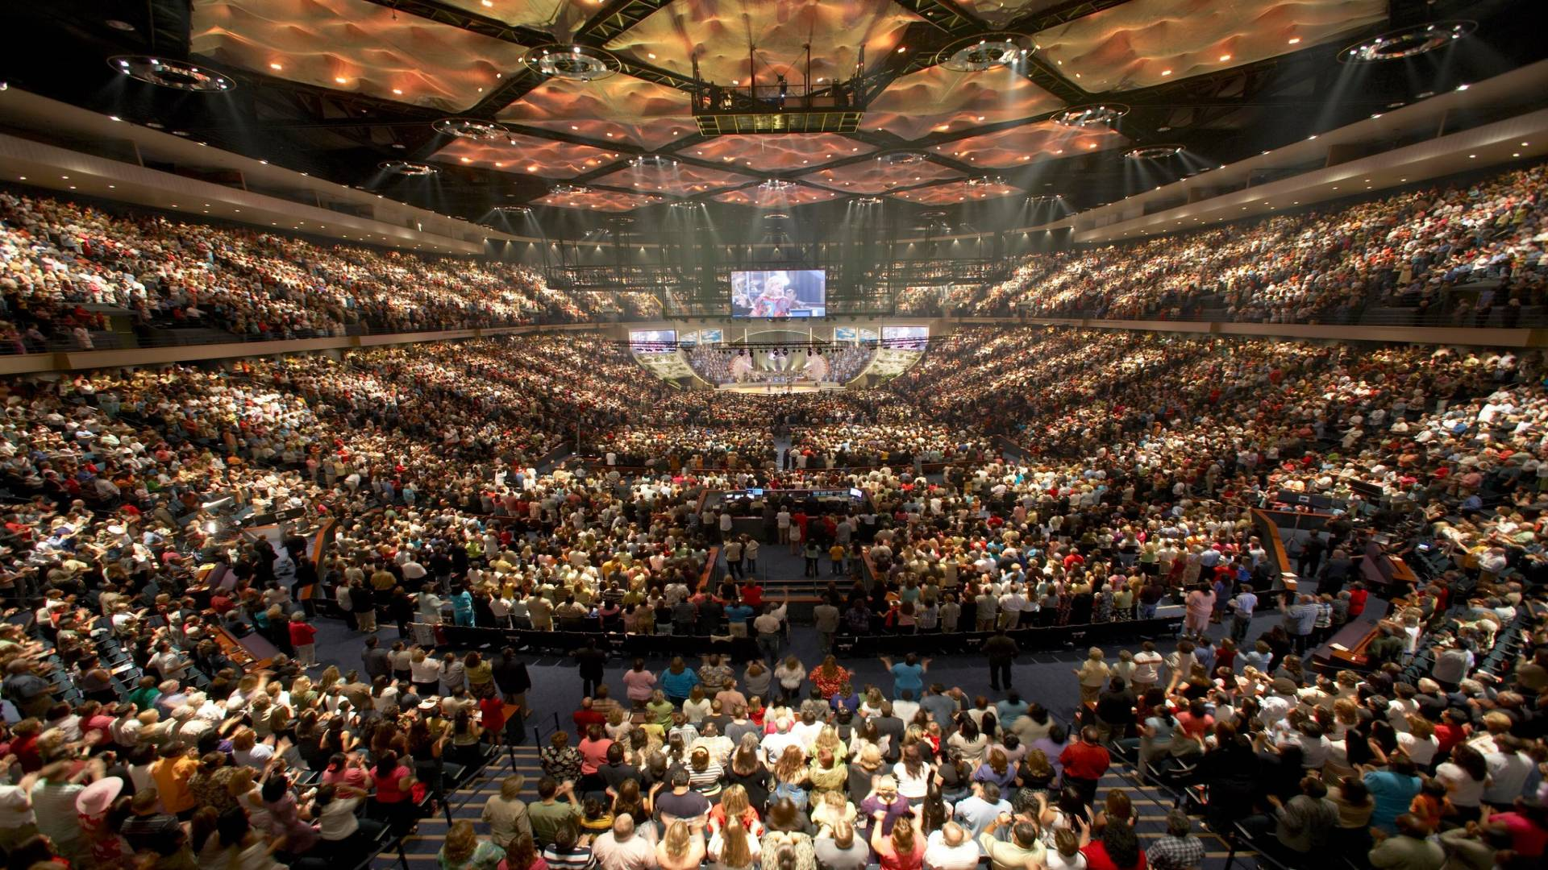
It Strengthens our Faith

Slide 35
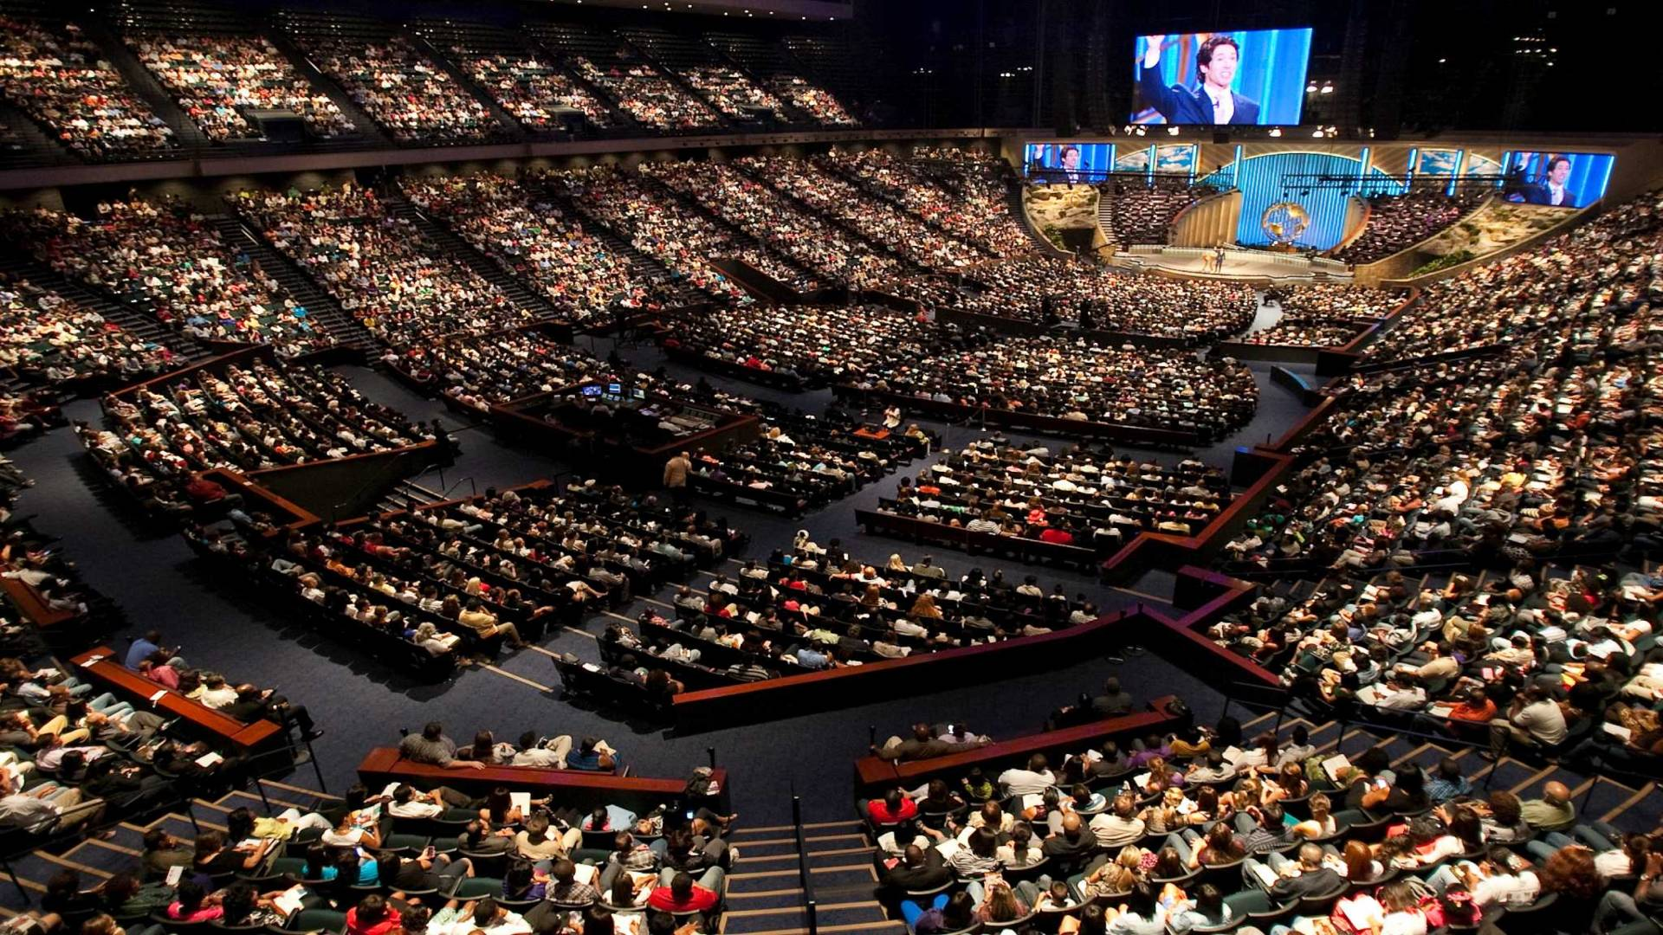
It Strengthens our Faith

Slide 36
3. Politics in America

Slide 37
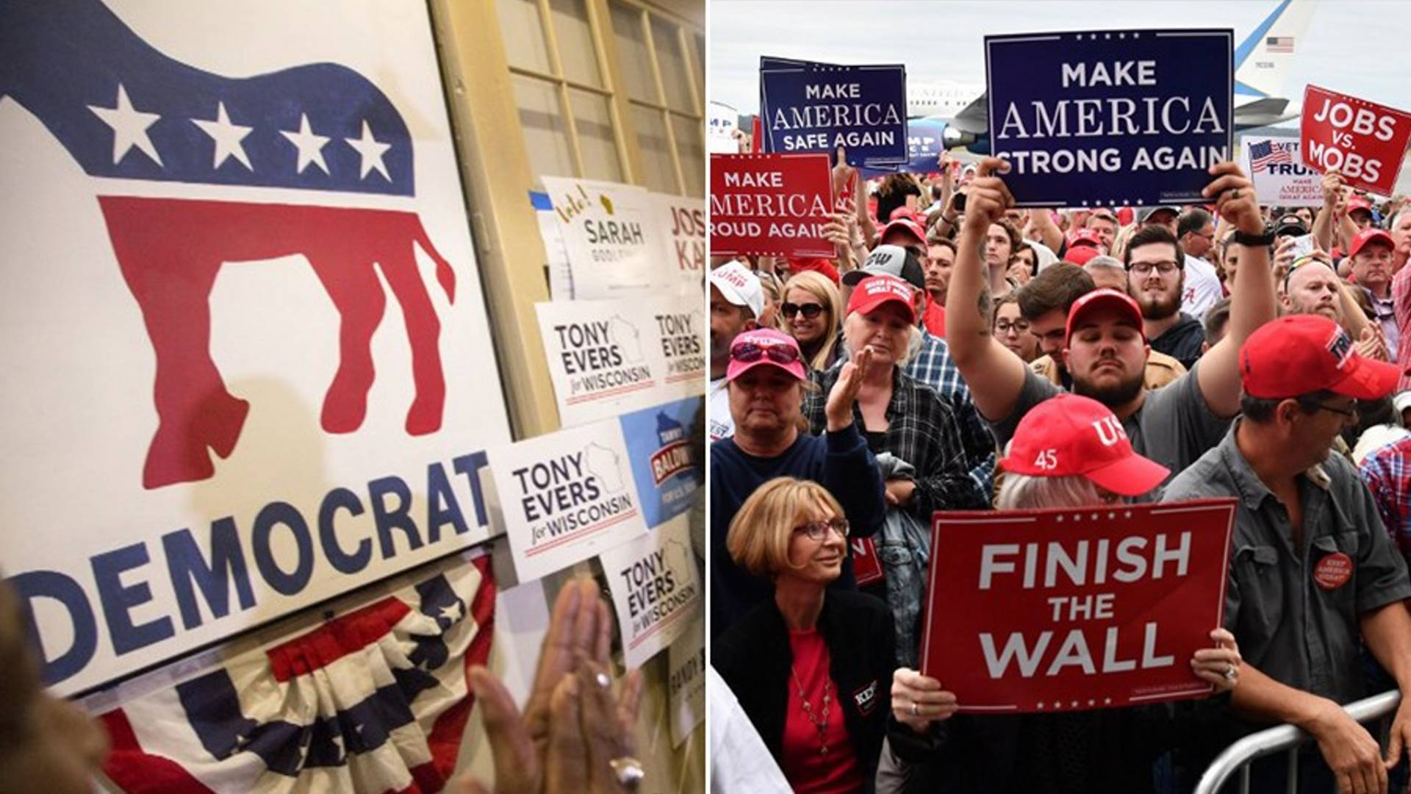
It infuses us with Joy

Slide 38
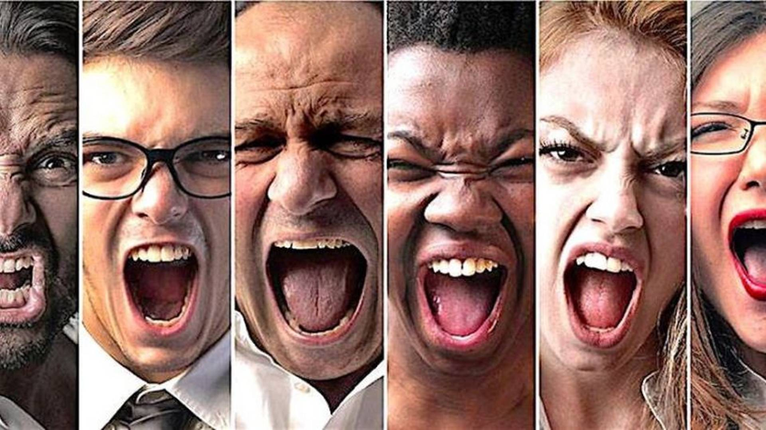
1. When you read the Bible, do you take time to think about what it says and how God wants you to apply it to your life?

Slide 39
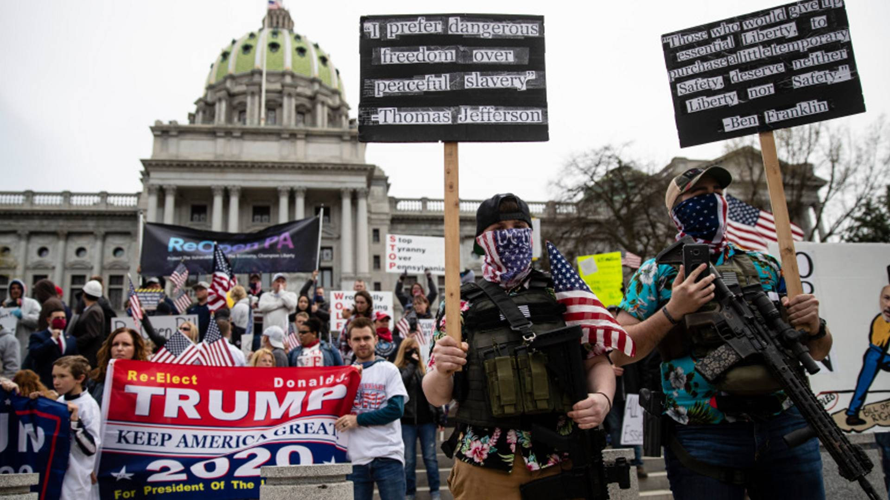
1. When you read the Bible, do you take time to think about what it says and how God wants you to apply it to your life?

Slide 40
4. Rock, Pop, Rap and Movie Stars

Slide 41
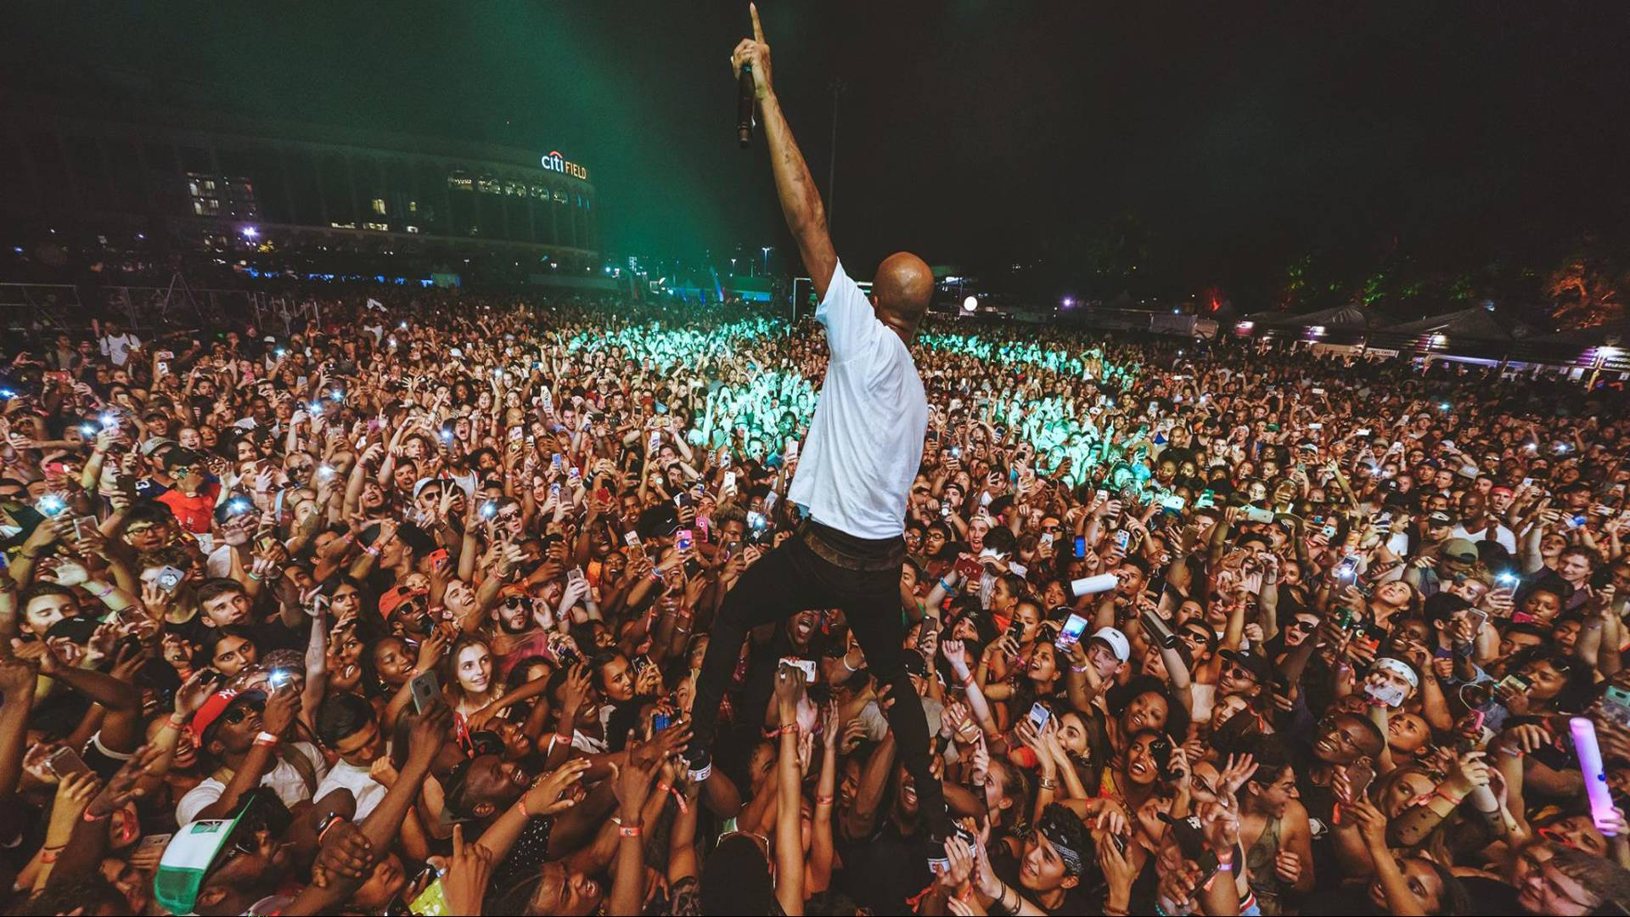
3. What changes can you make today that will facilitate meditation on God’s Word?

Slide 42
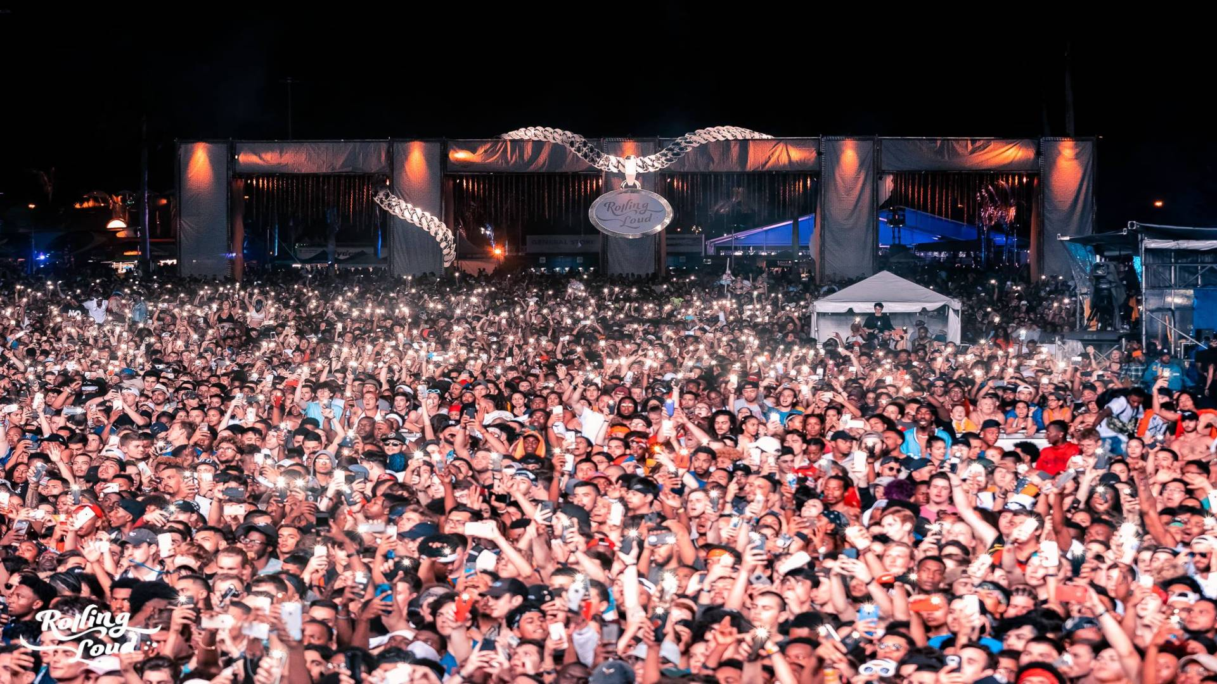
4. How has Scripture encouraged, strengthened, guided, or convicted you when you’ve taken time to read and pray about it?

Slide 43
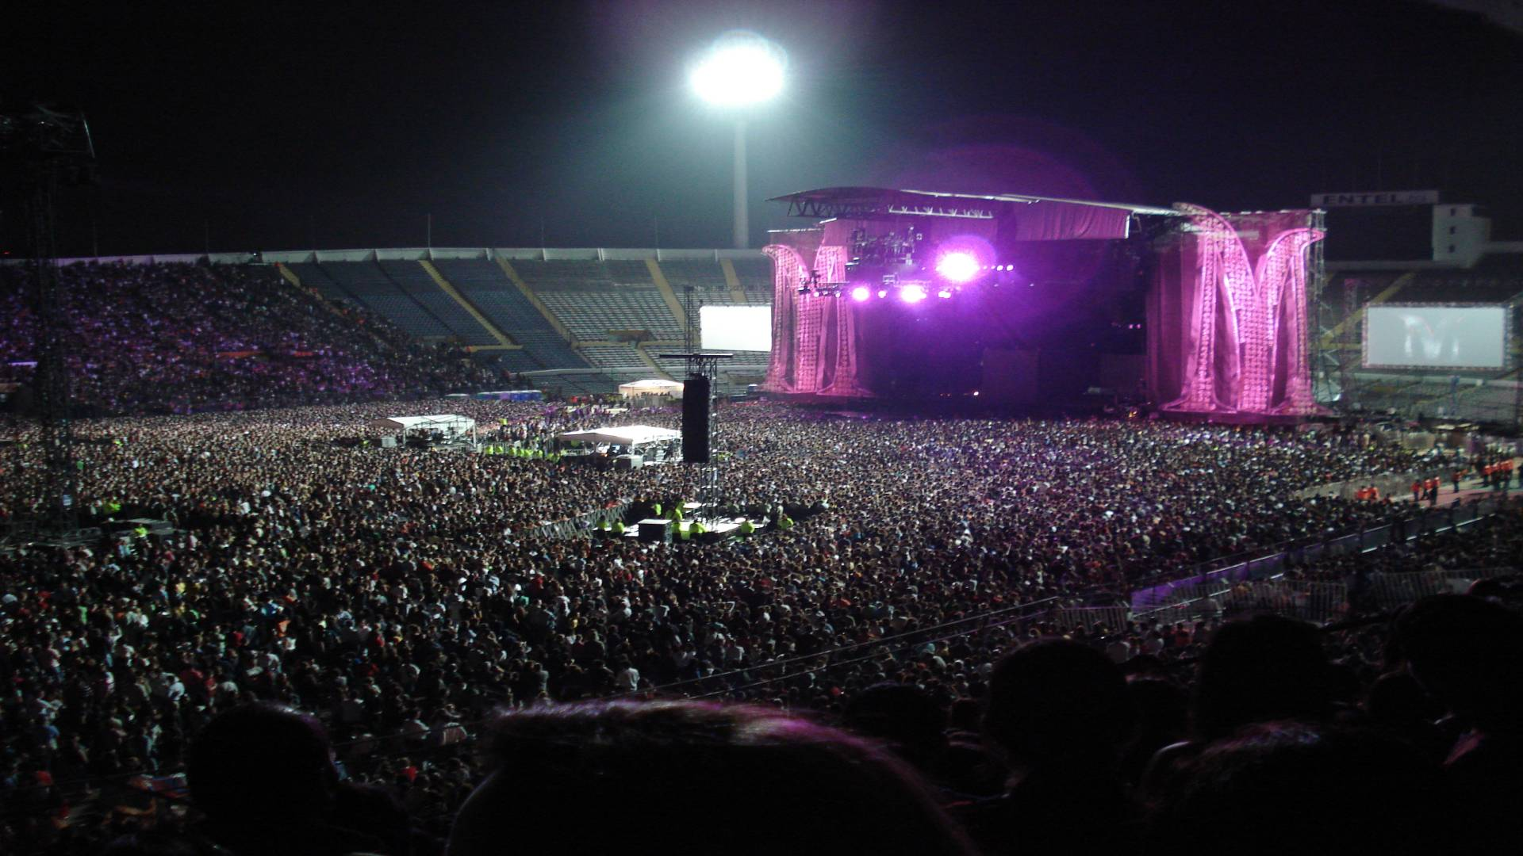
5. What other benefits of meditation have you experienced

Slide 44
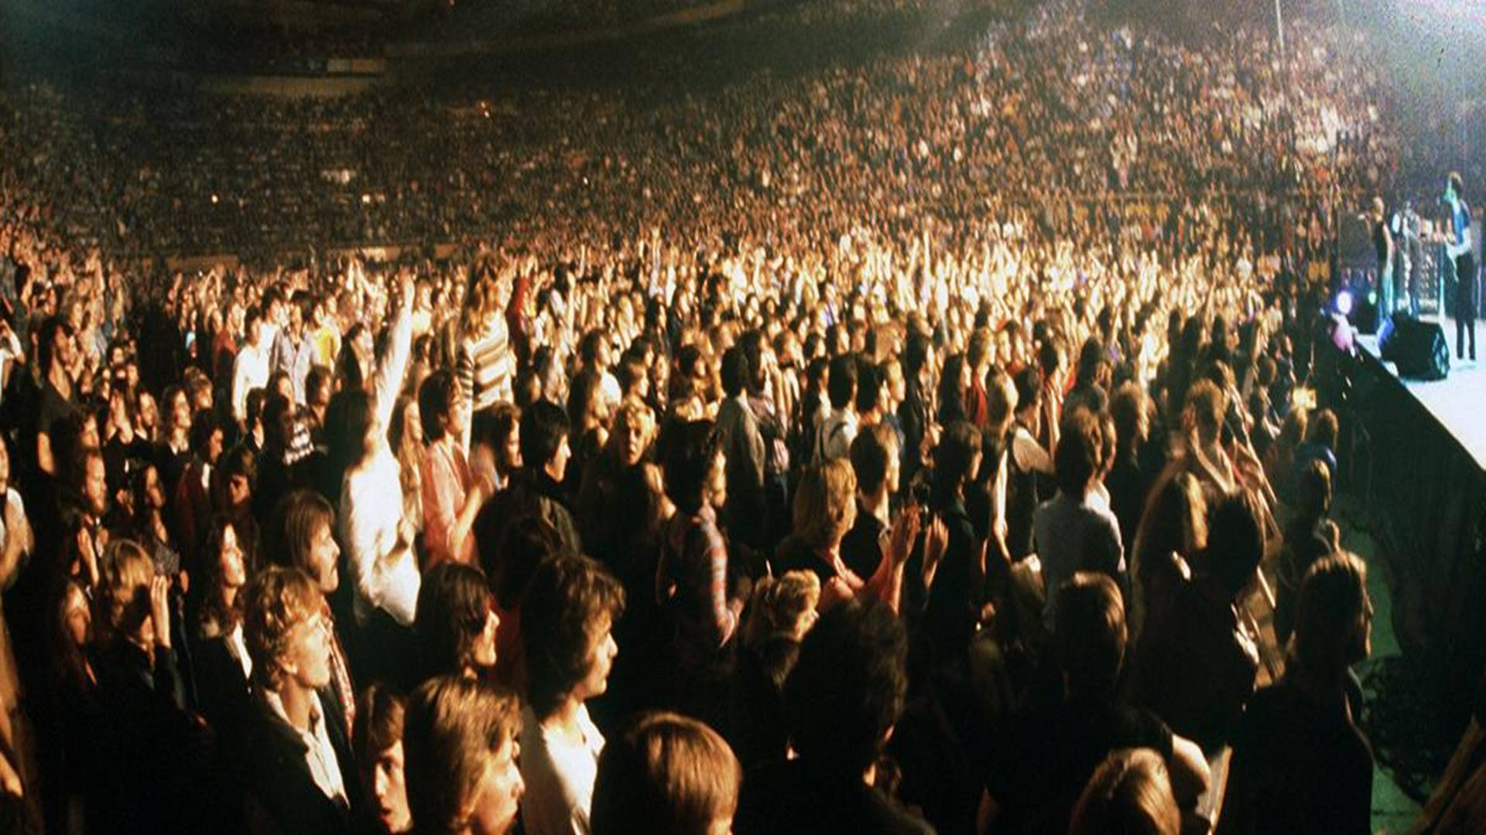
5. What other benefits of meditation have you experienced

Slide 45
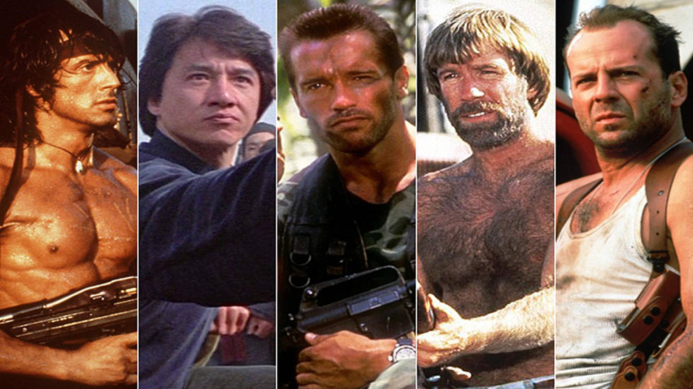
3. What changes can you make today that will facilitate meditation on God’s Word?

Slide 46
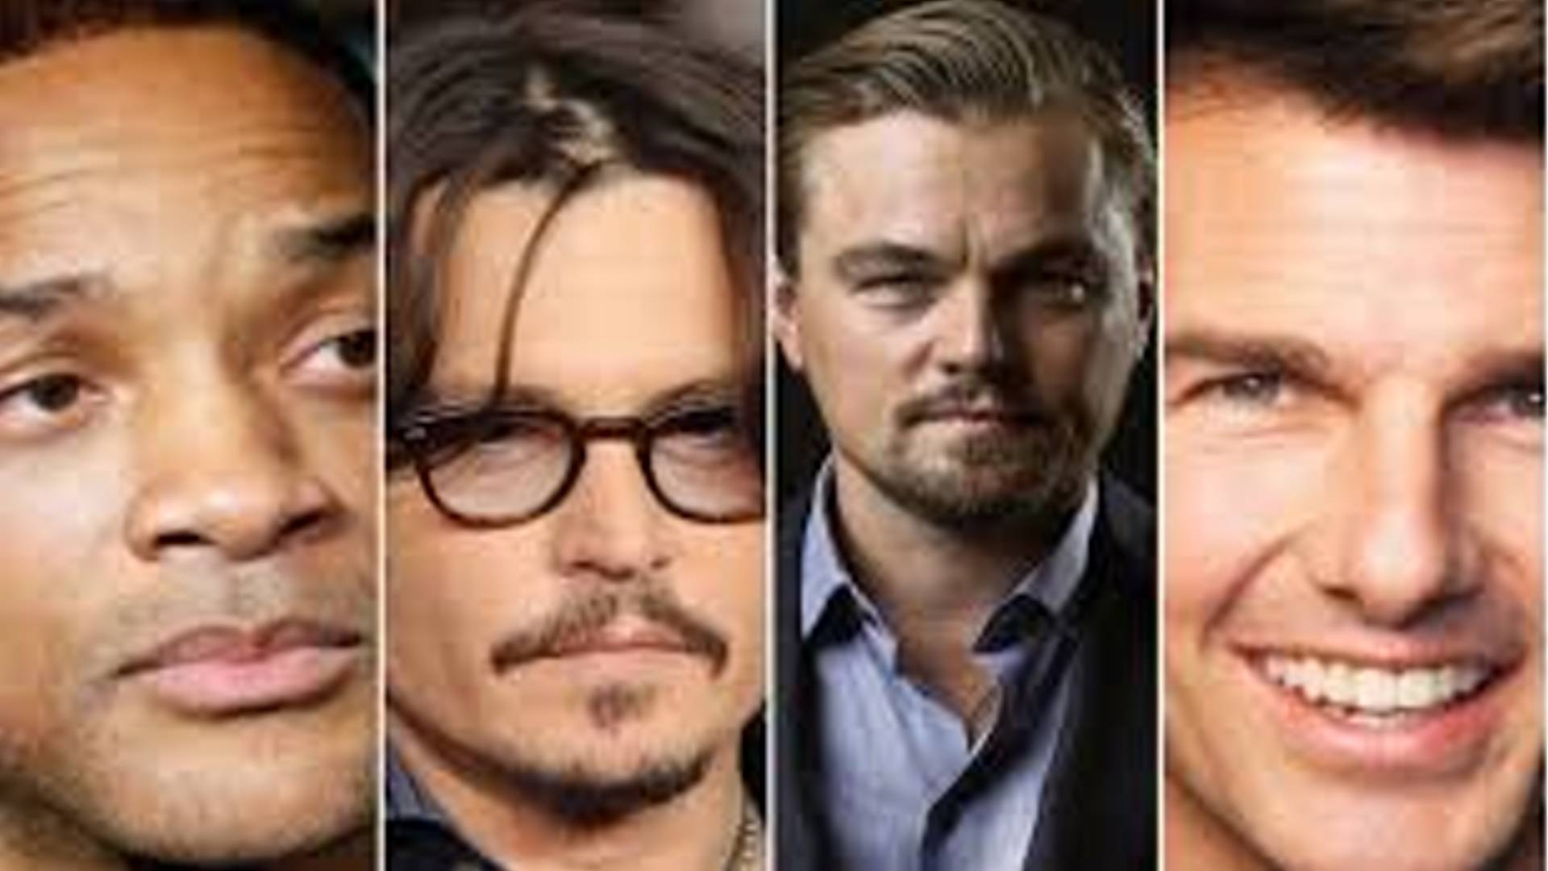
4. How has Scripture encouraged, strengthened, guided, or convicted you when you’ve taken time to read and pray about it?

Slide 47
Abominations in America

Slide 48
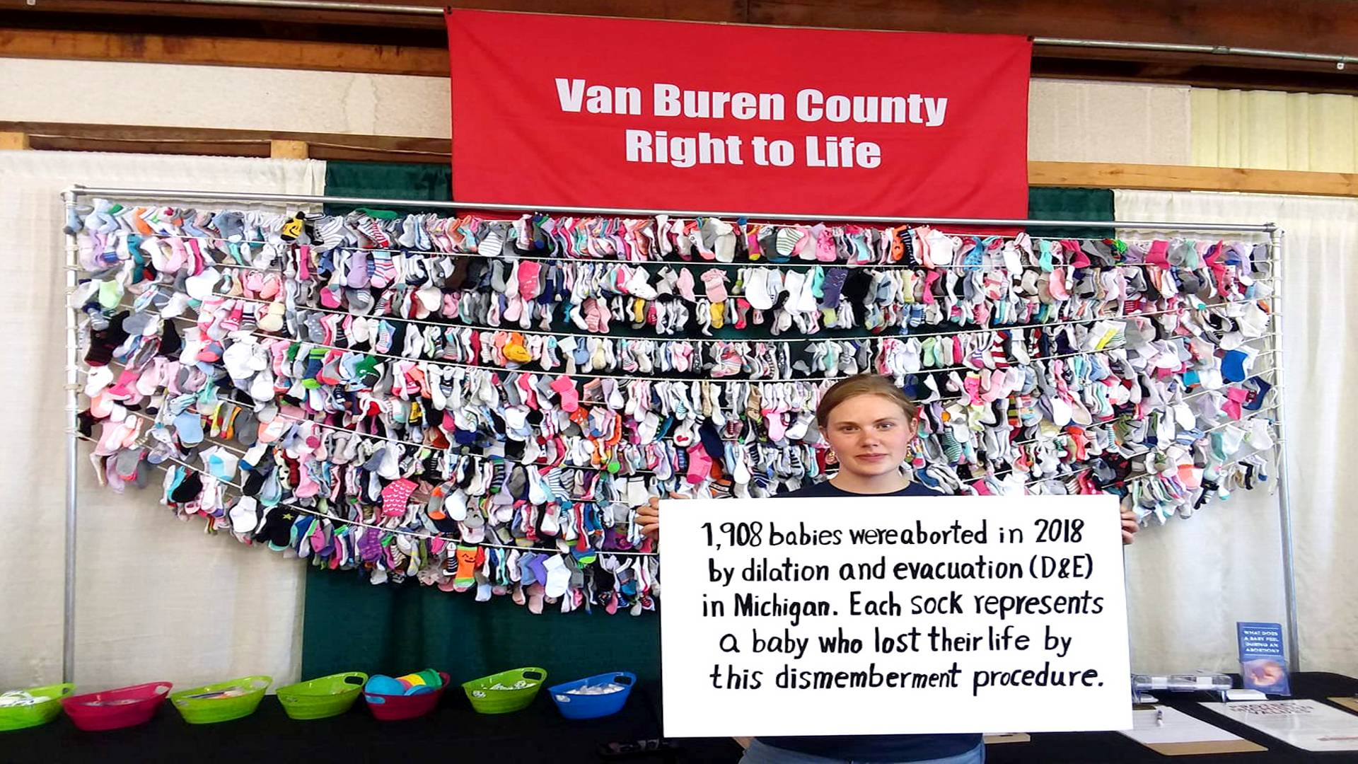
3. What changes can you make today that will facilitate meditation on God’s Word?

Slide 49
4. How has Scripture encouraged, strengthened, guided, or convicted you when you’ve taken time to read and pray about it?

Slide 50
5. What other benefits of meditation have you experienced

Slide 51
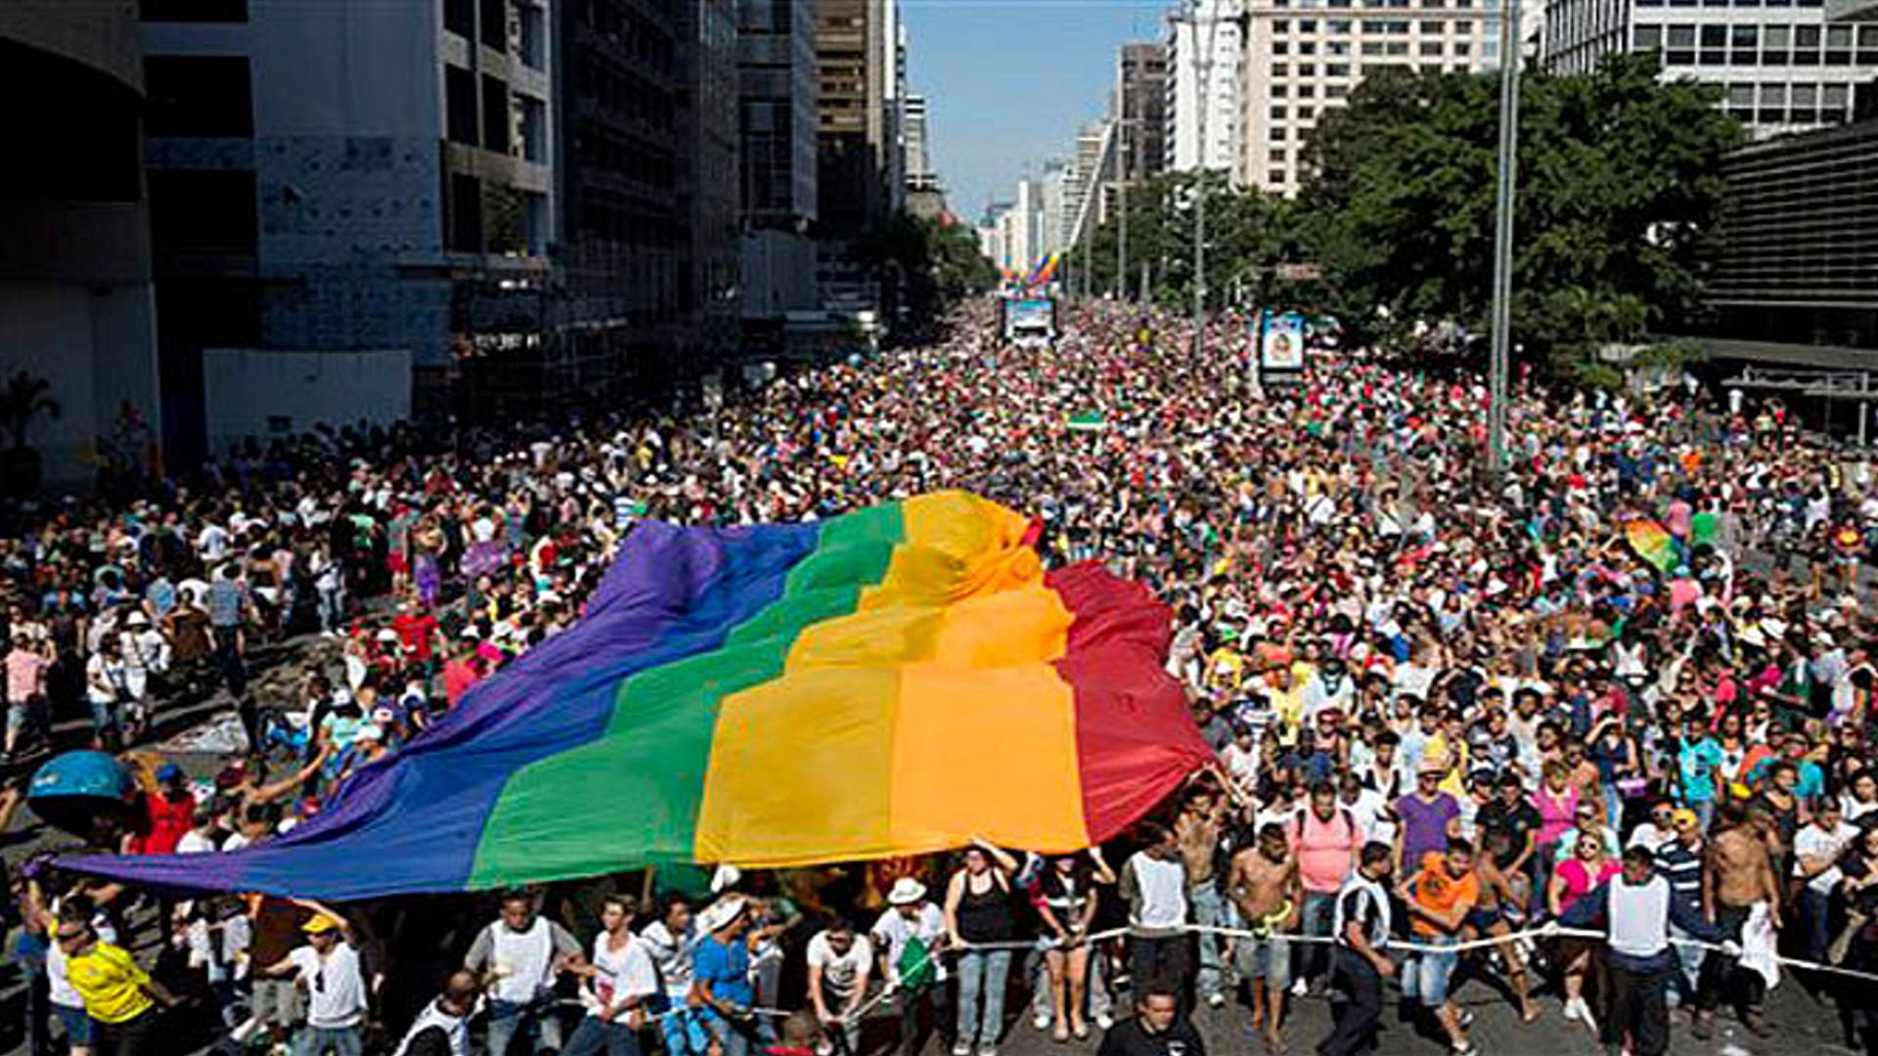
3. What changes can you make today that will facilitate meditation on God’s Word?

Slide 52
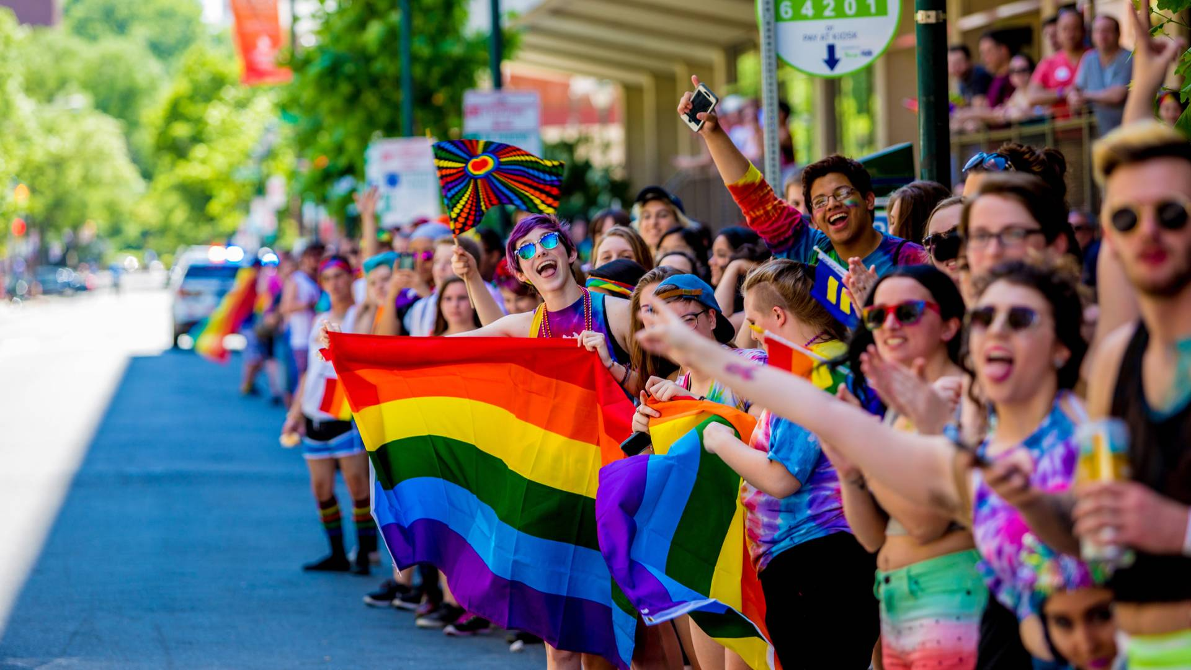
4. How has Scripture encouraged, strengthened, guided, or convicted you when you’ve taken time to read and pray about it?

Slide 53
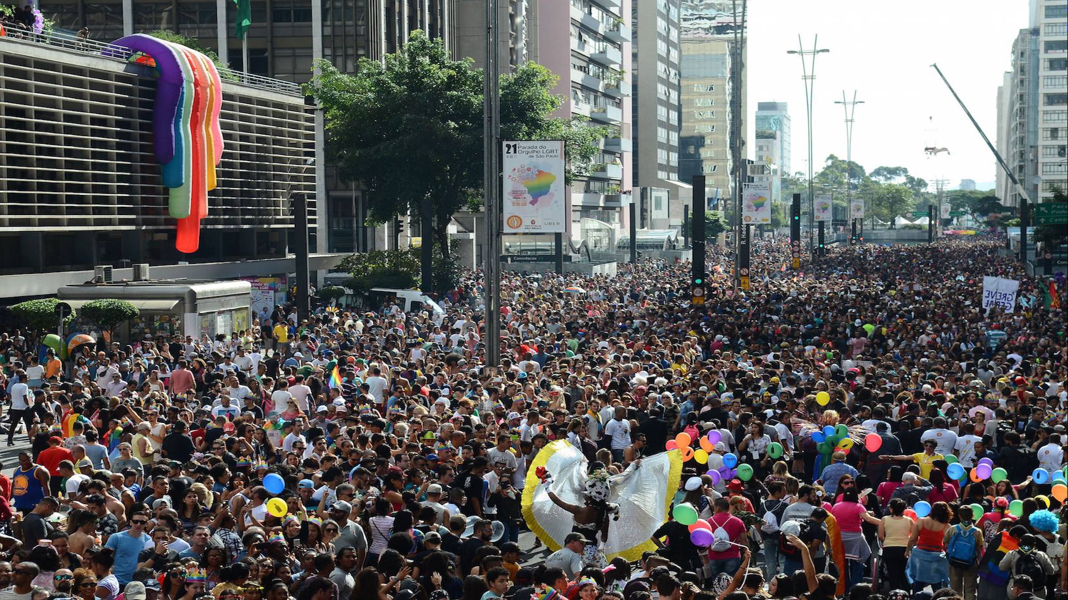
5. What other benefits of meditation have you experienced

Slide 54
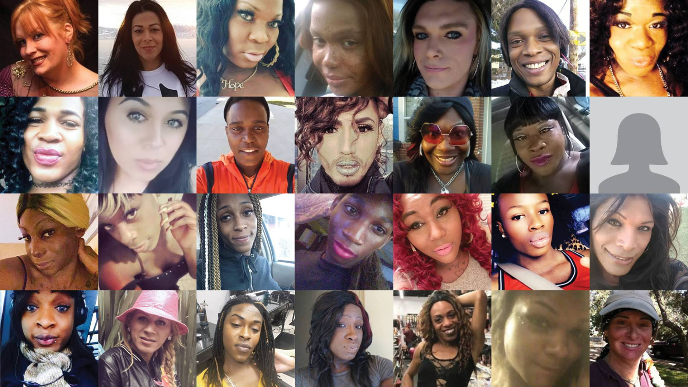
5. What other benefits of meditation have you experienced

Slide 55
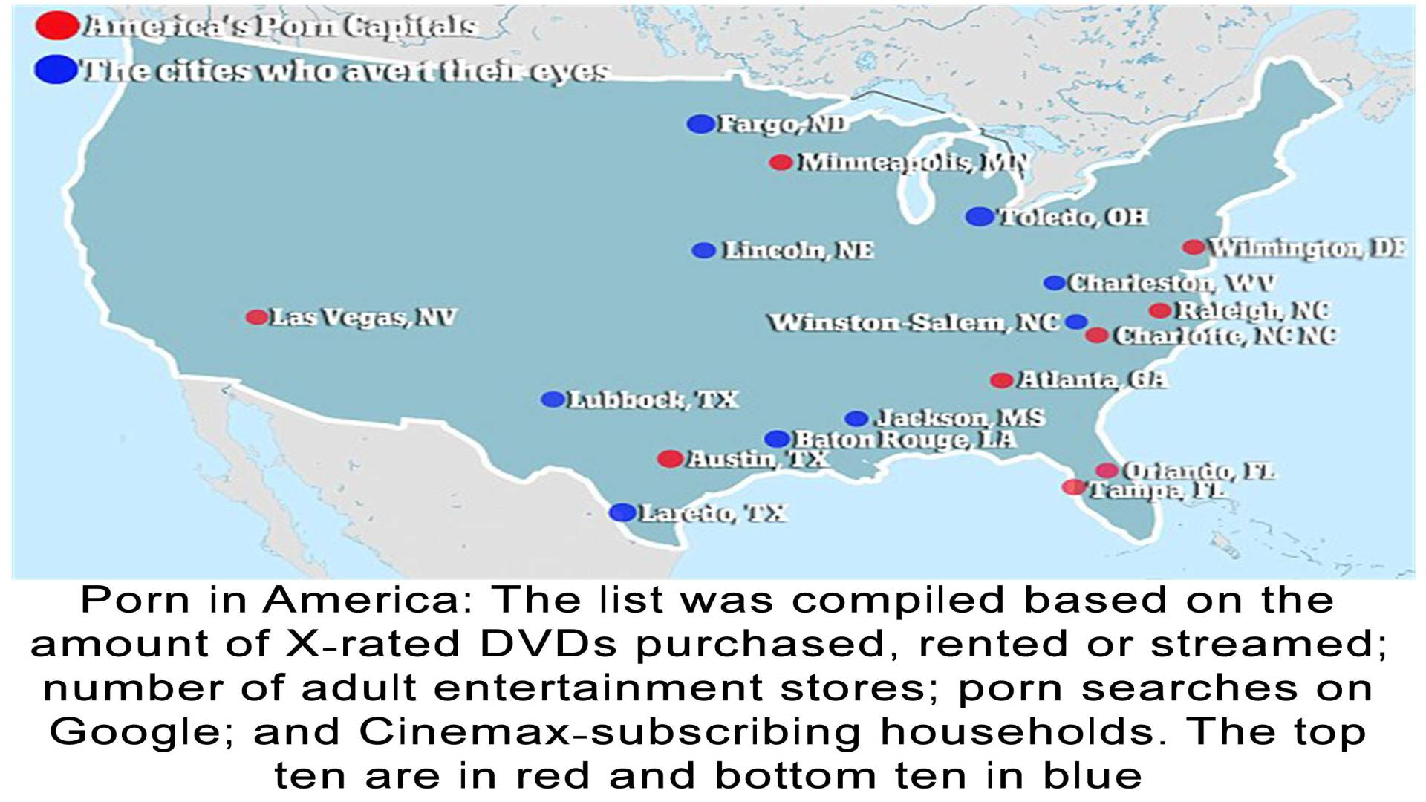
5. What other benefits of meditation have you experienced

Slide 56
5. What other benefits of meditation have you experienced

Slide 57
Proverbs 14:33-35
33 Wisdom rests in the heart of him who has understanding, But what is in the heart of fools is made known. 34 Righteousness exalts a nation, But sin is a reproach to any people. 35 The king's favor is toward a wise servant, But his wrath is against him who causes shame.

Slide 58
Psalm 9:17
“The wicked shall be turned into hell, And all the nations that forget God”

Slide 59
Mark 1:14-15
14 Now after John was put in prison, Jesus came to Galilee, preaching the gospel of the kingdom of God, 15 and saying, "The time is fulfilled, and the kingdom of God is at hand. Repent, and believe in the gospel."

Slide 60
Acts 3:19-21
19 Repent therefore and be converted, that your sins may be blotted out, so that times of refreshing may come from the presence of the Lord, 20 and that He may send Jesus Christ, who was preached to you before, 21 whom heaven must receive until the times of restoration of all things, which God has spoken by the mouth of all His holy prophets since the world began.

Slide 61
Acts 8:22-23
22 Repent therefore of this your wickedness, and pray God if perhaps the thought of your heart may be forgiven you. 23 For I see that you are poisoned by bitterness and bound by iniquity."

Slide 62
1 Thessalonians 4:13-18
13 But I do not want you to be ignorant, brethren, concerning those who have fallen asleep, lest you sorrow as others who have no hope. 14 For if we believe that Jesus died and rose again, even so God will bring with Him those who sleep in Jesus.

Slide 63
15 For this we say to you by the word of the Lord, that we who are alive and remain until the coming of the Lord will by no means precede those who are asleep. 16 For the Lord Himself will descend from heaven with a shout, with the voice of an archangel, and with the trumpet of God. And the dead in Christ will rise first.

Slide 64
17 Then we who are alive and remain shall be caught up together with them in the clouds to meet the Lord in the air. And thus we shall always be with the Lord. 18 Therefore comfort one another with these words.

Slide 65
1 Corinthians 15:50-54
50 Now this I say, brethren, that flesh and blood cannot inherit the kingdom of God; nor does corruption inherit incorruption. 51 Behold, I tell you a mystery: We shall not all sleep, but we shall all be changed-- 52 in a moment, in the twinkling of an eye, at the last trumpet. For the trumpet will sound, and the dead will be raised incorruptible, and we shall be changed.

Slide 66
53 For this corruptible must put on incorruption, and this mortal must put on immortality. 54 So when this corruptible has put on incorruption, and this mortal has put on immortality, then shall be brought to pass the saying that is written: "Death is swallowed up in victory."

Slide 67
Acts 2:38-39
38 Then Peter said to them, "Repent, and let every one of you be baptized in the name of Jesus Christ for the remission of sins; and you shall receive the gift of the Holy Spirit. 39 For the promise is to you and to your children, and to all who are afar off, as many as the Lord our God will call."

