Slide 1
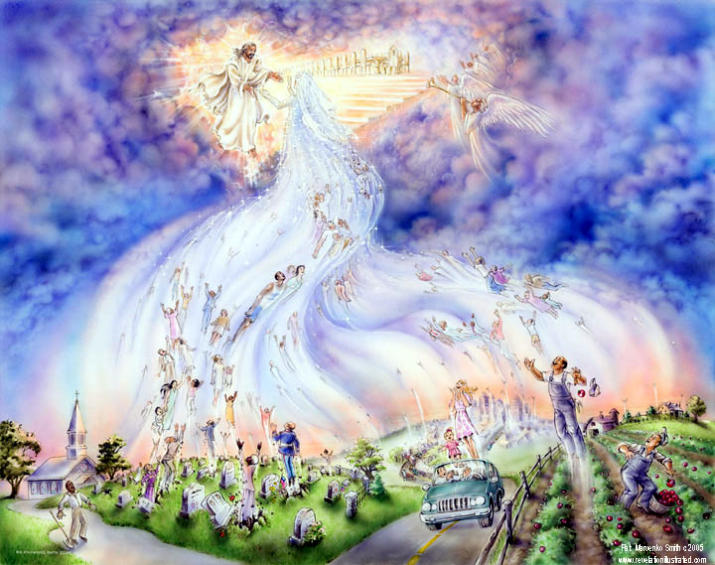
Jesus is Coming for His Bride
by Pastor Fee Soliven
1 Corinthians 15:50-52
Wednesday Evening
February 17, 2021

Slide 2
1 Corinthians 15:50-52
50 Now this I say, brethren, that flesh and blood cannot inherit the kingdom of God; nor does corruption inherit incorruption. 51 Behold, I tell you a mystery: We shall not all sleep, but we shall all be changed-- 52 in a moment, in the twinkling of an eye, at the last trumpet. For the trumpet will sound, and the dead will be raised incorruptible, and we shall be changed.

Slide 3
Jesus Said to Observe The Times

Slide 4
Matthew 24:3-14
3 Now as He sat on the Mount of Olives, the disciples came to Him privately, saying, "Tell us, when will these things be? And what will be the sign of Your coming, and of the end of the age?" 4 And Jesus answered and said to them: "Take heed that no one deceives you. 5 For many will come in My name, saying, 'I am the Christ,' and will deceive many.

Slide 5
6 And you will hear of wars and rumors of wars. See that you are not troubled; for all these things must come to pass, but the end is not yet. 7 For nation will rise against nation, and kingdom against kingdom. And there will be famines, pestilences, and earthquakes in various places. 8 All these are the beginning of sorrows.

Slide 6
9 Then they will deliver you up to tribulation and kill you, and you will be hated by all nations for My name's sake. 10 And then many will be offended, will betray one another, and will hate one another. 11 Then many false prophets will rise up and deceive many.

Slide 7
12 And because lawlessness will abound, the love of many will grow cold. 13 But he who endures to the end shall be saved. 14 And this gospel of the kingdom will be preached in all the world as a witness to all the nations, and then the end will come.

Slide 8
Jesus The Greatest Comforter

Slide 9
John 14:1-3
1 "Let not your heart be troubled; you believe in God, believe also in Me. 2 In My Father's house are many mansions; if it were not so, I would have told you. I go to prepare a place for you. 3 And if I go and prepare a place for you, I will come again and receive you to Myself; that where I am, there you may be also.

Slide 10
Acts 1:9-11
9 Now when He had spoken these things, while they watched, He was taken up, and a cloud received Him out of their sight. 10 And while they looked steadfastly toward heaven as He went up, behold, two men stood by them in white apparel,

Slide 11
11 who also said, "Men of Galilee, why do you stand gazing up into heaven? 11 This same Jesus, who was taken up from you into heaven, will so come in like manner as you saw Him go into heaven."

Slide 12
The Apostles Declared His 2nd Coming

Slide 13
Hebrews 10:37-39
37 "For yet a little while, And He who is coming will come and will not tarry. 38 Now the just shall live by faith; But if anyone draws back, My soul has no pleasure in him." 39 But we are not of those who draw back to perdition, but of those who believe to the saving of the soul.

Slide 14
James 5:7-8
7 Therefore be patient, brethren, until the coming of the Lord. See how the farmer waits for the precious fruit of the earth, waiting patiently for it until it receives the early and latter rain. 8 You also be patient. Establish your hearts, for the coming of the Lord is at hand.

Slide 15
1 Thessalonians 1:8-10
8 For from you the word of the Lord has sounded forth, not only in Macedonia and Achaia, but also in every place. Your faith toward God has gone out, so that we do not need to say anything. 9 For they themselves declare concerning us what manner of entry we had to you, and how you turned to God from idols to serve the living and true God,

Slide 16
10 and to wait for His Son from heaven, whom He raised from the dead, even Jesus who delivers us from the wrath to come.

Slide 17
Webster’s Third New International Dictionary Unabridged is:

Slide 18
“Christ’s raising up of His true church and its members to a realm above the earth where the whole company will enjoy celestial bliss with its Lord.”

Slide 19
1 Thessalonians 4:17
"Then we who are alive and remain shall be caught up together with them in the clouds to meet the Lord in the air. And thus we shall always be with the Lord."

Slide 20
Matthew 24:36-44
36 "But of that day and hour no one knows, not even the angels of heaven, but My Father only. 37 But as the days of Noah were, so also will the coming of the Son of Man be. 38 For as in the days before the flood, they were eating and drinking, marrying and giving in marriage, until the day that Noah entered the ark,

Slide 21
39 and did not know until the flood came and took them all away, so also will the coming of the Son of Man be. 40 Then two men will be in the field: one will be taken and the other left. 41 Two women will be grinding at the mill: one will be taken and the other left. 42 Watch therefore, for you do not know what hour your Lord is coming.

Slide 22
43 But know this, that if the master of the house had known what hour the thief would come, he would have watched and not allowed his house to be broken into. 44 Therefore you also be ready, for the Son of Man is coming at an hour you do not expect.

Slide 23
The Wrath OF God Is Appointed for
The Unbelieving

Slide 24
Matthew 24:29-31
29 "Immediately after the tribulation of those days the sun will be darkened, and the moon will not give its light; the stars will fall from heaven, and the powers of the heavens will be shaken. 30 Then the sign of the Son of Man will appear in heaven, and then all the tribes of the earth will mourn, and they will see the Son of Man coming on the clouds of heaven with power and great glory.

Slide 25
31 And He will send His angels with a great sound of a trumpet, and they will gather together His elect from the four winds, from one end of heaven to the other.

Slide 26
2 Thessalonians 1:3-12
3 We are bound to thank God always for you, brethren, as it is fitting, because your faith grows exceedingly, and the love of every one of you all abounds toward each other, 4 so that we ourselves boast of you among the churches of God for your patience and faith in all your persecutions and tribulations that you endure,

Slide 27
5 which is manifest evidence of the righteous judgment of God, that you may be counted worthy of the kingdom of God, for which you also suffer; 6 since it is a righteous thing with God to repay with tribulation those who trouble you, 7 and to give you who are troubled rest with us when the Lord Jesus is revealed from heaven with His mighty angels,

Slide 28
8 in flaming fire taking vengeance on those who do not know God, and on those who do not obey the gospel of our Lord Jesus Christ.9 These shall be punished with everlasting destruction from the presence of the Lord and from the glory of His power, 10 when He comes, in that Day, to be glorified in His saints and to be admired among all those who believe, because our testimony among you was believed.

Slide 29
11 Therefore we also pray always for you that our God would count you worthy of this calling, and fulfill all the good pleasure of His goodness and the work of faith with power, 12 that the name of our Lord Jesus Christ may be glorified in you, and you in Him, according to the grace of our God and the Lord Jesus Christ.

Slide 30
You Need to Be Born Again and Filled With Holy Ghost To Avoid This Day!

Slide 31
John 3:1-7
1 There was a man of the Pharisees named Nicodemus, a ruler of the Jews. 2 This man came to Jesus by night and said to Him, "Rabbi, we know that You are a teacher come from God; for no one can do these signs that You do unless God is with him." 3 Jesus answered and said to him, "Most assuredly, I say to you, unless one is born again, he cannot see the kingdom of God."

Slide 32
4 Nicodemus said to Him, "How can a man be born when he is old? Can he enter a second time into his mother's womb and be born?" 5 Jesus answered, "Most assuredly, I say to you, unless one is born of water and the Spirit, he cannot enter the kingdom of God. 6 That which is born of the flesh is flesh, and that which is born of the Spirit is spirit. 7 Do not marvel that I said to you, 'You must be born again.'

Slide 33
Romans 8:6-11
6 For to be carnally minded is death, but to be spiritually minded is life and peace. 7 Because the carnal mind is enmity against God; for it is not subject to the law of God, nor indeed can be. 8 So then, those who are in the flesh cannot please God. 9 But you are not in the flesh but in the Spirit, if indeed the Spirit of God dwells in you. Now if anyone does not have the Spirit of Christ, he is not His.

Slide 34
10 And if Christ is in you, the body is dead because of sin, but the Spirit is life because of righteousness. 11 But if the Spirit of Him who raised Jesus from the dead dwells in you, He who raised Christ from the dead will also give life to your mortal bodies through His Spirit who dwells in you.

Slide 35
Be Rapture Ready and Stay in A Continual Repented State Of Mind & Heart!

Slide 36
1 Thessalonians 4:13-18
13 But I do not want you to be ignorant, brethren, concerning those who have fallen asleep, lest you sorrow as others who have no hope. 14 For if we believe that Jesus died and rose again, even so God will bring with Him those who sleep in Jesus.

Slide 37
15 For this we say to you by the word of the Lord, that we who are alive and remain until the coming of the Lord will by no means precede those who are asleep. 16 For the Lord Himself will descend from heaven with a shout, with the voice of an archangel, and with the trumpet of God. And the dead in Christ will rise first.

Slide 38
17 Then we who are alive and remain shall be caught up together with them in the clouds to meet the Lord in the air. And thus we shall always be with the Lord. 18 Therefore comfort one another with these words.

Slide 39
1 Corinthians 15:50-54
50 Now this I say, brethren, that flesh and blood cannot inherit the kingdom of God; nor does corruption inherit incorruption. 51 Behold, I tell you a mystery: We shall not all sleep, but we shall all be changed-- 52 in a moment, in the twinkling of an eye, at the last trumpet. For the trumpet will sound, and the dead will be raised incorruptible, and we shall be changed.

Slide 40
53 For this corruptible must put on incorruption, and this mortal must put on immortality. 54 So when this corruptible has put on incorruption, and this mortal has put on immortality, then shall be brought to pass the saying that is written: "Death is swallowed up in victory."

Slide 41
20 Again, when a righteous man turns from his righteousness and commits iniquity, and I lay a stumbling block before him, he shall die; because you did not give him warning, he shall die in his sin, and his righteousness which he has done shall not be remembered; but his blood I will require at your hand.

Slide 42
Acts 2:38-39
38 Then Peter said to them, "Repent, and let every one of you be baptized in the name of Jesus Christ for the remission of sins; and you shall receive the gift of the Holy Spirit. 39 For the promise is to you and to your children, and to all who are afar off, as many as the Lord our God will call."

