Slide 1
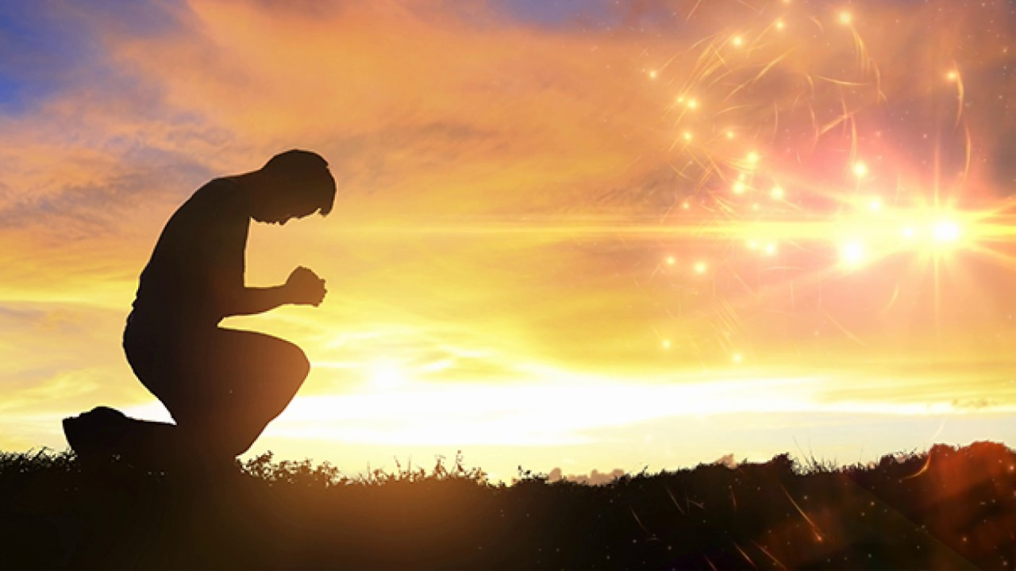
Pray and Trust God
by Pastor Fee Soliven
James 5:17-20
Wednesday Evening
March 3, 2021

Slide 2
James 5:17-20
17 Elijah was a man with a nature like ours, and he prayed earnestly that it would not rain; and it did not rain on the land for three years and six months. 18 And he prayed again, and the heaven gave rain, and the earth produced its fruit.

Slide 3
19 Brethren, if anyone among you wanders from the truth, and someone turns him back, 20 let him know that he who turns a sinner from the error of his way will save a soul from death and cover a multitude of sins.

Slide 4
17 Elijah was a man with a nature like ours, and he prayed earnestly that it would not rain; and it did not rain on the land for three years and six months.

Slide 5
1 Kings 17
1 And Elijah the Tishbite, of the inhabitants of Gilead, said to Ahab, "As the LORD God of Israel lives, before whom I stand, there shall not be dew nor rain these years, except at my word." 2 Then the word of the LORD came to him, saying,

Slide 6
3 "Get away from here and turn eastward, and hide by the Brook Cherith, which flows into the Jordan. 4 And it will be that you shall drink from the brook, and I have commanded the ravens to feed you there." 5 So he went and did according to the word of the LORD, for he went and stayed by the Brook Cherith, which flows into the Jordan.

Slide 7
6 The ravens brought him bread and meat in the morning, and bread and meat in the evening; and he drank from the brook. 7 And it happened after a while that the brook dried up, because there had been no rain in the land. 8 Then the word of the LORD came to him, saying, 9 "Arise, go to Zarephath, which belongs to Sidon, and dwell there. See, I have commanded a widow there to provide for you."

Slide 8
10 So he arose and went to Zarephath. And when he came to the gate of the city, indeed a widow was there gathering sticks. And he called to her and said, "Please bring me a little water in a cup, that I may drink." 11 And as she was going to get it, he called to her and said, "Please bring me a morsel of bread in your hand."

Slide 9
12 So she said, "As the LORD your God lives, I do not have bread, only a handful of flour in a bin, and a little oil in a jar; and see, I am gathering a couple of sticks that I may go in and prepare it for myself and my son, that we may eat it, and die." 13 And Elijah said to her, "Do not fear; go and do as you have said, but make me a small cake from it first, and bring it to me; and afterward make some for yourself and your son.

Slide 10
14 For thus says the LORD God of Israel: 'The bin of flour shall not be used up, nor shall the jar of oil run dry, until the day the LORD sends rain on the earth.' " 15 So she went away and did according to the word of Elijah; and she and he and her household ate for many days. 16 The bin of flour was not used up, nor did the jar of oil run dry, according to the word of the LORD which He spoke by Elijah.

Slide 11
17 Now it happened after these things that the son of the woman who owned the house became sick. And his sickness was so serious that there was no breath left in him. 18 So she said to Elijah, "What have I to do with you, O man of God? Have you come to me to bring my sin to remembrance, and to kill my son?“ 19 And he said to her, "Give me your son." So he took him out of her arms and carried him to the upper room where he was staying, and laid him on his own bed.

Slide 12
20 Then he cried out to the LORD and said, "O LORD my God, have You also brought tragedy on the widow with whom I lodge, by killing her son?" 21 And he stretched himself out on the child three times, and cried out to the LORD and said, "O LORD my God, I pray, let this child's soul come back to him." 22 Then the LORD heard the voice of Elijah; and the soul of the child came back to him, and he revived.

Slide 13
23 And Elijah took the child and brought him down from the upper room into the house, and gave him to his mother. And Elijah said, "See, your son lives!" 24 Then the woman said to Elijah, "Now by this I know that you are a man of God, and that the word of the LORD in your mouth is the truth."

Slide 14
18 And he prayed again, and the heaven gave rain, and the earth produced its fruit.

Slide 15
Matthew 21:18-22
18 Now in the morning, as He returned to the city, He was hungry. 19 And seeing a fig tree by the road, He came to it and found nothing on it but leaves, and said to it, "Let no fruit grow on you ever again." And immediately the fig tree withered away. 20 And when the disciples saw it, they marveled, saying, "How did the fig tree wither away so soon?"

Slide 16
21 So Jesus answered and said to them, "Assuredly, I say to you, if you have faith and do not doubt, you will not only do what was done to the fig tree, but also if you say to this mountain, 'Be removed and be cast into the sea,' it will be done. 22 And whatever things you ask in prayer, believing, you will receive."

Slide 17
Mark 11:20-24
20 Now in the morning, as they passed by, they saw the fig tree dried up from the roots. 21 And Peter, remembering, said to Him, "Rabbi, look! The fig tree which You cursed has withered away." 22 So Jesus answered and said to them, "Have faith in God.

Slide 18
23 For assuredly, I say to you, whoever says to this mountain, 'Be removed and be cast into the sea,' and does not doubt in his heart, but believes that those things he says will come to pass, he will have whatever he says. 24 Therefore I say to you, whatever things you ask when you pray, believe that you receive them, and you will have them.

Slide 19
Psalm 107:28-30
28 Then they cry out to the LORD in their trouble, And He brings them out of their distresses. 29 He calms the storm, So that its waves are still. 30 Then they are glad because they are quiet; So He guides them to their desired haven.

Slide 20
19 Brethren, if anyone among you wanders from the truth, and someone turns him back,

Slide 21
2 Timothy 4:1-5
1 I charge you therefore before God and the Lord Jesus Christ, who will judge the living and the dead at His appearing and His kingdom: 2 Preach the word! Be ready in season and out of season. Convince, rebuke, exhort, with all longsuffering and teaching.

Slide 22
3 For the time will come when they will not endure sound doctrine, but according to their own desires, because they have itching ears, they will heap up for themselves teachers; 4 and they will turn their ears away from the truth, and be turned aside to fables. 5 But you be watchful in all things, endure afflictions, do the work of an evangelist, fulfill your ministry.

Slide 23
2 Thessalonians 2:1-3
1 Now, brethren, concerning the coming of our Lord Jesus Christ and our gathering together to Him, we ask you, 2 not to be soon shaken in mind or troubled, either by spirit or by word or by letter, as if from us, as though the day of Christ had come. 3 Let no one deceive you by any means; for that Day will not come unless the falling away comes first, and the man of sin is revealed, the son of perdition...

Slide 24
20 let him know that he who turns a sinner from the error of his way will save a soul from death and cover a multitude of sins.

Slide 25
1 John 5:13-21
13 I have written this to you who believe in the name of the Son of God, so that you may know you have eternal life. 14 And we are confident that he hears us whenever we ask for anything that pleases him. 15 And since we know he hears us when we make our requests, we also know that he will give us what we ask for.

Slide 26
16 If you see a Christian brother or sister* sinning in a way that does not lead to death, you should pray, and God will give that person life. But there is a sin that leads to death, and I am not saying you should pray for those who commit it.

Slide 27
17 All wicked actions are sin, but not every sin leads to death. 18 We know that God’s children do not make a practice of sinning, for God’s Son holds them securely, and the evil one cannot touch them. 19 We know that we are children of God and that the world around us is under the control of the evil one.

Slide 28
20 And we know that the Son of God has come, and he has given us understanding so that we can know the true God.* And now we live in fellowship with the true God because we live in fellowship with his Son, Jesus Christ. He is the only true God, and he is eternal life. 21 Dear children, keep away from anything that might take God’s place in your hearts.*

Slide 29
1 Peter 4:7-8
7 But the end of all things is at hand; therefore be serious and watchful in your prayers. 8 And above all things have fervent love for one another, for "love will cover a multitude of sins."

Slide 30
Psalm 32:1-2
1 Blessed is he whose transgression is forgiven, Whose sin is covered. 2 Blessed is the man to whom the LORD does not impute iniquity, And in whose spirit there is no deceit.

Slide 31
Isaiah 43:25
25 "I, even I, am He who blots out your transgressions for My own sake; And I will not remember your sins.

Slide 32
Proverbs 11:30
The fruit of the righteous is a tree of life, And he who wins souls is wise.

Slide 33
Daniel 12:3
"Those who are wise shall shine Like the brightness of the firmament, And those who turn many to righteousness Like the stars forever and ever"

Slide 34
1 Thessalonians 4:13-18
13 But I do not want you to be ignorant, brethren, concerning those who have fallen asleep, lest you sorrow as others who have no hope. 14 For if we believe that Jesus died and rose again, even so God will bring with Him those who sleep in Jesus.

Slide 35
15 For this we say to you by the word of the Lord, that we who are alive and remain until the coming of the Lord will by no means precede those who are asleep. 16 For the Lord Himself will descend from heaven with a shout, with the voice of an archangel, and with the trumpet of God. And the dead in Christ will rise first.

Slide 36
17 Then we who are alive and remain shall be caught up together with them in the clouds to meet the Lord in the air. And thus we shall always be with the Lord. 18 Therefore comfort one another with these words.

Slide 37
1 Corinthians 15:50-54
50 Now this I say, brethren, that flesh and blood cannot inherit the kingdom of God; nor does corruption inherit incorruption. 51 Behold, I tell you a mystery: We shall not all sleep, but we shall all be changed-- 52 in a moment, in the twinkling of an eye, at the last trumpet. For the trumpet will sound, and the dead will be raised incorruptible, and we shall be changed.

Slide 38
53 For this corruptible must put on incorruption, and this mortal must put on immortality. 54 So when this corruptible has put on incorruption, and this mortal has put on immortality, then shall be brought to pass the saying that is written: "Death is swallowed up in victory."

Slide 39
20 Again, when a righteous man turns from his righteousness and commits iniquity, and I lay a stumbling block before him, he shall die; because you did not give him warning, he shall die in his sin, and his righteousness which he has done shall not be remembered; but his blood I will require at your hand.

Slide 40
Acts 2:38-39
38 Then Peter said to them, "Repent, and let every one of you be baptized in the name of Jesus Christ for the remission of sins; and you shall receive the gift of the Holy Spirit. 39 For the promise is to you and to your children, and to all who are afar off, as many as the Lord our God will call."

