Slide 1
Graves into Gardens
(Elevation Worship)

Slide 2
I searched the World but it couldn’t fill me. Man’s empty praise and treasures that fade Are never

Slide 3
Enough. Then you came along and put me back together And every desire Is now satisfied here in

Slide 4
Your love. Oh’ there’s nothing better than you. There’s nothing better than you. Lord there’s nothing

Slide 5
Nothing is better than you. I’m not afraid to show you my weakness. My failures and flaws Lord you’ve

Slide 6
Seen them all and you still call me friend . Cause the God of the mountain. Is the God of the Valley.

Slide 7
There’s not a place. Your mercy and grace. Wont find me again. Oh there’s nothing better than you. There’s

Slide 8
Nothing better than you. Lord there’s nothing. Nothing is better than you. Oh there’s nothing better

Slide 9
Better than you. There’s nothing better than you. Lord’ there’s nothing. Nothing is better than you.

Slide 10
You turn mourning to dancing. You give beauty for ashes. You turn shame into glory. You’re the only one

Slide 11
Who can. You turn mourning to dancing. You give beauty for ashes. You turn shame into glory. You’re

Slide 12
The only one who can. You turn graves into gardens. You turn bones into armies. You turn seas into

Slide 13
Highways. You’re the only one who can you’re the only one who can. Oh there’s nothing better than you

Slide 14
There’s nothing better than you. Lord there’s nothing. Nothing is better than you. Oh there’s nothing better

Slide 15
Than you. There’s nothing better than you. Lord, there’s nothing. Nothing is better than you. You turn

Slide 16
Graves into gardens. You turn bones into armies. You turn seas into highways. You’re the only one who

Slide 17
Can. You turn graves into gardens. You turn bones into armies. You turn seas into highways you’re the

Slide 18
Only one who can. You’re the only one who. You’re the only one who can.

Slide 19
Everlasting God
(Chris Tomlin)

Slide 20
Strength will rise as we wait upon the Lord. Wait upon the Lord, we will wait upon the Lord.

Slide 21
Strength will rise as we wait upon the Lord. Wait upon the Lord, we will wait upon the Lord.

Slide 22
Our God you reign forever. Our Hope Our strong Deliverer. You are the everlasting God.

Slide 23
The everlasting God. You do not faint you won’t grow weary. You’re the defender of the weak.

Slide 24
You comfort those in need. You lift us up on wings like eagles.

Slide 25
Strength will rise as we wait upon the Lord. Wait upon the Lord, we will wait upon the Lord.

Slide 26
Strength will rise as we wait upon the Lord. Wait upon the Lord, we will wait upon the Lord.

Slide 27
Our God you reign forever. Our Hope Our strong Deliverer. You are the everlasting God.

Slide 28
The everlasting God. You do not faint you won’t grow weary. You’re the defender of the weak.

Slide 29
You comfort those in need. You lift us up on wings like eagles.

Slide 30
Strength will rise as we wait upon the Lord. Wait upon the Lord, we will wait upon the Lord.

Slide 31
Strength will rise as we wait upon the Lord. Wait upon the Lord, we will wait upon the Lord.

Slide 32
“Great are you Lord”
(All Sons and Daughters)

Slide 33
You give life, You are love. You bring light in the darkness. You give hope, You restore

Slide 34
Every heart that is broken. And great are you Lord. It’s your breath in our lungs so we

Slide 35
Pour out our praise. We pour out our praise.
It’s your breath in our lungs. So we pour out

Slide 36
Our praise to you only. You give life, you are love. You bring light to the darkness. You

Slide 37
Give hope, You restore. Every heart that is broken. Great are you Lord. It’s your breath

Slide 38
In our lungs. So we pour out our praise we pour out our praise. It’s your breath in our

Slide 39
Lungs so we pour out our praise to you only. It’s your breath in our lungs. So we

Slide 40
Pour out our praise we pour out our praise. It’s your breath in our lungs. So we pour out

Slide 41
Our praise to you only. And all the earth will shout your praise. Our hearts will cry, these

Slide 42
Bones will sing. Great are You, Lord. And all the earth will shout your praise. Our hearts

Slide 43
Will cry these bones will sing. Great are you,Lord. And all the earth will shout your

Slide 44
Praise Our hearts will cry these bones will sing. Great are you, Lord. It’s your breath in

Slide 45
Our Lungs. So we pour out our praise. We pour out our praise. It’s your breath in our

Slide 46
Lungs so we pour out our praise to you only. Great are you, Lord. It’s your breath in

Slide 47
Our lungs so we pour out our praise. Pour out our praise. It’s your breath in our lungs

Slide 48
So we pour out our praise to you only. Great are you , Lord.

Slide 49
“O Come to the Altar”
(Elevation Worship)

Slide 50
Are you hurting and broken within? Overwhelmed by the weight of your sin? Jesus is calling

Slide 51
Have you come to the end of yourself. Do you thirst for a drink from the well? Jesus is calling

Slide 52
O Come to the Altar. The Father’s arms are open wide. Forgiveness was bought with. The precious

Slide 53
blood of Jesus Christ. Leave behind your regrets and mistakes. Come today there’s no reason to wait.

Slide 54
Jesus is calling. Bring your sorrows and trade them for joy. From the ashes a new life is born. Jesus is

Slide 55
Calling. O come to the Altar. The Father’s arms are open wide. Forgiveness was bought with the

Slide 56
Blood of Jesus Christ. O Come to the Altar. The Father’s arms are open wide. Forgiveness was

Slide 57
Bought with. The precious blood of Jesus Christ . Oh,
What a Savior. Isn’t he wonderful. Sing Hallelujah

Slide 58
Christ is risen. Bow down before him. For he is Lord of all . Sing Hallelujah Christ is risen. Oh what a

Slide 59
Savior. Isn’t he wonderful. Sing Hallelujah Christ is risen. Bow down before him. For he is Lord of all

Slide 60
Sing Hallelujah, Christ is Risen. O Come to the Altar. The Father’s arms are open wide.

Slide 61
Forgiveness was bought with. The precious Blood of Jesus Christ. O Come to the Altar. The Father’s arms

Slide 62
Are open wide. Forgiveness was bought with the precious blood of Jesus Christ.

Slide 63
Bear your cross as you wait for the crown. Tell the world of the treasure you’ve found.

Slide 64
“This is My Desire”

Slide 65
This is my desire, to Honor you. Lord with all my Heart I worship you. All I have within me

Slide 66
I give you Praise. All that I adore is in you. Lord I give you my heart. I give you my soul.

Slide 67
I live for you alone. Every breath that I take. Every moment im awake. Lord have your

Slide 68
Way in me. This is my desire, to honor you. Lord with all my heart. I worship you. All I

Slide 69
Have with in me. I give you praise. All that I adore is in you. Lord I give you my heart. I

Slide 70
Give you my soul. I live for you alone. Every breath that I take. Every moment I’m awake

Slide 71
Lord have your way in me.

Slide 74
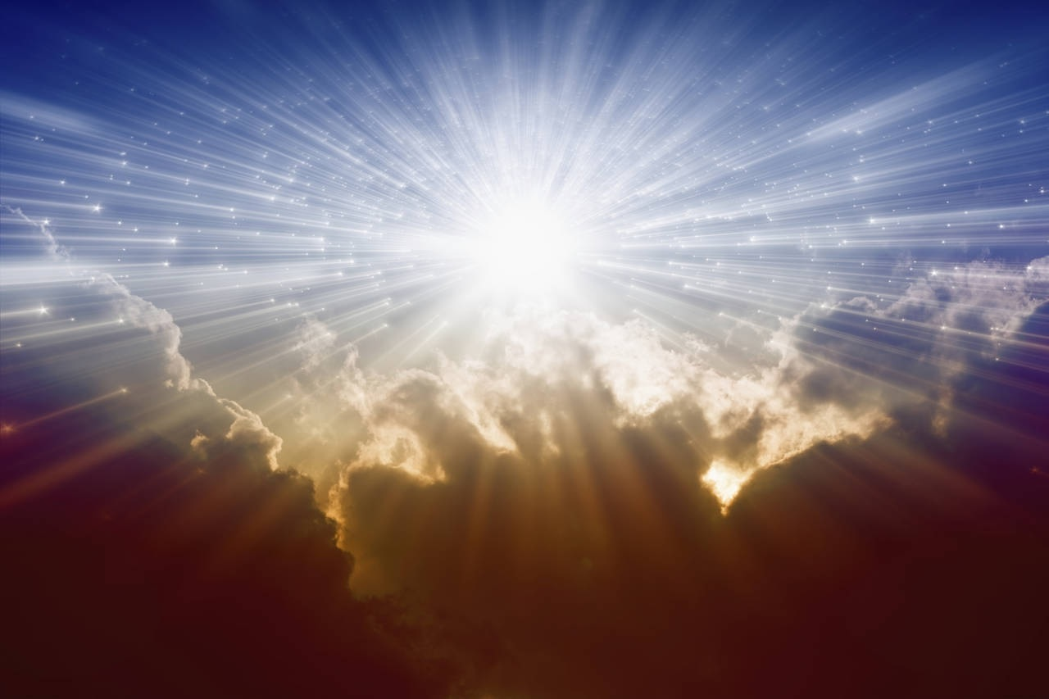
The Fire and Light of Jesus
by Pastor Fee Soliven
Matthew 5:13-16
Sunday Morning
March 14, 2021

Slide 75
Matthew 5:13-16
13 “You are the salt of the earth. But if the salt loses its saltiness, how can it be made salty again? It is no longer good for anything, except to be thrown out and trampled underfoot. 14 “You are the light of the world. A town built on a hill cannot be hidden.

Slide 76
15 Neither do people light a lamp and put it under a bowl. Instead they put it on its stand, and it gives light to everyone in the house. 16 In the same way, let your light shine before others, that they may see your good deeds and glorify your Father in heaven.

Slide 77
1. His Fire Attracts

Slide 78
Exodus 3:1-6
1 Now Moses was tending the flock of Jethro his father-in-law, the priest of Midian. And he led the flock to the back of the desert, and came to Horeb, the mountain of God. 2 And the Angel of the LORD appeared to him in a flame of fire from the midst of a bush. So he looked, and behold, the bush was burning with fire, but the bush was not consumed.

Slide 79
3 Then Moses said, "I will now turn aside and see this great sight, why the bush does not burn." 4 So when the LORD saw that he turned aside to look, God called to him from the midst of the bush and said, "Moses, Moses!" And he said, "Here I am." 5 Then He said, "Do not draw near this place. Take your sandals off your feet, for the place where you stand is holy ground."

Slide 80
6 Moreover He said, "I am the God of your father--the God of Abraham, the God of Isaac, and the God of Jacob." And Moses hid his face, for he was afraid to look upon God.

Slide 81
1 Corinthians 3:10-17
10 According to the grace of God which was given to me, as a wise master builder I have laid the foundation, and another builds on it. But let each one take heed how he builds on it. 11 For no other foundation can anyone lay than that which is laid, which is Jesus Christ.

Slide 82
12 Now if anyone builds on this foundation with gold, silver, precious stones, wood, hay, straw, 13 each one's work will become clear; for the Day will declare it, because it will be revealed by fire; and the fire will test each one's work, of what sort it is. 14 If anyone's work which he has built on it endures, he will receive a reward.

Slide 83
15 If anyone's work is burned, he will suffer loss; but he himself will be saved, yet so as through fire. 16 Do you not know that you are the temple of God and that the Spirit of God dwells in you? 17 If anyone defiles the temple of God, God will destroy him. For the temple of God is holy, which temple you are.

Slide 84
Matthew 3:11-12
11 I indeed baptize you with water unto repentance, but He who is coming after me is mightier than I, whose sandals I am not worthy to carry. He will baptize you with the Holy Spirit and fire. 12 His winnowing fan is in His hand, and He will thoroughly clean out His threshing floor, and gather His wheat into the barn; but He will burn up the chaff with unquenchable fire."

Slide 85
2. Light of Christ In Us

Slide 86
Acts 9:1-22
1 Then Saul, still breathing threats and murder against the disciples of the Lord, went to the high priest 2 and asked letters from him to the synagogues of Damascus, so that if he found any who were of the Way, whether men or women, he might bring them bound to Jerusalem.

Slide 87
3 And as he journeyed he came near Damascus, and suddenly a light shone around him from heaven. 4 Then he fell to the ground, and heard a voice saying to him, "Saul, Saul, why are you persecuting Me?" 5 And he said, "Who are You, Lord?" And the Lord said, "I am Jesus, whom you are persecuting. It is hard for you to kick against the goads."

Slide 88
6 So he, trembling and astonished, said, "Lord, what do You want me to do?" And the Lord said to him, "Arise and go into the city, and you will be told what you must do." 7 And the men who journeyed with him stood speechless, hearing a voice but seeing no one. 8 Then Saul arose from the ground, and when his eyes were opened he saw no one. But they led him by the hand and brought him into Damascus.

Slide 89
9 And he was three days without sight, and neither ate nor drank. 10 Now there was a certain disciple at Damascus named Ananias; and to him the Lord said in a vision, "Ananias." And he said, "Here I am, Lord." 11 So the Lord said to him, "Arise and go to the street called Straight, and inquire at the house of Judas for one called Saul of Tarsus, for behold, he is praying.

Slide 90
12 And in a vision he has seen a man named Ananias coming in and putting his hand on him, so that he might receive his sight." 13 Then Ananias answered, "Lord, I have heard from many about this man, how much harm he has done to Your saints in Jerusalem. 14 And here he has authority from the chief priests to bind all who call on Your name."

Slide 91
15 But the Lord said to him, "Go, for he is a chosen vessel of Mine to bear My name before Gentiles, kings, and the children of Israel. 16 For I will show him how many things he must suffer for My name's sake." 17 And Ananias went his way and entered the house; and laying his hands on him he said, "Brother Saul, the Lord Jesus, who appeared to you on the road as you came, has sent me that you may receive your sight and be filled with the Holy Spirit."

Slide 92
18 Immediately there fell from his eyes something like scales, and he received his sight at once; and he arose and was baptized. 19 So when he had received food, he was strengthened. Then Saul spent some days with the disciples at Damascus. 20 Immediately he preached the Christ in the synagogues, that He is the Son of God.

Slide 93
21 Then all who heard were amazed, and said, "Is this not he who destroyed those who called on this name in Jerusalem, and has come here for that purpose, so that he might bring them bound to the chief priests?" 22 But Saul increased all the more in strength, and confounded the Jews who dwelt in Damascus, proving that this Jesus is the Christ.

Slide 94
Matthew 5:16
"Let your light so shine before men, that they may see your good works, and glorify your Father which is in heaven."

Slide 95
Matthew 6:22-23
22 "The lamp of the body is the eye. If therefore your eye is good, your whole body will be full of light. 23 But if your eye is bad, your whole body will be full of darkness. If therefore the light that is in you is darkness, how great is that darkness!

Slide 96
John 3:19-21
19 And this is the condemnation, that the light has come into the world, and men loved darkness rather than light, because their deeds were evil. 20 For everyone practicing evil hates the light and does not come to the light, lest his deeds should be exposed. 21 But he who does the truth comes to the light, that his deeds may be clearly seen, that they have been done in God."

Slide 97
3. God's Supernatural Power

Slide 98
Psalm 33:8-9
8 Let all the earth fear the LORD; Let all the inhabitants of the world stand in awe of Him. 9 For He spoke, and it was done; He commanded, and it stood fast.

Slide 99
Colossians 1:16-18
16 For by Him all things were created that are in heaven and that are on earth, visible and invisible, whether thrones or dominions or principalities or powers. All things were created through Him and for Him.

Slide 100
17 And He is before all things, and in Him all things consist. 18 And He is the head of the body, the church, who is the beginning, the firstborn from the dead, that in all things He may have the preeminence.

Slide 101
Acts 1:8
"But you shall receive power when the Holy Spirit has come upon you; and you shall be witnesses to Me in Jerusalem, and in all Judea and Samaria, and to the end of the earth."

Slide 102
Acts 2:1-4
1 Now when the Day of Pentecost had fully come, they were all with one accord in one place. 2 And suddenly there came a sound from heaven, as of a rushing mighty wind, and it filled the whole house where they were sitting.

Slide 103
3 Then there appeared to them divided tongues, as of fire, and one sat upon each of them. 4 And they were all filled with the Holy Spirit and began to speak with other tongues, as the Spirit gave them utterance.

Slide 104
The Greatest Power is the
Resurrection Power!

Slide 105
Romans 8:9-13
9 But you are not in the flesh but in the Spirit, if indeed the Spirit of God dwells in you. Now if anyone does not have the Spirit of Christ, he is not His. 10 And if Christ is in you, the body is dead because of sin, but the Spirit is life because of righteousness.

Slide 106
11 But if the Spirit of Him who raised Jesus from the dead dwells in you, He who raised Christ from the dead will also give life to your mortal bodies through His Spirit who dwells in you. 12 Therefore, brethren, we are debtors--not to the flesh, to live according to the flesh.

Slide 107
13 For if you live according to the flesh you will die; but if by the Spirit you put to death the deeds of the body, you will live.

Slide 108
How Do You Receive This Power Today?

Slide 109
Acts 2:38-41
38 Then Peter said to them, "Repent, and let every one of you be baptized in the name of Jesus Christ for the remission of sins; and you shall receive the gift of the Holy Spirit. 39 For the promise is to you and to your children, and to all who are afar off, as many as the Lord our God will call."

Slide 110
40 And with many other words he testified and exhorted them, saying, "Be saved from this perverse generation." 41 Then those who gladly received his word were baptized; and that day about three thousand souls were added to them.

Slide 111
John 7:37-39
37 On the last day, that great day of the feast, Jesus stood and cried out, saying, "If anyone thirsts, let him come to Me and drink. 38 He who believes in Me, as the Scripture has said, out of his heart will flow rivers of living water." 39 But this He spoke concerning the Spirit, whom those believing in Him would receive; for the Holy Spirit was not yet given, because Jesus was not yet glorified.

Slide 112
Ask God for His Power by Faith!

Slide 113
Luke 11:9-13
9 "So I say to you, ask, and it will be given to you; seek, and you will find; knock, and it will be opened to you. 10 For everyone who asks receives, and he who seeks finds, and to him who knocks it will be opened. 11 If a son asks for bread from any father among you, will he give him a stone? Or if he asks for a fish, will he give him a serpent instead of a fish?

Slide 114
12 Or if he asks for an egg, will he offer him a scorpion? 13 If you then, being evil, know how to give good gifts to your children, how much more will your heavenly Father give the Holy Spirit to those who ask Him!"

Slide 115
Hebrews 11:6
"But without faith it is impossible to please Him, for he who comes to God must believe that He is, and that He is a rewarder of those who diligently seek Him."

Slide 116
1 Thessalonians 4:13-18
13 But I do not want you to be ignorant, brethren, concerning those who have fallen asleep, lest you sorrow as others who have no hope. 14 For if we believe that Jesus died and rose again, even so God will bring with Him those who sleep in Jesus.

Slide 117
15 For this we say to you by the word of the Lord, that we who are alive and remain until the coming of the Lord will by no means precede those who are asleep. 16 For the Lord Himself will descend from heaven with a shout, with the voice of an archangel, and with the trumpet of God. And the dead in Christ will rise first.

Slide 118
17 Then we who are alive and remain shall be caught up together with them in the clouds to meet the Lord in the air. And thus we shall always be with the Lord. 18 Therefore comfort one another with these words.

Slide 119
1 Corinthians 15:50-54
50 Now this I say, brethren, that flesh and blood cannot inherit the kingdom of God; nor does corruption inherit incorruption. 51 Behold, I tell you a mystery: We shall not all sleep, but we shall all be changed-- 52 in a moment, in the twinkling of an eye, at the last trumpet. For the trumpet will sound, and the dead will be raised incorruptible, and we shall be changed.

Slide 120
53 For this corruptible must put on incorruption, and this mortal must put on immortality. 54 So when this corruptible has put on incorruption, and this mortal has put on immortality, then shall be brought to pass the saying that is written: "Death is swallowed up in victory."

Slide 121
20 Again, when a righteous man turns from his righteousness and commits iniquity, and I lay a stumbling block before him, he shall die; because you did not give him warning, he shall die in his sin, and his righteousness which he has done shall not be remembered; but his blood I will require at your hand.

Slide 122
Acts 2:38-39
38 Then Peter said to them, "Repent, and let every one of you be baptized in the name of Jesus Christ for the remission of sins; and you shall receive the gift of the Holy Spirit. 39 For the promise is to you and to your children, and to all who are afar off, as many as the Lord our God will call."

