Slide 2
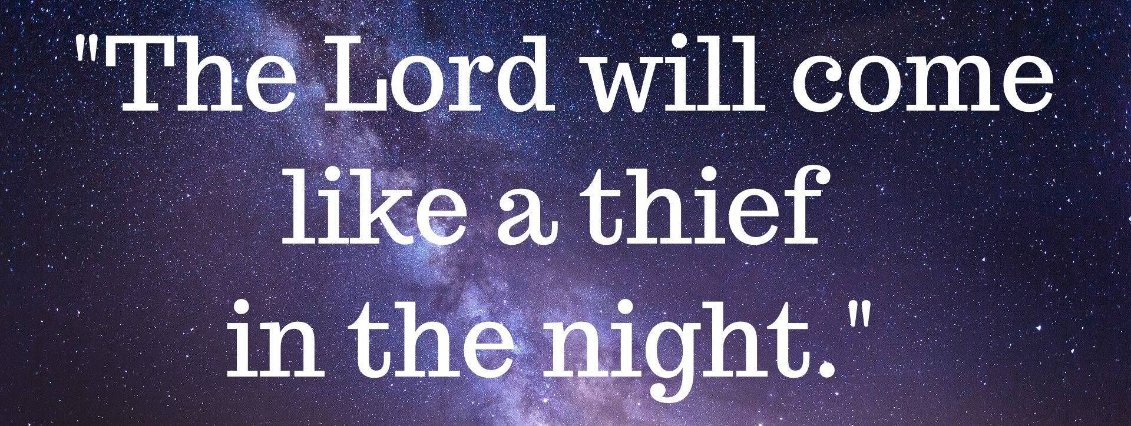
Jesus is Coming Like a Thief in the Night
by Pastor Fee Soliven
2 Peter 3:10-18
Wednesday Evening
April 28, 2021

Slide 3
2 Peter 3:10-18
10 But the day of the Lord will come as a thief in the night, in which the heavens will pass away with a great noise, and the elements will melt with fervent heat; both the earth and the works that are in it will be burned up.

Slide 4
11 Therefore, since all these things will be dissolved, what manner of persons ought you to be in holy conduct and godliness, 12 looking for and hastening the coming of the day of God, because of which the heavens will be dissolved, being on fire, and the elements will melt with fervent heat?

Slide 5
13 Nevertheless we, according to His promise, look for new heavens and a new earth in which righteousness dwells. 14 Therefore, beloved, looking forward to these things, be diligent to be found by Him in peace, without spot and blameless;

Slide 6
15 and account that the longsuffering of our Lord is salvation--as also our beloved brother Paul, according to the wisdom given to him, has written to you, 16 as also in all his epistles, speaking in them of these things, in which are some things hard to understand, which untaught and unstable people twist to their own destruction, as they do also the rest of the Scriptures.

Slide 7
17 You therefore, beloved, since you know this beforehand, beware lest you also fall from your own steadfastness, being led away with the error of the wicked; 18 but grow in the grace and knowledge of our Lord and Savior Jesus Christ. To Him be the glory both now and forever. Amen.

Slide 8
10 But the day of the Lord will come as a thief in the night, in which the heavens will pass away with a great noise, and the elements will melt with fervent heat; both the earth and the works that are in it will be burned up.

Slide 9
Matthew 24:22-24
22 And unless those days were shortened, no flesh would be saved; but for the elect's sake those days will be shortened. 23 Then if anyone says to you, 'Look, here is the Christ!' or 'There!' do not believe it. 24 For false christs and false prophets will rise and show great signs and wonders to deceive, if possible, even the elect.

Slide 10
Matthew 24:29
"Immediately after the tribulation of those days the sun will be darkened, and the moon will not give its light; the stars will fall from heaven, and the powers of the heavens will be shaken.”

Slide 11
Luke 21:25
"And there will be signs in the sun, in the moon, and in the stars; and on the earth distress of nations, with perplexity, the sea and the waves roaring;

Slide 12
1. The heavens will pass away with a terrible noise describes the end of the earth’s atmosphere and the sky above.

Slide 13
2. Everything in them will disappear in fire could mean that the celestial bodies will also be destroyed (the sun, moon, stars, and planets).

Slide 14
3. The earth and everything on it will be exposed to judgment is an extremely difficult phrase, which has given rise to numerous textual variants in various manuscripts.

Slide 15
Hebrews 1:10-12
And: "You, LORD, in the beginning laid the foundation of the earth, And the heavens are the work of Your hands. 11 They will perish, but You remain; And they will all grow old like a garment; 12 Like a cloak You will fold them up, And they will be changed. But You are the same, And Your years will not fail."

Slide 16
11 Therefore, since all these things will be dissolved, what manner of persons ought you to be in holy conduct and godliness, 12 looking for and hastening the coming of the day of God, because of which the heavens will be dissolved, being on fire, and the elements will melt with fervent heat?

Slide 17
Ephesians 1:3-4
3 Blessed be the God and Father of our Lord Jesus Christ, who has blessed us with every spiritual blessing in the heavenly places in Christ, 4 just as He chose us in Him before the foundation of the world, that we should be holy and without blame before Him in love…

Slide 18
Revelation 22:11
“He who is unjust, let him be unjust still; he who is filthy, let him be filthy still; he who is righteous, let him be righteous still; he who is holy, let him be holy still."

Slide 19
13 Nevertheless we, according to His promise, look for new heavens and a new earth in which righteousness dwells.

Slide 20
Romans 8:21
“because the creation itself also will be delivered from the bondage of corruption into the glorious liberty of the children of God”

Slide 21
Revelation 21:1-4
1 Now I saw a new heaven and a new earth, for the first heaven and the first earth had passed away. Also there was no more sea. 2 Then I, John, saw the holy city, New Jerusalem, coming down out of heaven from God, prepared as a bride adorned for her husband.

Slide 22
3 And I heard a loud voice from heaven saying, "Behold, the tabernacle of God is with men, and He will dwell with them, and they shall be His people. God Himself will be with them and be their God. 4 And God will wipe away every tear from their eyes; there shall be no more death, nor sorrow, nor crying. There shall be no more pain, for the former things have passed away."

Slide 23
Revelation 21:22-27
22 But I saw no temple in it, for the Lord God Almighty and the Lamb are its temple. 23 The city had no need of the sun or of the moon to shine in it, for the glory of God illuminated it. The Lamb is its light. 24 And the nations of those who are saved shall walk in its light, and the kings of the earth bring their glory and honor into it.
25 Its gates shall not be shut at all by day (there shall be no night there). 26 And they shall bring the glory and the honor of the nations into it. 27 But there shall by no means enter it anything that defiles, or causes an abomination or a lie, but only those who are written in the Lamb's Book of Life.

Slide 24
25 Its gates shall not be shut at all by day (there shall be no night there). 26 And they shall bring the glory and the honor of the nations into it. 27 But there shall by no means enter it anything that defiles, or causes an abomination or a lie, but only those who are written in the Lamb's Book of Life.

Slide 25
14 Therefore, beloved, looking forward to these things, be diligent to be found by Him in peace, without spot and blameless;

Slide 26
Titus 2:11-13
11 For the grace of God that brings salvation has appeared to all men, 12 teaching us that, denying ungodliness and worldly lusts, we should live soberly, righteously, and godly in the present age, 13 looking for the blessed hope and glorious appearing of our great God and Savior Jesus Christ,

Slide 27
14 who gave Himself for us, that He might redeem us from every lawless deed and purify for Himself His own special people, zealous for good works. 15 Speak these things, exhort, and rebuke with all authority. Let no one despise you.

Slide 28
17 You therefore, beloved, since you know this beforehand, beware lest you also fall from your own steadfastness, being led away with the error of the wicked;

Slide 29
18 but grow in the grace and knowledge of our Lord and Savior Jesus Christ. To Him be the glory both now and forever. Amen.

Slide 30
1 Thessalonians 4:13-18
13 But I do not want you to be ignorant, brethren, concerning those who have fallen asleep, lest you sorrow as others who have no hope. 14 For if we believe that Jesus died and rose again, even so God will bring with Him those who sleep in Jesus.

Slide 31
15 For this we say to you by the word of the Lord, that we who are alive and remain until the coming of the Lord will by no means precede those who are asleep. 16 For the Lord Himself will descend from heaven with a shout, with the voice of an archangel, and with the trumpet of God. And the dead in Christ will rise first.

Slide 32
17 Then we who are alive and remain shall be caught up together with them in the clouds to meet the Lord in the air. And thus we shall always be with the Lord. 18 Therefore comfort one another with these words.

Slide 33
1 Corinthians 15:50-54
50 Now this I say, brethren, that flesh and blood cannot inherit the kingdom of God; nor does corruption inherit incorruption. 51 Behold, I tell you a mystery: We shall not all sleep, but we shall all be changed-- 52 in a moment, in the twinkling of an eye, at the last trumpet. For the trumpet will sound, and the dead will be raised incorruptible, and we shall be changed.

Slide 34
53 For this corruptible must put on incorruption, and this mortal must put on immortality. 54 So when this corruptible has put on incorruption, and this mortal has put on immortality, then shall be brought to pass the saying that is written: "Death is swallowed up in victory."

Slide 35
20 Again, when a righteous man turns from his righteousness and commits iniquity, and I lay a stumbling block before him, he shall die; because you did not give him warning, he shall die in his sin, and his righteousness which he has done shall not be remembered; but his blood I will require at your hand.

Slide 36
Acts 2:38-39
38 Then Peter said to them, "Repent, and let every one of you be baptized in the name of Jesus Christ for the remission of sins; and you shall receive the gift of the Holy Spirit. 39 For the promise is to you and to your children, and to all who are afar off, as many as the Lord our God will call."

