Slide 1
God So Loved
(We The Kingdom)

Slide 2
Come all you weary. Come all you thirsty. Com to the well. That never runs dry. Drink of the water.

Slide 3
Come and thirst no more. Come all you sinners. Come find his mercy. Come to the table. He will

Slide 4
Satisfy. Taste of his goodnessThe world that he gave us. His one and only son to save us. Whoever

Slide 5
believes In him will live forever. Bring all your failures. Bring your addictions. Come lay them down

Slide 6
at the foot of the cross. Jesus is waiting there with open arms. See his open arms. For God so loved

Slide 7
the world. That he gave us. His one and only Son to save us. Whoever believes in him. Will live forever.

Slide 8
The Power of hell forever defeated. Now it is well. I’m walking in freedom. For God so loved. God so

Slide 9
loved the world. Praise God. Praise God. From whom all blessings flow. Praise him. Praise him.

Slide 10
For the wonders of his love. Praise God. Praise God. From whom all blessings flow. Praise him.

Slide 11
Praise him. For the wonders of his love. His amazing love. For God so Loved the world. That he

Slide 12
gave us. His one and only . Son to save. For God so loved the world that he gave us. His one and only

Slide 13
Son to save us. Whoever believes in him. Will live forever. The power of hell forever defeated. Now it is

Slide 14
Well. I’m walking in freedom. For God so loved. God so loved the world. Bring all your failures. Bring

Slide 15
your addictions. Come lay them down at the foot of the cross. Jesus is waiting. God so loved the world.

Slide 16
“Our God”
(Chris Tomlin)

Slide 17
Water, You turned into wine. Opened the eyes of the blind. There’s no one like you. None like you.

Slide 18
Into the darkness you shine. Out of the ashes we rise. There’s no one like you. None like you.

Slide 19
Our God is greater. Our God is stronger. God you are higher than any other . Our God is healer. Awesome

Slide 20
In power our God. Our God. Into the Darkness , you shine. Out of the ashes, we rise. There’s no one like

Slide 21
You none like you. Our God is Greater. Our God is stronger. God, you are higher than any other. Our

Slide 22
God Is healer. Awesome in Power. Our God, our God. Our God is greater. Our God is stronger.

Slide 23
God, You are higher than any other. Our God is healer. Awesome in Power. Our God, Our God.

Slide 24
Our God is greater. Our God is stronger. God, you are higher than any other. Our God is healer.

Slide 25
Awesome in Power. Our God, Our God. And if our God is for us. Then who could ever stop us?

Slide 26
And if our God is with us. Then what can stand against? And if our God is for us. Then who could

Slide 27
Ever stop us? And if our God is with us. Then what could stand against? Then what could stand against?

Slide 28
Our God is Greater. Our God is stronger. God you are higher then any other. Our God is healer.

Slide 29
Awesome in Power. Our God, Our God. Our god is greater Our God is greater. Our God is stronger.

Slide 30
God you are higher than any other. Our God is healer. Awesome in Power. Our God, Our God.

Slide 31
God you are higher than any other. Our God is healer. Awesome in Power. Our God, Our God.

Slide 32
”See A Victory”
(Elevation Worship)

Slide 33
The weapon may be formed but it wont prosper. When the darkness falls, it wont prevail. Cause The

Slide 34
God I serve knows only how to triumph. My God will never fail. Oh, My God will never fail. Im gonna see

Slide 35
A Victory. I’m gonna see a Victory. For the battle belongs to you Lord. I’m gonna see a Victory. I’m

Slide 36
Gonna see a Victory. For the battle belongs to you Lord. There’s power in the mighty name of Jesus.

Slide 37
War he wages, He will Win. Oh I’m not backing down from any giant. Cause, I know how the Story Ends

Slide 38
Yes, I know how the story ends. I’m gonna see a victory. I’m gonna see a Victory. For the battle

Slide 39
Belongs to you Lord. I’m gonna see a Victory. I’m gonna see a Victory. For the Battle belongs to you

Slide 40
Lord. I’m gonna see a victory.I’m gonna see a victory. For the battle belongs to you Lord. I’m gonna see a

Slide 41
Victory. I’m gonna see a Victory. For the battle belongs to you Lord. You take what the enemy

Slide 42
Meant for evil. And you turn it for good. You turn it for good. You take what the enemy meant for evil. And

Slide 43
You turn it for good. You turn it for good. You take what the enemy meant for Evil. And you turn it for

Slide 44
Good. You turn it for good. You take what the enemy meant for evil. And you turn it for good. You turn it for

Slide 45
Good. I’m gonna see a victory. I’m gonna see a victory. For the battle belongs to you Lord. I’m gonna

Slide 46
See a victory. I’m gonna see a Victory. For the battle belongs to you Lord. I’m gonna see a Victory. I’m

Slide 47
Gonna see a victory. For the battle belongs to you Lord. I’m gonna see a victory. I’m gonna see a victory

Slide 48
For the battle belongs to you Lord. For the battle belongs to you Lord.

Slide 49
”No Longer Slaves”
(Bethel)

Slide 50
You unravel me. With a melody. You surround me with song of deliverance. From my enemies. Til all

Slide 51
My fears are gone.. I’m no longer a slave to fear. I am a child of God. I’m no longer a slave to fear.

Slide 52
I am a child of God. From my mother’s womb you have chosen me. Love has called my name.

Slide 53
I’ve been born again. Into your family. Your blood flows through my veins. I’m no longer slave to fear

Slide 54
I am a child of god. I’m no longer a slave to fear. I am a child of God. Ooh, oooh. Ooh,oooh. Ooh, oooh.

Slide 55
Ooh, oooh. You split the sea so I could walk right through it. My fears are drowned in perfect Love.

Slide 56
You rescue me. So I could stand and say. I am a child of God. You split the sea so I could walk right

Slide 57
Through it. My fears are drowned in perfect love. You rescued me. So I could stand and say. I am a child

Slide 58
Of god. I am a child of God. Yes I am a child of God.

Slide 59
“Revelation Song”
(Kari Jobe)

Slide 60
Worthy is the Lamb who was slain. Holy holy is he.Sing a new songto him who sits on Heaven’s

Slide 61
Mercy seat. Worthy is the Lamb who was slain. Holy, holy is he. Sing a new song to him who sits on

Slide 62
Heaven’s mercy seat. Holy, Holy, holy is the Lord God almighty. Who was and is to come. With all

Slide 63
Creation I sing. Praise to the King of Kings. You are my everything and I will Adore you. Clothed in

Slide 64
Rainbows of living color. Flashes of lightning rolls of thunder. Blessing and honor strength and glory and

Slide 65
Power be. To you the only wise King. Holy, holy, holy is the Lord god Almighty. Who was and is to come.

Slide 66
With all Creation I sing praise to the King of Kings. You are my everything and I will adore you. Filled

Slide 67
With wonder. Awe struck Wonder at the mention of your name. Jesus your name is power, breath and

Slide 68
Living water. Such a marvelous mystery. Holy,holy, holy is the Lord God almighty. Who was and is and is

Slide 69
To come. With all creation I sing. Praise to the king of Kings. You are my everything. And I will Adore you.

Slide 70
Exodus 23:14-16
14 "Three times you shall keep a feast to Me in the year: 15 You shall keep the Feast of Unleavened Bread (you shall eat unleavened bread seven days, as I commanded you, at the time appointed in the month of Abib, for in it you came out of Egypt; none shall appear before Me empty);

Slide 72
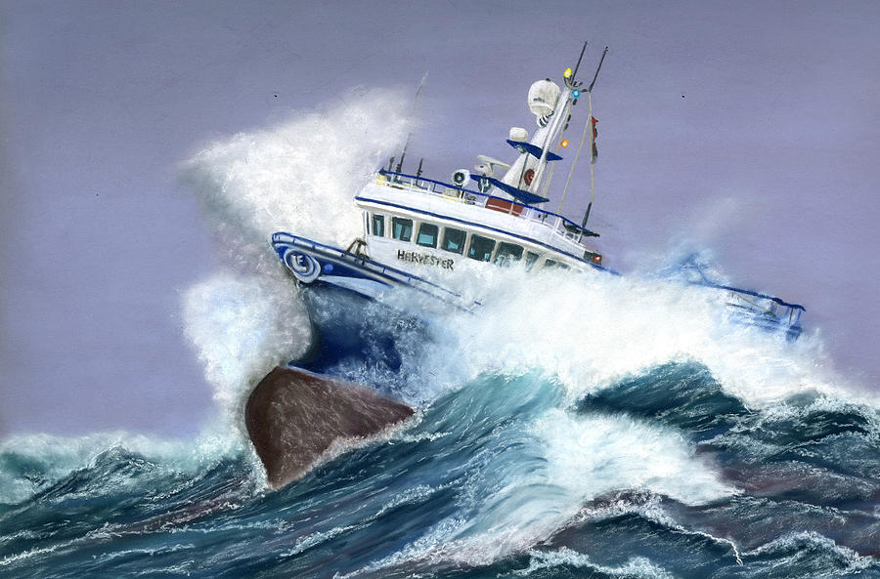
Jesus Our Captain
by Pastor Fee Soliven
Hebrews 2:10-15
Sunday Morning
May 23, 2021

Slide 73
Hebrews 2:10-15
10 For it was fitting for Him, for whom are all things and by whom are all things, in bringing many sons to glory, to make the captain of their salvation perfect through sufferings. 11 For both He who sanctifies and those who are being sanctified are all of one, for which reason He is not ashamed to call them brethren,

Slide 74
12 saying: "I will declare Your name to My brethren; In the midst of the assembly I will sing praise to You." 13 And again: "I will put My trust in Him." And again: "Here am I and the children whom God has given Me."

Slide 75
14 Inasmuch then as the children have partaken of flesh and blood, He Himself likewise shared in the same, that through death He might destroy him who had the power of death, that is, the devil, 15 and release those who through fear of death were all their lifetime subject to bondage. 16 For indeed He does not give aid to angels, but He does give aid to the seed of Abraham.

Slide 76
10 For it was fitting for Him, for whom are all things and by whom are all things, in bringing many sons to glory, to make the captain of their salvation perfect through sufferings.

Slide 77
11 For both He who sanctifies and those who are being sanctified are all of one, for which reason He is not ashamed to call them brethren,

Slide 78
Luke 9:26
“For whoever is ashamed of Me and My words, of him the Son of Man will be ashamed when He comes in His own glory, and in His Father's, and of the holy angels.”

Slide 79
12 saying: "I will declare Your name to My brethren; In the midst of the assembly I will sing praise to You."

Slide 80
Psalm 22:22-28
22 I will declare Your name to My brethren; In the midst of the assembly I will praise You. 23 You who fear the LORD, praise Him! All you descendants of Jacob, glorify Him, And fear Him, all you offspring of Israel!

Slide 81
24 For He has not despised nor abhorred the affliction of the afflicted; Nor has He hidden His face from Him; But when He cried to Him, He heard. 25 My praise shall be of You in the great assembly; I will pay My vows before those who fear Him. 26 The poor shall eat and be satisfied; Those who seek Him will praise the LORD. Let your heart live forever!

Slide 82
27 All the ends of the world Shall remember and turn to the LORD, And all the families of the nations Shall worship before You. 28 For the kingdom is the LORD's, And He rules over the nations.

Slide 83
Matthew 27:46
And about the ninth hour Jesus cried out with a loud voice, saying, "Eli, Eli, lama sabachthani?" that is, "My God, My God, why have You forsaken Me?"

Slide 84
13 And again: "I will put My trust in Him." And again: "Here am I and the children whom God has given Me."

Slide 85
Isaiah 8:17-18
17 And I will wait on the LORD, Who hides His face from the house of Jacob; And I will hope in Him. 18 Here am I and the children whom the LORD has given me! We are for signs and wonders in Israel From the LORD of hosts…

Slide 86
14 Inasmuch then as the children have partaken of flesh and blood, He Himself likewise shared in the same, that through death He might destroy him who had the power of death, that is, the devil,

Slide 87
Romans 6:9
“knowing that Christ, having been raised from the dead, dies no more. Death no longer has dominion over Him”

Slide 88
Job 1:12
“So the LORD said to Satan, "Behold, all that he has is in your power; only do not lay a hand on his person." So Satan went out from the presence of the LORD”

Slide 89
Job 2:6
And the LORD said to Satan, "Behold, he is in your hand, but spare his life."

Slide 90
Ephesians 4:25-27
25 Therefore, putting away lying, "Let each one of you speak truth with his neighbor," for we are members of one another. 26 Be angry, and do not sin": do not let the sun go down on your wrath, 27 nor give place to the devil.

Slide 91
Ephesians 6:11
“Put on the whole armor of God, that you may be able to stand against the wiles of the devil”

Slide 92
1 Timothy 3:7
“Moreover he must have a good testimony among those who are outside, lest he fall into reproach and the snare of the devil”

Slide 93
James 4:7
Therefore submit to God. Resist the devil and he will flee from you.

Slide 94
1 Peter 5:8-9
8 Be sober, be vigilant; because your adversary the devil walks about like a roaring lion, seeking whom he may devour. 9 Resist him, steadfast in the faith, knowing that the same sufferings are experienced by your brotherhood in the world.

Slide 95
Revelation 20:10
The devil, who deceived them, was cast into the lake of fire and brimstone where the beast and the false prophet are. And they will be tormented day and night forever and ever.

Slide 96
15 and release those who through fear of death were all their lifetime subject to bondage.

Slide 97
2 Corinthians 5:8
We are confident, yes, well pleased rather to be absent from the body and to be present with the Lord.

Slide 98
1 Thessalonians 4:13-18
13 But I do not want you to be ignorant, brethren, concerning those who have fallen asleep, lest you sorrow as others who have no hope. 14 For if we believe that Jesus died and rose again, even so God will bring with Him those who sleep in Jesus.

Slide 99
15 For this we say to you by the word of the Lord, that we who are alive and remain until the coming of the Lord will by no means precede those who are asleep. 16 For the Lord Himself will descend from heaven with a shout, with the voice of an archangel, and with the trumpet of God. And the dead in Christ will rise first.

Slide 100
17 Then we who are alive and remain shall be caught up together with them in the clouds to meet the Lord in the air. And thus we shall always be with the Lord. 18 Therefore comfort one another with these words.

Slide 101
1 Corinthians 15:50-54
50 Now this I say, brethren, that flesh and blood cannot inherit the kingdom of God; nor does corruption inherit incorruption. 51 Behold, I tell you a mystery: We shall not all sleep, but we shall all be changed-- 52 in a moment, in the twinkling of an eye, at the last trumpet. For the trumpet will sound, and the dead will be raised incorruptible, and we shall be changed.

Slide 102
53 For this corruptible must put on incorruption, and this mortal must put on immortality. 54 So when this corruptible has put on incorruption, and this mortal has put on immortality, then shall be brought to pass the saying that is written: "Death is swallowed up in victory."

Slide 103
20 Again, when a righteous man turns from his righteousness and commits iniquity, and I lay a stumbling block before him, he shall die; because you did not give him warning, he shall die in his sin, and his righteousness which he has done shall not be remembered; but his blood I will require at your hand.

Slide 104
Acts 2:38-39
38 Then Peter said to them, "Repent, and let every one of you be baptized in the name of Jesus Christ for the remission of sins; and you shall receive the gift of the Holy Spirit. 39 For the promise is to you and to your children, and to all who are afar off, as many as the Lord our God will call."

