Slide 1
Glorious Day
(Passion)CCLI # 7031388

Slide 2
I was buried beneath my shame. Who could carry that kind of weight. It was my tomb till I met you.

Slide 3
I was breathing but not alive. All my failures I try to hide. It was my tomb, Yeah Till I met you.

Slide 4
You Called My Name And I ran out out of that Grave. Out of the darkness Into your Glorious Day.

Slide 5
You Called My Name And I ran out out of that Grave. Out of the darkness Into your Glorious Day.

Slide 6
Now your Mercy has saved my soul. Now your freedom is all that I know. The old made New. Jesus

Slide 7
When I met you. When you called my Name and I ran out of that grave. Out of the darkness into your

Slide 8
Glorious Day. You called my name and I ran out of that Grave. Out of the darkness into your Glorious

Slide 9
Day. I needed Rescue My sin was heavy. But chains break at the weight of your Glory. I needed shelter

Slide 10
I was an orphan. Now you call me a citizen of Heaven. When I was broken you were my healing

Slide 11
now your love is the air that I’m breathing. I have a future my eyes are open. Cause when you call my

Slide 12
Name

Slide 13
And I ran out of that Grave. Out of the darkness. Into your Glorious Day. You Called my Name and I ran

Slide 14
Out of that Grave. Out of the darkness. Into your Glorious Day.

Slide 15
“God So Loved”
CCLI # 7138599

Slide 16
Come all you weary. Come all you thirsty. Come to the well that never runs dry. Drink of the water come

Slide 17
and thirst no more. Come all you sinners come find his mercy. Come to the table he will satisfy. Taste of

Slide 18
his goodness. Find what you’re looking for. For God so loved the world that he gave us. His one and only

Slide 19
Son to save us. Who ever believes in him. Shall live forever. Bring all your failures. Bring your addictions

Slide 20
come lay them down at the foot of the cross. Jesus is waiting there with open arms. For god so loved the

Slide 21
world that he gave us. The one and only son to save us. Who ever believes in him. Shall live forever. The

Slide 22
power of hell. Forever defeated. Now it is well. I’m walking in freedom. For God so loved. God so

Slide 23
loved the world. Praise God. Praise God. From whom all blessings flow. Praise him. Praise him

Slide 24
For the wonders of his Love. Praise god Praise God. From whom all blessings flow. Praise hIm. Praise

Slide 25
For the wonders of his love. His amazing love. For God so loved the world that he gave us. His one and

Slide 26
only son to save. For God so loved the world that he gave us his one and only son to save us. Who ever

Slide 27
believes in him. Shall live forever. The power of hell forever defeated. Now it is well im walking in

Slide 28
freedom for God so loved. For God so loved the world. Bring all your failures. Bring your addictions

Slide 29
Come lay them down at the foot of the cross. Jesus is waiting. God so loved the world.

Slide 30
“Battle Belongs”
(Phil Wickham)CCLI #7148126

Slide 31
When all I see is battle, you see my victory.When all I see is mountain, You see a mountain move. And as

Slide 32
I walk through the shadow, Your love surrounds me. There’s nothing to fear now for I am safe with you.

Slide 33
So when I fight, I’ll fight on my knees. With my hands lifted high. Oh God, the battle belongs to you. And

Slide 34
Every fear I lay at your feet. I’ll sing through the night. Oh God, the battle belongs to you. And if you

Slide 35
Are for me, who can stand against me, who can be against me? Yeah for Jesus, there’s nothing

Slide 36
Impossible for you. When all I see are the ashes., You see the beauty. Thank you God. When all I see

Slide 37
Is the cross, God, You see the empty tomb. So when I fight, I’ll fight on my knees. With my hands lifted

Slide 38
High. Oh God, the battle belongs to you. And every fear I lay at your feet. I’ll sing through the night.

Slide 39
Oh, God, the battle belongs to you. Almighty fortress, You go before us. Nothing can stand against the

Slide 40
power of our God. You shine in the shadow, You win every battle. Nothing can stand against the power

Slide 41
Of our God. All mighty fortress, you go before us. Nothing can stand against the power of our God. You

Slide 42
Shine in the shadows. You win every battle. Nothing can stand against the power of our God. So when I

Slide 43
Fight, I’ll fight on my knees. With my hands lifted high. Oh’ god, the battle belongs to you. And every

Slide 44
Fear I lay at your feet. I’ll sing through the night. Oh God, the battle belongs to you.

Slide 45
“Graves into Gardens”
CCLI# 7138219

Slide 46
I searched the World but it couldn’t fill me. Man’s empty praise and treasures that fade Are never

Slide 47
Enough. Then you came along and put me back together And every desire Is now satisfied here in

Slide 48
Your love. Oh’ there’s nothing better than you. There’s nothing better than you. Lord there’s nothing

Slide 49
Nothing is better than you. Im not afraid to show you my weakness. My failures and flaws Lord you’ve

Slide 50
Seen them all and you still call me friend.Cause the God of the mountain. Is the God of the Valley.

Slide 51
There’s not a place. Your mercy and grace. Wont find me again. Oh there’s nothing better than you. There’s

Slide 52
Nothing better than you. Lord there’s nothing. Nothing is better than you. Oh there’s nothing better

Slide 53
Better than you. There’s nothing better than you. Lord’ there’s nothing. Nothing is better than you.

Slide 54
You turn mourning to dancing. You give beauty for ashes. You turn shame into glory. You’re the only one

Slide 55
Who can. You turn mourning to dancing. You give beauty for ashes. You turn shame into glory. You’re

Slide 56
The only one who can. You turn graves into gardens. You turn bones into armies. You turn seas into

Slide 57
Highways. You’re the only one who can you’re the only one who can. Oh there’s nothing better than you

Slide 58
There’s nothing better than you. Lord there’s nothing. Nothing is better than you. Oh there’s nothing better

Slide 59
Than you. There’s nothing better than you. Lord, there’s nothing. Nothing is better than you. You turn

Slide 60
Graves into gardens. You turn bones into armies. You turn seas into highways. You’re the only one who

Slide 61
Can. You turn graves into gardens. You turn bones into armies. You turn seas into highways you’re the

Slide 62
Only one who can. You’re the only one who. You’re the only one who can.

Slide 63
“I Lift My Hands”
Ccli # 5869884

Slide 64
Be still there is a healer. His love is deeper than the sea. His mercy is unfailing. His arms, a fortress for

Slide 65
The weak. Let faith arise. Let faith arise. I lift my hands to believe again. You are my refuge. You are

Slide 66
My strength. As I pour out my heart, these things I remember. You are faithful. God Forever. Be still

Slide 67
There is a river. That flows from calvarys tree. A fountain for the thirsty. Pure grace that washes over

Slide 68
Me. Let faith arise. Let faith arise.. I lift my hands to believe again. You are my refuge, you are my

Slide 69
Strength. As I pour out my heart, these things I remember. You are faithful, god, Forever.

Slide 70
I lift my hands to believe again. You are my refuge, you are my strength. As I pour out my heart, these

Slide 71
Things I remember. You are faithful, God, forever. Let faith arise, Let faith arise. Openmy eyes, Open my

Slide 72
Eyes. I lift my hands to believe again. You are my refuge. You are my strength. As I pour out my heart.

Slide 73
These things I remember. You are faithful, God, forever. And I lift up my hands to believe again.

Slide 74
You are my refuge, You are my strength. As I pour out my heart, these things I remember. You are

Slide 75
Faithful God. You are faithful, God, forever.
Let faith arise. Let faith arise.

Slide 76
Exodus 23:14-16
14 "Three times you shall keep a feast to Me in the year: 15 You shall keep the Feast of Unleavened Bread (you shall eat unleavened bread seven days, as I commanded you, at the time appointed in the month of Abib, for in it you came out of Egypt; none shall appear before Me empty);

Slide 78
The Feast of Pentecost
by Pastor Fee Soliven
Exodus 23:14-16
Sunday Morning
May 16,2021 – Sivan 6, 5781

Slide 79
Exodus 23:14-16
14 "Three times you shall keep a feast to Me in the year: 15 You shall keep the Feast of Unleavened Bread (you shall eat unleavened bread seven days, as I commanded you, at the time appointed in the month of Abib, for in it you came out of Egypt; none shall appear before Me empty);

Slide 80
16 and the Feast of Harvest, the firstfruits of your labors which you have sown in the field; and the Feast of Ingathering at the end of the year, when you have gathered in the fruit of your labors from the field.

Slide 81
Feast of Weeks,
The Feast of Harvest,
The Latter Firstfruits
The Feast of Pentecost
and
The Feast of Shavuot

Slide 82
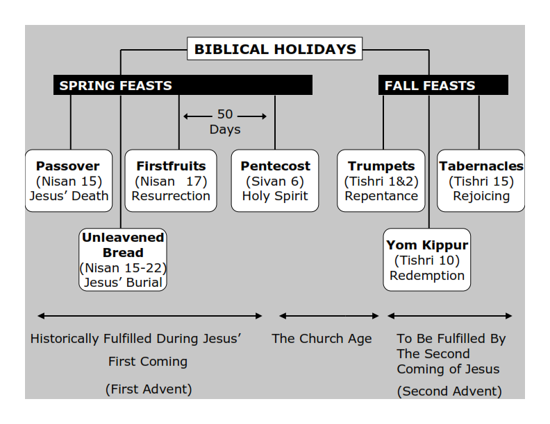
Philippians 3:20-21
20 For our citizenship is in heaven, from which we also eagerly wait for the Savior, the Lord Jesus Christ, 21 who will transform our lowly body that it may be conformed to His glorious body, according to the working by which He is able even to subdue all things to Himself.

Slide 83
Feast of Weeks

Slide 84
Leviticus 23:15-16
15'And you shall count for yourselves from the day after the Sabbath, from the day that you brought the sheaf of the wave offering: seven Sabbaths shall be completed. 16 Count fifty days to the day after the seventh Sabbath; then you shall offer a new grain offering to the LORD.

Slide 85
Latter Firstfruits

Slide 86
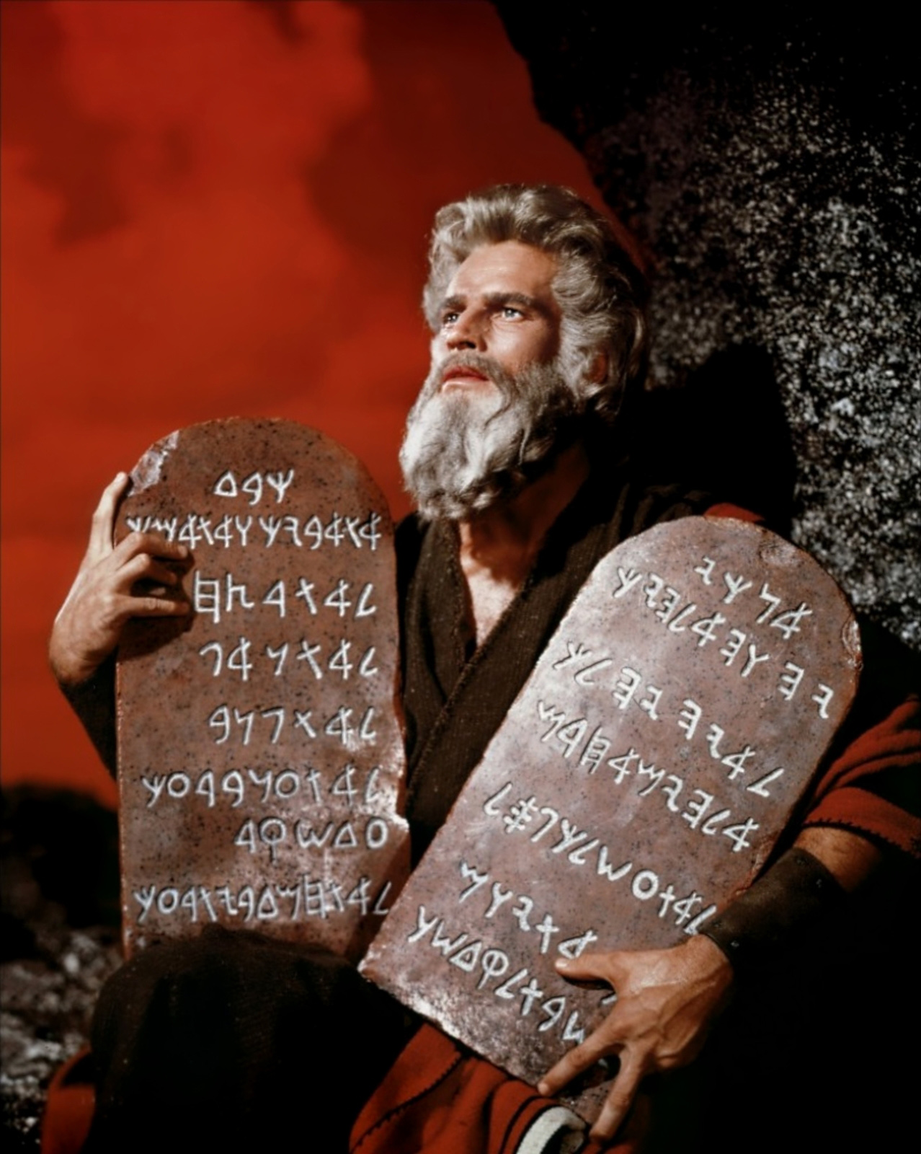

Slide 87
Acts 2:14-21
14 But Peter, standing up with the eleven, raised his voice and said to them, "Men of Judea and all who dwell in Jerusalem, let this be known to you, and heed my words. 15 For these are not drunk, as you suppose, since it is only the third hour of the day. 16 But this is what was spoken by the prophet Joel:

Slide 88
17'And it shall come to pass in the last days, says God, That I will pour out of My Spirit on all flesh; Your sons and your daughters shall prophesy, Your young men shall see visions, Your old men shall dream dreams. 18 And on My menservants and on My maidservants I will pour out My Spirit in those days; And they shall prophesy.

Slide 89
19 I will show wonders in heaven above And signs in the earth beneath: Blood and fire and vapor of smoke. 20 The sun shall be turned into darkness, And the moon into blood, Before the coming of the great and awesome day of the LORD. 21 And it shall come to pass That whoever calls on the name of the LORD Shall be saved.'

Slide 90
1. Pentecost serves as a reminder that God grants His Holy Spirit to the FirstFruits of His Spiritual Harvest.

Slide 91
Philippians 3:20-21
20 For our citizenship is in heaven, from which we also eagerly wait for the Savior, the Lord Jesus Christ, 21 who will transform our lowly body that it may be conformed to His glorious body, according to the working by which He is able even to subdue all things to Himself.

Slide 92
Exodus 23:16
16 and the Feast of Harvest, the firstfruits of your labors which you have sown in the field; and the Feast of Ingathering at the end of the year, when you have gathered in the fruit of your labors from the field.

Slide 93
Numbers 28:26
26'Also on the day of the firstfruits, when you bring a new grain offering to the LORD at your Feast of Weeks, you shall have a holy Convocation.

Slide 94
The Hebrew word for Feasts is also MOED meaning appointed times.
The Hebrew word for convocation is MIQRA meaning a dress rehearsal.

Slide 95
Pentecost
( Pentekostos in the original), which means "fiftieth"

Slide 96
2. The Gift of Pentecost: the Holy Spirit

Slide 97
Acts 1:12-15
12 Then they returned to Jerusalem from the mount called Olivet, which is near Jerusalem, a Sabbath day's journey. 13 And when they had entered, they went up into the upper room where they were staying: Peter, James, John, and Andrew; Philip and Thomas; Bartholomew and Matthew; James the son of Alphaeus and Simon the Zealot; and Judas the son of James.

Slide 98
14 These all continued with one accord in prayer and supplication, with the women and Mary the mother of Jesus, and with His brothers. 15 And in those days Peter stood up in the midst of the disciples (altogether the number of names was about a hundred and twenty)...

Slide 99
Acts 2:1-4
1 "Now when the Day of Pentecost had fully come, they were all with one accord in one place. 2 And suddenly there came a sound from heaven, as of a rushing mighty wind, and it filled the whole house where they were sitting.

Slide 100
3 Then there appeared to them divided tongues, as of fire, and one sat upon each of them. 4 And they were all filled with the Holy Spirit and began to speak with other tongues, as the Spirit gave them utterance"

Slide 101
Acts 2:17, Joel 2:28
"And it shall come to pass in the last days, says God, that I will pour out of My Spirit on all flesh".

Slide 102
Acts 2:38-39
38 "Repent, and let every one of you be baptized in the name of Jesus Christ for the remission of sins; and you shall receive the gift of the Holy Spirit. 39 For the promise is to you and to your children, and to all who are afar off, as many as the Lord our God will call".

Slide 103
The Law and God’s Grace!

Slide 104
Exodus 32:25-29
25 Now when Moses saw that the people were unrestrained (for Aaron had not restrained them, to their shame among their enemies), 26 then Moses stood in the entrance of the camp, and said, "Whoever is on the LORD's side, come to me." And all the sons of Levi gathered themselves together to him.

Slide 105
27 And he said to them, "Thus says the LORD God of Israel: 'Let every man put his sword on his side, and go in and out from entrance to entrance throughout the camp, and let every man kill his brother, every man his companion, and every man his neighbor.' "

Slide 106
28 So the sons of Levi did according to the word of Moses. And about three thousand men of the people fell that day. 29 Then Moses said, "Consecrate yourselves today to the LORD, that He may bestow on you a blessing this day, for every man has opposed his son and his brother."

Slide 107
Acts 2:40-42
40 And with many other words he testified and exhorted them, saying, "Be saved from this perverse generation." 41 Then those who gladly received his word were baptized; and that day about three thousand souls were added to them. 42 And they continued steadfastly in the apostles' doctrine and fellowship, in the breaking of bread, and in prayers.

Slide 108
3. Why we Need God's Spirit

Slide 109
1 Kings 8:46
"When they sin against You
(for there is no one who does not sin)...

Slide 110
John 16:8-9
8 And when He has come, He will convict the world of sin, and of righteousness, and of judgment: 9 of sin, because they do not believe in Me;

Slide 111
Romans 3:23
"for all have sinned and fall short of the glory of God"...

Slide 112
Deuteronomy 5:29
"Oh, that they had such a heart in them that they would fear Me and always keep all My commandments that it might be well with them and with their children forever!"

Slide 113
Jeremiah 17:9-10
9 "The heart is deceitful above all things, And desperately wicked; Who can know it? 10 I, the LORD, search the heart, I test the mind, Even to give every man according to his ways, According to the fruit of his doings.

Slide 114
Luke 10:27
"You shall love the LORD your God with all your heart, with all your soul, with all your strength, and with all your mind" and "[love] your neighbor as yourself."

Slide 115
The Holy Ghost is The Power To Raise Us From The Dead!

Slide 116
Romans 8:10-11
10 And if Christ is in you, the body is dead because of sin, but the Spirit is life because of righteousness. 11 But if the Spirit of Him who raised Jesus from the dead dwells in you, He who raised Christ from the dead will also give life to your mortal bodies through His Spirit who dwells in you.

Slide 117
4. The Holy Spirit at work in Our Lives

Slide 118
Acts 1:8
"But you shall receive power when the Holy Spirit has come upon you; and you shall be witnesses to Me in Jerusalem, and in all Judea and Samaria, and to the end of the earth."

Slide 119
Acts 17:6
"turning the world upside down"

Slide 120
Romans 15:13
"Now may the God of hope fill you with all joy and peace in believing, that you may abound in hope by the power of the Holy Spirit"

Slide 121
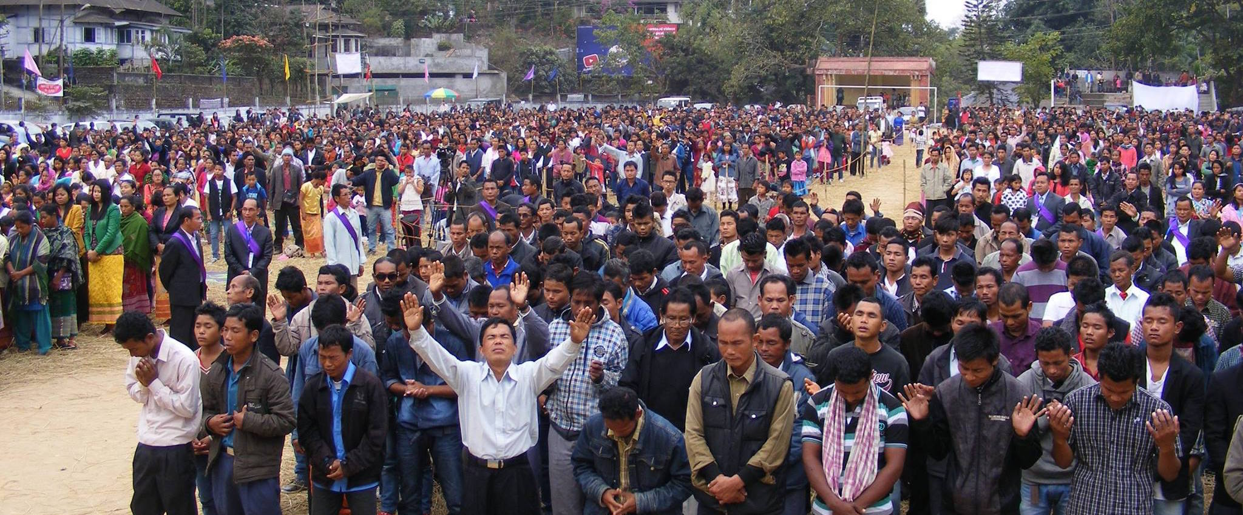
Acts 1:8
"But you shall receive power when the Holy Spirit has come upon you; and you shall be witnesses to Me in Jerusalem, and in all Judea and Samaria, and to the end of the earth."

Slide 122
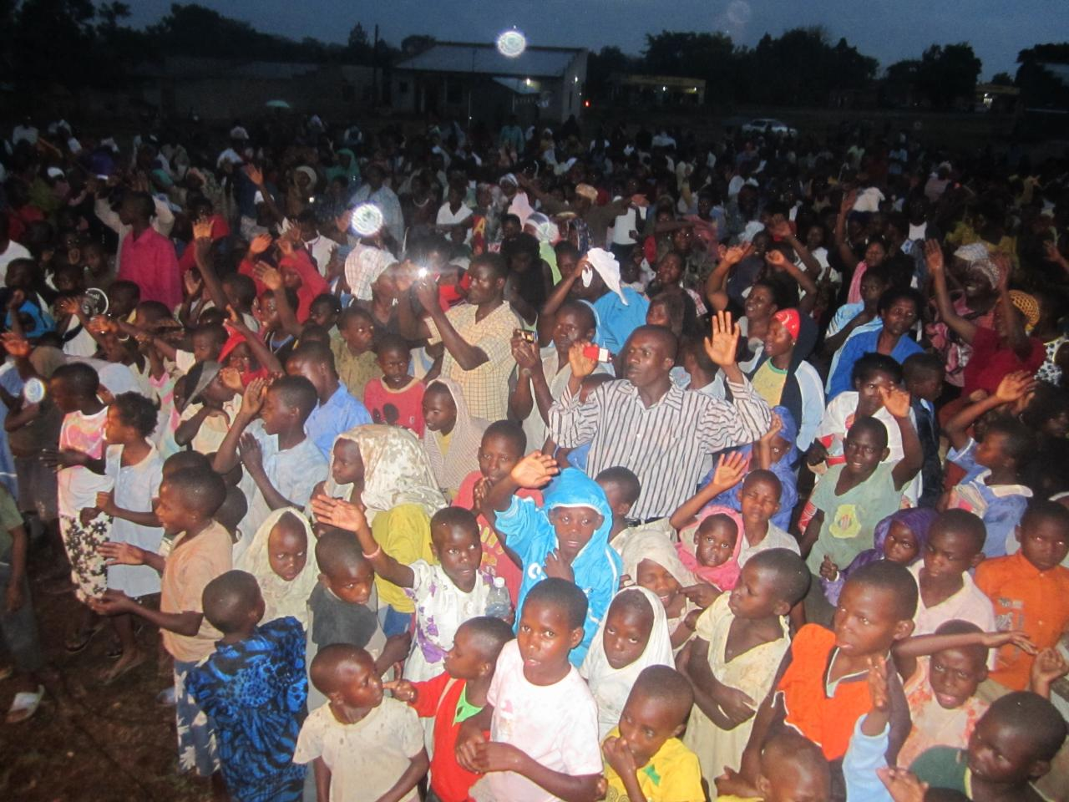
Acts 17:6
"turning the world upside down"

Slide 123
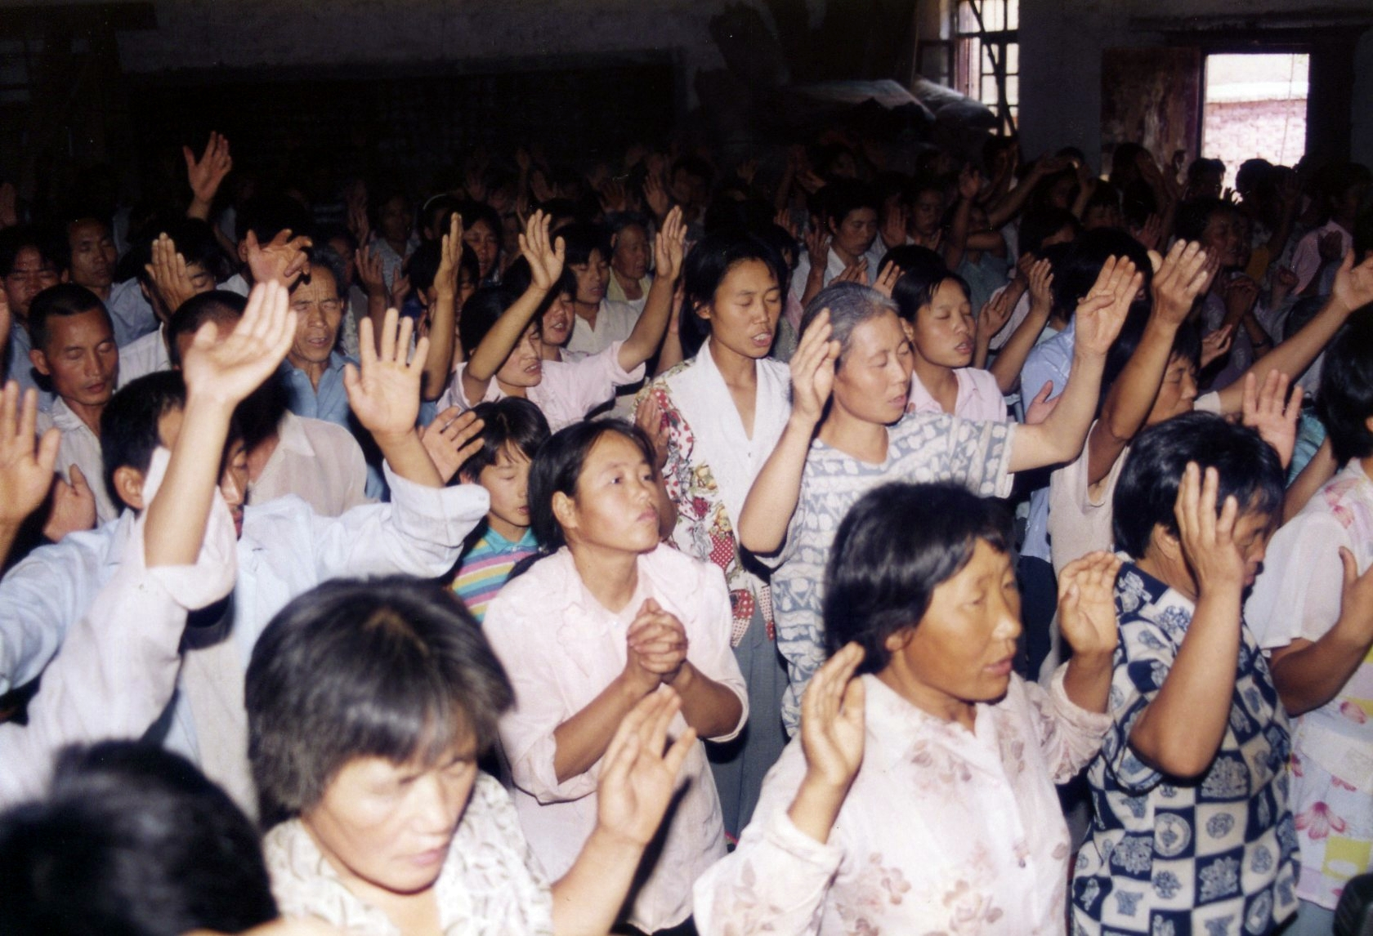
Romans 15:13
"Now may the God of hope fill you with all joy and peace in believing, that you may abound in hope by the power of the Holy Spirit"

Slide 124
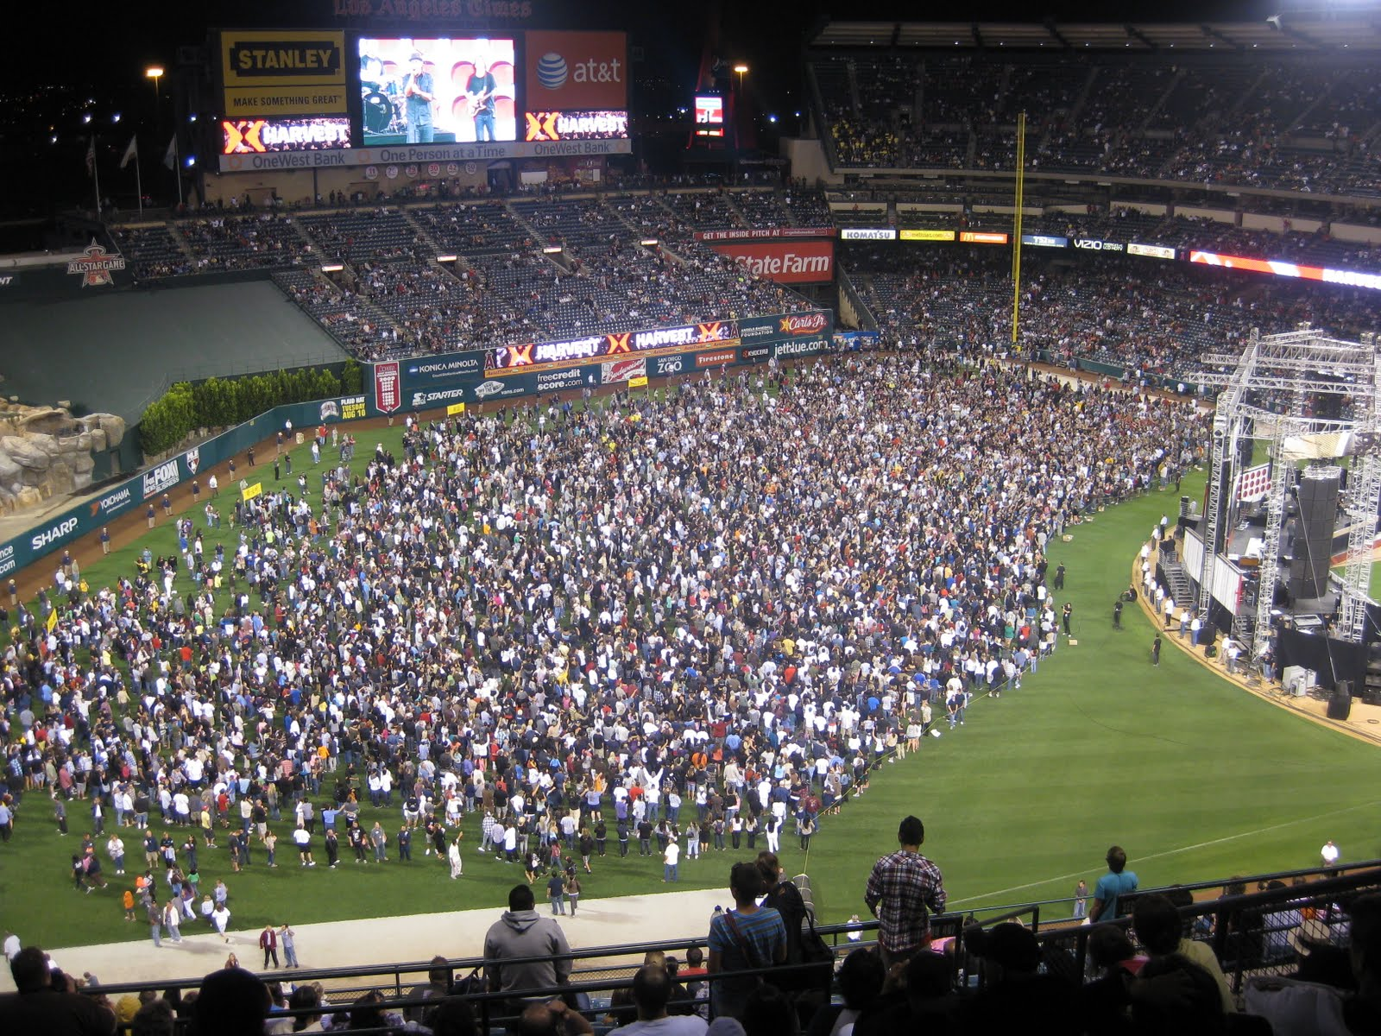

Slide 125
1 Thessalonians 4:13-18
13 But I do not want you to be ignorant, brethren, concerning those who have fallen asleep, lest you sorrow as others who have no hope. 14 For if we believe that Jesus died and rose again, even so God will bring with Him those who sleep in Jesus.

Slide 126
15 For this we say to you by the word of the Lord, that we who are alive and remain until the coming of the Lord will by no means precede those who are asleep. 16 For the Lord Himself will descend from heaven with a shout, with the voice of an archangel, and with the trumpet of God. And the dead in Christ will rise first.

Slide 127
17 Then we who are alive and remain shall be caught up together with them in the clouds to meet the Lord in the air. And thus we shall always be with the Lord. 18 Therefore comfort one another with these words.

Slide 128
Acts 2:38-39
38 Then Peter said to them, "Repent, and let every one of you be baptized in the name of Jesus Christ for the remission of sins; and you shall receive the gift of the Holy Spirit. 39 For the promise is to you and to your children, and to all who are afar off, as many as the Lord our God will call."

