Slide 2
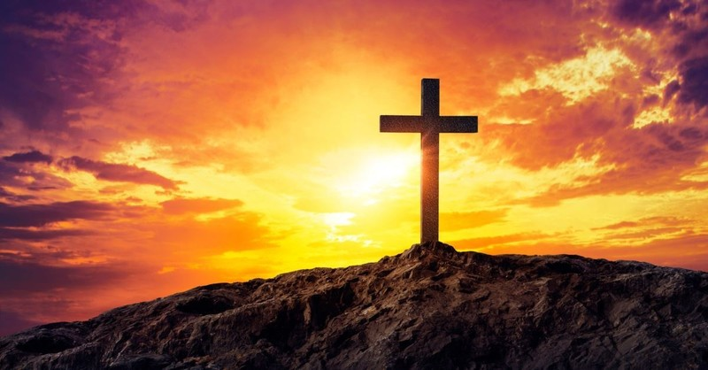
Render No One Evil for Evil
by Pastor Fee Soliven
1 Thessalonians 5:11-15
Wednesday Evening
October 20, 2021

Slide 3
1 Thessalonians 5:11-15
11 Therefore comfort each other and edify one another, just as you also are doing. 12 And we urge you, brethren, to recognize those who labor among you, and are over you in the Lord and admonish you,

Slide 4
13 and to esteem them very highly in love for their work's sake. Be at peace among yourselves. 14 Now we exhort you, brethren, warn those who are unruly, comfort the fainthearted, uphold the weak, be patient with all. 15 See that no one renders evil for evil to anyone, but always pursue what is good both for yourselves and for all.

Slide 5
11 Therefore comfort each other and edify one another, just as you also are doing.

Slide 6
2 Corinthians 1:3-5
3 Blessed be the God and Father of our Lord Jesus Christ, the Father of mercies and God of all comfort, 4 who comforts us in all our tribulation, that we may be able to comfort those who are in any trouble, with the comfort with which we ourselves are comforted by God. 5 For as the sufferings of Christ abound in us, so our consolation also abounds through Christ.

Slide 7
Psalm 119:49-50
49 Remember the word to Your servant, Upon which You have caused me to hope. 50 This is my comfort in my affliction, For Your word has given me life.

Slide 8
12 And we urge you, brethren, to recognize those who labor among you, and are over you in the Lord and admonish you,

Slide 9
1 Timothy 5:17-20
17 Let the elders who rule well be counted worthy of double honor, especially those who labor in the word and doctrine. 18 For the Scripture says, "You shall not muzzle an ox while it treads out the grain," and, "The laborer is worthy of his wages."

Slide 10
19 Do not receive an accusation against an elder except from two or three witnesses. 20 Those who are sinning rebuke in the presence of all, that the rest also may fear.

Slide 11
James 5:13-15
13 Is anyone among you suffering? Let him pray. Is anyone cheerful? Let him sing psalms. 14 Is anyone among you sick? Let him call for the elders of the church, and let them pray over him, anointing him with oil in the name of the Lord. 15 And the prayer of faith will save the sick, and the Lord will raise him up. And if he has committed sins, he will be forgiven.

Slide 12
13 and to esteem them very highly in love for their work's sake. Be at peace among yourselves.

Slide 13
Philippians 4:8-9
8 Finally, brethren, whatever things are true, whatever things are noble, whatever things are just, whatever things are pure, whatever things are lovely, whatever things are of good report, if there is any virtue and if there is anything praiseworthy--meditate on these things.

Slide 14
9 The things which you learned and received and heard and saw in me, these do, and the God of peace will be with you.

Slide 15
Proverbs 12:20
"Deceit is in the heart of those who devise evil, But counselors of peace have joy"

Slide 16
14 Now we exhort you, brethren, warn those who are unruly, comfort the fainthearted, uphold the weak, be patient with all.

Slide 17
Proverbs 13:4
The soul of a lazy man desires, and has nothing; But the soul of the diligent shall be made rich.

Slide 18
Proverbs 15:19
The way of the lazy man is like a hedge of thorns, But the way of the upright is a highway.

Slide 19
Psalm 46:1-3
1 God is our refuge and strength, A very present help in trouble. 2 Therefore we will not fear, Even though the earth be removed, And though the mountains be carried into the midst of the sea; 3 Though its waters roar and be troubled, Though the mountains shake with its swelling.

Slide 20
Romans 14:1
"Receive one who is weak in the faith, but not to disputes over doubtful things"

Slide 21
1 Corinthians 8:9
"But beware lest somehow this liberty of yours become a stumbling block to those who are weak"

Slide 22
15 See that no one renders evil for evil to anyone, but always pursue what is good both for yourselves and for all.

Slide 23
Matthew 5:38-39
38 "You have heard that it was said, 'An eye for an eye and a tooth for a tooth.' 39 But I tell you not to resist an evil person. But whoever slaps you on your right cheek, turn the other to him also.

Slide 24
Matthew 5:43-45
43 "You have heard that it was said, 'You shall love your neighbor and hate your enemy.' 44 But I say to you, love your enemies, bless those who curse you, do good to those who hate you, and pray for those who spitefully use you and persecute you, 45 that you may be sons of your Father in heaven; for He makes His sun rise on the evil and on the good, and sends rain on the just and on the unjust.

Slide 25
Romans 12:17-20
17 Repay no one evil for evil. Have regard for good things in the sight of all men. 18 If it is possible, as much as depends on you, live peaceably with all men. 19 Beloved, do not avenge yourselves, but rather give place to wrath; for it is written, "Vengeance is Mine, I will repay," says the Lord.

Slide 26
20 Therefore "If your enemy is hungry, feed him; If he is thirsty, give him a drink; For in so doing you will heap coals of fire on his head." 21 Do not be overcome by evil but overcome evil with good.

Slide 27
1 Thessalonians 4:13-18
13 But I do not want you to be ignorant, brethren, concerning those who have fallen asleep, lest you sorrow as others who have no hope. 14 For if we believe that Jesus died and rose again, even so God will bring with Him those who sleep in Jesus.

Slide 28
15 For this we say to you by the word of the Lord, that we who are alive and remain until the coming of the Lord will by no means precede those who are asleep. 16 For the Lord Himself will descend from heaven with a shout, with the voice of an archangel, and with the trumpet of God. And the dead in Christ will rise first.

Slide 29
17 Then we who are alive and remain shall be caught up together with them in the clouds to meet the Lord in the air. And thus we shall always be with the Lord. 18 Therefore comfort one another with these words.

Slide 30
1 Corinthians 15:50-54
50 Now this I say, brethren, that flesh and blood cannot inherit the kingdom of God; nor does corruption inherit incorruption. 51 Behold, I tell you a mystery: We shall not all sleep, but we shall all be changed-- 52 in a moment, in the twinkling of an eye, at the last trumpet. For the trumpet will sound, and the dead will be raised incorruptible, and we shall be changed.

Slide 31
53 For this corruptible must put on incorruption, and this mortal must put on immortality. 54 So when this corruptible has put on incorruption, and this mortal has put on immortality, then shall be brought to pass the saying that is written: "Death is swallowed up in victory."

Slide 32
20 Again, when a righteous man turns from his righteousness and commits iniquity, and I lay a stumbling block before him, he shall die; because you did not give him warning, he shall die in his sin, and his righteousness which he has done shall not be remembered; but his blood I will require at your hand.

Slide 33
Acts 2:38-39
38 Then Peter said to them, "Repent, and let every one of you be baptized in the name of Jesus Christ for the remission of sins; and you shall receive the gift of the Holy Spirit. 39 For the promise is to you and to your children, and to all who are afar off, as many as the Lord our God will call."

