Slide 2
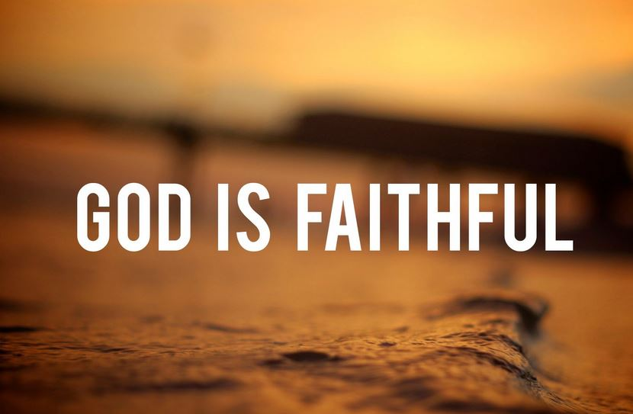
The Lord is Faithful
by Pastor Fee Soliven
2 Thessalonians 3:1-9
Wednesday Evening
December 8, 2021

Slide 3
2 Thessalonians 3:1-9
1 Finally, brethren, pray for us, that the word of the Lord may run swiftly and be glorified, just as it is with you, 2 and that we may be delivered from unreasonable and wicked men; for not all have faith. 3 But the Lord is faithful, who will establish you and guard you from the evil one.

Slide 4
4 And we have confidence in the Lord concerning you, both that you do and will do the things we command you. 5 Now may the Lord direct your hearts into the love of God and into the patience of Christ. 6 But we command you, brethren, in the name of our Lord Jesus Christ, that you withdraw from every brother who walks disorderly and not according to the tradition which he received from us.

Slide 5
7 For you yourselves know how you ought to follow us, for we were not disorderly among you; 8 nor did we eat anyone's bread free of charge, but worked with labor and toil night and day, that we might not be a burden to any of you, 9 not because we do not have authority, but to make ourselves an example of how you should follow us.

Slide 6
1 Finally, brethren, pray for us, that the word of the Lord may run swiftly and be glorified, just as it is with you,

Slide 7
1 Thessalonians 1:6-10
6 And you became followers of us and of the Lord, having received the word in much affliction, with joy of the Holy Spirit, 7 so that you became examples to all in Macedonia and Achaia who believe.

Slide 8
8 For from you the word of the Lord has sounded forth, not only in Macedonia and Achaia, but also in every place. Your faith toward God has gone out, so that we do not need to say anything.

Slide 9
9 For they themselves declare concerning us what manner of entry we had to you, and how you turned to God from idols to serve the living and true God, 10 and to wait for His Son from heaven, whom He raised from the dead, even Jesus who delivers us from the wrath to come.

Slide 10
2 and that we may be delivered from unreasonable and wicked men; for not all have faith.

Slide 11
Ephesians 6:10-18
10 Finally, my brethren, be strong in the Lord and in the power of His might. 11 Put on the whole armor of God, that you may be able to stand against the wiles of the devil.

Slide 12
12 For we do not wrestle against flesh and blood, but against principalities, against powers, against the rulers of the darkness of this age, against spiritual hosts of wickedness in the heavenly places. 13 Therefore take up the whole armor of God, that you may be able to withstand in the evil day, and having done all, to stand.

Slide 13
14 Stand therefore, having girded your waist with truth, having put on the breastplate of righteousness, 15 and having shod your feet with the preparation of the gospel of peace; 16 above all, taking the shield of faith with which you will be able to quench all the fiery darts of the wicked one.

Slide 14
17 And take the helmet of salvation, and the sword of the Spirit, which is the word of God; 18 praying always with all prayer and supplication in the Spirit, being watchful to this end with all perseverance and supplication for all the saints—

Slide 15
3 But the Lord is faithful, who will establish you and guard you from the evil one.

Slide 16
1 Corinthians 1:4-9
4 I thank my God always concerning you for the grace of God which was given to you by Christ Jesus, 5 that you were enriched in everything by Him in all utterance and all knowledge, 6 even as the testimony of Christ was confirmed in you,

Slide 17
7 so that you come short in no gift, eagerly waiting for the revelation of our Lord Jesus Christ, 8 who will also confirm you to the end, that you may be blameless in the day of our Lord Jesus Christ. 9 God is faithful, by whom you were called into the fellowship of His Son, Jesus Christ our Lord.

Slide 18
4 And we have confidence in the Lord concerning you, both that you do and will do the things we command you.

Slide 19
Acts 5:29
But Peter and the apostles answered, “We must obey God rather than men.

Slide 20
1 Peter 1:14
As obedient children, do not be conformed to the passions of your former ignorance,

Slide 21
1 John 5:3
For this is the love of God, that we keep his commandments. And his commandments are not burdensome.

Slide 22
Isaiah 1:19
If you are willing and obedient, you shall eat the good of the land;

Slide 23
Luke 6:46
“Why do you call me ‘Lord, Lord,’ and not do what I tell you?

Slide 24
5 Now may the Lord direct your hearts into the love of God and into the patience of Christ.

Slide 25
6 But we command you, brethren, in the name of our Lord Jesus Christ, that you withdraw from every brother who walks disorderly and not according to the tradition which he received from us.

Slide 26
“warn those who are lazy”

Slide 27
ataktos

Slide 28
7 For you yourselves know how you ought to follow us, for we were not disorderly among you; 8 nor did we eat anyone's bread free of charge, but worked with labor and toil night and day, that we might not be a burden to any of you,

Slide 29
9 not because we do not have authority, but to make ourselves an example of how you should follow us.

Slide 30
Luke 10:7
“And remain in the same house, eating and drinking such things as they give, for the laborer is worthy of his wages. Do not go from house to house”

Slide 31
1 Thessalonians 4:13-18
13 But I do not want you to be ignorant, brethren, concerning those who have fallen asleep, lest you sorrow as others who have no hope. 14 For if we believe that Jesus died and rose again, even so God will bring with Him those who sleep in Jesus.

Slide 32
15 For this we say to you by the word of the Lord, that we who are alive and remain until the coming of the Lord will by no means precede those who are asleep. 16 For the Lord Himself will descend from heaven with a shout, with the voice of an archangel, and with the trumpet of God. And the dead in Christ will rise first.

Slide 33
17 Then we who are alive and remain shall be caught up together with them in the clouds to meet the Lord in the air. And thus we shall always be with the Lord. 18 Therefore comfort one another with these words.

Slide 34
1 Corinthians 15:50-54
50 Now this I say, brethren, that flesh and blood cannot inherit the kingdom of God; nor does corruption inherit incorruption. 51 Behold, I tell you a mystery: We shall not all sleep, but we shall all be changed-- 52 in a moment, in the twinkling of an eye, at the last trumpet. For the trumpet will sound, and the dead will be raised incorruptible, and we shall be changed.

Slide 35
53 For this corruptible must put on incorruption, and this mortal must put on immortality. 54 So when this corruptible has put on incorruption, and this mortal has put on immortality, then shall be brought to pass the saying that is written: "Death is swallowed up in victory."

Slide 36
20 Again, when a righteous man turns from his righteousness and commits iniquity, and I lay a stumbling block before him, he shall die; because you did not give him warning, he shall die in his sin, and his righteousness which he has done shall not be remembered; but his blood I will require at your hand.

Slide 37
Acts 2:38-39
38 Then Peter said to them, "Repent, and let every one of you be baptized in the name of Jesus Christ for the remission of sins; and you shall receive the gift of the Holy Spirit. 39 For the promise is to you and to your children, and to all who are afar off, as many as the Lord our God will call."

