Slide 2
Child of Love
(We The Kingdom)

Slide 3
I was walking the wayside Lost on a lonely road I was chasing the high life Tryna satisfy my soul All the

Slide 4
lies I believed in Left me crying like the rain Then I saw lightning from Heaven And I've never been the

Slide 5
same I'm gonna climb a mountain I'm gonna shout about it I am a child of love I found a world of

Slide 6
freedom I found a friend in Jesus I am a child of love
I've felt the sting of the fire But I saw You in the

Slide 7
flames Just when I thought it was over You broke me out of the grave I'm gonna climb a mountain I'm

Slide 8
gonna shout about it I am a child of love I found a world of freedom I found a friend in Jesus I am a

Slide 9
child of love I am a child of love, yeah, oh I am a child of love Nothing can change the way You love

Slide 10
me Nothing can change the way I belong to You
Yes I do Nothing can separate Nothing can change

Slide 11
the way You love me Nothing can change the way
I belong to You Yes I do Nothing can separate I'm

Slide 12
gonna climb a mountain I am a child of love I found a world of freedom I am a child of love I'm gonna climb

Slide 13
a mountain I'm gonna shout about it I am a child of love I found a world of freedom I found a friend in

Slide 14
Jesus I am a child of love, oh yeah Yeah, I am a child of love I am a child of love

Slide 15
Been the same. I’m gonna climb the mountain. I’m gonna shout about it. I am a child of love. I found a

Slide 16
World of freedom. I found a friend in Jesus. I am a child of love. I’ve felt the sting of the fire. But I saw

Slide 17
You in the flames. Just when I thought it was over. You broke me out of the grave. I’m gonna climb A

Slide 18
Mountain. I’m gonna shout about it. I am a child of love. I found a world of freedom. I found a friend in

Slide 19
Jesus. I am a child of love. I’m gona climb a mountain, I’m gonna shout about it. I am a child of

Slide 20
Love. I found a world of freedom, I found a friend in Jesus. I am a child of love. Yeah Oh I am a child of

Slide 21
Love. Yeah oh I am a child of love. Nothing can change the way you love me. Nothing can change

Slide 22
The way. I belong to you. Yes’ I do, nothing can separate. Nothing can change the way you love me.

Slide 23
Nothing can change the way. I belong to you. Yes, I do. Nothing can separate. I’m gonna climb a

Slide 24
Mountain, I am a child of love. I found a world of Freedom. I am a child of Love. I’m gonna climb a

Slide 25
Mountain, I’m gonna shout about it. I am a child of love. I found a world of freedom. I found a friend in

Slide 26
Jesus. I am a child of Love. I’m gonna climb a mountain. I’m gonna shout about it. I am a child of

Slide 27
Love. I found a world of freedom. I found a friend in Jesus. I am a child of love. Oh Yeah, oh I am a child

Slide 28
Of love. Oh yeah, oh I am a child of love. Oh yeah ,I am a child of love.

Slide 29
Graves into Gardens
(Elevation Worship)

Slide 30
I searched the World but it couldn’t fill me. Man’s empty praise and treasures that fade Are never

Slide 31
Enough. Then you came along and put me back together And every desire Is now satisfied here in

Slide 32
Your love. Oh’ there’s nothing better than you. There’s nothing better than you. Lord there’s nothing

Slide 33
Nothing is better than you. Im not afraid to show you my weakness. My failures and flaws Lord you’ve

Slide 34
Seen them all and you still call me friend.Cause the God of the mountain. Is the God of the Valley.

Slide 35
There’s not a place. Your mercy and grace. Wont find me again. Oh there’s nothing better than you. There’s

Slide 36
Nothing better than you. Lord there’s nothing. Nothing is better than you. Oh there’s nothing better

Slide 37
Better than you. There’s nothing better than you. Lord’ there’s nothing. Nothing is better than you.

Slide 38
You turn mourning to dancing. You give beauty for ashes. You turn shame into glory. You’re the only one

Slide 39
Who can. You turn mourning to dancing. You give beauty for ashes. You turn shame into glory. You’re

Slide 40
The only one who can. You turn graves into gardens. You turn bones into armies. You turn seas into

Slide 41
Highways. You’re the only one who can you’re the only one who can. Oh there’s nothing better than you

Slide 42
There’s nothing better than you. Lord there’s nothing. Nothing is better than you. Oh there’s nothing better

Slide 43
Than you. There’s nothing better than you. Lord, there’s nothing. Nothing is better than you. You turn

Slide 44
Graves into gardens. You turn bones into armies. You turn seas into highways. You’re the only one who

Slide 45
Can. You turn graves into gardens. You turn bones into armies. You turn seas into highways you’re the

Slide 46
Only one who can. You’re the only one who. You’re the only one who can.

Slide 47
“No Longer Slaves”
(Bethel)

Slide 48
You unravel me with a melody. You surround me with a song. Of deliverance from my enemies. Til

Slide 49
All my fears are gone. I’m no longer a slave to fear. I am a child of God. I’m no longer a slave to fear.

Slide 50
I am a child of God . From my mother’s womb. You have chosen me. Love has called my name. I’ve

Slide 51
been born again into your family. Your blood has flows through my veins. I’m no longer a slave to fear.

Slide 52
I am a child of God. I’m no longer a slave to fear. I am a child of God.I’m no longer a slave to fear. I am

Slide 53
A child of God. I’m no longer a slave to fear. I am a child of God. Ooh, Ooh ,Ooh, ooh. Ooh, Ooh, Ooh,

Slide 54
Oooh. You split the sea so I could walk right through it. My fears are drowned in perfect love. You rescued

Slide 55
Me so I could stand and sing. I am a child of God. You split the sea so I can walk right through it. My

Slide 56
fears are drowned in perfect love. You rescued me so I could stand and sing. I am a child of God.

Slide 57
Yes I am a child of God. Oh I am A child of God.

Slide 58
Jesus We Love You
(Bethel)

Slide 59
Old things have passed away Your love has stayed the same Your constant grace remains the

Slide 60
Cornerstone Things that we thought were dead Are breathing in life again You cause your Son to shine

Slide 61
on darkest nights For all that you've done, we will pour out our love This will be our anthem song Jesus

Slide 62
we love you Oh how we love you You are the one our, our hearts adore The hopeless have found their

Slide 63
Hope The orphans now have a home All that was lost has found its place in you You lift our weary head

Slide 64
You make us strong instead You took these rags and made us beautiful For all that you've done, we will

Slide 65
pour out our love This will be our anthem song Jesus we love you Oh how we love you You are the one

Slide 66
our, our hearts adore Oh, Jesus we love you Oh how we love you You are the one our, our hearts adore

Slide 67
Our hearts adore (we adore you) Our hearts adore
Our hearts adore Our affection, our devotion Poured

Slide 68
out on the feet of Jesus Our affection, our devotion
Poured out on the feet of Jesus Our affection, our

Slide 69
Devotion Poured out on the feet of Jesus Our affection, our devotion Poured out on the feet of

Slide 70
Jesus We love you Oh how we love you You are the one our, our hearts adore Jesus we love you

Slide 71
Oh how we love you You are the one our, our hearts adore Oh, Jesus we love you Oh how we love you

Slide 72
You are the one our, our hearts adore Just sing out a new song today Oh, oh how we love you Oh, you are

Slide 73
worthy Jesus, of our love, our adoration, we love you God Oh lift your voice, oh Oh we love you, oh

Slide 74
we love you, oh Oh how we love you (sing Jesus)
Oh, Jesus we love you Oh how we love you (you

Slide 75
are) You are the one our, our hearts adore

Slide 76
At The Cross Ran Red
(Chris Tomlin)

Slide 77
There's a place Where mercy reigns And never dies
There's a place Where streams of grace Flow deep

Slide 78
and wide Where all the love I've ever found Comes like a flood Comes flowing down At the cross, at the

Slide 79
cross I surrender my life I'm in awe of You I'm in awe of You Where Your love ran red And my sin washed

Slide 80
white I owe all to You I owe all to You Jesus There's a place Where sin and shame Are powerless Where

Slide 81
my heart Has peace with God And forgiveness Where all the love I've ever found Comes like a flood

Slide 82
Comes flowing down At the cross, at the cross I surrender my life I'm in awe of You I'm in awe of You

Slide 83
Where Your love ran red And my sin washed white
I owe all to You I owe all to You Here my hope is

Slide 84
found Here on holy ground Here I bow down Here I bow down Here arms open wide Here You save my

Slide 85
life Here I bow down Here I bow down At the cross, at the cross I surrender my life I'm in awe of You I'm

Slide 86
in awe of You Where Your love ran red And my sin washed white I owe all to You I owe all to

Slide 87
You I owe all to You I owe all to You Jesus (oh)
Where Your love ran red Your love ran red

Slide 89
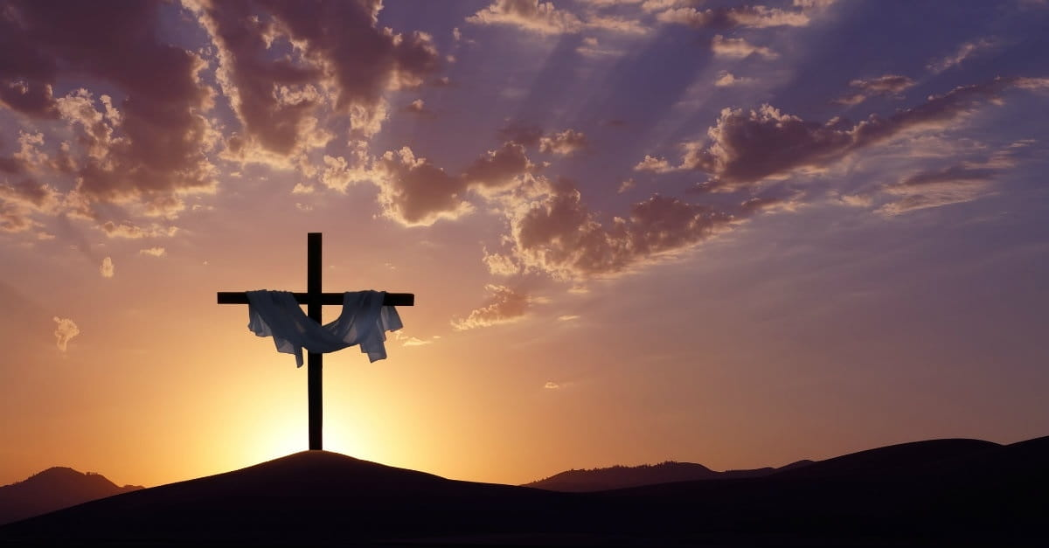
The 7 Utterances of Jesus
by Pastor Fee Soliven
John 19:16-24
Sunday Morning
March 27, 2022

Slide 90
John 19:16-24
6 Then he delivered Him to them to be crucified. So they took Jesus and led Him away. 17 And He, bearing His cross, went out to a place called the Place of a Skull, which is called in Hebrew, Golgotha, 18 where they crucified Him, and two others with Him, one on either side, and Jesus in the center. 19 Now Pilate wrote a title and put it on the cross. And the writing was: JESUS OF NAZARETH, THE KING OF THE JEWS.

Slide 91
20 Then many of the Jews read this title, for the place where Jesus was crucified was near the city; and it was written in Hebrew, Greek, and Latin. 21 Therefore the chief priests of the Jews said to Pilate, "Do not write, 'The King of the Jews,' but, 'He said, "I am the King of the Jews." ' "22 Pilate answered, "What I have written, I have written."

Slide 92
23 Then the soldiers, when they had crucified Jesus, took His garments and made four parts, to each soldier a part, and also the tunic. Now the tunic was without seam, woven from the top in one piece. 24 They said therefore among themselves, "Let us not tear it, but cast lots for it, whose it shall be," that the Scripture might be fulfilled which says: "They divided My garments among them, And for My clothing they cast lots." Therefore the soldiers did these things.

Slide 93
Acts 10:39
“And we are witnesses of all things which He did both in the land of the Jews and in Jerusalem, whom they killed by hanging on a tree”

Slide 94
Words from the Cross

Slide 95
The First Utterance:

Slide 96
Luke 23:34
Then Jesus said, "Father, forgive them, for they do not know what they do." And they divided His garments and cast lots.

Slide 97
The Second Utterance:

Slide 98
Luke 23:43
And Jesus said to him, "Assuredly, I say to you, today you will be with Me in Paradise."

Slide 99
The Third Utterance:

Slide 100
John 19:26-27
26 When Jesus therefore saw His mother, and the disciple whom He loved standing by, He said to His mother, "Woman, behold your son!" 27 Then He said to the disciple, "Behold your mother!" And from that hour that disciple took her to his own home.

Slide 101
The Fourth Utterance:

Slide 102
Mark 15:34
And at the ninth hour Jesus cried out with a loud voice, saying, "Eloi, Eloi, lama sabachthani?" which is translated, "My God, My God, why have You forsaken Me?"

Slide 103
The Fifth Utterance:

Slide 104
John 19:28
After this, Jesus, knowing that all things were now accomplished, that the Scripture might be fulfilled, said, "I thirst!"

Slide 105
The Sixth Utterance:

Slide 106
John 19:30
So, when Jesus had received the sour wine, He said, "It is finished!"

Slide 107
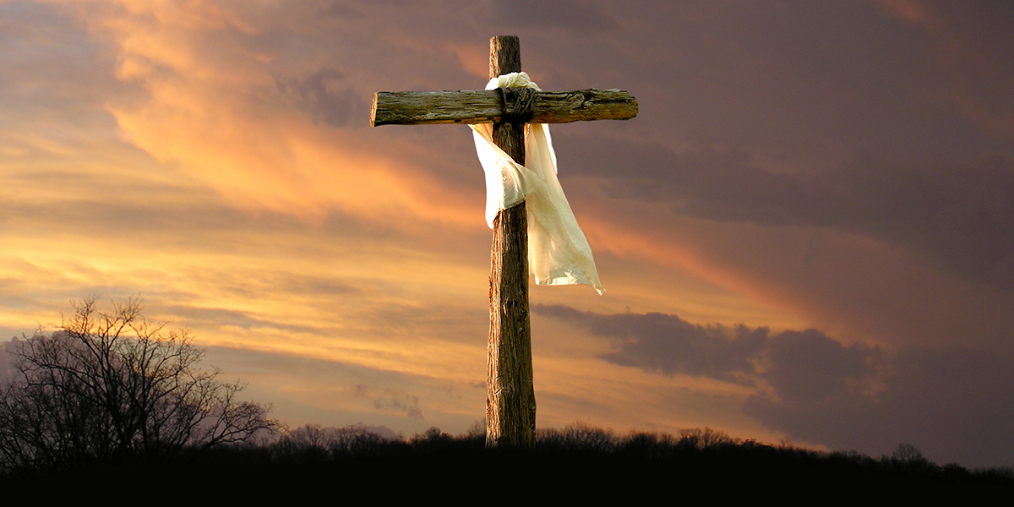
Photo of a Cross>

Slide 108
"Whosoever will, let him come,"

Slide 109
The Seventh Utterance:

Slide 110
Luke 23:46
And when Jesus had cried out with a loud voice, He said, "Father, 'into Your hands I commit My spirit.' " Having said this, He breathed His last.

Slide 111
Fulfillment of Prophecy

Slide 112
Hebrews 10:4-18
4 For it is not possible that the blood of bulls and goats could take away sins. 5 Therefore, when He came into the world, He said: "Sacrifice and offering You did not desire, But a body You have prepared for Me. 6 In burnt offerings and sacrifices for sin You had no pleasure. 7 Then I said, 'Behold, I have come--In the volume of the book it is written of Me--To do Your will, O God.' "

Slide 113
8 Previously saying, "Sacrifice and offering, burnt offerings, and offerings for sin You did not desire, nor had pleasure in them" (which are offered according to the law), 9 then He said, "Behold, I have come to do Your will, O God." He takes away the first that He may establish the second. 10 By that will we have been sanctified through the offering of the body of Jesus Christ once for all.

Slide 114
11 And every priest stands ministering daily and offering repeatedly the same sacrifices, which can never take away sins. 12 But this Man, after He had offered one sacrifice for sins forever, sat down at the right hand of God, 13 from that time waiting till His enemies are made His footstool. 14 For by one offering He has perfected forever those who are being sanctified.

Slide 115
15 But the Holy Spirit also witnesses to us; for after He had said before, 16 "This is the covenant that I will make with them after those days, says the LORD: I will put My laws into their hearts, and in their minds I will write them," 17 then He adds, "Their sins and their lawless deeds I will remember no more." 18 Now where there is remission of these, there is no longer an offering for sin.

Slide 116
Christ the Propitiation for Sin

Slide 117
Romans 3:21-26
21 But now the righteousness of God apart from the law is revealed, being witnessed by the Law and the Prophets, 22 even the righteousness of God, through faith in Jesus Christ, to all and on all who believe. For there is no difference; 23 for all have sinned and fall short of the glory of God, 24 being justified freely by His grace through the redemption that is in Christ Jesus,

Slide 118
25 whom God set forth as a propitiation by His blood, through faith, to demonstrate His righteousness, because in His forbearance God had passed over the sins that were previously committed, 26 to demonstrate at the present time His righteousness, that He might be just and the justifier of the one who has faith in Jesus.

Slide 119
3 Now as He sat on the Mount of Olives, the disciples came to Him privately, saying, "Tell us, when will these things be? And what will be the sign of Your coming, and of the end of the age?" 4 And Jesus answered and said to them: "Take heed that no one deceives you.

Slide 120
1 Thessalonians 4:13-18
13 But I do not want you to be ignorant, brethren, concerning those who have fallen asleep, lest you sorrow as others who have no hope. 14 For if we believe that Jesus died and rose again, even so God will bring with Him those who sleep in Jesus.

Slide 121
15 For this we say to you by the word of the Lord, that we who are alive and remain until the coming of the Lord will by no means precede those who are asleep. 16 For the Lord Himself will descend from heaven with a shout, with the voice of an archangel, and with the trumpet of God. And the dead in Christ will rise first.

Slide 122
17 Then we who are alive and remain shall be caught up together with them in the clouds to meet the Lord in the air. And thus we shall always be with the Lord. 18 Therefore comfort one another with these words.

Slide 123
1 Corinthians 15:50-54
50 Now this I say, brethren, that flesh and blood cannot inherit the kingdom of God; nor does corruption inherit incorruption. 51 Behold, I tell you a mystery: We shall not all sleep, but we shall all be changed-- 52 in a moment, in the twinkling of an eye, at the last trumpet. For the trumpet will sound, and the dead will be raised incorruptible, and we shall be changed.

Slide 124
53 For this corruptible must put on incorruption, and this mortal must put on immortality. 54 So when this corruptible has put on incorruption, and this mortal has put on immortality, then shall be brought to pass the saying that is written: "Death is swallowed up in victory."

Slide 125
20 Again, when a righteous man turns from his righteousness and commits iniquity, and I lay a stumbling block before him, he shall die; because you did not give him warning, he shall die in his sin, and his righteousness which he has done shall not be remembered; but his blood I will require at your hand.

Slide 126
Acts 2:38-39
38 Then Peter said to them, "Repent, and let every one of you be baptized in the name of Jesus Christ for the remission of sins; and you shall receive the gift of the Holy Spirit. 39 For the promise is to you and to your children, and to all who are afar off, as many as the Lord our God will call."

