Slide 2
House of The Lord
(by Phil Wickham)

Slide 3
We worship the God who was We worship the God who is We worship the God who evermore will be He

Slide 4
opened the prison doors He parted the raging sea My God, He holds the victory There's joy in the

Slide 5
house of the Lord There's joy in the house of the Lord today And we won't be quiet We shout out Your

Slide 6
praise There's joy in the house of the Lord Our God is surely in this place And we won't be quiet We

Slide 7
shout out Your praise (Oh-oh, oh) we shout out Your praise (Oh-oh, oh) We sing to the God who heals We

Slide 8
sing to the God who saves We sing to the God who always makes a way 'Cause He hung up on that

Slide 9
cross Then He rose up from that grave My God's still rolling stones away There's joy in the house of the

Slide 10
Lord There's joy in the house of the Lord today And we won't be quiet We shout out Your praise There's

Slide 11
joy in the house of the Lord Our God is surely in this place And we won't be quiet We shout out Your

Slide 12
praise We were the beggars Now we're royalty We were the prisoners Now we're running free We are

Slide 13
forgiven, accepted Redeemed by His grace Let the house of the Lord sing praise 'Cause we were the

Slide 14
beggars Now we're royalty We were the prisoners
Now we're running free We are forgiven, accepted

Slide 15
Redeemed by His grace Let the house of the Lord sing praise There's joy in the house of the Lord

Slide 16
(there is joy in the house) There's joy in the house of the Lord today And we won't be quiet (oh yeah)

Slide 17
We shout out Your praise (I wanna shout out Your praise) There's joy in the house of the Lord (there is

Slide 18
joy) Our God is surely in this place (there is joy) And we won't be quiet We shout out Your praise (we

Slide 19
gonna shout out Your praise) There's joy in the house of the Lord There's joy in the house of the

Slide 20
Lord today And we won't be quiet We shout out Your praise (we gonna shout out Your praise) There's joy

Slide 21
in the house of the Lord (there is joy, there is joy)
Our God is surely in this place (joy in this place)

Slide 22
And we won't be quiet (we won't be quiet) We shout out Your praise We shout out Your praise There is

Slide 23
joy in the house, there is joy in the house today We shout out Your praise We shout out Your praise

Slide 24
“God So Loved”
(We the Kingdom)

Slide 25
Come all you weary Come all you thirsty Come to the well That never runs dry Drink of the water

Slide 26
Come and thirst no more Come all you sinners
Come find His mercy Come to the table He will

Slide 27
satisfy Taste of His goodness Find what you're looking for For God so loved The world that He gave

Slide 28
us His one and only Son to save us Whoever believes in Him Will live forever Bring all your failures

Slide 29
Bring your addictions Come lay them down At the foot of the cross Jesus is waiting there With open

Slide 30
arms See His open arms For God so loved The world that He gave us His one and only Son to save

Slide 31
us Whoever believes in Him Will live forever The power of hell Forever defeated Now it is well I'm

Slide 32
walking in freedom For God so loved God so loved the world Praise God Praise God From whom all

Slide 33
blessings flow Praise Him Praise Him For the wonders of His love Praise God Praise God From

Slide 34
whom all blessings flow Praise Him Praise Him For the wonders of His love His amazing love For God

Slide 35
so loved The world that He gave us His one and only Son to save For God so loved The world that He

Slide 36
gave us His one and only Son to save us Whoever believes in Him Will live forever (He did it all for you,

Slide 37
yeah) The power of hell Forever defeated Now it is well I'm walking in freedom For God so love God so

Slide 38
love the world Bring all your failures Bring your addictions Come lay them down At the foot of

Slide 39
the cross Jesus is waiting God so loved the world

Slide 40
”King of My Heart”
(Bethel)

Slide 41
Let the King of my heart Be the mountain where I run The fountain I drink from Oh, He is my song Let

Slide 42
the King of my heart Be the shadow where I hide
The ransom for my life Oh, He is my song 'Cause

Slide 43
You are good You are good, oh oh You are good You are good, oh oh You are good You are good, oh

Slide 44
Oh You are good You are good, oh oh And let the King of my heart Be the wind inside my sails The

Slide 45
anchor in the waves Oh oh, He is my song Let the King of my heart Be the fire inside my veins The

Slide 46
echo of my days Oh oh, He is my song Let the King of my heart Be the wind inside my sails The anchor

Slide 47
in the waves Oh oh, He is my song Let the King of my heart Be the fire inside my veins The echo of my

Slide 48
days Oh, He is my song 'Cause You are good You are good, oh oh You are good You are good, oh oh

Slide 49
You are good You are good, oh oh You are good You are good, oh oh You're never gonna let You're never

Slide 50
gonna let me down And You're never gonna let
You're never gonna let me down You're never gonna

Slide 51
Let You're never gonna let me down You're never gonna let You're never gonna let me down You're

Slide 52
never gonna let You're never gonna let You're never gonna let me down You're never gonna let You're

Slide 53
never gonna let me down You're never gonna let
You're never gonna let me down Oh 'cause You are

Slide 54
Good You are good, oh oh 'Cause You are good You are good, oh oh 'Cause You are good You are good,

Slide 55
oh oh You are good You are good, oh oh You're never gonna let You're never gonna let me down

Slide 56
You're never gonna let You're never gonna let me down You're never gonna let You're never gonna let

Slide 57
me down You're never gonna let You're never gonna let me down 'Cause You are good You are good, oh

Slide 58
Oh You are good You are good, oh oh

Slide 59
“Nothing Else”
(Cody Carnes)

Slide 60
I'm caught up in Your presence I just want to sit here at Your feet I'm caught up in this holy moment I never

Slide 61
wanna leave Oh, I'm not here for blessings Jesus, You don't owe me anything More than anything that

Slide 62
You can do I just want You I'm sorry when I've just gone through the motions I'm sorry when I just sang

Slide 63
with my agenda I'm sorry when I forgot that You're enough Take me back to where we started I open up

Slide 64
moment I never wanna leave Oh, I'm not here for blessings Jesus, You don't owe me anything And

Slide 65
more than anything that You can do I just want You
I just want You Nothing else, nothing else Nothing

Slide 66
else will do I just want You Nothing else, nothing else
Nothing else will do I just want You Nothing else,

Slide 67
nothing else Nothing else will do I just want You
Nothing else, nothing else, Jesus Nothing else will do

Slide 68
I just want You Nothing else, nothing else Nothing else will do I just want You Nothing else, nothing

Slide 69
else, Jesus Nothing else will do I'm coming back to where we started I'm coming back to where

Slide 70
we started When I first felt Your love You're all that matters, Jesus You're all that matters I'm coming

Slide 71
back to what really matters Just Your heart I just wanna bless Your heart, Jesus I'm caught up in Your

Slide 72
presence I just want to sit here at Your feet I'm caught up in this holy moment I never wanna leave

Slide 73
And oh, I'm not here for blessings Jesus, You don't owe me anything More than anything that You can

Slide 74
Do Oh, I just want You
Do Oh, I just want You

Slide 75
Goodness of God
(by Bethel)

Slide 76
I love You, Lord For Your mercy never fails me All my days, I've been held in Your hands From the moment

Slide 77
that I wake up Until I lay my head Oh, I will sing of the goodness of God And all my life You have been

Slide 78
faithful And all my life You have been so, so good With every breath that I am able Oh, I will sing of the

Slide 79
goodness of God I love Your voice You have led me through the fire In the darkest night You are close

Slide 80
God (yeah) And all my life You have been faithful (oh) And all my life You have been so, so good With

Slide 81
every breath that I am able Oh, I will sing of the goodness of God (yeah) 'Cause Your goodness is

Slide 82
running after It's running after me Your goodness is running after It's running after me With my life laid

Slide 83
down I'm surrendered now I give You everything
'Cause Your goodness is running after It's running

Slide 84
after me (oh-oh) 'Cause Your goodness is running after It's running after me Your goodness is running

Slide 85
after It's running after me With my life laid down I'm surrendered now I give You everything 'Cause Your

Slide 86
goodness is running after It keeps running after me
And all my life You have been faithful And all my life

Slide 87
You have been so, so good With every breath that I am able Oh, I'm gonna sing of the goodness of God

Slide 88
(I'm gonna sing, I'm gonna sing) 'Cause all my life You have been faithful And all my life You have been

Slide 89
so, so good With every breath that I am able Oh, I'm gonna sing of the goodness of God Oh, I'm gonna

Slide 90
sing of the goodness of God

Slide 92
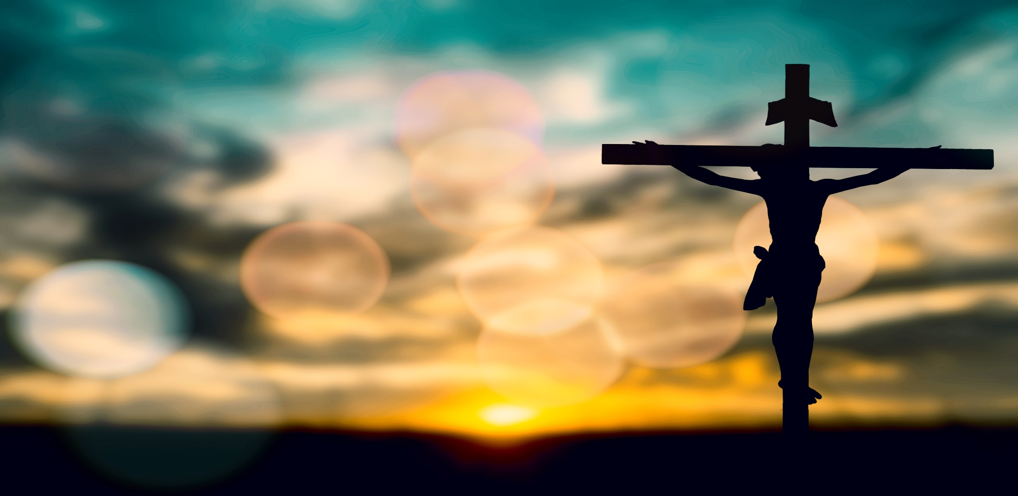
The Stages of The Cross Part 2
By Pastor Fee Soliven
Luke 22:39-42
Sunday Morning
April 10, 2022

Slide 93
Luke 22:39-42
39 Coming out, He went to the Mount of Olives, as He was accustomed, and His disciples also followed Him. 40 When He came to the place, He said to them, "Pray that you may not enter into temptation." 41 And He was withdrawn from them about a stone's throw, and He knelt down and prayed, 42 saying, "Father, if it is Your will, take this cup away from Me; nevertheless not My will, but Yours, be done."

Slide 94
The First 7 Stages of The Cross
1st Station of the Cross
Jesus on the Mount of Olives
2nd Station of the Cross
Jesus is betrayed by Judas and Arrested
3rd Station of the Cross
Jesus is condemned by the Sanhedrin

Slide 95
4th Station of the Cross
Peter denies Jesus
5th Station of the Cross
Jesus is judged by Pontius Pilate
6th Station of the Cross
Jesus is Scourged and Crowned with Thorns
7th Station of the Cross
Jesus Takes up His Cross

Slide 96
Via Dolorosa

Slide 97
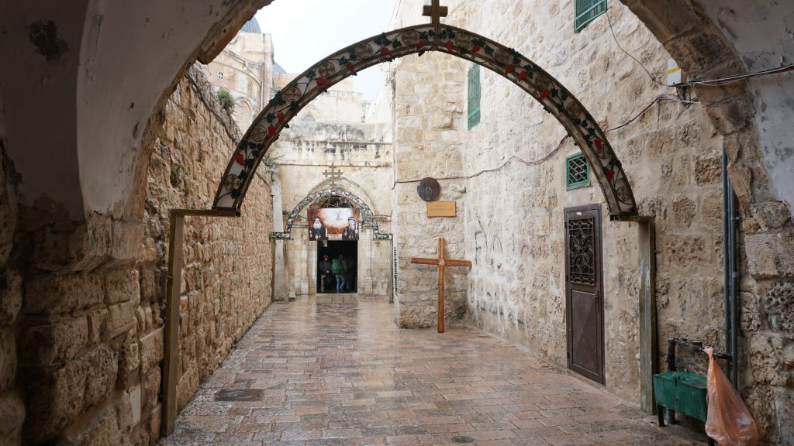
1. Do you remember the last time you felt down or discouraged?

Slide 98
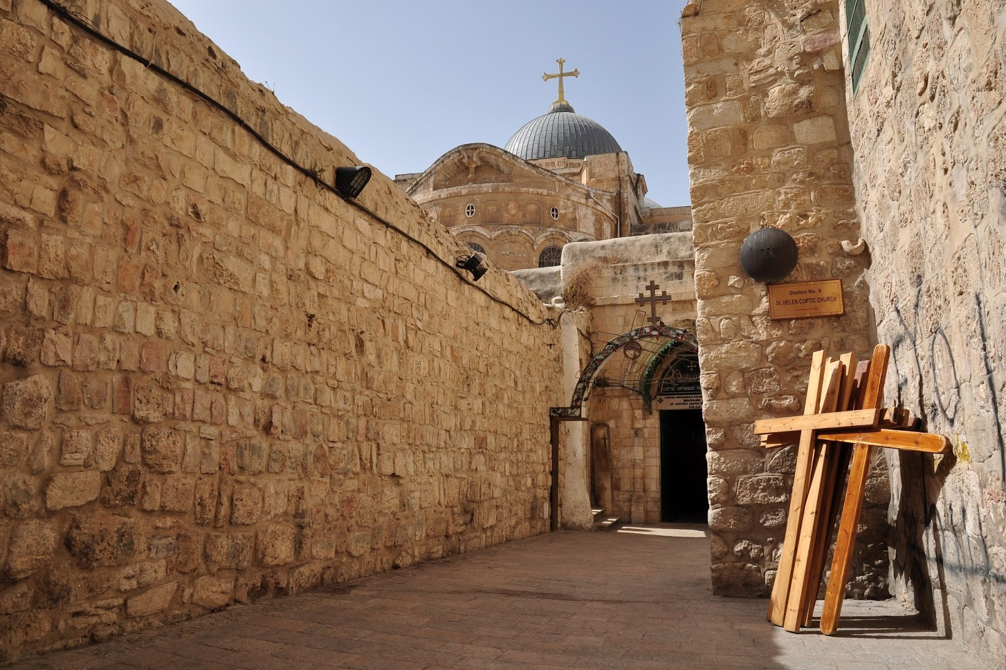
2. What caused you to feel this way?

Slide 99
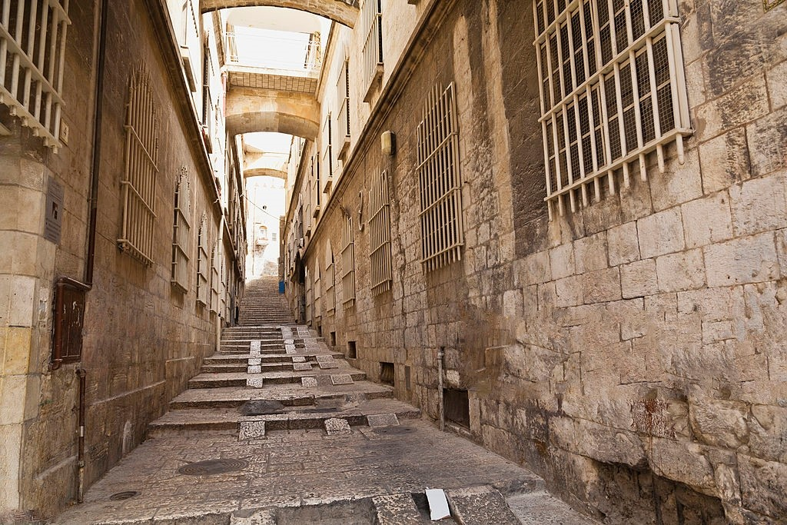
The apostle Paul is an inspiring example of someone who was down but not out.

Slide 100
8th Station of the Cross
Simon of Cyrene helps
Jesus carry His cross

Slide 101
Luke 23:26-27
26 Now as they led Him away, they laid hold of a certain man, Simon a Cyrenian, who was coming from the country, and on him they laid the cross that he might bear it after Jesus. 27 And a great multitude of the people followed Him, and women who also mourned and lamented Him.

Slide 102
Psalm 98:3
“He has remembered His mercy and His faithfulness to the house of Israel; All the ends of the earth have seen the salvation of our God.”

Slide 103
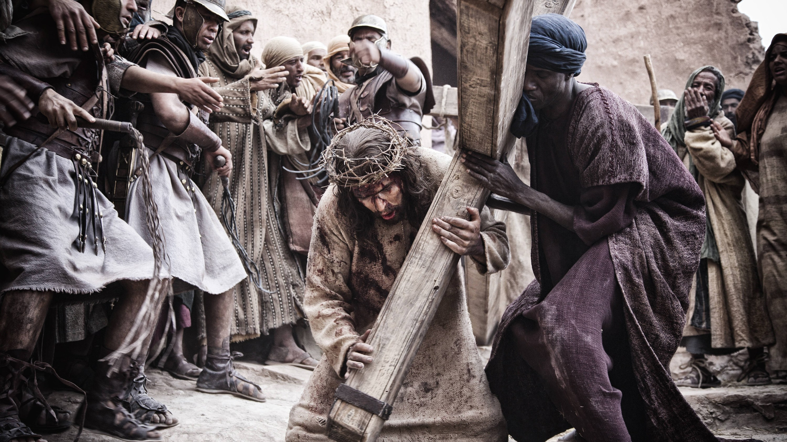
2nd Station of the Cross
Jesus is betrayed by
Judas and Arrested

Slide 104
2 Timothy 1:8-9
Therefore do not be ashamed of the testimony of our Lord, nor of me His prisoner, but share with me in the sufferings for the gospel according to the power of God, 9 who has saved us and called us with a holy calling, not according to our works, but according to His own purpose and grace which was given to us in Christ Jesus before time began…

Slide 105
9th Station of the Cross
Jesus meets
the Women of Jerusalem

Slide 106
Luke 23:27-31
27 And a great multitude of the people followed Him, and women who also mourned and lamented Him. 28 But Jesus, turning to them, said, "Daughters of Jerusalem, do not weep for Me, but weep for yourselves and for your children. 29 For indeed the days are coming in which they will say, 'Blessed are the barren, wombs that never bore, and breasts which never nursed!'

Slide 107
30 Then they will begin 'to say to the mountains, "Fall on us!" and to the hills, "Cover us!" ' 31 For if they do these things in the green wood, what will be done in the dry?"

Slide 108
John 18:36
Jesus answered, "My kingdom is not of this world. If My kingdom were of this world, My servants would fight, so that I should not be delivered to the Jews; but now My kingdom is not from here."

Slide 109
10th Station of the Cross
Jesus is Crucified

Slide 110
Luke 23:33-47
33 And when they had come to the place called Calvary, there they crucified Him, and the criminals, one on the right hand and the other on the left. 34 Then Jesus said, "Father, forgive them, for they do not know what they do." And they divided His garments and cast lots.

Slide 111
35 And the people stood looking on. But even the rulers with them sneered, saying, "He saved others; let Him save Himself if He is the Christ, the chosen of God." 36 The soldiers also mocked Him, coming and offering Him sour wine, 37 and saying, "If You are the King of the Jews, save Yourself."

Slide 112
38 And an inscription also was written over Him in letters of Greek, Latin, and Hebrew: THIS IS THE KING OF THE JEWS. 39 Then one of the criminals who were hanged blasphemed Him, saying, "If You are the Christ, save Yourself and us." 40 But the other, answering, rebuked him, saying, "Do you not even fear God, seeing you are under the same condemnation?

Slide 113
41 And we indeed justly, for we receive the due reward of our deeds; but this Man has done nothing wrong." 42 Then he said to Jesus, "Lord, remember me when You come into Your kingdom." 43 And Jesus said to him, "Assuredly, I say to you, today you will be with Me in Paradise." 44 Now it was about the sixth hour, and there was darkness over all the earth until the ninth hour.

Slide 114
45 Then the sun was darkened, and the veil of the temple was torn in two. 46 And when Jesus had cried out with a loud voice, He said, "Father, 'into Your hands I commit My spirit.' " Having said this, He breathed His last. 47 So when the centurion saw what had happened, he glorified God, saying, "Certainly this was a righteous Man!"

Slide 115
Hebrews 2:3
“how shall we escape if we neglect so great a salvation, which at the first began to be spoken by the Lord, and was confirmed to us by those who heard Him…”

Slide 116
Acts 4:12
“Salvation is found in no one else, for there is no other name under heaven given to men by which we must be saved"

Slide 117
11th Station of the Cross
Jesus promises His kingdom
to the Believing Thief

Slide 118
Luke 23:43
And Jesus said to him, "Assuredly, I say to you, today you will be with Me in Paradise."

Slide 119
Ephesians 2:8-9
8 For by grace you have been saved through faith, and that not of yourselves; it is the gift of God, 9 not of works, lest anyone should boast.

Slide 120
12th Station of the Cross
Jesus on the cross speaks
with His Mother and Disciples

Slide 121
John 19:26-27
26 When Jesus therefore saw His mother, and the disciple whom He loved standing by, He said to His mother, "Woman, behold your son!" 27 Then He said to the disciple, "Behold your mother!" And from that hour that disciple took her to his own home.

Slide 122
13th Station of the Cross
Jesus Dies on the Cross

Slide 123
Luke 23:44-46
44 Now it was about the sixth hour, and there was darkness over all the earth until the ninth hour. 45 Then the sun was darkened, and the veil of the temple was torn in two. 46 And when Jesus had cried out with a loud voice, He said, "Father, 'into Your hands I commit My spirit.' " Having said this, He breathed His last.

Slide 124
Mark 15:37-38
37 And Jesus cried out with a loud voice, and breathed His last. 38 Then the veil of the temple was torn in two from top to bottom.

Slide 125
Hebrews 4:14-16
14 Seeing then that we have a great High Priest who has passed through the heavens, Jesus the Son of God, let us hold fast our confession. 15 For we do not have a High Priest who cannot sympathize with our weaknesses, but was in all points tempted as we are, yet without sin. 16 Let us therefore come boldly to the throne of grace, that we may obtain mercy and find grace to help in time of need.

Slide 126
14th Station of the Cross
Jesus is laid in the Tomb

Slide 127
Luke 23:50-54
50 Now behold, there was a man named Joseph, a council member, a good and just man. 51 He had not consented to their decision and deed. He was from Arimathea, a city of the Jews, who himself was also waiting for the kingdom of God.

Slide 128
52 This man went to Pilate and asked for the body of Jesus. 53 Then he took it down, wrapped it in linen, and laid it in a tomb that was hewn out of the rock, where no one had ever lain before. 54 That day was the Preparation, and the Sabbath drew near.

Slide 129
John 19:38
“After this, Joseph of Arimathea, being a disciple of Jesus, but secretly, for fear of the Jews, asked Pilate that he might take away the body of Jesus; and Pilate gave him permission. So he came and took the body of Jesus.”

Slide 130
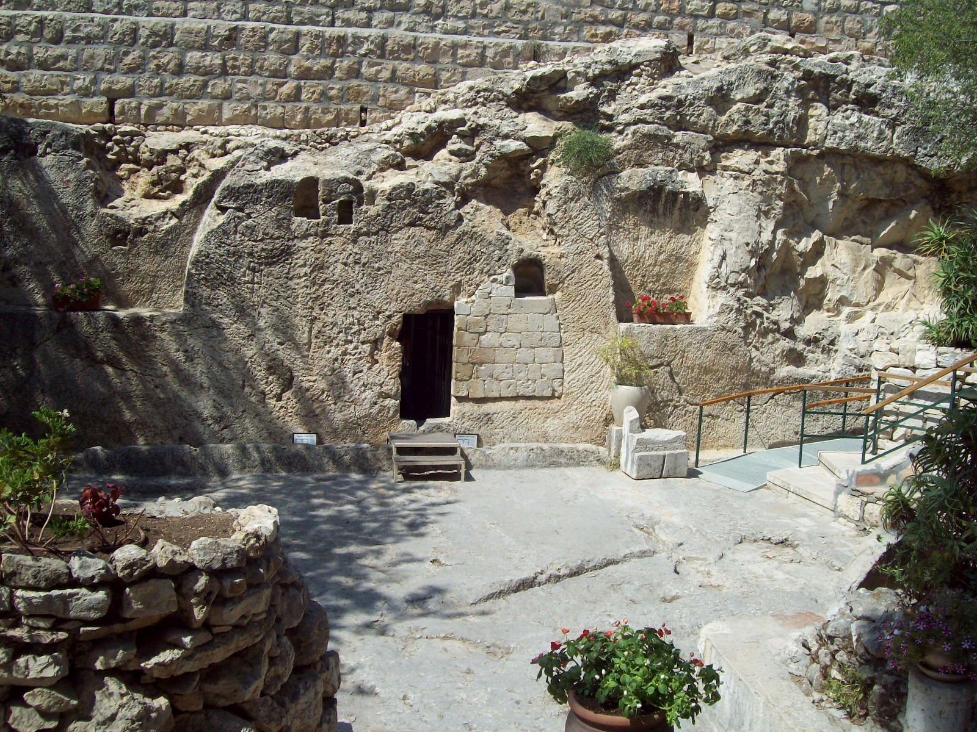
3. When you’re feeling down, where is your focus?

Slide 131
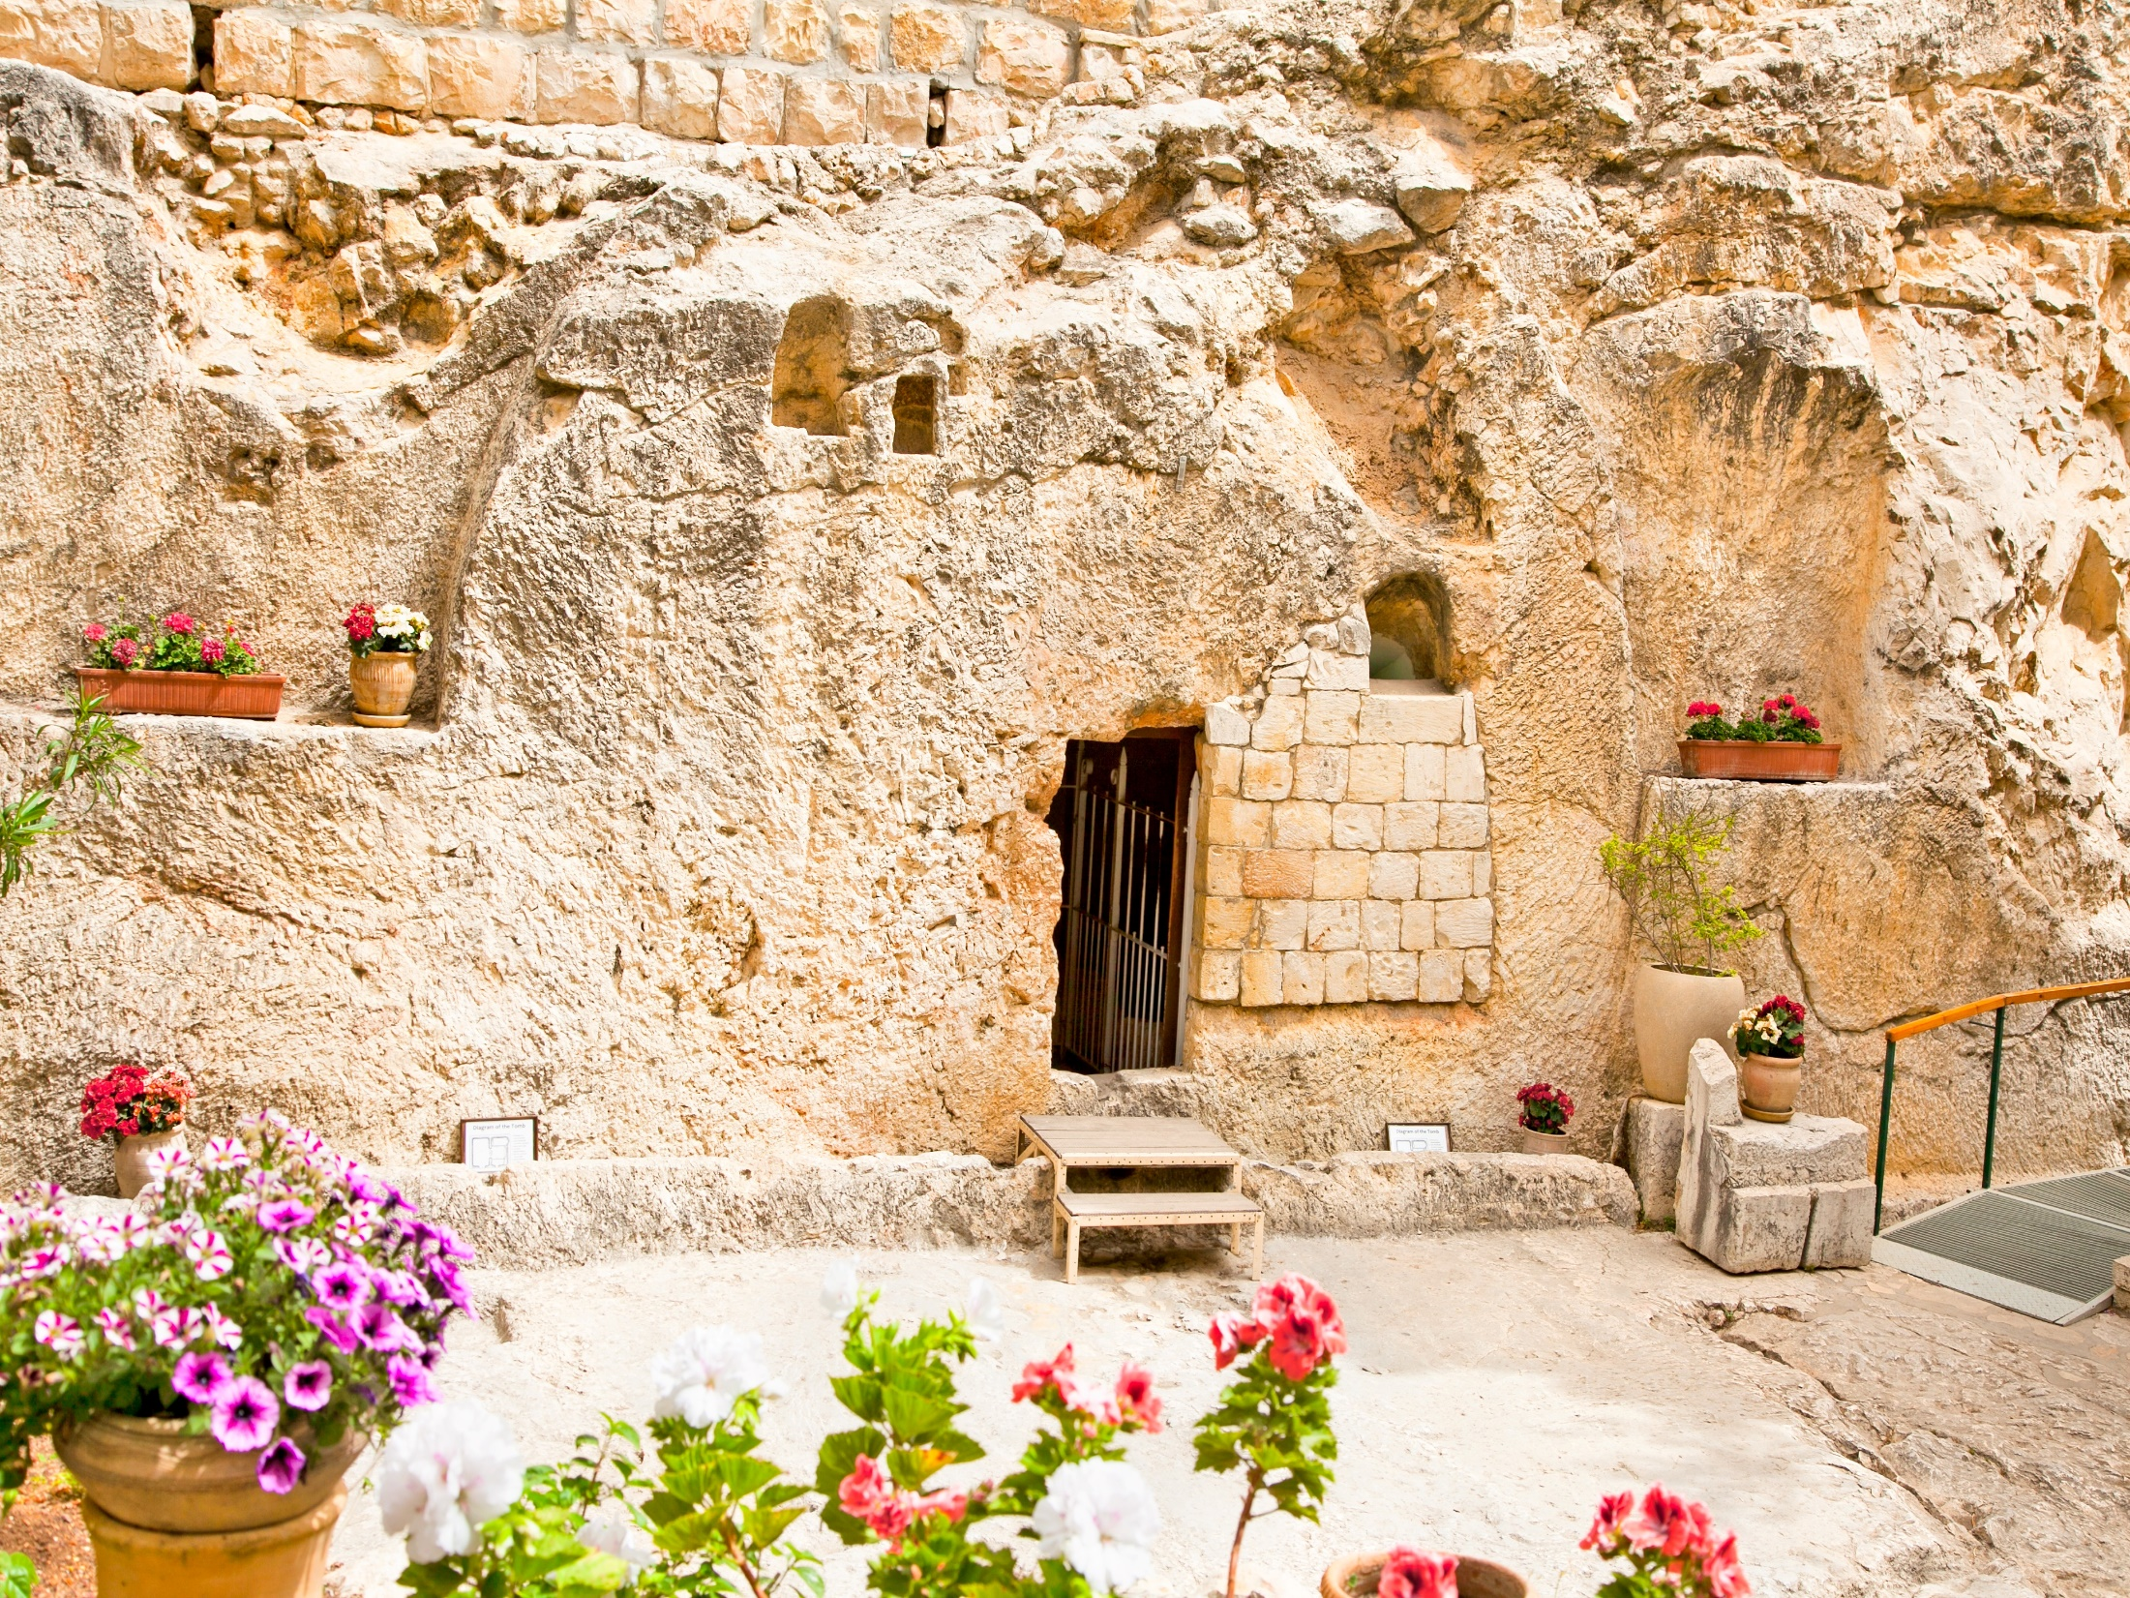
4. How would focusing on the Lord change your response to discouragement?

Slide 132
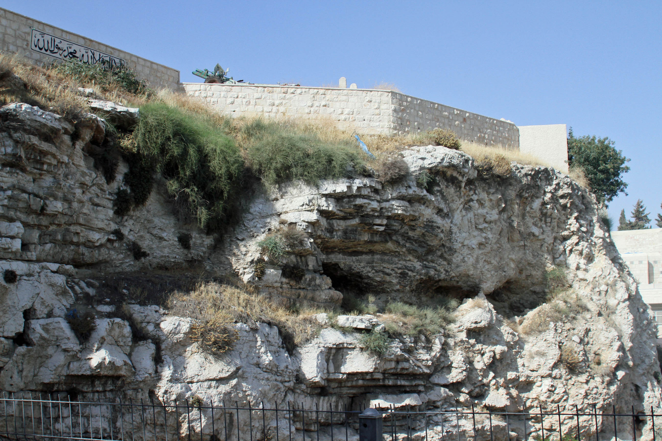
5. Who in your life has been an example of perseverance through hardship? For whom are you setting an example?

Slide 133
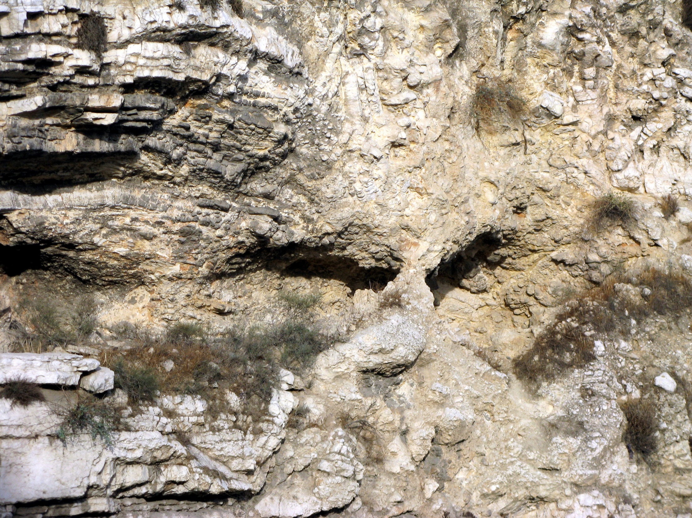
5. Who in your life has been an example of perseverance through hardship? For whom are you setting an example?

Slide 134
John 3:16
“For God so loved the world that He gave His only begotten Son, that whoever believes in Him should not perish but have everlasting life.”

Slide 135
John 3:17-21
17 For God did not send His Son into the world to condemn the world, but that the world through Him might be saved. 18 He who believes in Him is not condemned; but he who does not believe is condemned already, because he has not believed in the name of the only begotten Son of God.

Slide 136
19 And this is the condemnation, that the light has come into the world, and men loved darkness rather than light, because their deeds were evil. 20 For everyone practicing evil hates the light and does not come to the light, lest his deeds should be exposed. 21 But he who does the truth comes to the light, that his deeds may be clearly seen, that they have been done in God."

Slide 137
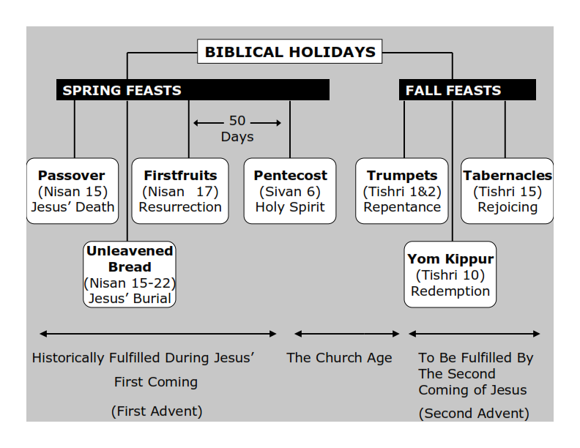
Philippians 3:20-21
20 For our citizenship is in heaven, from which we also eagerly wait for the Savior, the Lord Jesus Christ, 21 who will transform our lowly body that it may be conformed to His glorious body, according to the working by which He is able even to subdue all things to Himself.

Slide 138
1 Thessalonians 4:13-18
13 But I do not want you to be ignorant, brethren, concerning those who have fallen asleep, lest you sorrow as others who have no hope. 14 For if we believe that Jesus died and rose again, even so God will bring with Him those who sleep in Jesus.

Slide 139
15 For this we say to you by the word of the Lord, that we who are alive and remain until the coming of the Lord will by no means precede those who are asleep. 16 For the Lord Himself will descend from heaven with a shout, with the voice of an archangel, and with the trumpet of God. And the dead in Christ will rise first.

Slide 140
17 Then we who are alive and remain shall be caught up together with them in the clouds to meet the Lord in the air. And thus we shall always be with the Lord. 18 Therefore comfort one another with these words.

Slide 141
1 Corinthians 15:50-54
50 Now this I say, brethren, that flesh and blood cannot inherit the kingdom of God; nor does corruption inherit incorruption. 51 Behold, I tell you a mystery: We shall not all sleep, but we shall all be changed-- 52 in a moment, in the twinkling of an eye, at the last trumpet. For the trumpet will sound, and the dead will be raised incorruptible, and we shall be changed.

Slide 142
53 For this corruptible must put on incorruption, and this mortal must put on immortality. 54 So when this corruptible has put on incorruption, and this mortal has put on immortality, then shall be brought to pass the saying that is written: "Death is swallowed up in victory."

Slide 143
20 Again, when a righteous man turns from his righteousness and commits iniquity, and I lay a stumbling block before him, he shall die; because you did not give him warning, he shall die in his sin, and his righteousness which he has done shall not be remembered; but his blood I will require at your hand.

Slide 144
Acts 2:38-39
38 Then Peter said to them, "Repent, and let every one of you be baptized in the name of Jesus Christ for the remission of sins; and you shall receive the gift of the Holy Spirit. 39 For the promise is to you and to your children, and to all who are afar off, as many as the Lord our God will call."

