Slide 2
“How Great Is Our God”
(Chris Tomlin)

Slide 3
The splendor of a King, clothed in majesty Let all the Earth rejoice All the Earth rejoice He wraps himself in

Slide 4
light And darkness tries to hide And trembles at His voice Trembles at His voice How great is our God,

Slide 5
sing with me How great is our God, and all will see
How great, how great is our God Age to age He

Slide 6
stands And time is in His hands Beginning and the end Beginning and the end The Godhead Three in

Slide 7
One Father Spirit Son The Lion and the Lamb The Lion and the Lamb How great is our God, sing with

Slide 8
me How great is our God, and all will see How great, how great is our God Name above all names (how

Slide 9
great is our God, sing with me) Worthy of our praise (how great is our God, and all will see) My heart will

Slide 10
sing How great is our God You're the name above all names (how great is our God, sing with me) You are

Slide 11
worthy of our praise (how great is our God, and all will see) And my heart will sing How great is our God

Slide 12
How great is our God, sing with me How great is our God, and all will see How great, how great is our God

Slide 13
How great is our God, sing with me How great is our God, and all will see How great, how great is our God

Slide 14
How great is our God, sing with me How great is our God, and all will see How great,

Slide 15
how great is our God

Slide 16
Graves into Gardens
(Elevation Worship)

Slide 17
I searched the World but it couldn’t fill me. Man’s empty praise and treasures that fade Are never

Slide 18
Enough. Then you came along and put me back together And every desire Is now satisfied here in

Slide 19
Your love. Oh’ there’s nothing better than you. There’s nothing better than you. Lord there’s nothing

Slide 20
Nothing is better than you. Im not afraid to show you my weakness. My failures and flaws Lord you’ve

Slide 21
Seen them all and you still call me friend.Cause the God of the mountain. Is the God of the Valley.

Slide 22
There’s not a place. Your mercy and grace. Wont find me again. Oh there’s nothing better than you. There’s

Slide 23
Nothing better than you. Lord there’s nothing. Nothing is better than you. Oh there’s nothing better

Slide 24
Better than you. There’s nothing better than you. Lord’ there’s nothing. Nothing is better than you.

Slide 25
You turn mourning to dancing. You give beauty for ashes. You turn shame into glory. You’re the only one

Slide 26
Who can. You turn mourning to dancing. You give beauty for ashes. You turn shame into glory. You’re

Slide 27
The only one who can. You turn graves into gardens. You turn bones into armies. You turn seas into

Slide 28
Highways. You’re the only one who can you’re the only one who can. Oh there’s nothing better than you

Slide 29
There’s nothing better than you. Lord there’s nothing. Nothing is better than you. Oh there’s nothing better

Slide 30
Than you. There’s nothing better than you. Lord, there’s nothing. Nothing is better than you. You turn

Slide 31
Graves into gardens. You turn bones into armies. You turn seas into highways. You’re the only one who

Slide 32
Can. You turn graves into gardens. You turn bones into armies. You turn seas into highways you’re the

Slide 33
Only one who can. You’re the only one who. You’re the only one who can.

Slide 34
above all names Be exalted now in the heavens As Your glory fills this place You alone deserve our

Slide 35
praise You’re the name above all names Worthy is Your name, Jesus You deserve the praise Worthy is

Slide 36
Your name Worthy is Your name, Jesus You deserve the praise Worthy is Your name Worthy is Your

Slide 37
name, Jesus You deserve the praise Worthy is Your name Worthy is Your name, Jesus You deserve the

Slide 38
praise Worthy is Your name Oh, oh

Slide 39
Rattle
(Elevation Worship)

Slide 40
Saturday was silent. Surely it was through. Since when has impossible. Ever stopped you. Friday’s

Slide 41
Disappointment. Is Sunday’s empty tomb. Since when has impossible ever stopped you.

Slide 42
This is the sound of dry bones rattling. This is the praise make a dead man walk again. Open the

Slide 43
Grave I’m coming out I’m gonna live, gonna live again. This is the sound of dry bones rattling.

Slide 44
Pentecostal fire stirring something new. You’re not gonna run out of miracles anytime soon. Yeah,

Slide 45
Resurrection power runs in my veins too. I believe there’s another miracle here in this room.

Slide 46
This is the sound of dry bones rattling. This is the praise make a dead man walk again. Open the

Slide 47
Grave im coming out I’m gonna live, gonna live again. This is the sound of dry bones rattling.

Slide 48
My God is able to save and deliver and heal

Slide 49
And restore anything that he wants to. Just ask the man who was thrown on the bones of Elisha. If

Slide 50
There’s anything that He can’t do. Just ask the stone that was rolled at the tomb in the garden. What

Slide 51
Happens when God says to move. I feel him moving it now. I feel him doing it now. I feel him doing it now.

Slide 52
Do it now, Do it now. This is the sound of dry bones rattling. This is the praise make a dead man walk

Slide 53
Again. Open the grave I’m coming out. I’m gonna live gonna live again. Open the grave I’m coming out

Slide 54
I’m gonna live gonna live again. Open the grave I’m coming out I’m gonna live gonna live again. This is

Slide 55
The sound of dry bones rattling.

Slide 56
“Build My Life”
(Pat Barret)

Slide 57
Worthy of every song we could ever sing Worthy of all the praise we could ever bring Worthy of every

Slide 58
breath we could ever breathe We live for you Oh, we live for you Jesus, the Name above every other

Slide 59
name Jesus, the only One who could ever save (worthy...) Worthy of every breath we could ever

Slide 60
breathe We live for you Holy, there is no one like You There is none beside You Open up my eyes in

Slide 61
wonder Show me who You are and fill me With Your heart and lead me In your love to those around me

Slide 62
Jesus, the Name above every other name Jesus, the only One who could ever save Worthy of every

Slide 63
breathe we could ever breathe We live for You, Oh! We live for for You Holy, there is no one like You

Slide 64
There is none beside You Open up my eyes I wonder Show me who You are and fill me With Your

Slide 65
heart and lead me In your love to those around me I will build my life upon Your love It is a firm foundation

Slide 66
I will put my trust in You alone And I will not be shaken I will build my life upon Your love It is a firm

Slide 67
foundation I will put my trust in You alone And I will not be shaken Holy, there is no one like You There is

Slide 68
none beside You Open up my eyes in wonder Show me who You are and fill me With Your heart and lead

Slide 69
me In your love to those around me I will build my life upon Your love It is a firm foundation I will put my

Slide 70
trust in You alone And I will not be shaken I will build my life upon Your love It is a firm foundation I will put

Slide 71
my trust in You alone And I will not be shaken

Slide 72
“Jesus We Love You”
(Bethal Music)

Slide 73
Old things have passed away Your love has stayed the same Your constant grace remains the

Slide 74
cornerstone Things that we thought were dead Are breathing in life again You cause your Son to shine

Slide 75
on darkest nights For all that you've done, we will pour out our love This will be our anthem song Jesus

Slide 76
we love you Oh how we love you You are the one our, our hearts adore The hopeless have found their

Slide 77
hope The orphans now have a home All that was lost has found its place in you You lift our weary

Slide 78
head You make us strong instead You took these rags and made us beautiful For all that you've done,

Slide 79
we will pour out our love This will be our anthem song Jesus we love you Oh how we love you You

Slide 80
are the on our, our hearts adore Oh, Jesus we love you Oh how we love you You are the one our, our

Slide 81
hearts adore Our hearts adore (we adore you) Our hearts adore Our hearts adore Our affection, our

Slide 82
devotion Poured out on the feet of Jesus Our affection, our devotion Poured out on the feet of

Slide 83
Jesus Our affection, our devotion Poured out on the feet of Jesus Our affection, our devotion Poured out

Slide 84
on the feet of Jesus We love you Oh how we love you You are the one our, our hearts adore Jesus we

Slide 85
love you Oh how we love you You are the one our, our hearts adore Oh, Jesus we love you Oh how we

Slide 86
love you You are the one our, our hearts adore Just sing out a new song today Oh, oh how we love you

Slide 87
Oh, you are worthy Jesus, of our love, our adoration, we love you God Oh lift your voice, oh Oh we love

Slide 88
you, oh we love you, oh Oh how we love you (sing Jesus) Oh, Jesus we love you Oh how we love you

Slide 89
(you are) You are the one our, our hearts adore

Slide 91
Arming The Saints to Stand
by Pastor Fee Soliven
Matthew 12:43-45
Sunday Morning
August 28, 2022

Slide 92
Matthew 12:43-45
43 "When an unclean spirit goes out of a man, he goes through dry places, seeking rest, and finds none. 44 Then he says, 'I will return to my house from which I came.' And when he comes, he finds it empty, swept, and put in order.

Slide 93
45 Then he goes and takes with him seven other spirits more wicked than himself, and they enter and dwell there; and the last state of that man is worse than the first. So shall it also be with this wicked generation."

Slide 94
Israel’s Promise from God of Obedience

Slide 95
Deuteronomy 28:1-10
1 "Now it shall come to pass, if you diligently obey the voice of the LORD your God, to observe carefully all His commandments which I command you today, that the LORD your God will set you high above all nations of the earth. 2 And all these blessings shall come upon you and overtake you, because you obey the voice of the LORD your God:

Slide 96
3 Blessed shall you be in the city, and blessed shall you be in the country. 4 Blessed shall be the fruit of your body, the produce of your ground and the increase of your herds, the increase of your cattle and the offspring of your flocks. 5 Blessed shall be your basket and your kneading bowl. 6 Blessed shall you be when you come in, and blessed shall you be when you go out.

Slide 97
7 "The LORD will cause your enemies who rise against you to be defeated before your face; they shall come out against you one way and flee before you seven ways. 8 The LORD will command the blessing on you in your storehouses and in all to which you set your hand, and He will bless you in the land which the LORD your God is giving you.

Slide 98
9 The LORD will establish you as a holy people to Himself, just as He has sworn to you, if you keep the commandments of the LORD your God and walk in His ways. 10 Then all peoples of the earth shall see that you are called by the name of the LORD, and they shall be afraid of you.

Slide 99
Israel’s Promise from God of Disobedience

Slide 100
Deuteronomy 28:15-20
15 "But it shall come to pass, if you do not obey the voice of the LORD your God, to observe carefully all His commandments and His statutes which I command you today, that all these curses will come upon you and overtake you:

Slide 101
16 Cursed shall you be in the city, and cursed shall you be in the country. 17 Cursed shall be your basket and your kneading bowl. 18 Cursed shall be the fruit of your body and the produce of your land, the increase of your cattle and the offspring of your flocks. 19 Cursed shall you be when you come in, and cursed shall you be when you go out.

Slide 102
20 "The LORD will send on you cursing, confusion, and rebuke in all that you set your hand to do, until you are destroyed and until you perish quickly, because of the wickedness of your doings in which you have forsaken Me.

Slide 103
Deuteronomy 28:47-51
47 "Because you did not serve the LORD your God with joy and gladness of heart, for the abundance of everything, 48 therefore you shall serve your enemies, whom the LORD will send against you, in hunger, in thirst, in nakedness, and in need of everything; and He will put a yoke of iron on your neck until He has destroyed you.

Slide 104
49 The LORD will bring a nation against you from afar, from the end of the earth, as swift as the eagle flies, a nation whose language you will not understand, 50 a nation of fierce countenance, which does not respect the elderly nor show favor to the young.

Slide 105
51 And they shall eat the increase of your livestock and the produce of your land, until you are destroyed; they shall not leave you grain or new wine or oil, or the increase of your cattle or the offspring of your flocks, until they have destroyed you.

Slide 106
The Unholy Trinity

Slide 107
Baal, Ashtoreth and Molech

Slide 108
Baal the Possessor

Slide 109
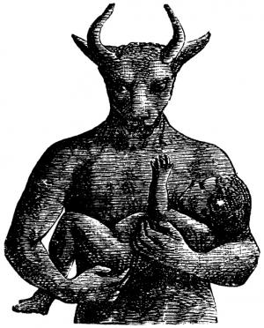

Slide 110
Judges 2:11-23
11 Then the children of Israel did evil in the sight of the LORD, and served the Baals; 12 and they forsook the LORD God of their fathers, who had brought them out of the land of Egypt; and they followed other gods from among the gods of the people who were all around them, and they bowed down to them; and they provoked the LORD to anger.

Slide 111
13 They forsook the LORD and served Baal and the Ashtoreths. 14 And the anger of the LORD was hot against Israel. So He delivered them into the hands of plunderers who despoiled them; and He sold them into the hands of their enemies all around, so that they could no longer stand before their enemies.

Slide 112
15 Wherever they went out, the hand of the LORD was against them for calamity, as the LORD had said, and as the LORD had sworn to them. And they were greatly distressed. 16 Nevertheless, the LORD raised up judges who delivered them out of the hand of those who plundered them.

Slide 113
17 Yet they would not listen to their judges, but they played the harlot with other gods, and bowed down to them. They turned quickly from the way in which their fathers walked, in obeying the commandments of the LORD; they did not do so.

Slide 114
18 And when the LORD raised up judges for them, the LORD was with the judge and delivered them out of the hand of their enemies all the days of the judge; for the LORD was moved to pity by their groaning because of those who oppressed them and harassed them.

Slide 115
19 And it came to pass, when the judge was dead, that they reverted and behaved more corruptly than their fathers, by following other gods, to serve them and bow down to them. They did not cease from their own doings nor from their stubborn way.

Slide 116
20 Then the anger of the LORD was hot against Israel; and He said, "Because this nation has transgressed My covenant which I commanded their fathers, and has not heeded My voice, 21 I also will no longer drive out before them any of the nations which Joshua left when he died,

Slide 117
22 so that through them I may test Israel, whether they will keep the ways of the LORD, to walk in them as their fathers kept them, or not." 23 Therefore the LORD left those nations, without driving them out immediately; nor did He deliver them into the hand of Joshua.

Slide 118
The Enchantress Ashtoreth

Slide 119
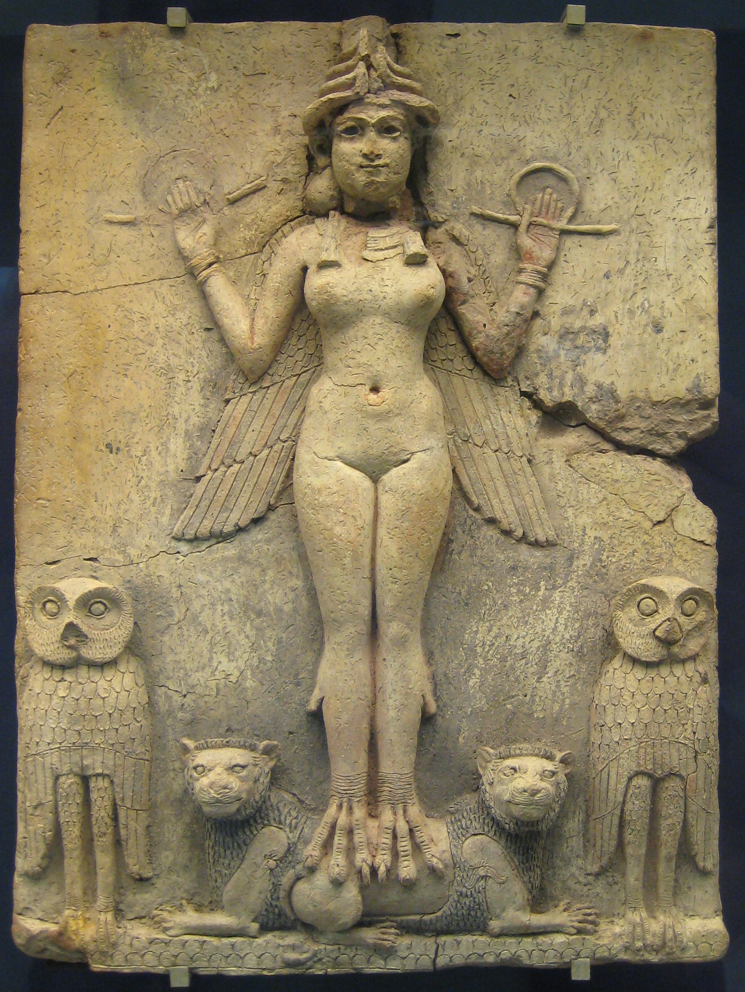

Slide 120
This goddess had many names throughout the World. They were Ishtar, Aphrodites, Venus and the Bible called her Ashtoreth

Slide 122
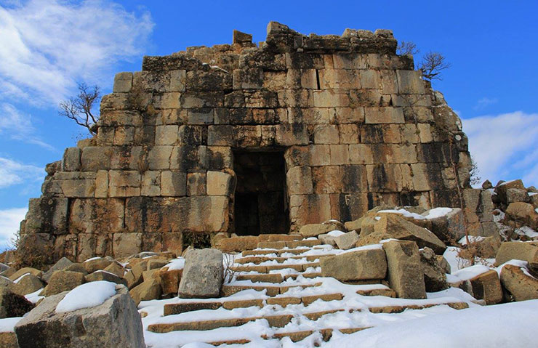
Photo> Temple

Slide 123
This area is now modern Iraq, Kuwait, Turkey and Syria

Slide 124
Molech The Destroyer

Slide 125
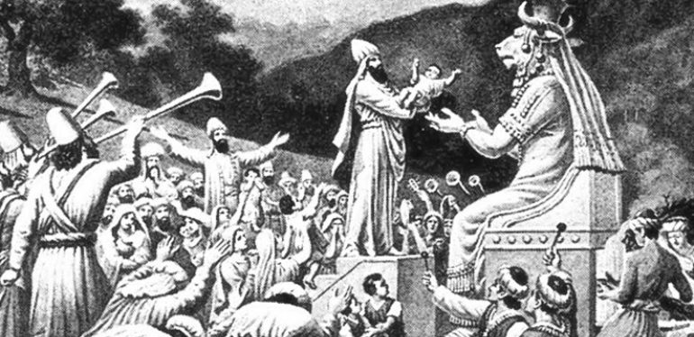
4. Do our prayers change God’s mind?

Slide 126
Jeremiah 32:26-35
26 Then the word of the LORD came to Jeremiah, saying, 27 "Behold, I am the LORD, the God of all flesh. Is there anything too hard for Me? 28 Therefore thus says the LORD: 'Behold, I will give this city into the hand of the Chaldeans, into the hand of Nebuchadnezzar king of Babylon, and he shall take it.

Slide 127
29 And the Chaldeans who fight against this city shall come and set fire to this city and burn it, with the houses on whose roofs they have offered incense to Baal and poured out drink offerings to other gods, to provoke Me to anger; 30 because the children of Israel and the children of Judah have done only evil before Me from their youth. For the children of Israel have provoked Me only to anger with the work of their hands," says the LORD.

Slide 128
31 For this city has been to Me a provocation of My anger and My fury from the day that they built it, even to this day; so I will remove it from before My face 32 because of all the evil of the children of Israel and the children of Judah, which they have done to provoke Me to anger--they, their kings, their princes, their priests, their prophets, the men of Judah, and the inhabitants of Jerusalem.

Slide 129
33 And they have turned to Me the back, and not the face; though I taught them, rising up early and teaching them, yet they have not listened to receive instruction. 34 But they set their abominations in the house which is called by My name, to defile it.

Slide 130
35 And they built the high places of Baal which are in the Valley of the Son of Hinnom, to cause their sons and their daughters to pass through the fire to Molech, which I did not command them, nor did it come into My mind that they should do this abomination, to cause Judah to sin.'

Slide 131
Revelation 12:7-10
7 And war broke out in heaven: Michael and his angels fought with the dragon; and the dragon and his angels fought, 8 but they did not prevail, nor was a place found for them in heaven any longer.

Slide 132
9 So the great dragon was cast out, that serpent of old, called the Devil and Satan, who deceives the whole world; he was cast to the earth, and his angels were cast out with him.

Slide 133
America

Slide 134
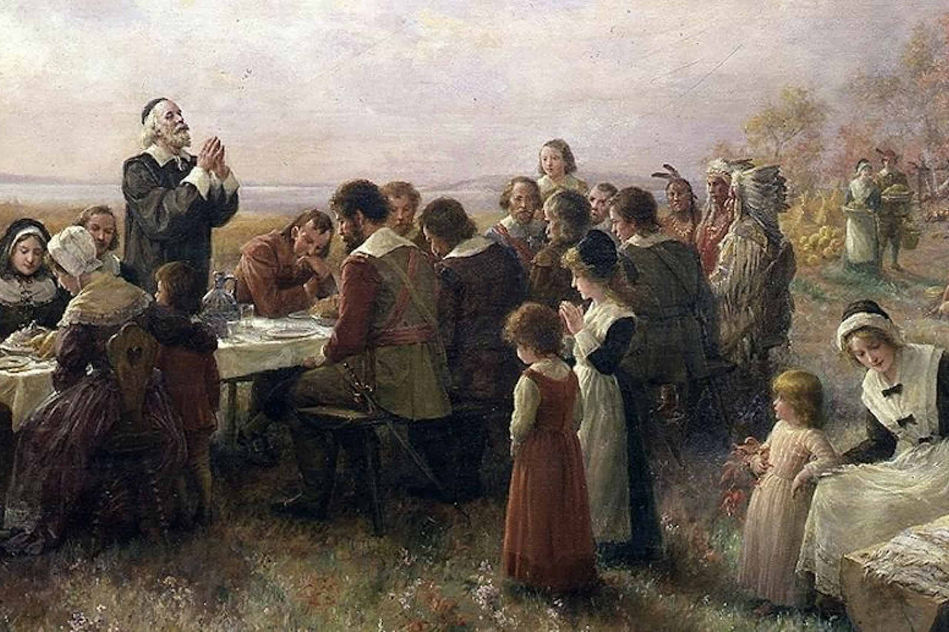
4. How would you characterize your prayer life?

Slide 135
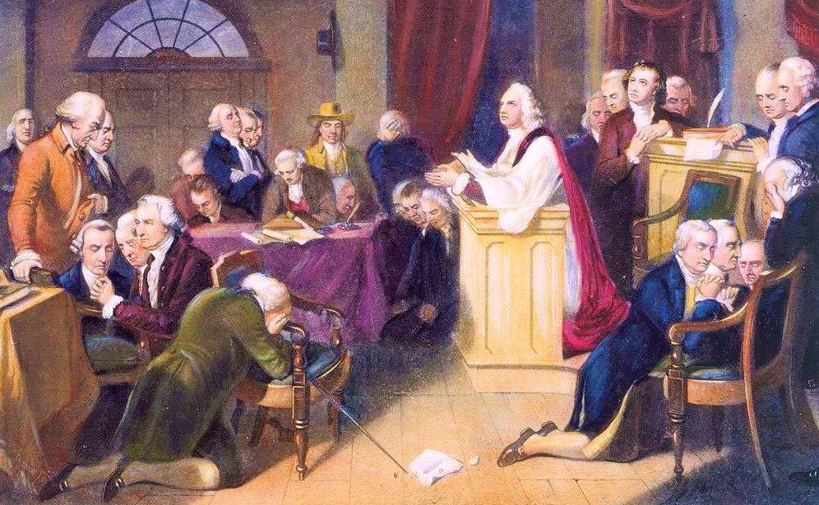
5. What keeps you from being faithful in prayer?

Slide 136
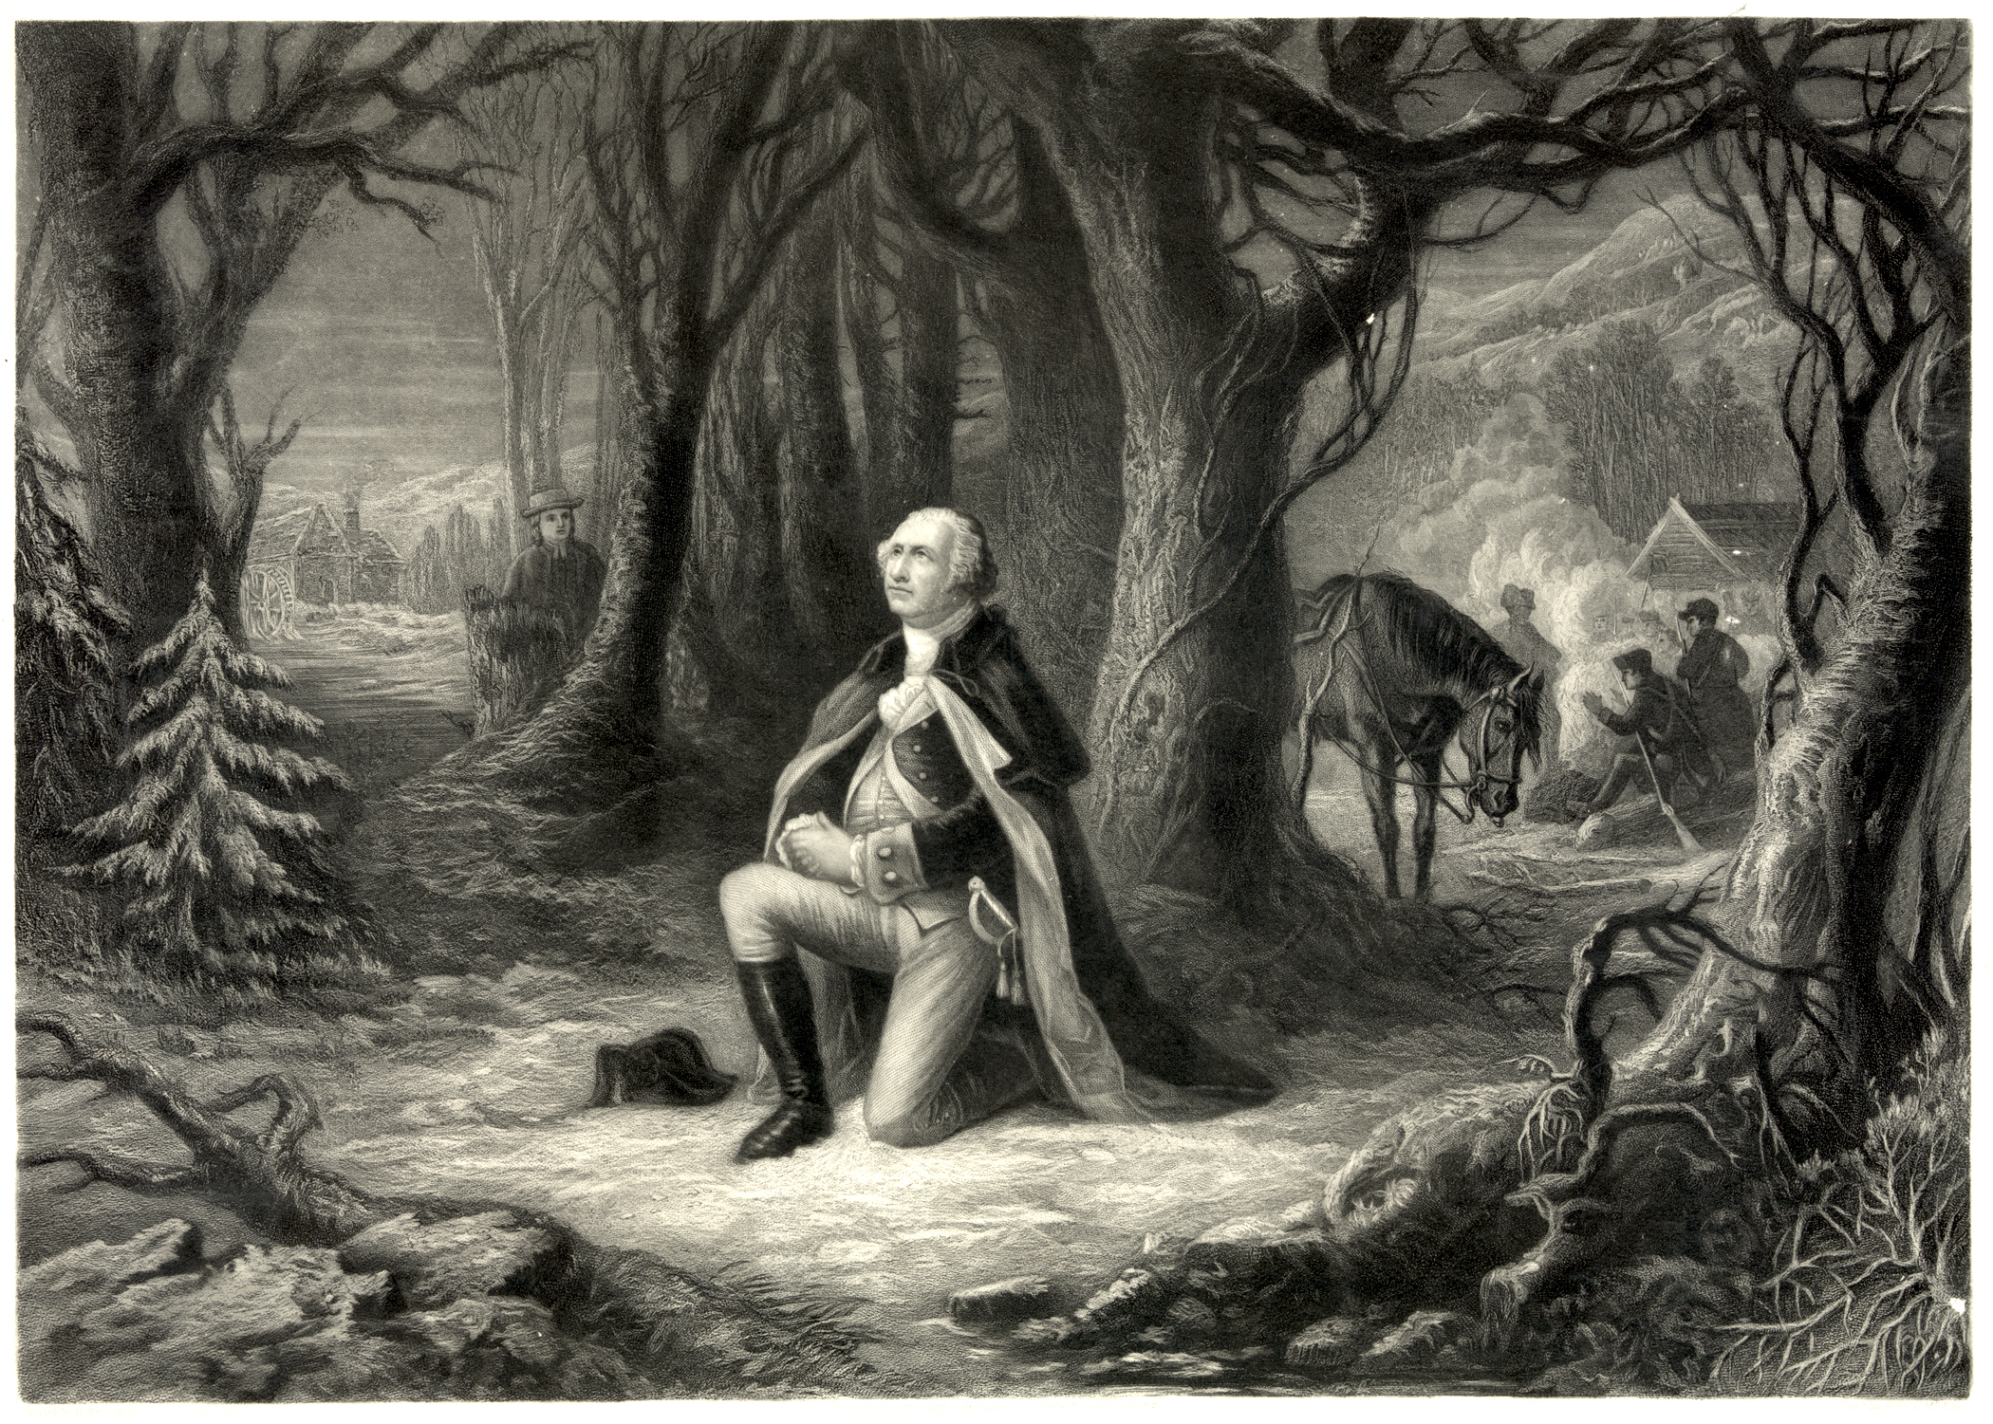
6. What are you forfeiting when you don’t pray?

Slide 137
“Since we ought to be no less persuaded that the propitious smiles of heaven, can never be expected on a nation that disregards the eternal rules of order and right, which heaven itself has ordained. And since the preservation of the sacred fire of liberty, and the destiny of the republican model of government, are justly considered as deeply,

Slide 138
perhaps as finally staked on the experiment entrusted to the hands of the American people”
President George Washington April 20, 1789

Slide 139
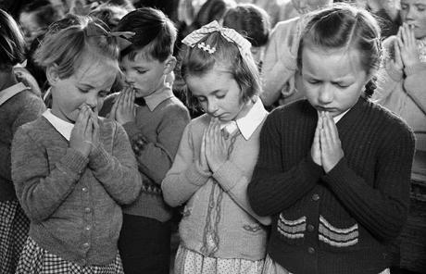
perhaps as finally staked on the experiment entrusted to the hands of the American people”
President George Washington April 20, 1789

Slide 140
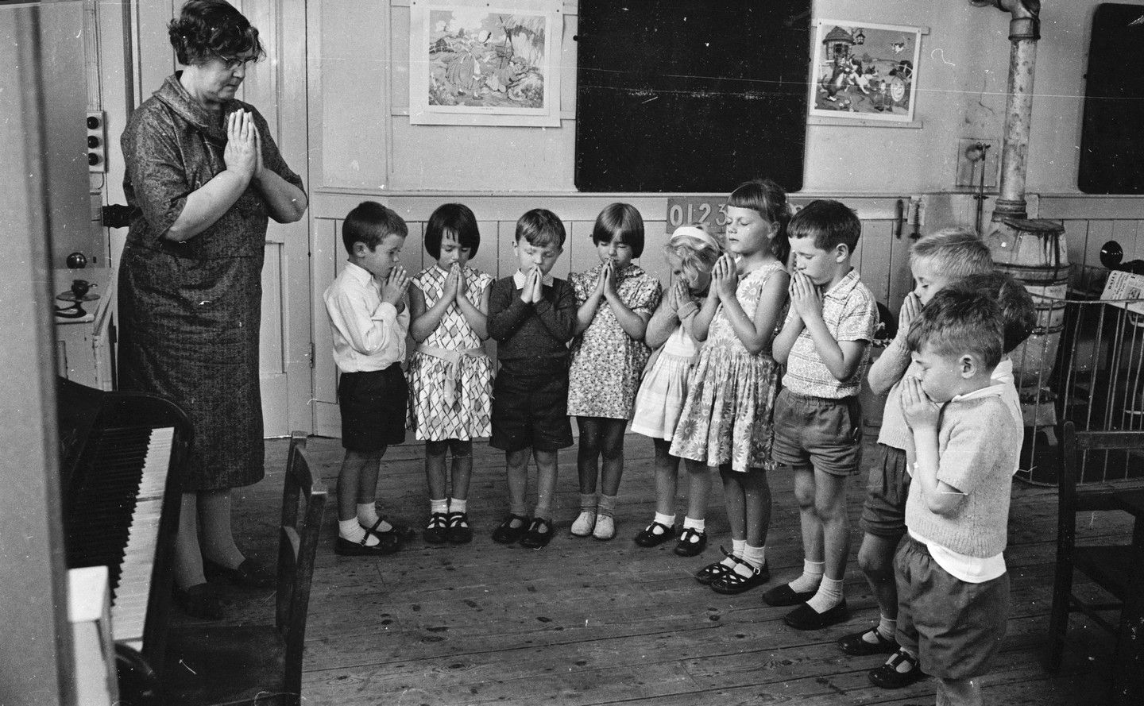
perhaps as finally staked on the experiment entrusted to the hands of the American people”
President George Washington April 20, 1789

Slide 141
perhaps as finally staked on the experiment entrusted to the hands of the American people”
President George Washington April 20, 1789

Slide 142
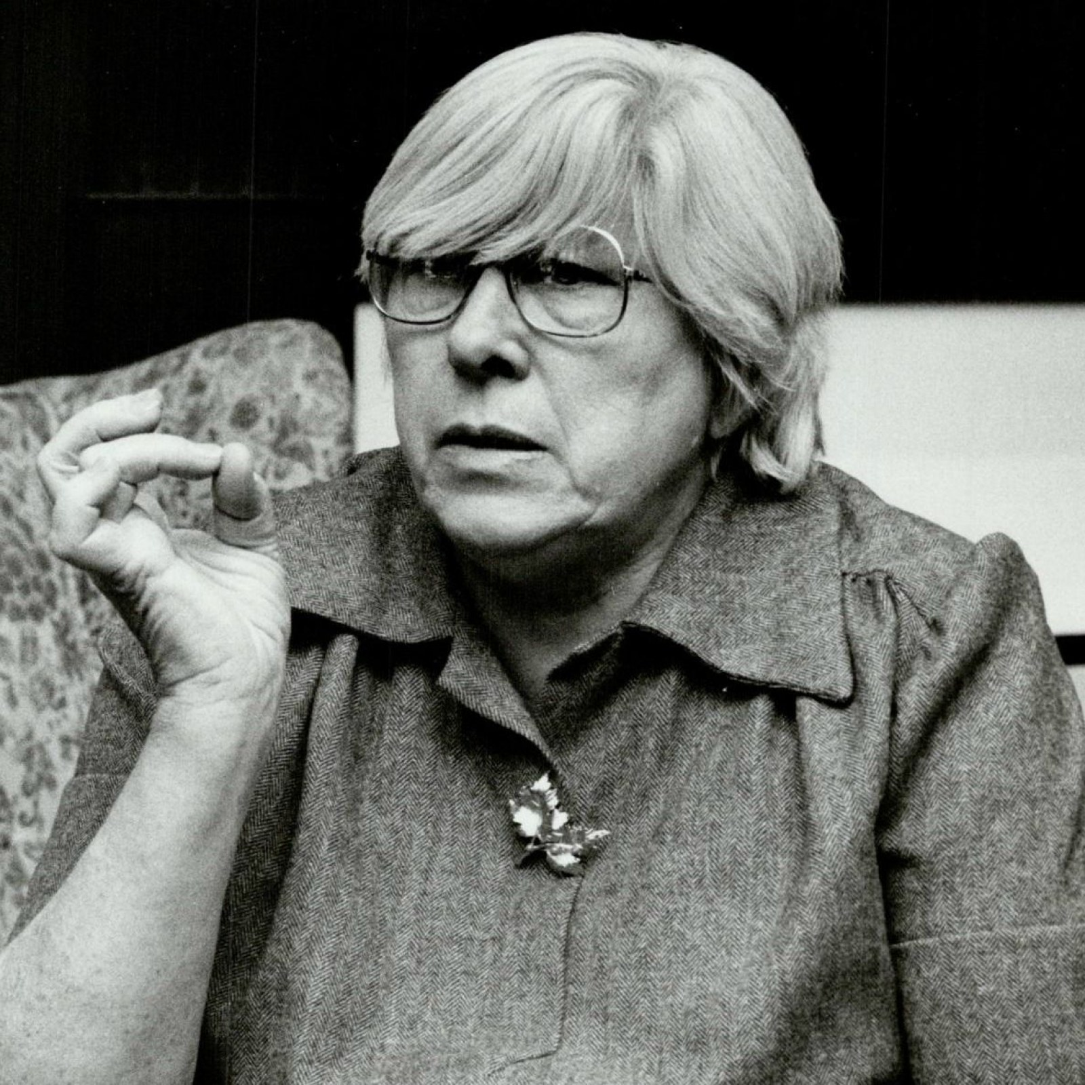
Atheist
Madalyn Murray O'Hair

Slide 143
On June 25, 1962, the United States Supreme Court decided in Engel v. Vitale that a prayer approved by the New York Board of Regents for use in schools violated the First Amendment by constituting an establishment of religion.

Slide 144
The following year, in Abington School District v. Schempp, the Court disallowed Bible readings in public schools for similar reasons. These two landmark Supreme Court decisions centered on the place of religion in public education, and particularly the place of Protestantism, which had long been accepted as the given American faith tradition.

Slide 145
Both decisions ultimately changed the face of American civil society, and in turn, helped usher in the last half-century of the culture wars.

Slide 146
Schools, Courts, Culture,
Family and Society

Slide 147
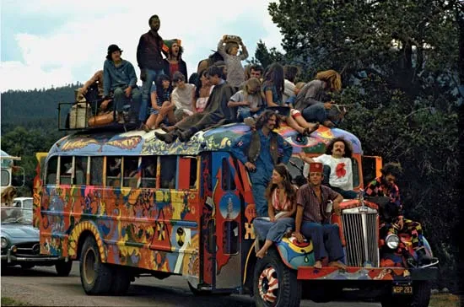
1 Thessalonians 4:13-18
13 But I do not want you to be ignorant, brethren, concerning those who have fallen asleep, lest you sorrow as others who have no hope. 14 For if we believe that Jesus died and rose again, even so God will bring with Him those who sleep in Jesus.

Slide 148
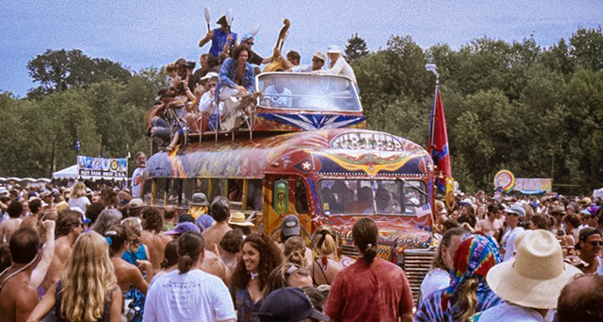
1 Thessalonians 4:13-18
13 But I do not want you to be ignorant, brethren, concerning those who have fallen asleep, lest you sorrow as others who have no hope. 14 For if we believe that Jesus died and rose again, even so God will bring with Him those who sleep in Jesus.

Slide 149
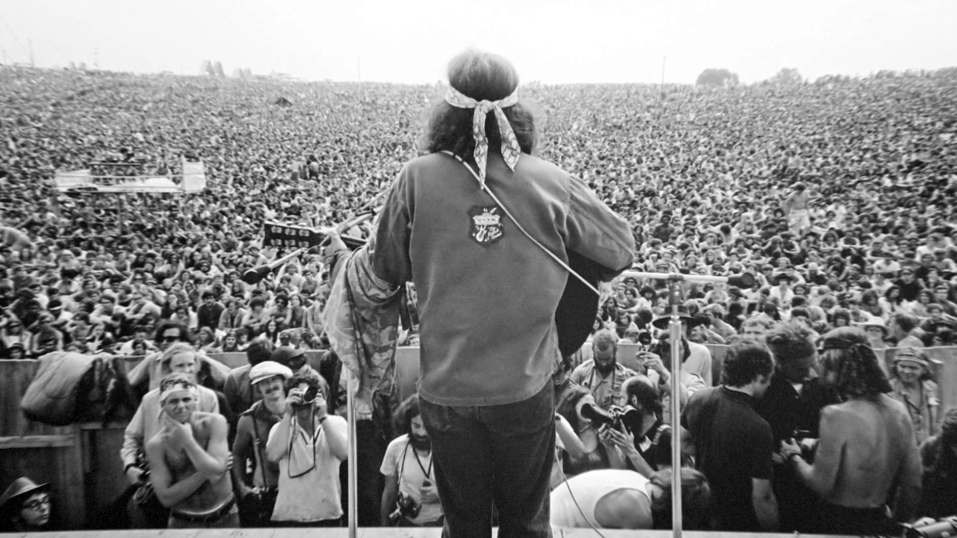
1 Thessalonians 4:13-18
13 But I do not want you to be ignorant, brethren, concerning those who have fallen asleep, lest you sorrow as others who have no hope. 14 For if we believe that Jesus died and rose again, even so God will bring with Him those who sleep in Jesus.

Slide 150
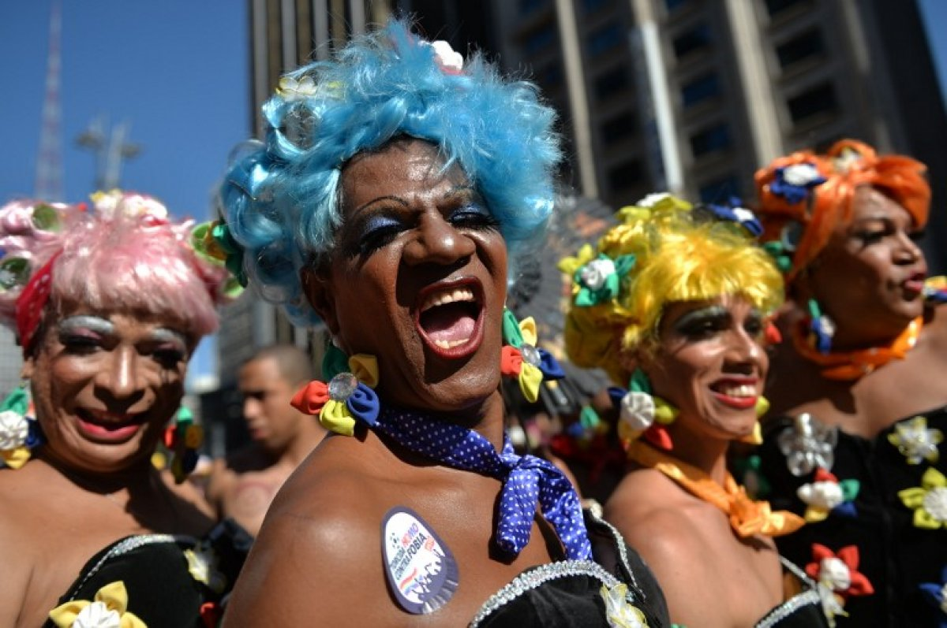
1 Thessalonians 4:13-18
13 But I do not want you to be ignorant, brethren, concerning those who have fallen asleep, lest you sorrow as others who have no hope. 14 For if we believe that Jesus died and rose again, even so God will bring with Him those who sleep in Jesus.

Slide 151
1 Thessalonians 4:13-18
13 But I do not want you to be ignorant, brethren, concerning those who have fallen asleep, lest you sorrow as others who have no hope. 14 For if we believe that Jesus died and rose again, even so God will bring with Him those who sleep in Jesus.

Slide 152
1 Thessalonians 4:13-18
13 But I do not want you to be ignorant, brethren, concerning those who have fallen asleep, lest you sorrow as others who have no hope. 14 For if we believe that Jesus died and rose again, even so God will bring with Him those who sleep in Jesus.

Slide 153
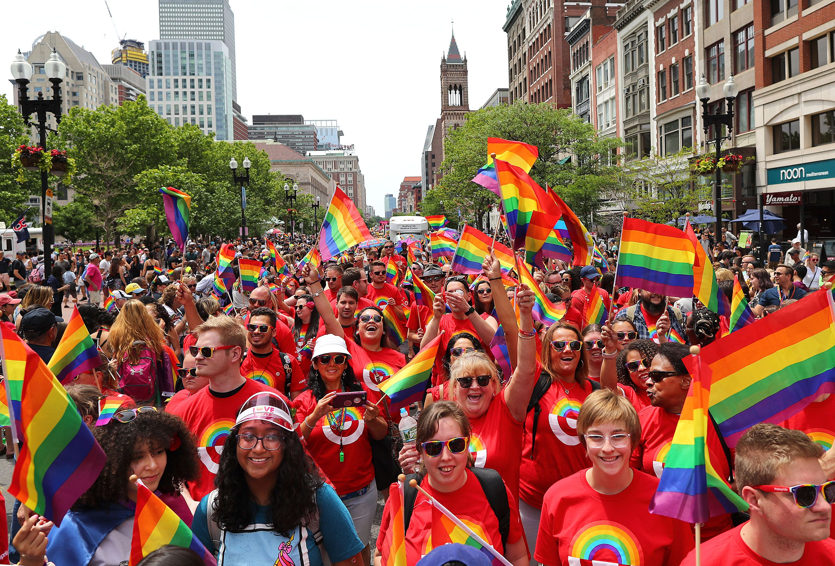
1 Thessalonians 4:13-18
13 But I do not want you to be ignorant, brethren, concerning those who have fallen asleep, lest you sorrow as others who have no hope. 14 For if we believe that Jesus died and rose again, even so God will bring with Him those who sleep in Jesus.

Slide 154
17 Then we who are alive and remain shall be caught up together with them in the clouds to meet the Lord in the air. And thus we shall always be with the Lord. 18 Therefore comfort one another with these words.

Slide 155
Roe v. Wade, 410 U.S. 113 (1973),[1] was a landmark decision of the U.S. Supreme Court in which the Court ruled that the Constitution of the United States conferred the right to have an abortion.

Slide 156
The decision struck down many federal and state abortion laws,[2][3] and caused an ongoing abortion debate in the United States about whether, or to what extent, abortion should be legal, who should decide the legality of abortion, and what the role of moral and religious views in the political sphere should be.

Slide 157
The decision also shaped debate concerning which methods the Supreme Court should use in constitutional adjudication.

Slide 158
Over 63 million abortions have occurred in the US since Roe v. Wade decision in 1973

Slide 159
Fox News Reported more than 63 million abortions are estimated to have taken place in the U.S. since the Supreme Court's 1973 Roe v. Wade ruling that granted federal protections to women seeking to terminate their pregnancies, according to one analysis.

Slide 160
The National Right to Life Committee (NRLC), the nation's oldest pro-life organization, estimates that 63,459,781 abortions have taken place since 1973. That estimate was gathered by tracking data from the Centers for Disease Control and Prevention (CDC) and the Guttmacher Institute, which previously served as a research arm of the nation's preeminent abortion provider, Planned Parenthood.

Slide 161
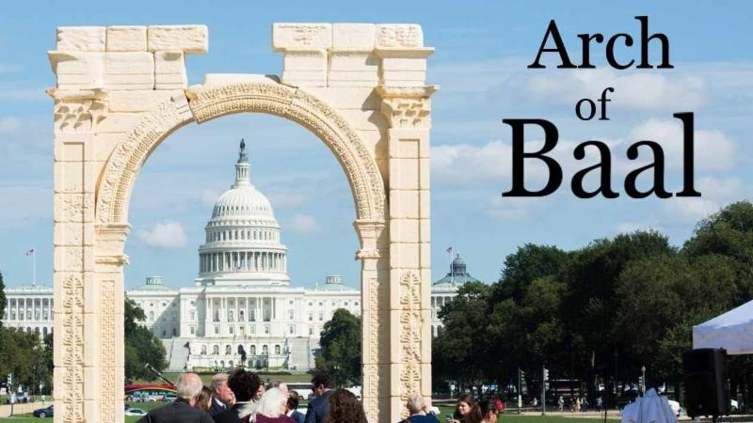
17 Then we who are alive and remain shall be caught up together with them in the clouds to meet the Lord in the air. And thus we shall always be with the Lord. 18 Therefore comfort one another with these words.

Slide 162
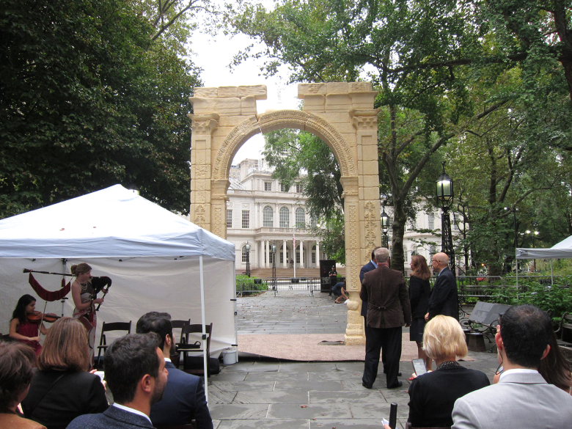
17 Then we who are alive and remain shall be caught up together with them in the clouds to meet the Lord in the air. And thus we shall always be with the Lord. 18 Therefore comfort one another with these words.

Slide 163
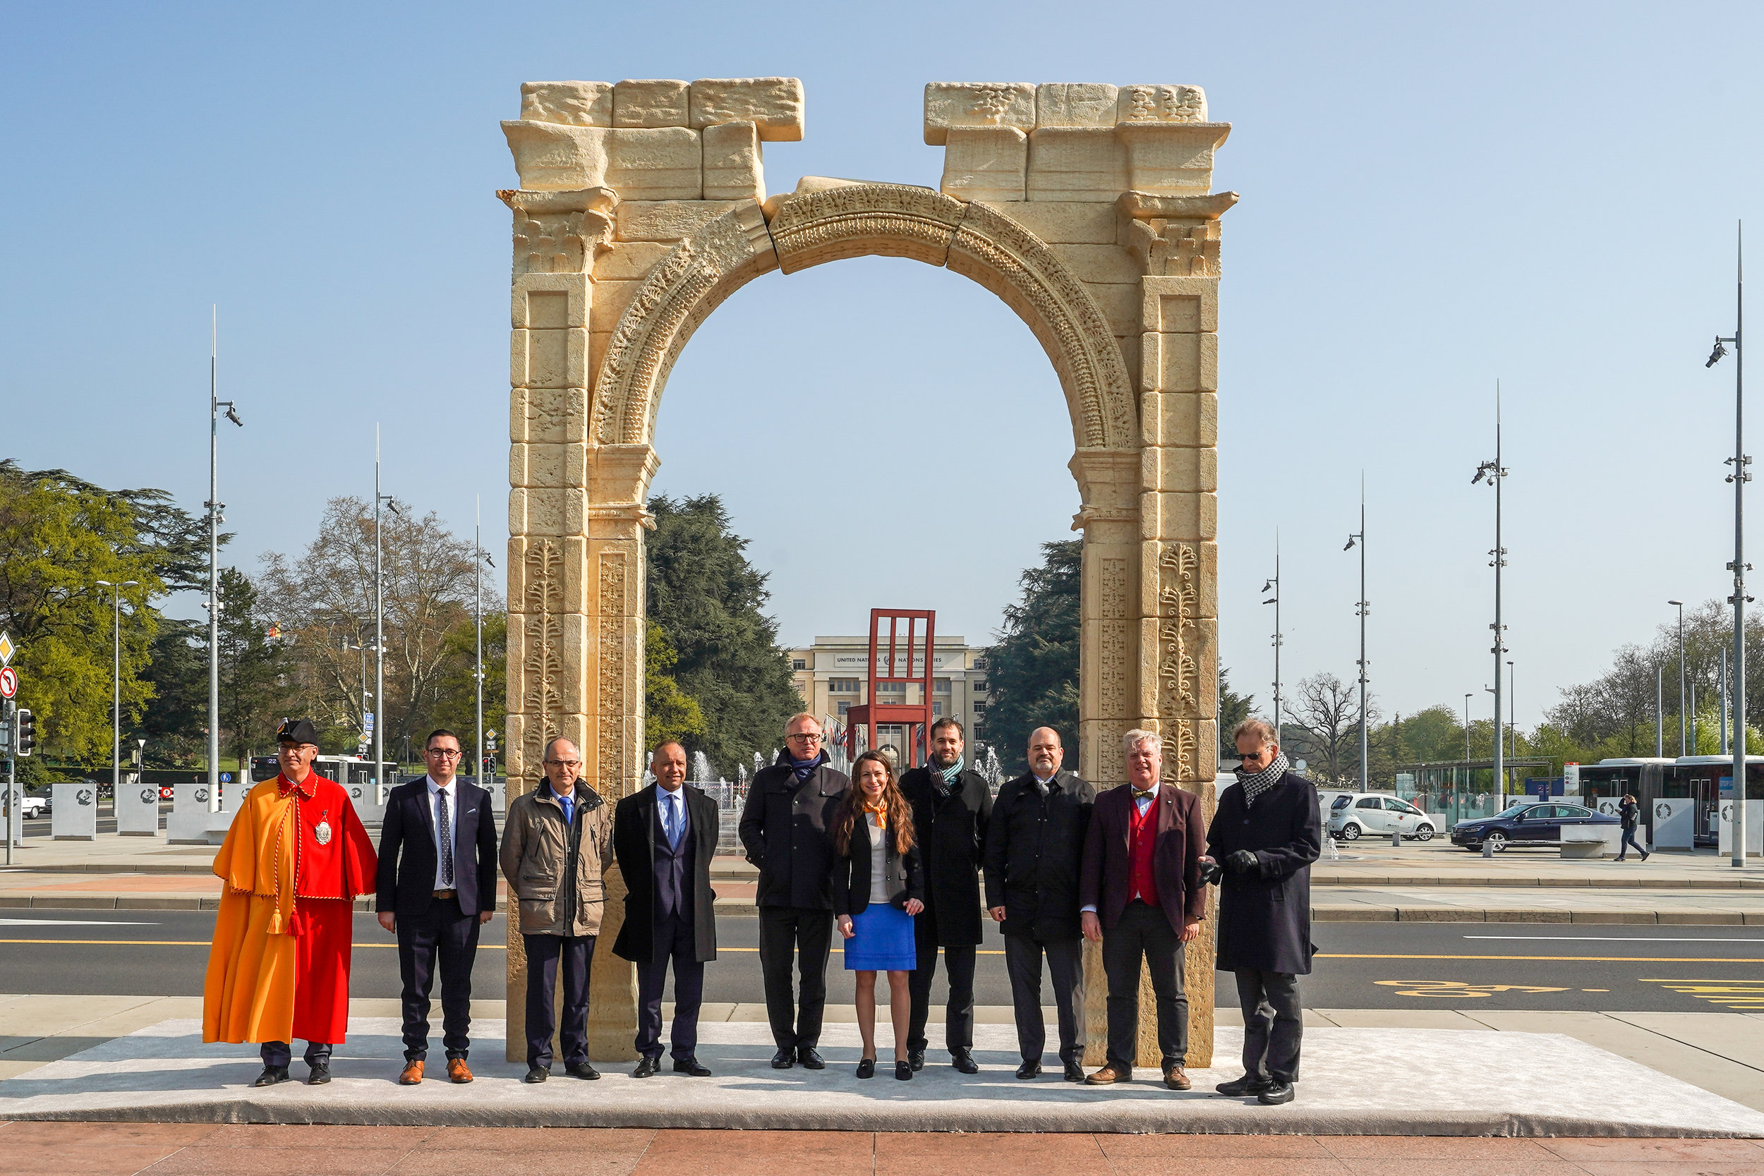
17 Then we who are alive and remain shall be caught up together with them in the clouds to meet the Lord in the air. And thus we shall always be with the Lord. 18 Therefore comfort one another with these words.

Slide 164
17 Then we who are alive and remain shall be caught up together with them in the clouds to meet the Lord in the air. And thus we shall always be with the Lord. 18 Therefore comfort one another with these words.

Slide 165
17 Then we who are alive and remain shall be caught up together with them in the clouds to meet the Lord in the air. And thus we shall always be with the Lord. 18 Therefore comfort one another with these words.

Slide 166
1 Corinthians 15:50-54
50 Now this I say, brethren, that flesh and blood cannot inherit the kingdom of God; nor does corruption inherit incorruption. 51 Behold, I tell you a mystery: We shall not all sleep, but we shall all be changed-- 52 in a moment, in the twinkling of an eye, at the last trumpet. For the trumpet will sound, and the dead will be raised incorruptible, and we shall be changed.

Slide 167
2 Timothy 3:1-7
1 But know this, that in the last days perilous times will come: 2 For men will be lovers of themselves, lovers of money, boasters, proud, blasphemers, disobedient to parents, unthankful, unholy, 3 unloving, unforgiving, slanderers, without self-control, brutal, despisers of good, 4 traitors, headstrong, haughty, lovers of pleasure rather than lovers of God,

Slide 168
5 having a form of godliness but denying its power. And from such people turn away! 6 For of this sort are those who creep into households and make captives of gullible women loaded down with sins, led away by various lusts, 7 always learning and never able to come to the knowledge of the truth.

Slide 169
Matthew 12:43-45
43 "When an unclean spirit goes out of a man, he goes through dry places, seeking rest, and finds none. 44 Then he says, 'I will return to my house from which I came.' And when he comes, he finds it empty, swept, and put in order.

Slide 170
45 Then he goes and takes with him seven other spirits more wicked than himself, and they enter and dwell there; and the last state of that man is worse than the first. So shall it also be with this wicked generation."

Slide 171
Ephesians 6:13-18
13 Therefore take up the whole armor of God, that you may be able to withstand in the evil day, and having done all, to stand. 14 Stand therefore, having girded your waist with truth, having put on the breastplate of righteousness, 15 and having shod your feet with the preparation of the gospel of peace;

Slide 172
16 above all, taking the shield of faith with which you will be able to quench all the fiery darts of the wicked one. 17 And take the helmet of salvation, and the sword of the Spirit, which is the word of God; 18 praying always with all prayer and supplication in the Spirit, being watchful to this end with all perseverance and supplication for all the saints—

Slide 173
Ephesians 6:10-12
10 Finally, my brethren, be strong in the Lord and in the power of His might. 11 Put on the whole armor of God, that you may be able to stand against the wiles of the devil. 12 For we do not wrestle against flesh and blood, but against principalities, against powers, against the rulers of the darkness of this age, against spiritual hosts of wickedness in the heavenly places.

Slide 174
1 Thessalonians 4:13-18
13 But I do not want you to be ignorant, brethren, concerning those who have fallen asleep, lest you sorrow as others who have no hope. 14 For if we believe that Jesus died and rose again, even so God will bring with Him those who sleep in Jesus.

Slide 175
15 For this we say to you by the word of the Lord, that we who are alive and remain until the coming of the Lord will by no means precede those who are asleep. 16 For the Lord Himself will descend from heaven with a shout, with the voice of an archangel, and with the trumpet of God. And the dead in Christ will rise first.

Slide 176
17 Then we who are alive and remain shall be caught up together with them in the clouds to meet the Lord in the air. And thus we shall always be with the Lord. 18 Therefore comfort one another with these words.

Slide 177
1 Corinthians 15:50-54
50 Now this I say, brethren, that flesh and blood cannot inherit the kingdom of God; nor does corruption inherit incorruption. 51 Behold, I tell you a mystery: We shall not all sleep, but we shall all be changed-- 52 in a moment, in the twinkling of an eye, at the last trumpet. For the trumpet will sound, and the dead will be raised incorruptible, and we shall be changed.

Slide 178
53 For this corruptible must put on incorruption, and this mortal must put on immortality. 54 So when this corruptible has put on incorruption, and this mortal has put on immortality, then shall be brought to pass the saying that is written: "Death is swallowed up in victory."

Slide 179
20 Again, when a righteous man turns from his righteousness and commits iniquity, and I lay a stumbling block before him, he shall die; because you did not give him warning, he shall die in his sin, and his righteousness which he has done shall not be remembered; but his blood I will require at your hand.

Slide 180
Acts 2:38-39
38 Then Peter said to them, "Repent, and let every one of you be baptized in the name of Jesus Christ for the remission of sins; and you shall receive the gift of the Holy Spirit. 39 For the promise is to you and to your children, and to all who are afar off, as many as the Lord our God will call."

