Slide 2
“This is Amazing Grace”
(Phil Wickham)

Slide 3
Who breaks the power of sin and darkness. Who’s love is mighty and so much stronger. The King of

Slide 4
glory ,the king above all kings. Who shakes the whole earth with holy thunder. And leaves us

Slide 5
in awe and wonder? The King of Glory, the King above all Kings. This is amazing grace. This is

Slide 6
unfailing love. That you would would take my place. That you would bear my cross. You laid down your

Slide 7
life. That I would be set free. Oh, Jesus I sing for all that you’ve done for me. Who brings our chaos back

Slide 8
into order. Who makes the orphans a son and daughter. The King of Glory, The King of Glory

Slide 9
into order. Who makes the orphans a son and daughter. The King of Glory, The King of Glory

Slide 10
Who rules the nation. With truth and justice . Shines like the sun in all of his brilliance. The King of Glory

Slide 11
The King above all Kings. This is Amazing Grace. This is unfailing love. That you would take my place.

Slide 12
That you would bear my cross. You laid down your life. That I would be set free. Oh, Jesus, I sing for

Slide 13
All that you've done for me. Worthy is the Lamb who was slain. Worthy is the King who conquered the

Slide 14
grave. Worthy is the Lamb who was slain. Worthy is the King who conquered the grave. Worthy is the

Slide 15
Lamb who was slain. Worthy, Worthy , Worthy. This is Amazing Grace. This is unfailing love. That you

Slide 16
would take my place. That you would bear my cross. You laid down your life. That I would be set free

Slide 17
Oh, Jesus I sing for. All that you’ve done for me.

Slide 18
“Go Tell It On The Mountain”
(Cedamont Kids)

Slide 19
Go, tell it on the mountain Over the hills and everywhere Go, tell it on the mountain That Jesus

Slide 20
Christ is born While shepherds kept their watching
O'er silent flocks by night Behold throughout the

Slide 21
Heavens There shone a Holy light Go, tell it on the mountain Over the hills and everywhere Go, tell it on

Slide 22
the mountain That Jesus Christ is born The shepherds feared and trembled When, lo! Above the

Slide 23
Earth Rang out the angel chorus That hailed our Savior's birth Go, tell it on the mountain Over the hills

Slide 24
and everywhere Go, tell it on the mountain That Jesus Christ is born Down in a lowly manger Our

Slide 25
humble Christ was born And brought us all salvation
That blessed Christmas morn Go, tell it on the mountain

Slide 26
Over the hills and everywhere Go, tell it on the mountain That Jesus Christ is born

Slide 27
That Jesus Christ is born

Slide 28
“Hark The Herald Angels Sing”
(Charles Wesley)

Slide 29
Hark! The herald angels sing "Glory to the new-born king Peace on earth and mercy mild God and sinners

Slide 30
reconciled“ Joyful all ye nations rise Join the triumph of the skies With angelic host proclaim "Christ is born

Slide 31
in Bethlehem“ Hark! The herald angels sing "Glory to the new-born king“ Hail the heaven-born Prince of

Slide 32
Peace! Hail the Sun of Righteousness! Light and life to all He brings Risen with healing in His wings Mild

Slide 33
He lays His glory by Born that man no more may die
Born to raise the sons of earth Born to give them

Slide 34
second birth Hark! The herald angels sing "Glory to the new-born king“ Hark! The herald

Slide 35
angels sing "Glory to the new-born king Peace on earth and mercy mild God and sinners reconciled"

Slide 36
Joyful all ye nations rise Join the triumph of the skies
With angelic host proclaim "Christ is born in

Slide 37
Bethlehem“ Hark! The herald angels sing "Glory to the new-born king“ "Glory to the new-born king"

Slide 38
“The First Noel”
(Carie Underwood)

Slide 39
The First Noel the Angels did say Was to certain poor shepherds in fields as they lay In fields where they

Slide 40
lay keeping their sheep On a cold winter's night that was so deep Noel Noel Noel Noel Born is the King of

Slide 41
Israel! They looked up and saw a star Shining in the East beyond them far And to the earth it gave great

Slide 42
Light And so it continued both day and night Noel Noel Noel Noel Born is the King of Israel! And by the

Slide 43
light of that same star Three Wise men came from country far To seek for a King was their intent And to!

Slide 44
follow the star wherever it went Noel Noel Noel Noel
Born is the King of Israel! This star drew nigh to the

Slide 45
Northwest O'er Bethlehem it took it's rest And there it did both Pause and stay Right o'er the place where

Slide 46
Jesus lay Noel Noel Noel Noel Born is the King of Israel! Then let us all with one accord Sing praises to

Slide 47
our heavenly Lord That hath made Heaven and earth of nought And with his blood mankind hath bought

Slide 48
Noel Noel Noel Noel Born is the King of Israel! Noel Noel Noel Noel Born is the King Born is the King

Slide 49
Born is the King of Israel

Slide 50
“O Holy Night”
(Adolphe Adam)

Slide 51
[Verse 1] O Holy night! The stars are brightly shining
It is the night of our dear Savior's birth Long lay the

Slide 52
world in sin and error pining 'Til He appears and the soul felt its worth A thrill of hope the weary world

Slide 53
Rejoices For yonder breaks a new and glorious morn
Fall on your knees; O hear the Angel voices! O night

Slide 54
divine, O night when Christ was born O night, O Holy night, O night divine! [Verse 2] Led by the light of

Slide 55
Faith serenely beaming With glowing hearts by His cradle we stand So led by light of a star sweetly

Slide 56
Gleaming Here come the Wise Men from Orient land The King of kings lay thus in lowly manger

Slide 57
In all our trials born to be our friend He knows our need, to our weakness is no stranger Behold your

Slide 58
King; before Him lowly bend Behold your King; before Him lowly bend [Verse 3] Truly He taught us

Slide 59
to love one another; His law is love and His Gospel is Peace Chains shall He break, for the slave is our

Slide 60
Brother And in His name, all oppression shall cease
Sweet hymns of joy in grateful chorus raise we Let

Slide 61
all within us Praise His Holy name Christ is the Lord; O praise His name forever!

Slide 62
His power and glory evermore proclaim
His power and glory evermore proclaim

Slide 63
“Silent Night”
(Joseph Moore)

Slide 64
Silent night, holy night! All is calm, all is bright. Round yon Virgin, Mother and Child. Holy infant so

Slide 65
tender and mild, Sleep in heavenly peace, Sleep in heavenly peace Silent night, holy night!

Slide 66
Shepherds quake at the sight. Glories stream from heaven afar Heavenly hosts sing Alleluia, Christ the

Slide 67
Savior is born! Christ the Savior is born Silent night, holy night! Son of God love's pure light. Radiant

Slide 68
beams from Thy holy face With dawn of redeeming grace, Jesus Lord, at Thy birth

Slide 69
Jesus Lord, at Thy birth

Slide 70
“Joy To The World”
(Isaac Watts)

Slide 71
VERSE 1 Joy to the world! The Lord is come Let earth receive her King Let every heart prepare Him

Slide 72
Room And heaven and nature sing And heaven and nature sing VERSE 2 Joy to the world! The Savior

Slide 73
Reigns Let men their songs employ While fields and floods, rocks, hills, and plains Repeat the sounding

Slide 74
Joy Repeat the sounding joy VERSE 3 No more let sins and sorrows grow Nor thorns infest the

Slide 75
Ground He comes to make His blessings flow Far as the curse is found Far as the curse is found

Slide 76
VERSE 4 He rules the world with truth and grace
And makes the nations prove The glories of His

Slide 77
Righteousness And wonders of His love And wonders of His love

Slide 78
Let heaven and nature sing (Our God reigns)

Slide 81
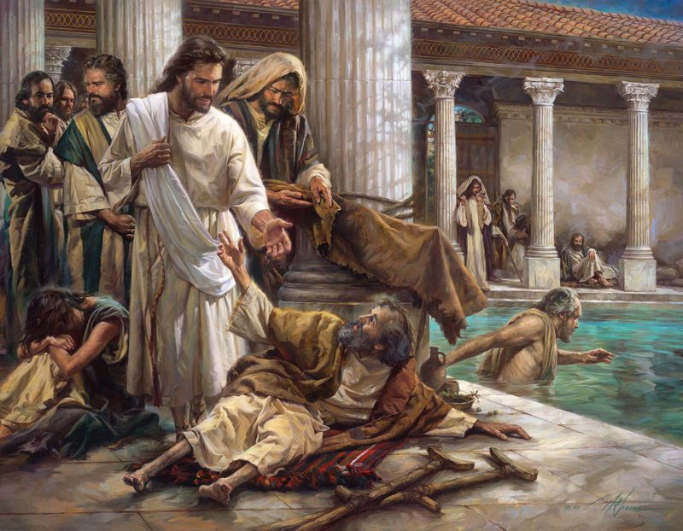
Jesus Came to Rescue Us
by Pastor Fee Soliven
Isaiah 9:6-7
Saturday Evening
December 17, 2022

Slide 82
In the book of Isaiah the Prophet Isaiah wrote and said:

Slide 83
Isaiah 9:6-7
6 For unto us a Child is born, Unto us a Son is given; And the government will be upon His shoulder. And His name will be called Wonderful, Counselor, Mighty God, Everlasting Father, Prince of Peace.

Slide 84
7 Of the increase of His government and peace There will be no end, Upon the throne of David and over His kingdom, To order it and establish it with judgment and justice From that time forward, even forever. The zeal of the LORD of hosts will perform this.

Slide 85
The Prophet Micah prophesied his exact Birthplace:

Slide 86
Micah 5:2
"But you, Bethlehem, Though you are little among the thousands of Judah, Yet out of you shall come forth to Me The One to be Ruler in Israel, Whose goings forth are from of old, From everlasting."

Slide 87
Luke 1:26-38
26 Now in the sixth month the angel Gabriel was sent by God to a city of Galilee named Nazareth, 27 to a virgin betrothed to a man whose name was Joseph, of the house of David. The virgin's name was Mary. 28 And having come in, the angel said to her, "Rejoice, highly favored one, the Lord is with you; blessed are you among women!"

Slide 88
29 But when she saw him, she was troubled at his saying, and considered what manner of greeting this was. 30 Then the angel said to her, "Do not be afraid, Mary, for you have found favor with God. 31 And behold, you will conceive in your womb and bring forth a Son, and shall call His name JESUS.

Slide 89
32 He will be great, and will be called the Son of the Highest; and the Lord God will give Him the throne of His father David. 33 And He will reign over the house of Jacob forever, and of His kingdom there will be no end." 34 Then Mary said to the angel, "How can this be, since I do not know a man?"

Slide 90
35 And the angel answered and said to her, "The Holy Spirit will come upon you, and the power of the Highest will overshadow you; therefore, also, that Holy One who is to be born will be called the Son of God. 36 Now indeed, Elizabeth your relative has also conceived a son in her old age; and this is now the sixth month for her who was called barren.

Slide 91
37 For with God nothing will be impossible." 38 Then Mary said, "Behold the maidservant of the Lord! Let it be to me according to your word." And the angel departed from her.

Slide 92
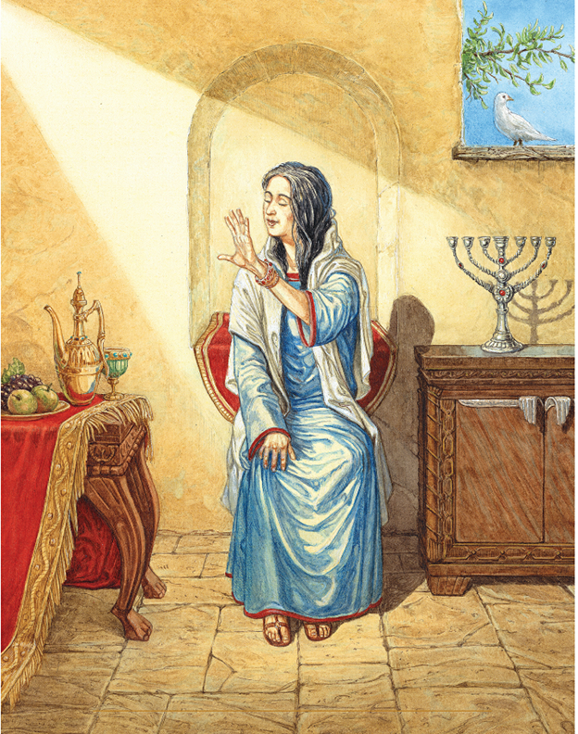

Slide 93
“Mary Did You Know”
(Pentatonix)

Slide 94
Mary, did you know that your baby boy Would one day walk on water? Mary, did you know that your

Slide 95
baby boy Would save our sons and daughters? Did you know that your baby boy Has come to make you

Slide 96
new? This child that you delivered, will soon deliver you Mary, did you know that your baby boy Will give

Slide 97
sight to a blind man? Mary, did you know that your baby boy Will calm the storm with his hand? Did you

Slide 98
know that your baby boy Has walked where angels trod? When you kiss your little baby You kiss the face

Slide 99
of God Mary, did you know? Mary, did you know?
Mary, did you know? Did you know? Mary, did you

Slide 100
know? Mary, did you know? Mary, did you know? Mary, did you know? Mary, did you know? Mary, did

Slide 101
you know? The blind will see, the deaf will hear The dead will live again The lame will leap, the dumb will

Slide 102
Speak The praises of the Lamb Mary, did you know that your baby boy Is Lord of all creation? Mary, did

Slide 103
you know that your baby boy Would one day rule the nations? Did you know that your baby boy Is

Slide 104
heaven's perfect Lamb? That sleeping child you're holding is the great, I Am Mary, did you know? (Mary,

Slide 105
did you know?) Mary, did you know? (Mary, did you know?) Mary, did you know? Oh

Slide 106
Luke 2:1-20
1 And it came to pass in those days that a decree went out from Caesar Augustus that all the world should be registered. 2 This census first took place because the Governor of Syria had issued it.

Slide 107
3 So all went to be registered, everyone to his own city. 4 Joseph also went up from Galilee, out of the city of Nazareth, into Judea, to the city of David, which is called Bethlehem, because he was of the house and lineage of David, 5 to be registered with Mary, his betrothed wife, who was with child. 6 So it was, that while they were there, the days were completed for her to be delivered.

Slide 108
7 And she brought forth her firstborn Son, and wrapped Him in swaddling cloths, and laid Him in a manger, because there was no room for them in the inn. 8 Now there were in the same country shepherds living out in the fields, keeping watch over their flock by night.

Slide 109
9 And behold, an angel of the Lord stood before them, and the glory of the Lord shone around them, and they were greatly afraid. 10 Then the angel said to them, "Do not be afraid, for behold, I bring you good tidings of great joy which will be to all people. 11 For there is born to you this day in the city of David a Savior, who is Christ the Lord.

Slide 110
12 And this will be the sign to you: You will find a Babe wrapped in swaddling cloths, lying in a manger." 13 And suddenly there was with the angel a multitude of the heavenly host praising God and saying: 14 "Glory to God in the highest, And on earth peace, goodwill toward men!"

Slide 111
15 So it was, when the angels had gone away from them into heaven, that the shepherds said to one another, "Let us now go to Bethlehem and see this thing that has come to pass, which the Lord has made known to us." 16 And they came with haste and found Mary and Joseph, and the Babe lying in a manger.

Slide 112
17 Now when they had seen Him, they made widely known the saying which was told them concerning this Child. 18 And all those who heard it marveled at those things which were told them by the shepherds. 19 But Mary kept all these things and pondered them in her heart. 20 Then the shepherds returned, glorifying and praising God for all the things that they had heard and seen, as it was told them.

Slide 113
John 3:16-17
16 For God so loved the world that He gave His only begotten Son, that whoever believes in Him should not perish but have everlasting life. 17 For God did not send His Son into the world to condemn the world, but that the world through Him might be saved.

Slide 114
Hebrews 12:2
“looking unto Jesus, the author and finisher of our faith, who for the joy that was set before Him endured the cross, despising the shame, and has sat down at the right hand of the throne of God”

Slide 115
Isaiah 53:1-12
1 Who has believed our report? And to whom has the arm of the LORD been revealed? 2 For He shall grow up before Him as a tender plant, And as a root out of dry ground. He has no form or comeliness; And when we see Him, There is no beauty that we should desire Him.

Slide 116
3 He is despised and rejected by men, A Man of sorrows and acquainted with grief. And we hid, as it were, our faces from Him; He was despised, and we did not esteem Him. 4 Surely He has borne our griefs And carried our sorrows; Yet we esteemed Him stricken, Smitten by God, and afflicted. 5 But He was wounded for our transgressions, He was bruised for our iniquities; The chastisement for our peace was upon Him, And by His stripes we are healed.

Slide 117
6 All we like sheep have gone astray; We have turned, everyone, to his own way; And the LORD has laid on Him the iniquity of us all. 7 He was oppressed and He was afflicted, Yet He opened not His mouth; He was led as a lamb to the slaughter, And as a sheep before its shearers is silent, So He opened not His mouth.

Slide 118
8 He was taken from prison and from judgment, And who will declare His generation? For He was cut off from the land of the living; For the transgressions of My people He was stricken. 9 And they made His grave with the wicked--But with the rich at His death, Because He had done no violence, Nor was any deceit in His mouth.

Slide 119
10 Yet it pleased the LORD to bruise Him; He has put Him to grief. When You make His soul an offering for sin, He shall see His seed, He shall prolong His days, And the pleasure of the LORD shall prosper in His hand. 11 He shall see the labor of His soul, and be satisfied. By His knowledge My righteous Servant shall justify many, For He shall bear their iniquities.

Slide 120
12 Therefore I will divide Him a portion with the great, And He shall divide the spoil with the strong, Because He poured out His soul unto death, And He was numbered with the transgressors, And He bore the sin of many, And made intercession for the transgressors.

Slide 121
2 Corinthians 5:21
“For He made Him who knew no sin to be sin for us, that we might become the righteousness of God in Him”

Slide 122
He’s Coming Back Again!

Slide 123
1 Thessalonians 4:13-18
13 But I do not want you to be ignorant, brethren, concerning those who have fallen asleep, lest you sorrow as others who have no hope. 14 For if we believe that Jesus died and rose again, even so God will bring with Him those who sleep in Jesus.

Slide 124
15 For this we say to you by the word of the Lord, that we who are alive and remain until the coming of the Lord will by no means precede those who are asleep. 16 For the Lord Himself will descend from heaven with a shout, with the voice of an archangel, and with the trumpet of God. And the dead in Christ will rise first.

Slide 125
17 Then we who are alive and remain shall be caught up together with them in the clouds to meet the Lord in the air. And thus we shall always be with the Lord. 18 Therefore comfort one another with these words.

Slide 126
1 Corinthians 15:50-54
50 Now this I say, brethren, that flesh and blood cannot inherit the kingdom of God; nor does corruption inherit incorruption. 51 Behold, I tell you a mystery: We shall not all sleep, but we shall all be changed-- 52 in a moment, in the twinkling of an eye, at the last trumpet. For the trumpet will sound, and the dead will be raised incorruptible, and we shall be changed.

Slide 127
53 For this corruptible must put on incorruption, and this mortal must put on immortality. 54 So when this corruptible has put on incorruption, and this mortal has put on immortality, then shall be brought to pass the saying that is written: "Death is swallowed up in victory."

Slide 128
Acts 2:38-39
38 Then Peter said to them, "Repent, and let every one of you be baptized in the name of Jesus Christ for the remission of sins; and you shall receive the gift of the Holy Spirit. 39 For the promise is to you and to your children, and to all who are afar off, as many as the Lord our God will call."

Slide 129
“Feliz Navidad”
(Jose Feliciano)

Slide 130
Feliz Navidad Feliz Navidad Feliz Navidad
Prospero Ano y Felicidad.
.

Slide 131
Feliz Navidad Feliz Navidad Feliz Navidad
Prospero Ano y Felicidad.

Slide 132
I wanna wish you a Merry Christmas
From the bottom of my heart

Slide 133
I wanna wish you a Merry Christmas
I wanna wish you a Merry Christmas

Slide 134
Feliz Navidad Feliz Navidad Feliz Navidad
Prospero Ano y Felicidad.

Slide 135
Feliz Navidad Feliz Navidad Feliz Navidad
Prospero Ano y Felicidad.

Slide 136
I wanna wish you a Merry Christmas
I wanna wish you a Merry Christmas

Slide 137
I wanna wish you a Merry Christmas
From the bottom of my heart.

