Slide 2
”No Longer Slaves”
(Bethel)

Slide 3
You unravel me. With a melody. You surround me with song of deliverance. From my enemies. Til’ all

Slide 4
My fears are gone.. I’m no longer a slave to fear. I am a child of God. I’m no longer a slave to fear.

Slide 5
I am a child of God. From my mother’s womb you have chosen me. Love has called my name.

Slide 6
I’ve been born again. Into your family. Your blood flows through my veins. I’m no longer slave to fear

Slide 7
I am a child of god. I’m no longer a slave to fear. I am a child of God. Ooh, oooh . Ooh , oooh. Ooh, oooh.

Slide 8
Ooh, oooh . You split the sea so I could walk right through it. My fears are drowned in perfect Love.

Slide 9
You rescue me. So I could stand and say. I am a child of God. You split the sea so I could walk right

Slide 10
Through it. My fears are drowned in perfect love. You rescued me. So I could stand and say. I am a child

Slide 11
Of god. I am a child of God. Yes I am a child of God.

Slide 12
“How Great Is Our God”
(Chris Tomlin)

Slide 13
The splendor of a King, clothed in majesty Let all the Earth rejoice All the Earth rejoice He wraps himself in

Slide 14
light And darkness tries to hide And trembles at His voice Trembles at His voice How great is our God,

Slide 15
sing with me How great is our God, and all will see
How great, how great is our God Age to age He

Slide 16
stands And time is in His hands Beginning and the end Beginning and the end The Godhead Three in

Slide 17
One Father Spirit Son The Lion and the Lamb The Lion and the Lamb How great is our God, sing with

Slide 18
me How great is our God, and all will see How great, how great is our God Name above all names (how

Slide 19
great is our God, sing with me) Worthy of our praise (how great is our God, and all will see) My heart will

Slide 20
sing How great is our God You're the name above all names (how great is our God, sing with me) You are

Slide 21
worthy of our praise (how great is our God, and all will see) And my heart will sing How great is our God

Slide 22
How great is our God, sing with me How great is our God, and all will see How great, how great is our God

Slide 23
How great is our God, sing with me How great is our God, and all will see How great, how great is our God

Slide 24
How great is our God, sing with me How great is our God, and all will see How great,

Slide 25
how great is our God

Slide 26
Nothing Else
(Cody Carnes)

Slide 27
I'm caught up in Your presence I just want to sit here at Your feet I'm caught up in this holy moment I never

Slide 28
wanna leave Oh, I'm not here for blessings Jesus, You don't owe me anything More than anything that

Slide 29
You can do I just want You I'm sorry when I've just gone through the motions I'm sorry when I just sang

Slide 30
another song Take me back to where we started I open up my heart to You I'm sorry when I've come

Slide 31
with my agenda I'm sorry when I forgot that You're enough Take me back to where we started I open up

Slide 32
my heart to You I'm caught up in Your presence I just want to sit here at Your feet I'm caught up in this holy

Slide 33
moment I never wanna leave Oh, I'm not here for blessings Jesus, You don't owe me anything And

Slide 34
more than anything that You can do I just want You
I just want You Nothing else, nothing else Nothing

Slide 35
else will do I just want You Nothing else, nothing else
Nothing else will do I just want You Nothing else,

Slide 36
nothing else Nothing else will do I just want You Nothing else, nothing else, Jesus Nothing else will do

Slide 37
I just want You Nothing else, nothing else Nothing else will do I just want You Nothing else, nothing

Slide 38
else, Jesus Nothing else will do I'm coming back to where we started I'm coming back to where we

Slide 39
started When I first felt Your love You're all that matters, Jesus You're all that matters I'm coming

Slide 40
back to what really matters Just Your heart I just wanna bless Your heart, Jesus I'm caught up in

Slide 41
Your presence I just want to sit here at Your feet I'm caught up in this holy moment I never wanna leave

Slide 42
And oh, I'm not here for blessings Jesus, You don't owe me anything More than anything that You can

Slide 43
do Oh, I just want You

Slide 44
“The Heart of Worship”
(Matt Redman)

Slide 45
When the music fades All is stripped away And I simply come Longin' just to bring Something that's of

Slide 46
worth That will bless Your heart I'll bring You more than a song For a song in itself Is not what You have

Slide 47
required You search much deeper within Through the ways things appear You're looking into my heart I'm

Slide 48
comin' back to the heart of worship And it's all about You It's all about You, Jesus I'm sorry, Lord, for the

Slide 49
thing I've made it When it's all about You It's all about You, Jesus King of endless worth No one could

Slide 50
express How much You deserve? Though I'm weak and poor All I have is Yours Every single breath I'll

Slide 51
bring You more than a song For a song in itself Is not what You have required You search much deeper

Slide 52
within Through the way things appear You're looking into my heart, yeah I'm comin' back to the heart of

Slide 53
worship And it's all about You It's all about You, Jesus
I'm sorry, Lord, for the thing I've made it When it's all

Slide 54
about You It's all about You, Jesus I'm comin' back to the heart of worship 'Cause it's all about You It's all

Slide 55
about You, Jesus I'm sorry, Lord, for the thing I’ve made it 'Cause it's all about You It's all about You,

Slide 56
Jesus, yeah All about You I'll bring You more than a song I'll bring You more than a song, more than a

Slide 57
song I'll bring You more than a song I'll bring You more than a song (than a song) You're looking into

Slide 58
my heart You're looking into my heart You're looking into my heart Into my heart I'll bring You more than a

Slide 59
song I'll bring You more than a song, yeah, yeah I'll bring You more than a song I'll bring You more than a song

Slide 60
Open The Eyes of My Heart
(Michael W. Smith)

Slide 61
Open the eyes of my heart, Lord Open the eyes of my heart I want to see You I want to see You Open

Slide 62
the eyes of my heart, Lord Open the eyes of my heart I want to see You I want to see You To see You

Slide 63
high and lifted up Shinin' in the light of Your glory Pour out Your power and love As we sing holy, holy,

Slide 64
holy Open the eyes of my heart, Lord Open the eyes of my heart I want to see You I want to see You Open

Slide 65
the eyes of my heart, Lord Open the eyes of my heart I want to see You I want to see You To see You

Slide 66
high and lifted up Shinin' in the light of Your glory Pour out Your power and love As we sing holy, holy,

Slide 67
holy To see You high and lifted up Shinin' in the light of Your glory Pour out Your power and love As we

Slide 68
sing holy, holy, holy To see You high and lifted up Shinin' in the light of Your glory Pour out Your power

Slide 69
and love As we sing holy, holy, holy Holy, holy, holy We cry holy, holy, holy You are holy, holy, holy I want

Slide 70
to see you Holy, holy, holy Holy, holy, holy You are holy, holy, holy I want to see you Holy, holy, holy

Slide 71
Holy, holy, holy Holy, holy, holy, I want to see you Holy, holy, holy Holy, holy, holy Holy, holy, holy, I

Slide 72
want to see you Holy, holy, holy Holy, holy, holy Holy, holy, holy, I want to see you Holy, holy, holy

Slide 73
Holy, holy, holy Holy, holy, holy, I want to see you Holy, holy, holy Holy, holy, holy Holy, holy, holy, I

Slide 74
want to see you Holy, holy, holy Holy, holy, holy Holy, holy, holy, I want to see you.

Slide 79
Only Jesus Can Save Us Now
by Pastor Fee Soliven
Proverbs 14:31-35
Sunday Morning
January 29, 2023

Slide 80
Proverbs 14:31-35
31 He who oppresses the poor reproaches his Maker, But he who honors Him has mercy on the needy. 32 The wicked is banished in his wickedness, But the righteous has a refuge in his death. 33 Wisdom rests in the heart of him who has understanding, But what is in the heart of fools is made known.

Slide 81
34 Righteousness exalts a nation, But sin is a reproach to any people. 35 The king's favor is toward a wise servant, But his wrath is against him who causes shame.

Slide 82
2 Kings 21:1-16
1 Manasseh was twelve years old when he became king, and he reigned fifty-five years in Jerusalem. His mother's name was Hephzibah. 2 And he did evil in the sight of the LORD, according to the abominations of the nations whom the LORD had cast out before the children of Israel.

Slide 83
3 For he rebuilt the high places which Hezekiah his father had destroyed; he raised up altars for Baal, and made a wooden image, as Ahab king of Israel had done; and he worshiped all the host of heaven and served them. 4 He also built altars in the house of the LORD, of which the LORD had said, "In Jerusalem I will put My name."

Slide 84
5 And he built altars for all the host of heaven in the two courts of the house of the LORD. 6 Also he made his son pass through the fire, practiced soothsaying, used witchcraft, and consulted spiritists and mediums. He did much evil in the sight of the LORD, to provoke Him to anger.

Slide 85
7 He even set a carved image of Asherah that he had made, in the house of which the LORD had said to David and to Solomon his son, "In this house and in Jerusalem, which I have chosen out of all the tribes of Israel, I will put My name forever; 8 and I will not make the feet of Israel wander anymore from the land which I gave their fathers--only if they are careful to do according to all that I have commanded them, and according to all the law that My servant Moses commanded them."

Slide 86
9 But they paid no attention, and Manasseh seduced them to do more evil than the nations whom the LORD had destroyed before the children of Israel. 10 And the LORD spoke by His servants the prophets, saying, 11 "Because Manasseh king of Judah has done these abominations (he has acted more wickedly than all the Amorites who were before him, and has also made Judah sin with his idols),

Slide 87
12 therefore thus says the LORD God of Israel: 'Behold, I am bringing such calamity upon Jerusalem and Judah, that whoever hears of it, both his ears will tingle. 13 And I will stretch over Jerusalem the measuring line of Samaria and the plummet of the house of Ahab; I will wipe Jerusalem as one wipes a dish, wiping it and turning it upside down.

Slide 88
14 So I will forsake the remnant of My inheritance and deliver them into the hand of their enemies; and they shall become victims of plunder to all their enemies, 15 because they have done evil in My sight, and have provoked Me to anger since the day their fathers came out of Egypt, even to this day.' " 16 Moreover Manasseh shed very much innocent blood, till he had filled Jerusalem from one end to another, besides his sin by which he made Judah sin, in doing evil in the sight of the LORD.

Slide 89
46 This day the LORD will deliver you into my hand, and I will strike you and take your head from you. And this day I will give the carcasses of the camp of the Philistines to the birds of the air and the wild beasts of the earth, that all the earth may know that there is a God in Israel.

Slide 90
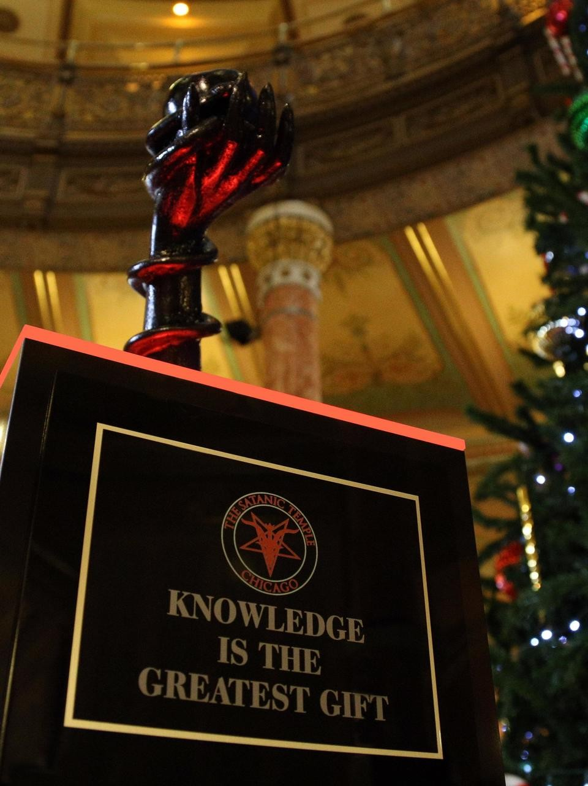

Slide 91
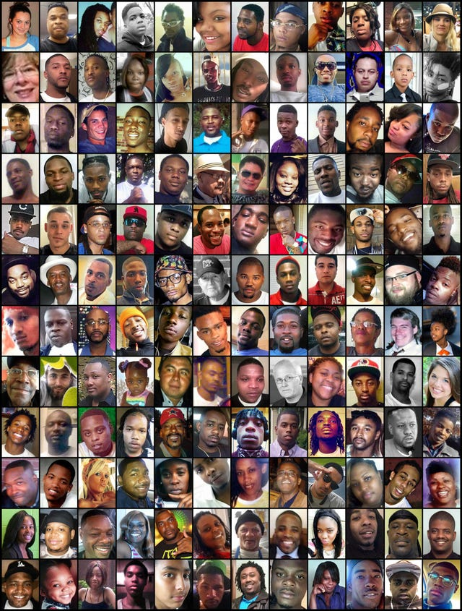

Slide 92
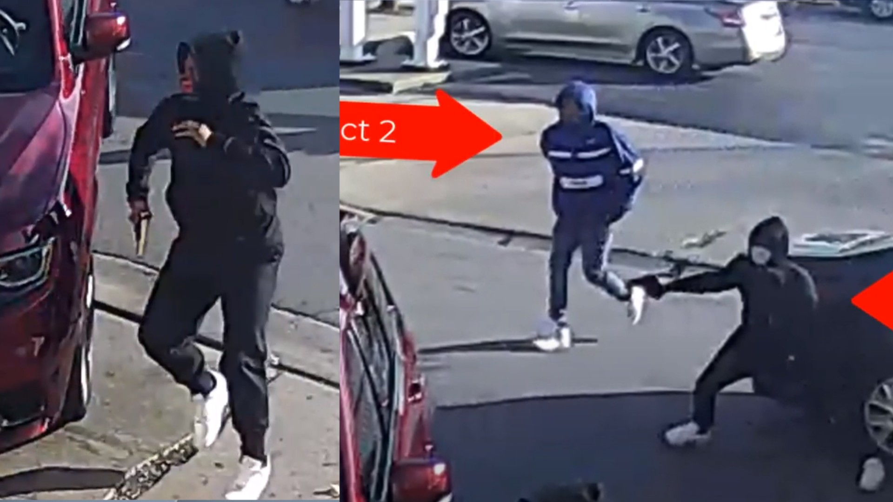
Matthew 11:28-30
28 Come to Me, all you who labor and are heavy laden, and I will give you rest. 29 Take My yoke upon you and learn from Me, for I am gentle and lowly in heart, and you will find rest for your souls. 30 For My yoke is easy and My burden is light."

Slide 93
John 16:32-33
32 Indeed the hour is coming, yes, has now come, that you will be scattered, each to his own, and will leave Me alone. And yet I am not alone, because the Father is with Me. 33 These things I have spoken to you, that in Me you may have peace. In the world you will have tribulation; but be of good cheer, I have overcome the world."

Slide 94
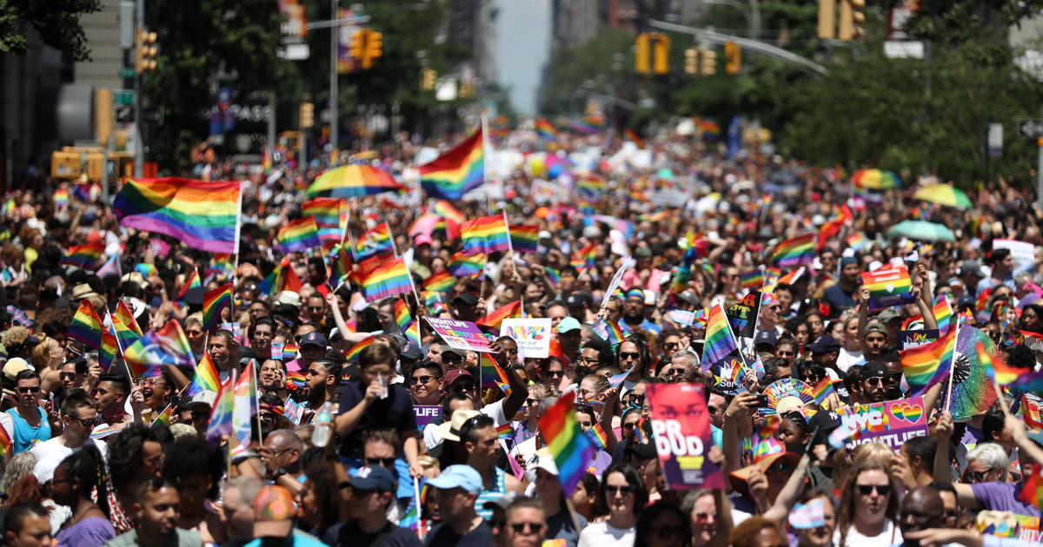
How should we respond if the foundations are destroyed?

Slide 95
1. Turn to God

Slide 96
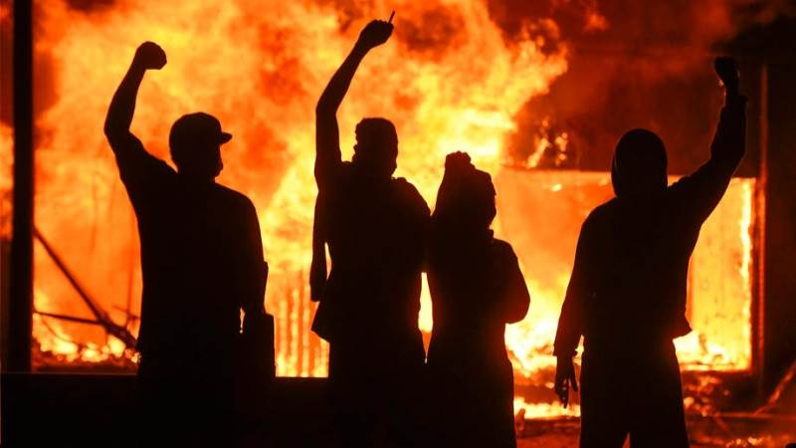
“In the LORD I put my trust”

Slide 97
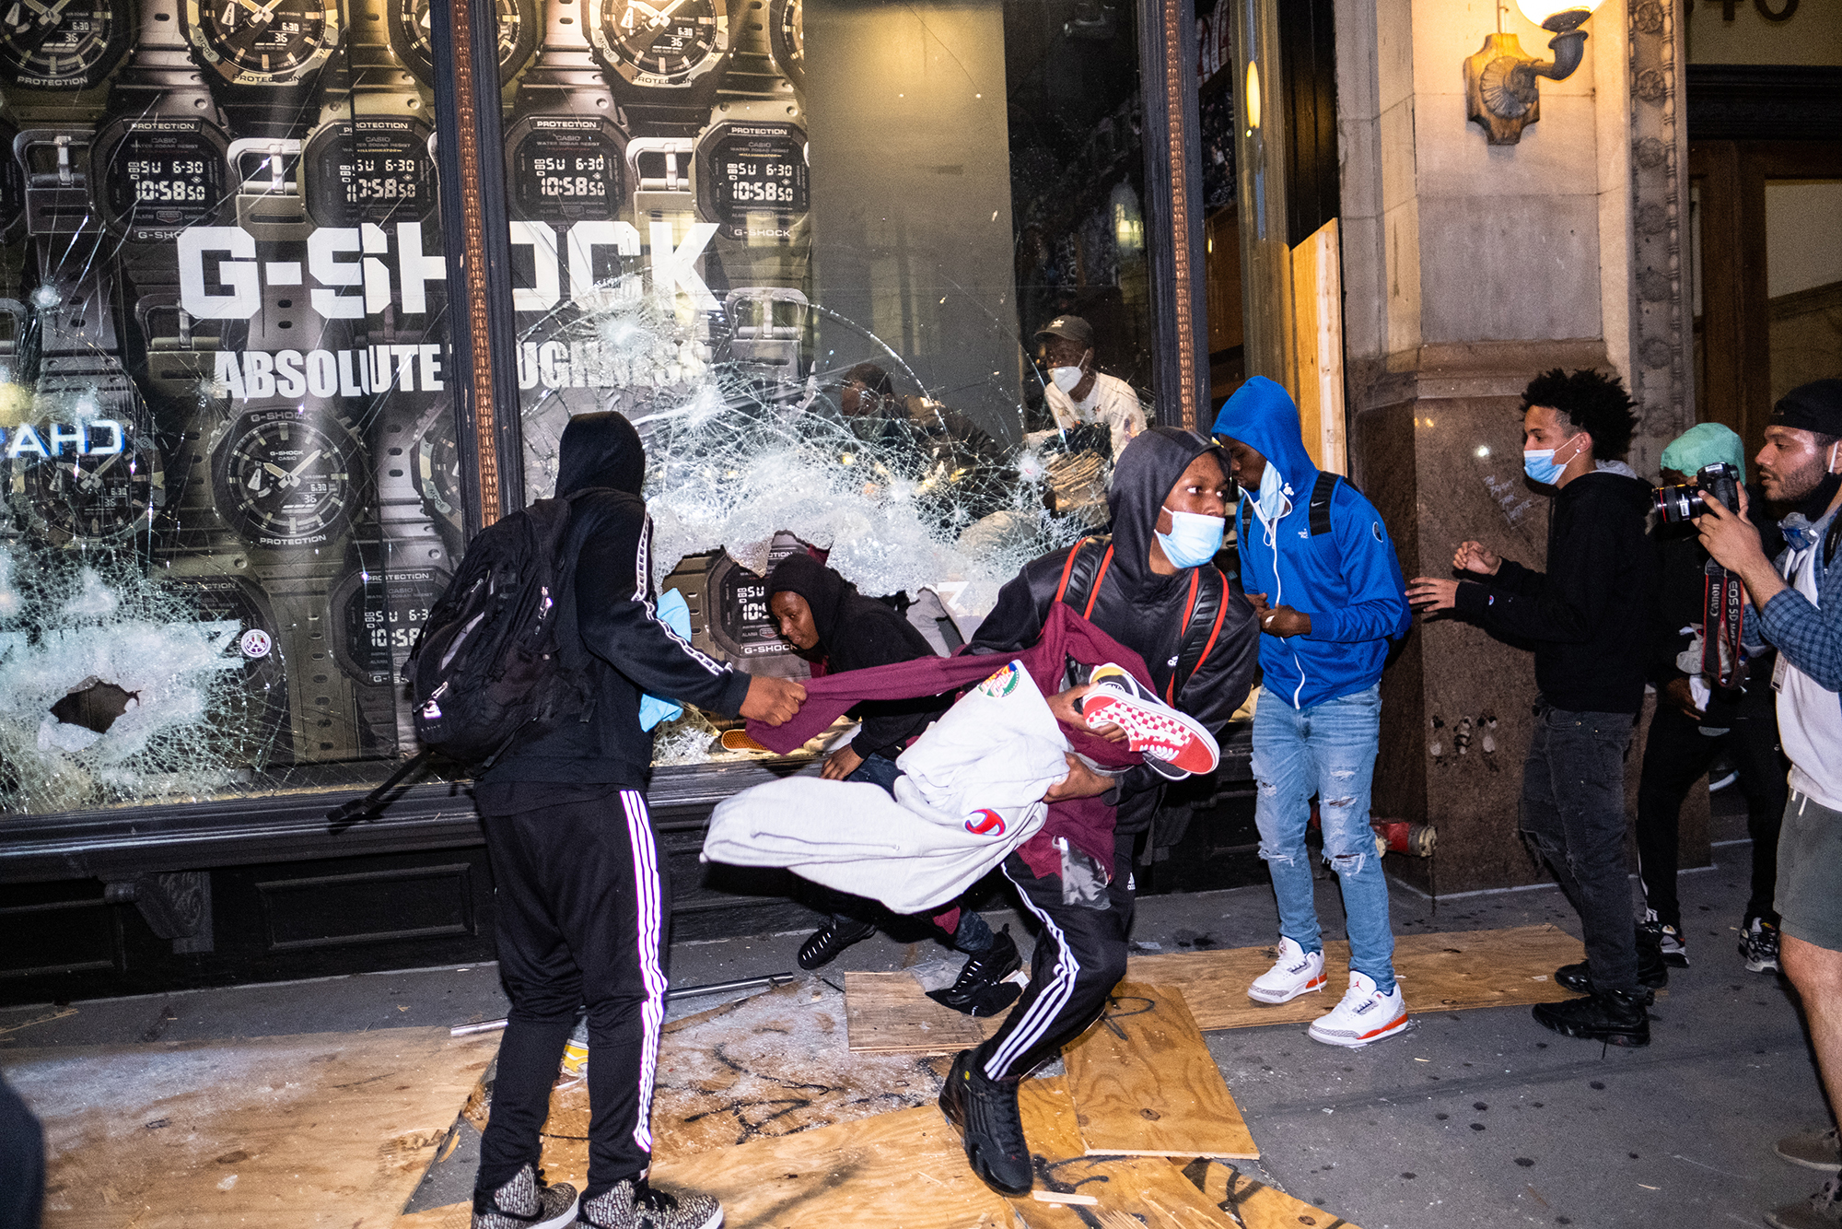
2. Don’t Run

Slide 98
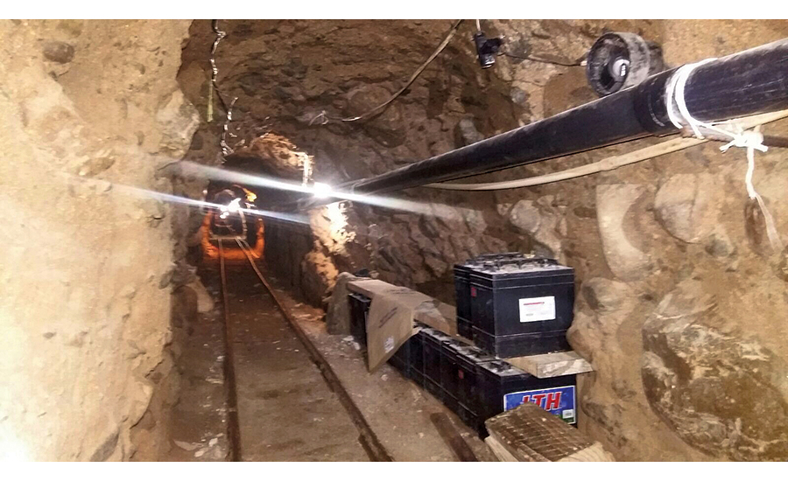
“How can you say to my soul, ‘Flee as a bird to your mountain’?”

Slide 99
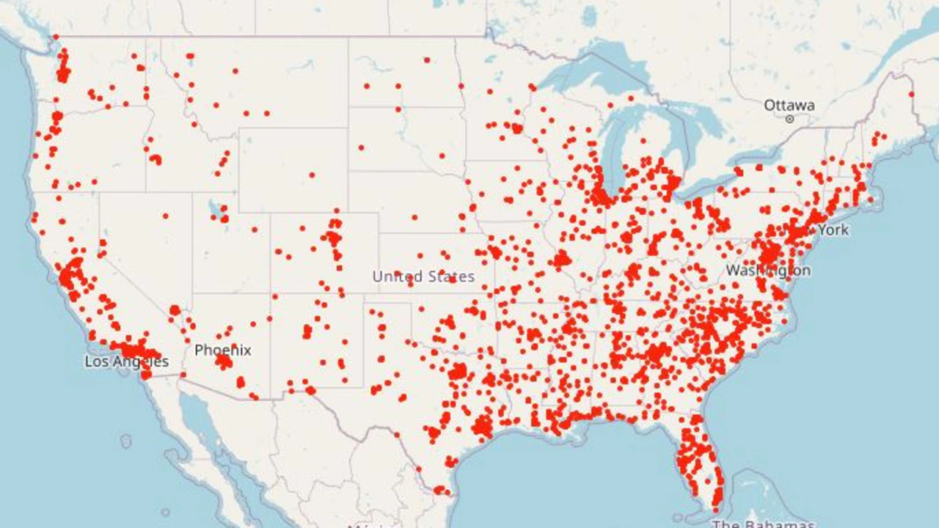
“How can you say to my soul, ‘Flee as a bird to your mountain’?”

Slide 100
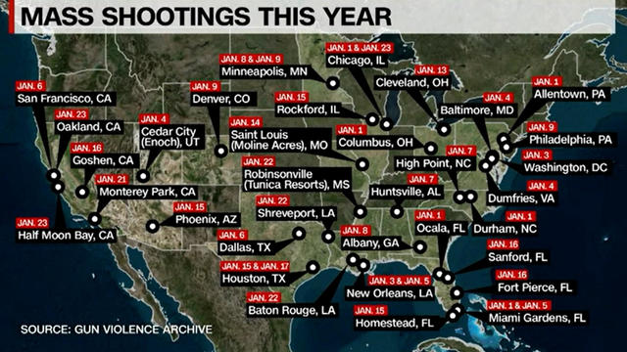
“How can you say to my soul, ‘Flee as a bird to your mountain’?”

Slide 101
Proverbs 14:34
“Righteousness exalts a nation, But sin is a reproach to any people.”

Slide 102
Psalm 9:15-17
15 The nations have sunk down in the pit which they made; In the net which they hid, their own foot is caught. 16 The LORD is known by the judgment He executes; The wicked is snared in the work of his own hands. Meditation. Selah 17 The wicked shall be turned into hell, And all the nations that forget God.

Slide 103
America needs a Josiah!

Slide 104
Josiah and The Road to
Reform and Revival

Slide 105
2 Kings 22:1-23
1 Josiah was eight years old when he became king, and he reigned thirty-one years in Jerusalem. His mother's name was Jedidah the daughter of Adaiah of Bozkath. 2 And he did what was right in the sight of the LORD, and walked in all the ways of his father David; he did not turn aside to the right hand or to the left.

Slide 106
3 Now it came to pass, in the eighteenth year of King Josiah, that the king sent Shaphan the scribe, the son of Azaliah, the son of Meshullam, to the house of the LORD, saying: 4 "Go up to Hilkiah the high priest, that he may count the money which has been brought into the house of the LORD, which the doorkeepers have gathered from the people.

Slide 107
5 And let them deliver it into the hand of those doing the work, who are the overseers in the house of the LORD; let them give it to those who are in the house of the LORD doing the work, to repair the damages of the house—6 to carpenters and builders and masons--and to buy timber and hewn stone to repair the house. 7 However there need be no accounting made with them of the money delivered into their hand, because they deal faithfully."

Slide 108
8 Then Hilkiah the high priest said to Shaphan the scribe, "I have found the Book of the Law in the house of the LORD." And Hilkiah gave the book to Shaphan, and he read it. 9 So Shaphan the scribe went to the king, bringing the king word, saying, "Your servants have gathered the money that was found in the house, and have delivered it into the hand of those who do the work, who oversee the house of the LORD."

Slide 109
10 Then Shaphan the scribe showed the king, saying, "Hilkiah the priest has given me a book." And Shaphan read it before the king.
11 Now it happened, when the king heard the words of the Book of the Law, that he tore his clothes. 12 Then the king commanded Hilkiah the priest, Ahikam the son of Shaphan, Achbor the son of Michaiah, Shaphan the scribe, and Asaiah a servant of the king, saying,

Slide 110
13 "Go, inquire of the LORD for me, for the people and for all Judah, concerning the words of this book that has been found; for great is the wrath of the LORD that is aroused against us, because our fathers have not obeyed the words of this book, to do according to all that is written concerning us."

Slide 111
14 So Hilkiah the priest, Ahikam, Achbor, Shaphan, and Asaiah went to Huldah the prophetess, the wife of Shallum the son of Tikvah, the son of Harhas, keeper of the wardrobe. (She dwelt in Jerusalem in the Second Quarter.) And they spoke with her. 15 Then she said to them, "Thus says the LORD God of Israel, 'Tell the man who sent you to Me,

Slide 112
16 Thus says the LORD: 'Behold, I will bring calamity on this place and on its inhabitants--all the words of the book which the king of Judah has read—17 because they have forsaken Me and burned incense to other gods, that they might provoke Me to anger with all the works of their hands. Therefore My wrath shall be aroused against this place and shall not be quenched.' " '

Slide 113
18 "But to the king of Judah, who sent you to inquire of the LORD, in this manner you shall speak to him, 'Thus says the LORD God of Israel: "Concerning the words which you have heard—19 because your heart was tender, and you humbled yourself before the LORD when you heard what I spoke against this place and against its inhabitants, that they would become a desolation and a curse, and you tore your clothes and wept before Me, I also have heard you," says the LORD.

Slide 114
20 Surely, therefore, I will gather you to your fathers, and you shall be gathered to your grave in peace; and your eyes shall not see all the calamity which I will bring on this place." ' " So they brought word to the king.

Slide 115
What was the message that the Lord sent to Josiah?

Slide 116
2 Kings 22:16
“Behold, I bring evil on this place and on its inhabitants, even all the words of the book which the king of Judah has read.”

Slide 117
2 Kings 22:17
“Because they have forsaken Me and have burned incense to other gods that they might provoke Me to anger with all the work of their hands, therefore My wrath burns against this place, and it shall not be quenched.”

Slide 118
2 Kings 22:18-19
“But to the king of Judah who sent you to inquire of the Lord thus you shall say to him….‘Because your heart was tender and you humbled yourself before the Lord when you heard what I spoke against this place and against its inhabitants that they should become a desolation and a curse, and you have torn your clothes and wept before Me, I truly have heard you,’ declares the Lord.”

Slide 119
2 Kings 22:20
“Therefore, behold, I will gather you to your fathers, and you will be gathered to your grave in peace, and your eyes will not see all the evil which I will bring on this place.”

Slide 120
Ecclesiastes 1:9-11
9 What has been, will be again, what has been done will be done again; there is nothing new under the sun. 10 Is there anything of which one can say, "Look! This is something new"? It was here already, long ago; it was here before our time. 11 There is no remembrance of men of old, and even those who are yet to come
will not be remembered by those who follow.

Slide 121
Amos 3:3-7
3 Can two walk together, unless they are agreed? 4 Will a lion roar in the forest, when he has no prey? Will a young lion cry out of his den, if he has caught nothing? 5 Will a bird fall into a snare on the earth, where there is no trap for it? Will a snare spring up from the earth, if it has caught nothing at all?

Slide 122
6 If a trumpet is blown in a city, will not the people be afraid? If there is calamity in a city, will not the LORD have done it? 7 Surely the Lord GOD does nothing, Unless He reveals His secret to His servants the prophets.

Slide 123
1 Thessalonians 4:13-18
13 But I do not want you to be ignorant, brethren, concerning those who have fallen asleep, lest you sorrow as others who have no hope. 14 For if we believe that Jesus died and rose again, even so God will bring with Him those who sleep in Jesus.

Slide 124
15 For this we say to you by the word of the Lord, that we who are alive and remain until the coming of the Lord will by no means precede those who are asleep. 16 For the Lord Himself will descend from heaven with a shout, with the voice of an archangel, and with the trumpet of God. And the dead in Christ will rise first.

Slide 125
17 Then we who are alive and remain shall be caught up together with them in the clouds to meet the Lord in the air. And thus we shall always be with the Lord. 18 Therefore comfort one another with these words.

Slide 126
1 Corinthians 15:50-54
50 Now this I say, brethren, that flesh and blood cannot inherit the kingdom of God; nor does corruption inherit incorruption. 51 Behold, I tell you a mystery: We shall not all sleep, but we shall all be changed-- 52 in a moment, in the twinkling of an eye, at the last trumpet. For the trumpet will sound, and the dead will be raised incorruptible, and we shall be changed.

Slide 127
53 For this corruptible must put on incorruption, and this mortal must put on immortality. 54 So when this corruptible has put on incorruption, and this mortal has put on immortality, then shall be brought to pass the saying that is written: "Death is swallowed up in victory."

Slide 128
20 Again, when a righteous man turns from his righteousness and commits iniquity, and I lay a stumbling block before him, he shall die; because you did not give him warning, he shall die in his sin, and his righteousness which he has done shall not be remembered; but his blood I will require at your hand.

Slide 129
Acts 2:38-39
38 Then Peter said to them, "Repent, and let every one of you be baptized in the name of Jesus Christ for the remission of sins; and you shall receive the gift of the Holy Spirit. 39 For the promise is to you and to your children, and to all who are afar off, as many as the Lord our God will call."

