Slide 2
Graves into Gardens
(Elevation Worship)

Slide 3
I searched the World but it couldn’t fill me. Man’s empty praise and treasures that fade Are never

Slide 4
Enough. Then you came along and put me back together And every desire Is now satisfied here in

Slide 5
Your love. Oh’ there’s nothing better than you. There’s nothing better than you. Lord there’s nothing

Slide 6
Nothing is better than you. Im not afraid to show you my weakness. My failures and flaws Lord you’ve

Slide 7
Seen them all and you still call me friend.Cause the God of the mountain. Is the God of the Valley.

Slide 8
There’s not a place. Your mercy and grace. Wont find me again. Oh there’s nothing better than you. There’s

Slide 9
Nothing better than you. Lord there’s nothing. Nothing is better than you. Oh there’s nothing better

Slide 10
Better than you. There’s nothing better than you. Lord’ there’s nothing. Nothing is better than you.

Slide 11
You turn mourning to dancing. You give beauty for ashes. You turn shame into glory. You’re the only one

Slide 12
Who can. You turn mourning to dancing. You give beauty for ashes. You turn shame into glory. You’re

Slide 13
The only one who can. You turn graves into gardens. You turn bones into armies. You turn seas into

Slide 14
Highways. You’re the only one who can you’re the only one who can. Oh there’s nothing better than you

Slide 15
There’s nothing better than you. Lord there’s nothing. Nothing is better than you. Oh there’s nothing better

Slide 16
Than you. There’s nothing better than you. Lord, there’s nothing. Nothing is better than you. You turn

Slide 17
Graves into gardens. You turn bones into armies. You turn seas into highways. You’re the only one who

Slide 18
Can. You turn graves into gardens. You turn bones into armies. You turn seas into highways you’re the

Slide 19
Only one who can. You’re the only one who. You’re the only one who can.

Slide 20
above all names Be exalted now in the heavens As Your glory fills this place You alone deserve our

Slide 21
praise You’re the name above all names Worthy is Your name, Jesus You deserve the praise Worthy is

Slide 22
Your name Worthy is Your name, Jesus You deserve the praise Worthy is Your name Worthy is Your

Slide 23
name, Jesus You deserve the praise Worthy is Your name Worthy is Your name, Jesus You deserve the

Slide 24
praise Worthy is Your name Oh, oh

Slide 25
Cornerstone
(Hillsong)

Slide 26
My hope is built on nothing less. Than Jesus blood and righteousness. I dare not trust the sweetest

Slide 27
frame. But wholly trust in Jesus name. My hope is built on nothing less. Than Jesus blood and

Slide 28
righteousness. I dare not trust the sweetest frame Burt wholly trust in Jesus name. Christ alone,

Slide 29
Cornerstone weak made strong in the Savior’s love. Through the storm, He is Lord. Lord of all. When

Slide 30
Darkness seems to hide his face. I rest on his unchanging grace. In every high and stormy gale my

Slide 31
anchor holds within the Veil. My anchor holds within the veil. Christ alone Cornerstone.Weak made strong

Slide 32
in the Savior’s love. Through the storm, He is Lord. Lord of all. He is Lord, Lord of all. Christ alone

Slide 33
Cornerstone, weak made strong in the Savior’s love. Through the storm, He is Lord. Lord of all. When he

Slide 34
Shall come with trumpet sound. Oh may I then in him be found. Dressed in His righteousness alone.

Slide 35
Faultless stand before the throne. Christ alone, Cornerstone. Weak made stong in the Savior’s love.

Slide 36
Through the storm, He is Lord lord of all.

Slide 37
“How Great Is Our God”
(Chris Tomlin)

Slide 38
The splendor of a King, clothed in majesty Let all the Earth rejoice All the Earth rejoice He wraps himself in

Slide 39
light And darkness tries to hide And trembles at His voice Trembles at His voice How great is our God,

Slide 40
sing with me How great is our God, and all will see
How great, how great is our God Age to age He

Slide 41
stands And time is in His hands Beginning and the end Beginning and the end The Godhead Three in

Slide 42
One Father Spirit Son The Lion and the Lamb The Lion and the Lamb How great is our God, sing with

Slide 43
me How great is our God, and all will see How great, how great is our God Name above all names (how

Slide 44
great is our God, sing with me) Worthy of our praise (how great is our God, and all will see) My heart will

Slide 45
sing How great is our God You're the name above all names (how great is our God, sing with me) You are

Slide 46
worthy of our praise (how great is our God, and all will see) And my heart will sing How great is our God

Slide 47
How great is our God, sing with me How great is our God, and all will see How great, how great is our God

Slide 48
How great is our God, sing with me How great is our God, and all will see How great, how great is our God

Slide 49
How great is our God, sing with me How great is our God, and all will see How great,

Slide 50
how great is our God

Slide 51
Champion
(Bethel Music)

Slide 52
I've tried so hard to see it Took me so long to believe it That You'd choose someone like me To carry Your

Slide 53
victory Perfection could never earn it You give what we don't deserve and You take the broken things

Slide 54
And raise them to glory You are my champion Giants fall when You stand Undefeated Every battle

Slide 55
You've won I am who You say I am You crown me with confidence I am seated In the Heavenly place

Slide 56
Undefeated With the One who has conquered it all
Now I can finally see it You're teaching me how to

Slide 57
receive it So let all the striving cease, oh This is my victory You are my champion Giants fall when You

Slide 58
stand Undefeated Every battle You've won I am who You say I am You crown me with confidence I am

Slide 59
seated In the Heavenly place Undefeated With the One who has conquered it all It all, it all, it

Slide 60
all, it all When I lift my voice and shout Every wall comes crashing down I have the authority Jesus has

Slide 61
given me When I open up my mouth Miracles start breaking out I have the authority Jesus has given me

Slide 62
When I lift my voice and shout Every wall comes crashing down I have the authority (yes, I do) Jesus

Slide 63
has given me When I open up my mouth Miracles start breaking out I have the authority Jesus has

Slide 64
given me You are my champion Giants fall when You stand Undefeated Every battle You've won I am

Slide 65
who You say I am You crown me with confidence I am seated In the Heavenly place Undefeated By the

Slide 66
power of Your name I am seated in the Heavenly place Undefeated With the One who has conquered

Slide 67
it all I know who I am, because I know whose I am, Hallelujah There's nothing left to prove There’s

Slide 68
nothing left to prove He freely gave it to us Rejoice, rejoice, rejoice Freely He gave When I-,

Slide 69
come on sing When I lift up my voice and shout (come on) Every wall comes crashing down I have

Slide 70
the authority (Jesus has) Jesus has given me When I open up my mouth Miracles start breaking out (it

Slide 71
starts to break out) I have the authority Jesus has given me (when I lift) When I lift my voice and shout

Slide 72
(come on) Every wall comes crashing down I have the authority Jesus has given me (now declare it,

Slide 73
when I) When I open up my mouth Miracles start breaking out I have the authority Jesus has given me

Slide 74
You are my champion (Sing it out, come on, giants) Giants fall when You stand Undefeated Every battle

Slide 75
You've won (I am) I am who You say I am (You crown me) You crown me with confidence I am seated In

Slide 76
the Heavenly place Undefeated (by the power, come on) By the power of Your name I am seated (in

Slide 77
Heaven) In the Heavenly place Undefeated With the One who has conquered it all

Slide 78
“Worthy”
(Elevation Worship)

Slide 79
It was my cross You bore So I could live in the freedom You died for And now my life is Yours And I

Slide 80
will sing of Your goodness forevermore Worthy is Your name, Jesus You deserve the praise Worthy is

Slide 81
Your name Worthy is Your name, Jesus You deserve the praise Worthy is Your name And now my shame

Slide 82
is gone I stand amazed in Your love undeniable Your grace goes on and on And I will sing of Your

Slide 83
goodness forevermore Worthy is Your name, Jesus
You deserve the praise Worthy is Your name Worthy

Slide 84
is Your name, Jesus You deserve the praise Worthy is Your name Worthy is Your name, Jesus You

Slide 85
deserve the praise Worthy is Your name Worthy is Your name, Jesus You deserve the praise Worthy is

Slide 86
Your name Be exalted now in the heavens As Your glory fills this place You alone deserve our praise

Slide 87
You're the name above all names Be exalted now in the heavens As Your glory fills this place You alone

Slide 88
deserve our praise You're the name above all names Be exalted now in the heavens As Your glory

Slide 89
fills this place You alone deserve our praise You're the name above all names Be exalted now in the

Slide 90
heavens As Your glory fills this place You alone deserve our praise You're the name above all names

Slide 91
Be exalted now in the heavens As Your glory fills this place You alone deserve our praise You're the

Slide 92
name above all names Be exalted now in the heavens As Your glory fills this place You alone

Slide 93
deserve our praise You're the name above all names Worthy is Your name, Jesus You deserve the

Slide 94
praise Worthy is Your name Worthy is Your name, Jesus You deserve the praise Worthy is Your name

Slide 95
Worthy is Your name, Jesus You deserve the praise Worthy is Your name Worthy is Your name, Jesus

Slide 96
You deserve the praise Worthy is Your name Oh, oh

Slide 97
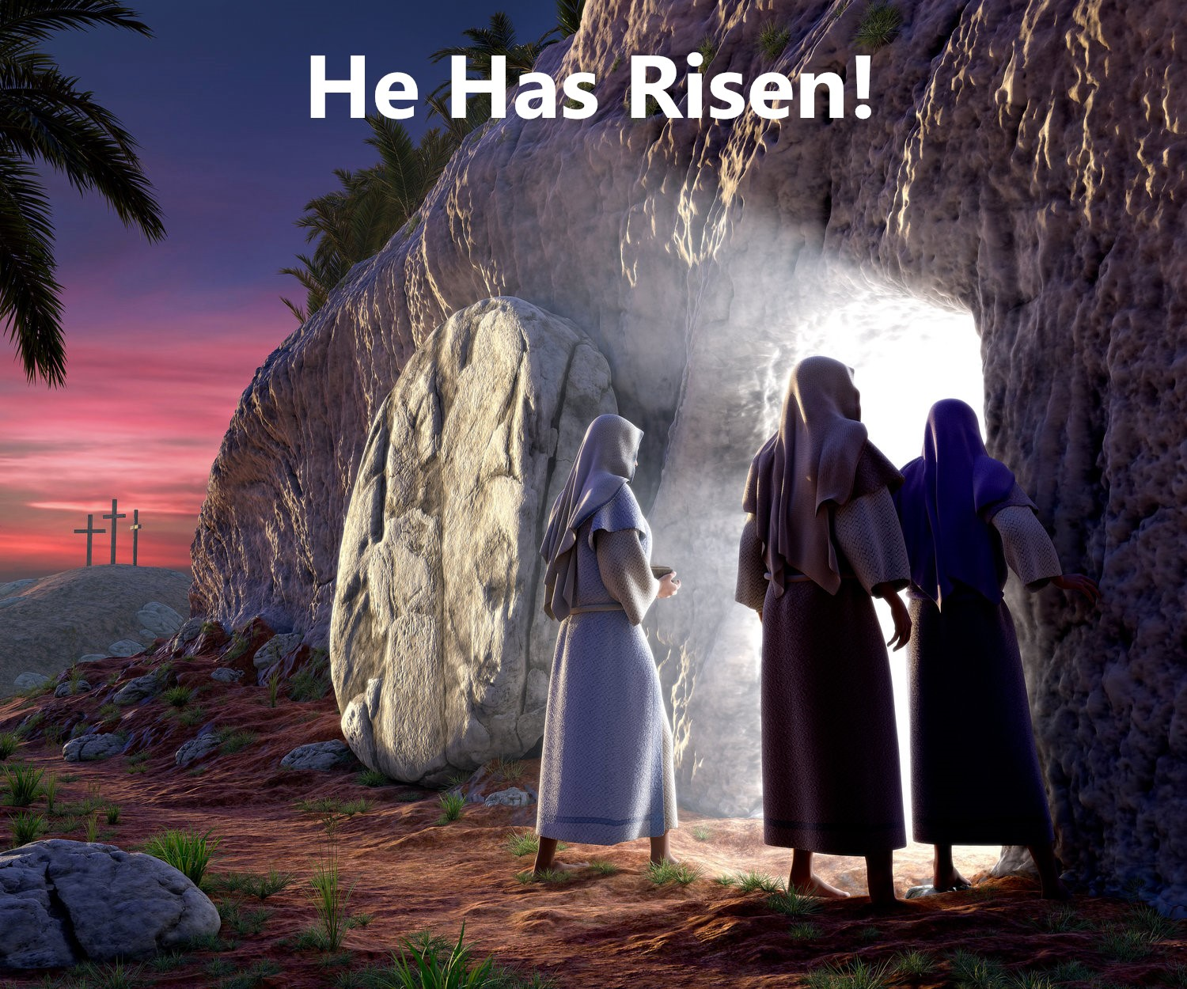
Jesus and The Feast of Firstfruits
by Pastor Fee Soliven
1 Corinthians 15:20-26
Sunday Morning
April 9, 2023

Slide 98
1 Corinthians 15:20-26
20 But now Christ is risen from the dead, and has become the firstfruits of those who have fallen asleep. 21 For since by man came death, by Man also came the resurrection of the dead. 22 For as in Adam all die, even so in Christ all shall be made alive. 23 But each one in his own order: Christ the firstfruits, afterward those who are Christ's at His coming.

Slide 99
24 Then comes the end, when He delivers the kingdom to God the Father, when He puts an end to all rule and all authority and power. 25 For He must reign till He has put all enemies under His feet. 26 The last enemy that will be destroyed is death

Slide 100
BIBLICAL HOLIDAYS
SPRING FEASTS
FALL FEASTS
50 Days
Passover
(Nisan 15)
Jesus’ Death
First Fruits
(Nisan 17)
Resurrection
Pentecost
(Sivan 6)
Holy Spirit
Trumpets
(Tishri 1&2)
Repentance
Tabernacles
(Tishri 15)
Rejoicing
Unleavened
Bread
(Nisan 15-22)
Jesus’ Burial
Yom Kippur
(Tishri 10)
Redemption
Historically Fulfilled During Jesus’
First Coming
The Church Age
To Be Fulfilled By The Second Coming of Jesus
(Second Advent)
(First Advent)

Slide 101
One of Jesus’ first agendas on coming to earth was to destroy the works of the devil!

Slide 102
1 John 3:7-9
7 Little children, let no one deceive you. He who practices righteousness is righteous, just as He is righteous. 8 He who sins is of the devil, for the devil has sinned from the beginning. For this purpose the Son of God was manifested, that He might destroy the works of the devil. 9 Whoever has been born of God does not sin, for His seed remains in him; and he cannot sin, because he has been born of God.

Slide 103
If you’ve been a Christian for any length of time, you’re probably very familiar with the story of Jesus Christ’s resurrection.

Slide 104
But has it changed how you live?

Slide 105
What impact does Christ’s resurrection have on your thinking, conversation, and conduct?

Slide 106
Truths About the Resurrection

Slide 107
Jesus Christ is alive at the
Father’s right hand.

Slide 108
Hebrews 10:12
“But He, having offered one sacrifice for sins for all time, sat down at the right hand of God”

Slide 109
We are Forgiven and Eternally
Secure in Christ

Slide 110
Ephesians 1:13-14
13 In Him you also trusted, after you heard the word of truth, the gospel of your salvation; in whom also, having believed, you were sealed with the Holy Spirit of promise, 14 who is the guarantee of our inheritance until the redemption of the purchased possession, to the praise of His glory.

Slide 111
We are going to live forever!

Slide 112
John 3:16
“For God so loved the world, that He gave His only Son, so that everyone who believes in Him will not perish, but have eternal life”

Slide 113
We too will be physically Resurrected!

Slide 114
1 Corinthians 15:42-49
42 So also is the resurrection of the dead. The body is sown in corruption, it is raised in incorruption. 43 It is sown in dishonor, it is raised in glory. It is sown in weakness, it is raised in power. 44 It is sown a natural body, it is raised a spiritual body. There is a natural body, and there is a spiritual body.

Slide 115
45 And so it is written, "The first man Adam became a living being." The last Adam became a life-giving spirit. 46 However, the spiritual is not first, but the natural, and afterward the spiritual. 47 The first man was of the earth, made of dust; the second Man is the Lord from heaven.

Slide 116
48 As was the man of dust, so also are those who are made of dust; and as is the heavenly Man, so also are those who are heavenly. 49 And as we have borne the image of the man of dust, we shall also bear the image of the heavenly Man.

Slide 117
Heaven is our home!

Slide 118
John 14:3
“And if I go and prepare a place for you, I will come again and receive you to Myself; that where I am, there you may be also”

Slide 119
John 10:10
“The thief does not come except to steal, and to kill, and to destroy. I have come that they may have life, and that they may have it more abundantly”

Slide 120
We will see our Loved Ones!

Slide 121
2 Corinthians 5:8
“We are confident, yes, well pleased rather to be absent from the body and to be present with the Lord”

Slide 122
Has Christ made a difference in your life?

Slide 123
Are you growing in holiness?

Slide 124
1 Peter 1:15-16
15 but as He who called you is holy, you also be holy in all your conduct, 16 because it is written, "Be holy, for I am holy."

Slide 125
Hebrews 12:14
“Pursue peace with all people, and holiness, without which no one will see the Lord”

Slide 126
What is your message as a believer?

Slide 127
Are you a beacon to the people with whom you work and live?

Slide 128
Ephesians 4:30-32
30 And do not grieve the Holy Spirit of God, by whom you were sealed for the day of redemption. 31 Let all bitterness, wrath, anger, clamor, and evil speaking be put away from you, with all malice. 32 And be kind to one another, tenderhearted, forgiving one another, just as God in Christ forgave you.

Slide 129
Are you serving the Lord in the power of the Holy Spirit?

Slide 130
John 16:8-11
8 And when He has come, He will convict the world of sin, and of righteousness, and of judgment: 9 of sin, because they do not believe in Me; 10 of righteousness, because I go to My Father and you see Me no more; 11 of judgment, because the ruler of this world is judged.

Slide 131
Romans 1:16-17
16 For I am not ashamed of the gospel of Christ, for it is the power of God to salvation for everyone who believes, for the Jew first and also for the Greek. 17 For in it the righteousness of God is revealed from faith to faith; as it is written, "The just shall live by faith."

Slide 132
Do you realize that you are
never alone?

Slide 133
Hebrews 13:5-6
Let your conduct be without covetousness; be content with such things as you have. For He Himself has said, "I will never leave you nor forsake you." 6 So we may boldly say: "The LORD is my helper; I will not fear. What can man do to me?"

Slide 134
1. How often do you think about Christ’s resurrection?

Slide 135
2. What hope does it offer in the midst of your daily life?

Slide 136
3. How has Jesus’ resurrection affected how you live?

Slide 137
4. Is death to sin evident in your character, conversations, and conduct?

Slide 138
5. Could those who know you well say that you are living a new kind of life, or would they say you are still living as you did before salvation?

Slide 139
1 Thessalonians 4:13-18
13 But I do not want you to be ignorant, brethren, concerning those who have fallen asleep, lest you sorrow as others who have no hope. 14 For if we believe that Jesus died and rose again, even so God will bring with Him those who sleep in Jesus.

Slide 140
15 For this we say to you by the word of the Lord, that we who are alive and remain until the coming of the Lord will by no means precede those who are asleep. 16 For the Lord Himself will descend from heaven with a shout, with the voice of an archangel, and with the trumpet of God. And the dead in Christ will rise first.

Slide 141
17 Then we who are alive and remain shall be caught up together with them in the clouds to meet the Lord in the air. And thus we shall always be with the Lord. 18 Therefore comfort one another with these words.

Slide 142
1 Corinthians 15:50-54
50 Now this I say, brethren, that flesh and blood cannot inherit the kingdom of God; nor does corruption inherit incorruption. 51 Behold, I tell you a mystery: We shall not all sleep, but we shall all be changed-- 52 in a moment, in the twinkling of an eye, at the last trumpet. For the trumpet will sound, and the dead will be raised incorruptible, and we shall be changed.

Slide 143
53 For this corruptible must put on incorruption, and this mortal must put on immortality. 54 So when this corruptible has put on incorruption, and this mortal has put on immortality, then shall be brought to pass the saying that is written: "Death is swallowed up in victory."

Slide 144
20 Again, when a righteous man turns from his righteousness and commits iniquity, and I lay a stumbling block before him, he shall die; because you did not give him warning, he shall die in his sin, and his righteousness which he has done shall not be remembered; but his blood I will require at your hand.

Slide 145
Acts 2:38-39
38 Then Peter said to them, "Repent, and let every one of you be baptized in the name of Jesus Christ for the remission of sins; and you shall receive the gift of the Holy Spirit. 39 For the promise is to you and to your children, and to all who are afar off, as many as the Lord our God will call."

