Slide 2
“Lion and the Lamb”
(Big Daddy Weave)

Slide 3
He’s coming on the clouds. Kings and Kingdoms will bow down. And every chain will break. As broken

Slide 4
Hearts declare his praise. For who can stop the Lord all mighty. And Our God is the lion. The Lion of Judah

Slide 5
He’s roaring with power.. And fighting our battles. And every knee will bow before him. Our God is

Slide 6
The Lamb. The Lamb that was slain. For the sins of the world. His blood breaks the chains. And every

Slide 7
Knee will bow before the Lion and the Lamb. Yes Every knee will bow before him. So open up the

Slide 8
Gates. Make way before the King of Kings. The God who comes to save. Is here to set the captives free.

Slide 9
For who can stop the Lord Almighty. Our God is the Lion. The Lion of Judah. He’s roaring with power

Slide 10
And fighting our battles. Every knee will bow before him. Our God is the lamb. The lamb that was slain.

Slide 11
For the sins of the world his blood breaks the chains. And every knee will bow before the Lion and the

Slide 12
The Lamb. Every knee will bow before him. For who can stop the Lord almighty. Who can stop the Lord

Slide 13
Almighty. Who can stop the Lord Almighty. No One.
Who can stop the Lord almighty. Who can stop the

Slide 14
Lord almighty. Who can stop the Lord almighty. Who can stop the Lord. And Our God is the Lion. The

Slide 15
Lion of Judah. He’s roaring with power and fighting our battles. Every knee will bow before him.

Slide 16
Our God is the Lamb. The lamb that was slain. For the sins of the world. His blood breaks the chains

Slide 17
And every knee will bow before the Lion ans the Lamb. Every knee will bow before him.

Slide 18
Gratitude
(Brandon Lake)

Slide 19
All my words fall short I got nothing new How could I express All my gratitude? I could sing these songs

Slide 20
As I often do But every song must end And You never do So I throw up my hands And praise You

Slide 21
again and again 'Cause all that I have is a hallelujah
Hallelujah And I know it's not much But I've nothing

Slide 22
else fit for a King Except for a heart singing hallelujah Hallelujah I've got one response I've got

Slide 23
just one move With my arm stretched wide I will worship You So I throw up my hands And praise You

Slide 24
again and again 'Cause all that I have is a hallelujah
Hallelujah And I know it's not much But I've nothing

Slide 25
else fit for a King Except for a heart singing hallelujah Hallelujah So come on, my soul Oh, don't

Slide 26
you get shy on me Lift up your song 'Cause you've got a lion inside of those lungs Get up and praise the

Slide 27
Lord Oh come on, my soul Oh, don't you get shy on me Lift up your song 'Cause you've got a lion inside

Slide 28
of those lungs Get up and praise the Lord Come on, my soul Oh, don't you get shy on me Lift up your

Slide 29
song 'Cause you've got a lion inside of those lungs Get up and praise the Lord, hey Praise the Lord

Slide 30
Praise the Lord Praise the Lord So I throw up my hands Praise You again and again 'Cause all that I

Slide 31
have is a hallelujah Hallelujah And I know it's not much But I've nothing else fit for a King Except for a

Slide 32
heart singing hallelujah Hallelujah

Slide 33
“Great Are You Lord”
(All Sons & Daughters)

Slide 34
You give life, You are love You bring light to the darkness You give hope, You restore Every heart

Slide 35
that is broken And great are You, Lord It's Your breath in our lungs So we pour out our praise

Slide 36
We pour out our praise It's Your breath in our lungs So we pour out our praise to You only You give life,

Slide 37
You are love You bring light to the darkness You give hope, You restore (You restore) Every heart that

Slide 38
is broken And great are You, Lord It's Your breath in our lungs So we pour out our praise We pour out our

Slide 39
praise It's Your breath in our lungs So we pour out our praise to You only It's Your breath in our lungs

Slide 40
So we pour out our praise We pour out our praise It's Your breath in our lungs So we pour out our praise to

Slide 41
You only And all the earth will shout Your praise Our hearts will cry, these bones will sing Great are You,

Slide 42
Lord And all the earth will shout Your praise Our hearts will cry, these bones will sing Great are You,

Slide 43
Lord And all the earth will shout Your praise Our hearts will cry, these bones will say Great are You,

Slide 44
Lord It's Your breath in our lungs So we pour out our praise We pour out our praise It's Your breath in our

Slide 45
lungs So we pour out our praise to You only It's Your breath in our lungs So we pour out our praise We

Slide 46
pour out our praise It's Your breath in our lungs So we pour out our praise to You only

Slide 47
“Worthy of it all”
(David Brymer)

Slide 48
All the saints and angels. They bow before the throne. All the elders cast their crowns before the

Slide 49
Lamb of God and sing. All the saints and angels. They bow before your throne. All the elders cast their

Slide 50
Crowns before the lamb of God and sing. You are worthy of it all. You are worthy of it all. For from you

Slide 51
All. For from you are all things and to you are all things. You deserve the glory. Day and night, night

Slide 52
Night and day. Let incense arise. Day and night, night and day. Let incense arise. Day and night, night

Slide 53
And day let incense arise. Day and night night and day. You are worthy of it all. You are worthy of it all

Slide 54
For from you are al things. And to you are all things. You deserve the glory. You are worthy of it all. You

Slide 55
Are worthy of it all. For from you are all things and to you are all things. You deserve the glory. We exalt

Slide 56
Thee. We exalt thee. We exalt thee, Oh, Lord.
We exalt thee. We exalt thee, We exalt thee, Oh

Slide 57
“God Really Loves Us”
(Crowder)

Slide 58
I've got a friend Closer than a brother There is no judgement Oh, how He loves me I've got a friend And

Slide 59
He is my strength He is my portion With me in the valley With me in the fire With me in the storm Let all

Slide 60
O Come to the Altar. The Father’s arms are open wide. Forgiveness was bought with. The precious

Slide 61
my life testify Hallelujah We are not alone God really loves us God really loves us Hallelujah Oh, praise my

Slide 62
soul God really loves us God really loves us His mercy's enough His grace is sufficient So come if

Slide 63
you're needing Forgiveness or healing His mercy's enough Oh, and this is our hope The cross, it has

Slide 64
spoken Death is no more Christ is the Lord Oh, this is our hope, yeah Hallelujah We are not alone God

Slide 65
really loves us God really loves us Hallelujah Oh, praise my soul God really loves us (yes, He does)

Slide 66
God really loves us And oh-oh, oh-oh Sing oh-oh, oh-oh Scream (oh-oh) What a Father What a Friend

Slide 67
What a Savior He is (sing oh-oh) What a Father What a Friend What a Savior He is Hallelujah We are

Slide 68
not alone God really loves us God really loves us
Hallelujah Oh, praise my soul God really loves us

Slide 69
Oh, God really loves us (yes) What a Father What a Friend What a Savior He is (thank you, Jesus) What

Slide 70
a Father What a Friend What a Savior He is (oh) What a Father What a Friend What a Savior He is

Slide 71
What a Father What a Friend What a Savior He is

Slide 73
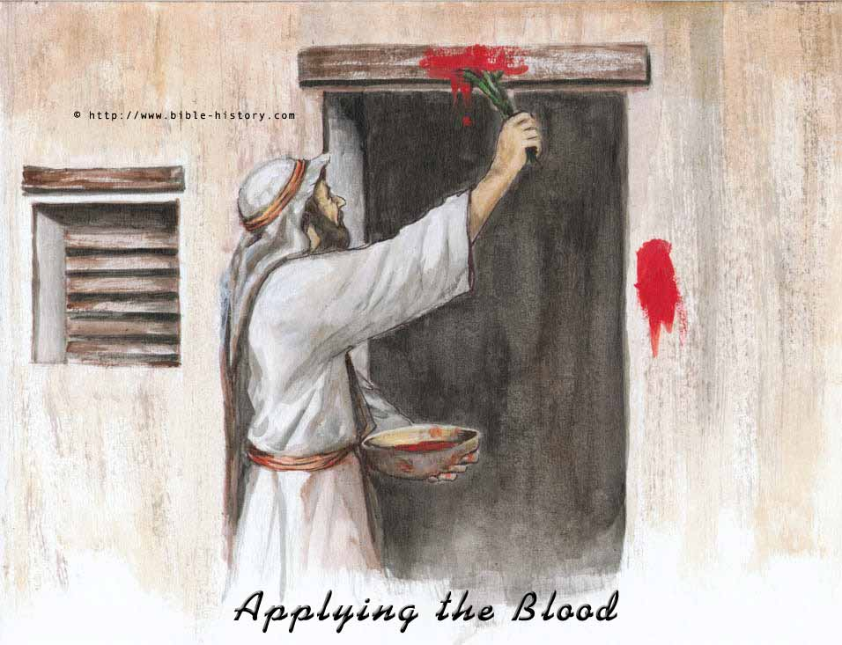
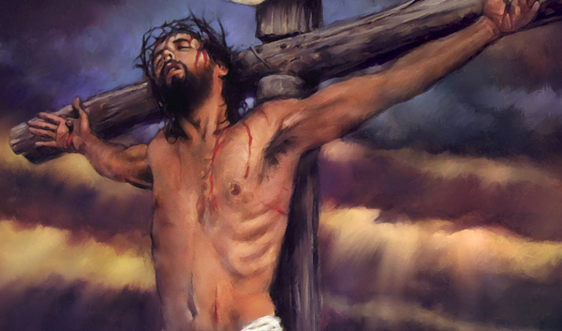
Jesus And the Feast of Passover
by Pastor Fee Soliven
1 Corinthians 5:7-8
Sunday Morning
April 2, 2023

Slide 74
1 Corinthians 5:7-8
7 Therefore purge out the old leaven, that you may be a new lump, since you truly are unleavened. For indeed Christ, our Passover, was sacrificed for us. 8 Therefore let us keep the feast, not with old leaven, nor with the leaven of malice and wickedness, but with the unleavened bread of sincerity and truth.

Slide 75
This Thursday Through Saturday Sundown April 6 - 8, 2023 all around the world The Passover Feast is celebrated around the world. On the Biblical calendar it is Nissan 15-18, 5783. It’s when Jesus was crucified, died and was buried in his tomb. But even more profound is This Saturday April 8, 2023 on Nissan 17, 5783
Jesus Rose from the Dead

Slide 76
John 19:14-16
14 Now it was the Preparation Day of the Passover, and about the sixth hour. And he said to the Jews, "Behold your King!" 15 But they cried out, "Away with Him, away with Him! Crucify Him!" Pilate said to them, "Shall I crucify your King?" The chief priests answered, "We have no king but Caesar!" 16 Then he delivered Him to them to be crucified. So they took Jesus and led Him away.

Slide 77
John 19:17-18
17 And He, bearing His cross, went out to a place called the Place of a Skull, which is called in Hebrew, Golgotha, 18 where they crucified Him, and two others with Him, one on either side, and Jesus in the center.

Slide 78
John 19:31-34
31 Therefore, because it was the Preparation Day, that the bodies should not remain on the cross on the Sabbath (for that Sabbath was a high day), the Jews asked Pilate that their legs might be broken, and that they might be taken away.

Slide 79
32 Then the soldiers came and broke the legs of the first and of the other who was crucified with Him. 33 But when they came to Jesus and saw that He was already dead, they did not break His legs. 34 But one of the soldiers pierced His side with a spear, and immediately blood and water came out.

Slide 80
John 19:40-42
40 Then they took the body of Jesus, and bound it in strips of linen with the spices, as the custom of the Jews is to bury. 41 Now in the place where He was crucified there was a garden, and in the garden a new tomb in which no one had yet been laid. 42 So there they laid Jesus, because of the Jews' Preparation Day, for the tomb was nearby.

Slide 81
BIBLICAL HOLIDAYS
SPRING FEASTS
FALL FEASTS
50 Days
Passover
(Nisan 15)
Jesus’ Death
First Fruits
(Nisan 17)
Resurrection
Pentecost
(Sivan 6)
Holy Spirit
Trumpets
(Tishri 1&2)
Repentance
Tabernacles
(Tishri 15)
Rejoicing
Unleavened
Bread
(Nisan 15-22)
Jesus’ Burial
Yom Kippur
(Tishri 10)
Redemption
Historically Fulfilled During Jesus’
First Coming
The Church Age
To Be Fulfilled By The Second Coming of Jesus
(Second Advent)
(First Advent)

Slide 82
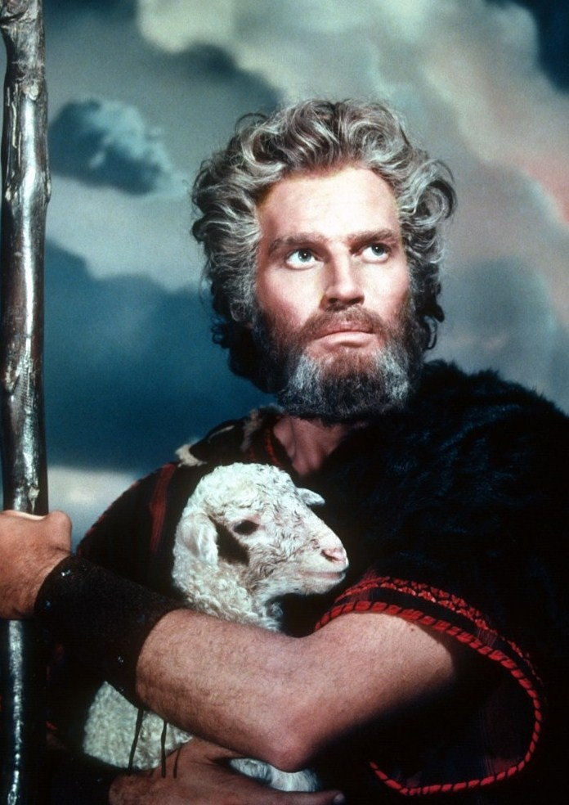
The Passover Feast
By Pastor Fee Soliven
Sunday Morning
October 9th, 2011

Slide 83
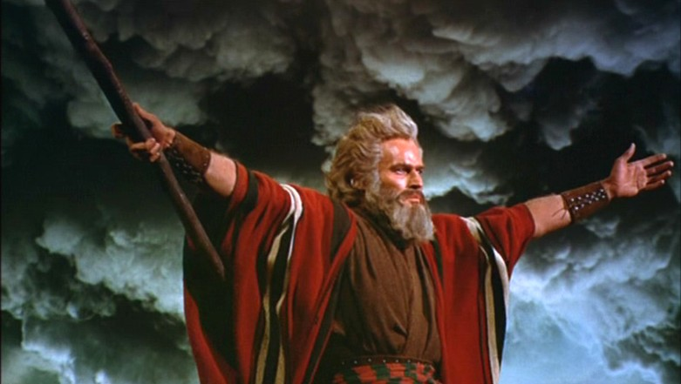
The Passover Feast
By Pastor Fee Soliven
Sunday Morning
October 9th, 2011

Slide 84
Exodus 12:3-13
3 Speak to all the congregation of Israel, saying: 'On the tenth day of this month every man shall take for himself a lamb, according to the house of his father, a lamb for a household. 4 And if the household is too small for the lamb, let him and his neighbor next to his house take it according to the number of the persons; according to each man's need you shall make your count for the lamb.

Slide 85
5 Your lamb shall be without blemish, a male of the first year. You may take it from the sheep or from the goats. 6 Now you shall keep it until the fourteenth day of the same month. Then the whole assembly of the congregation of Israel shall kill it at twilight. 7 And they shall take some of the blood and put it on the two doorposts and on the lintel of the houses where they eat it.

Slide 86
8 Then they shall eat the flesh on that night; roasted in fire, with unleavened bread and with bitter herbs they shall eat it. 9 Do not eat it raw, nor boiled at all with water, but roasted in fire--its head with its legs and its entrails. 10 You shall let none of it remain until morning, and what remains of it until morning you shall burn with fire.

Slide 87
11 And thus you shall eat it: with a belt on your waist, your sandals on your feet, and your staff in your hand. So you shall eat it in haste. It is the LORD's Passover. 12 For I will pass through the land of Egypt on that night, and will strike all the firstborn in the land of Egypt, both man and beast; and against all the gods of Egypt I will execute judgment: I am the LORD.

Slide 88
13 Now the blood shall be a sign for you on the houses where you are. And when I see the blood, I will pass over you; and the plague shall not be on you to destroy you when I strike the land of Egypt.

Slide 89
Leviticus 23:2
And the LORD spoke to Moses, saying, Speak to the children of Israel, and say to them, Concerning the Feasts of the LORD, which you shall proclaim to be holy convocations, even these are my feasts.

Slide 90
The Hebrew word for Feasts is also MOED meaning appointed times.
The Hebrew word for convocation is MIQRA meaning a dress rehearsal.

Slide 91
The Parallels of Passover and
Jesus Christ our Savior.

Slide 92
As Israel was in Bondage to Egypt, so
Man is a Slave to Sin.

Slide 93
2. Each of us was born into this
world as a slave to sin.

Slide 94
Romans 5:18-21
18 Therefore, as through one man's offense judgment came to all men, resulting in condemnation, even so through one Man's righteous act the free gift came to all men, resulting in justification of life. 19 For as by one man's disobedience many were made sinners, so also by one Man's obedience many will be made righteous.

Slide 95
20 Moreover the law entered that the offense might abound. But where sin abounded, grace abounded much more, 21 so that as sin reigned in death, even so grace might reign through righteousness to eternal life through Jesus Christ our Lord.

Slide 96
Romans 3:23-25
23 for all have sinned and fall short of the glory of God, 24 being justified freely by His grace through the redemption that is in Christ Jesus, 25 whom God set forth as a propitiation by His blood, through faith, to demonstrate His righteousness, because in His forbearance God had passed over the sins that were previously committed…

Slide 97
3. Why can’t we simply stop sinning?

Slide 98
Romans 6:20-23
20 For when you were slaves of sin, you were free in regard to righteousness. 21 What fruit did you have then in the things of which you are now ashamed? For the end of those things is death. 22 But now having been set free from sin, and having become slaves of God, you have your fruit to holiness, and the end, everlasting life. 23 For the wages of sin is death, but the gift of God is eternal life in Christ Jesus our Lord.

Slide 99
4. Just as the Hebrew people could not just leave Egypt, we cannot simply
leave our sin.

Slide 100
2 Corinthians 1:9-10
9 Yes, we had the sentence of death in ourselves, that we should not trust in ourselves but in God who raises the dead, 10 who delivered us from so great a death, and does deliver us; in whom we trust that He will still deliver us,

Slide 101
5. God promised that the firstborn in Egypt would die.

Slide 102
Hebrews 9:27-28
27 And as it is appointed for men to die once, but after this the judgment, 28 so Christ was offered once to bear the sins of many. To those who eagerly wait for Him He will appear a second time, apart from sin, for salvation.

Slide 103
6. Some 1500 years later a prophet named John The Baptist was preaching about the coming Kingdom of God.

Slide 104
John 1:29
The next day John saw Jesus coming toward him, and said, "Behold! The Lamb of God who takes away the sin of the world!

Slide 105
7. As the Blood of the Lamb Saved the Hebrews, so the Blood of Christ Saves Us!

Slide 106
1 John 1:5-10
5 This is the message which we have heard from Him and declare to you, that God is light and in Him is no darkness at all. 6 If we say that we have fellowship with Him, and walk in darkness, we lie and do not practice the truth.

Slide 107
7 But if we walk in the light as He is in the light, we have fellowship with one another, and the blood of Jesus Christ His Son cleanses us from all sin. 8 If we say that we have no sin, we deceive ourselves, and the truth is not in us.

Slide 108
9 If we confess our sins, He is faithful and just to forgive us our sins and to cleanse us from all unrighteousness. 10 If we say that we have not sinned, we make Him a liar, and His word is not in us.

Slide 109
Genesis 3:21-24
21 Also for Adam and his wife the LORD God made tunics of skin, and clothed them. 22 Then the LORD God said, "Behold, the man has become like one of Us, to know good and evil. And now, lest he put out his hand and take also of the tree of life, and eat, and live forever"—

Slide 110
23 therefore the LORD God sent him out of the garden of Eden to till the ground from which he was taken. 24 So He drove out the man…

Slide 111
Hebrews 9:22
“And according to the law almost all things are purified with blood, and without shedding of blood there is no remission”

Slide 112
Leviticus 17:11
“For the life of the flesh is in the blood, and I have given it to you upon the altar to make atonement for your souls; for it is the blood that makes atonement for the soul”

Slide 113
Hebrews 10:4-10
4 For it is not possible that the blood of bulls and goats could take away sins. 5 Therefore, when He came into the world, He said: "Sacrifice and offering You did not desire, But a body You have prepared for Me.

Slide 114
6 In burnt offerings and sacrifices for sin You had no pleasure. 7 Then I said, 'Behold, I have come-- In the volume of the book it is written of Me-- To do Your will, O God.' " 8 Previously saying, "Sacrifice and offering, burnt offerings, and offerings for sin You did not desire, nor had pleasure in them" (which are offered according to the law),

Slide 115
9 then He said, "Behold, I have come to do Your will, O God." He takes away the first that He may establish the second. 10 By that will we have been sanctified through the offering of the body of Jesus Christ once for all.

Slide 116
1 Peter 1:18-19
18 knowing that you were not redeemed with corruptible things, like silver or gold, from your aimless conduct received by tradition from your fathers, 19 but with the precious blood of Christ, as of a lamb without blemish and without spot.

Slide 117
Hebrews 11:27
“By faith he kept the Passover and the sprinkling of blood, lest he who destroyed the firstborn should touch them. And by Faith we have received Jesus Christ!

Slide 118
Ephesians 2:8-9
8 For by grace you have been saved through faith, and that not of yourselves; it is the gift of God, 9 not of works, lest anyone should boast.

Slide 119
Luke 24:44-49
44 Then He said to them, "These are the words which I spoke to you while I was still with you, that all things must be fulfilled which were written in the Law of Moses and the Prophets and the Psalms concerning Me." 45 And He opened their understanding, that they might comprehend the Scriptures.

Slide 120
46 Then He said to them, "Thus it is written, and thus it was necessary for the Christ to suffer and to rise from the dead the third day, 47 and that repentance and remission of sins should be preached in His name to all nations, beginning at Jerusalem.

Slide 121
48 And you are witnesses of these things. 49 Behold, I send the Promise of My Father upon you; but tarry in the city of Jerusalem until you are endued with power from on high."

Slide 123
1 Thessalonians 4:13-18
13 But I do not want you to be ignorant, brethren, concerning those who have fallen asleep, lest you sorrow as others who have no hope. 14 For if we believe that Jesus died and rose again, even so God will bring with Him those who sleep in Jesus.

Slide 124
15 For this we say to you by the word of the Lord, that we who are alive and remain until the coming of the Lord will by no means precede those who are asleep. 16 For the Lord Himself will descend from heaven with a shout, with the voice of an archangel, and with the trumpet of God. And the dead in Christ will rise first.

Slide 125
17 Then we who are alive and remain shall be caught up together with them in the clouds to meet the Lord in the air. And thus we shall always be with the Lord. 18 Therefore comfort one another with these words.

Slide 126
1 Corinthians 15:50-54
50 Now this I say, brethren, that flesh and blood cannot inherit the kingdom of God; nor does corruption inherit incorruption. 51 Behold, I tell you a mystery: We shall not all sleep, but we shall all be changed-- 52 in a moment, in the twinkling of an eye, at the last trumpet. For the trumpet will sound, and the dead will be raised incorruptible, and we shall be changed.

Slide 127
53 For this corruptible must put on incorruption, and this mortal must put on immortality. 54 So when this corruptible has put on incorruption, and this mortal has put on immortality, then shall be brought to pass the saying that is written: "Death is swallowed up in victory."

Slide 128
20 Again, when a righteous man turns from his righteousness and commits iniquity, and I lay a stumbling block before him, he shall die; because you did not give him warning, he shall die in his sin, and his righteousness which he has done shall not be remembered; but his blood I will require at your hand.

Slide 129
Acts 2:38-39
38 Then Peter said to them, "Repent, and let every one of you be baptized in the name of Jesus Christ for the remission of sins; and you shall receive the gift of the Holy Spirit. 39 For the promise is to you and to your children, and to all who are afar off, as many as the Lord our God will call."

