Slide 2
Stand In Your Love (Bethel)

Slide 3
When darkness tries to roll over my bones When sorrow comes to steal the joy I own When

Slide 4
brokenness and pain is all I know I won't be shaken, no, I won't be shaken 'Cause my fear doesn't stand a

Slide 5
chance When I stand in Your love My fear doesn't stand a chance When I stand in Your love My fear

Slide 6
doesn't stand a chance When I stand in Your love
Shame no longer has a place to hide And I am not a

Slide 7
captive to the lies I'm not afraid to leave my past behind Oh, I won't be shaken, no, I won't be shaken

Slide 8
My fear doesn't stand a chance When I stand in Your love My fear doesn't stand a chance When I stand in

Slide 9
Your love My fear doesn't stand a chance When I stand in Your love Oh, I'm standing There's power

Slide 10
that can break off every chain There's power that can empty out a grave There's resurrection power that

Slide 11
can save There's power in Your name, power in Your name My fear doesn't stand a chance When I stand

Slide 12
in Your love My fear doesn't stand a chance When I stand in Your love My fear doesn't stand a chance

Slide 13
When I stand in Your love Oh, when, when I'm standing in Your love Oh, my fear doesn't stand a

Slide 14
chance When I stand in Your love My fear doesn't stand a chance When I stand in Your love My fear

Slide 15
chance When I stand in Your love My fear doesn't stand a chance When I stand in Your love My fear

Slide 16
doesn't stand a chance When I stand in Your love
Oh, I standing in Your love Oh, standing on the rock

Slide 17
Oh, I am standing, standing in Your love

Slide 18
”No Longer Slaves”
(Bethel)

Slide 19
You unravel me. With a melody. You surround me with song of deliverance. From my enemies. Til’ all

Slide 20
My fears are gone.. I’m no longer a slave to fear. I am a child of God. I’m no longer a slave to fear.

Slide 21
I am a child of God. From my mother’s womb you have chosen me. Love has called my name.

Slide 22
I’ve been born again. Into your family. Your blood flows through my veins. I’m no longer slave to fear

Slide 23
I am a child of god. I’m no longer a slave to fear. I am a child of God. Ooh, oooh . Ooh , oooh. Ooh, oooh.

Slide 24
Ooh, oooh . You split the sea so I could walk right through it. My fears are drowned in perfect Love.

Slide 25
You rescue me. So I could stand and say. I am a child of God. You split the sea so I could walk right

Slide 26
Through it. My fears are drowned in perfect love. You rescued me. So I could stand and say. I am a child

Slide 27
Of god. I am a child of God. Yes I am a child of God.

Slide 28
“Great are you Lord”
(All Sons and Daughters)

Slide 29
You give life, You are love. You bring light in the darkness. You give hope, You restore

Slide 30
Every heart that is broken. And great are you Lord. It’s your breath in our lungs so we

Slide 31
Pour out our praise. We pour out our praise.
It’s your breath in our lungs. So we pour out

Slide 32
Our praise to you only. You give life, you are love. You bring light to the darkness. You

Slide 33
Give hope, You restore. Every heart that is broken. Great are you Lord. It’s your breath

Slide 34
In our lungs. So we pour out our praise we pour out our praise. It’s your breath in our

Slide 35
Lungs so we pour out our praise to you only. It’s your breath in our lungs. So we

Slide 36
Pour out our praise we pour out our praise. It’s your breath in our lungs. So we pour out

Slide 37
Our praise to you only. And all the earth will shout your praise. Our hearts will cry, these

Slide 38
Bones will sing. Great are You, Lord. And all the earth will shout your praise. Our hearts

Slide 39
Will cry these bones will sing. Great are you,Lord. And all the earth will shout your

Slide 40
Praise Our hearts will cry these bones will sing. Great are you, Lord. It’s your breath in

Slide 41
Our Lungs. So we pour out our praise. We pour out our praise. It’s your breath in our

Slide 42
Lungs so we pour out our praise to you only. Great are you, Lord. It’s your breath in

Slide 43
Our lungs so we pour out our praise. Pour out our praise. It’s your breath in our lungs

Slide 44
So we pour out our praise to you only. Great are you , Lord.

Slide 45
“Worthy Of It All”
(Bethel Music)

Slide 46
All the saints and angels. They bow before the throne. All the elders cast their crowns before the

Slide 47
Lamb of God and sing. All the saints and angels. They bow before your throne. All the elders cast their

Slide 48
Crowns before the lamb of God and sing. You are worthy of it all. You are worthy of it all. For from you

Slide 49
All. For from you are all things and to you are all things. You deserve the glory. Day and night, night

Slide 50
Night and day. Let incense arise. Day and night, night and day. Let incense arise. Day and night, night

Slide 51
And day let incense arise. Day and night night and day. You are worthy of it all. You are worthy of it all

Slide 52
For from you are al things. And to you are all things. You deserve the glory. You are worthy of it all. You

Slide 53
Are worthy of it all. For from you are all things and to you are all things. You deserve the glory. We exalt

Slide 54
Thee. We exalt thee. We exalt thee, Oh, Lord.
We exalt thee. We exalt thee, We exalt thee, Oh

Slide 55
Who You Say I Am
(Hillsong)

Slide 56
Who am I that the highest King would welcome me?
I was lost, but He brought me in Oh His love for me

Slide 57
Oh His love for me Who the Son sets free Oh, is free indeed I'm a child of God, yes, I am Free at last, He

Slide 58
has ransomed me His grace runs deep While I was a slave to sin, Jesus died for me Yes, He died for me

Slide 59
Who the Son sets free Oh is free indeed I'm a child of God, yes, I am In my Father's house There's a

Slide 60
place for me I'm a child of God, yes, I am I am chosen, not forsaken I am who You say I am You are

Slide 61
for me, not against me I am who You say I am I am chosen, not forsaken I am who You say I am You are

Slide 62
for me, not against me I am who You say I am I am who You say I am Who the Son sets free Oh is free

Slide 63
indeed I'm a child of God, yes, I am In my Father's house There's a place for me I'm a child of God, yes,

Slide 64
I am In my Father's house There's a place for me I'm a child of God, yes, I am I am chosen, not forsaken I

Slide 65
am who You say I am You are for me, not against me
I am who You say I am I am chosen, not forsaken I

Slide 66
am who You say I am You are for me, not against me
I am who You say I am I am chosen, not forsaken I

Slide 67
am who You say I am You are for me, not against me I am who You say I am Oh I am who

Slide 68
You say I am Yes, I am who you say I am Who the Son sets free Oh is free indeed I'm a child of God,

Slide 69
yes, I am In my Father's house There's a place for me I'm a child of God, yes, I am

Slide 72
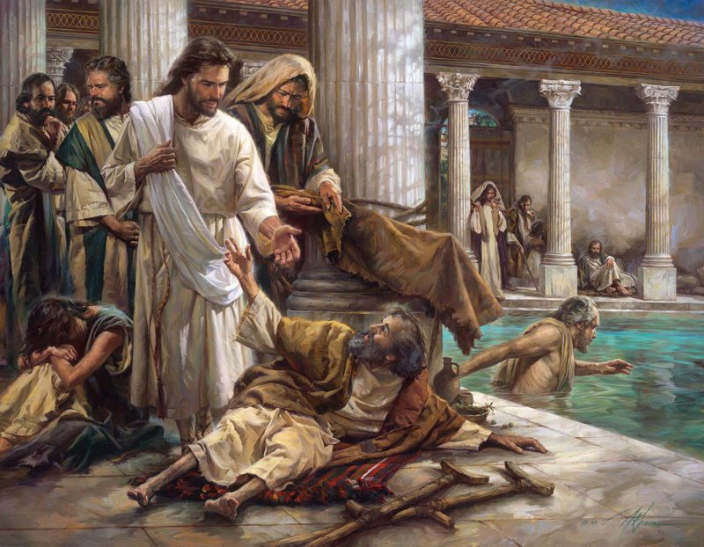
Jesus is Our Deliverer
by Pastor Fee Soliven
Psalm 18:1-6
Sunday Morning
July 21, 2024

Slide 73
Psalm 18:1-6
1 I will love You, O LORD, my strength. 2 The LORD is my rock and my fortress and my deliverer; My God, my strength, in whom I will trust; My shield and the horn of my salvation, my stronghold. 3 I will call upon the LORD, who is worthy to be praised; So shall I be saved from my enemies.

Slide 74
4 The pangs of death surrounded me, And the floods of ungodliness made me afraid. 5 The sorrows of Sheol surrounded me; The snares of death confronted me. 6 In my distress I called upon the LORD, And cried out to my God; He heard my voice from His temple, And my cry came before Him, even to His ears.

Slide 75
David's Declaration

Slide 76
1. David's Love for God

Slide 77
Psalm 18:35-36
35 You have also given me the shield of Your salvation; Your right hand has held me up, Your gentleness has made me great. 36 You enlarged my path under me; So my feet did not slip.

Slide 78
2 Samuel 5:9-10
9 Then David dwelt in the stronghold, and called it the City of David. And David built all around from the Millo and inward. 10 So David went on and became great, and the LORD God of hosts was with him.

Slide 79
2 Samuel 7:9-11
9 And I have been with you wherever you have gone, and have cut off all your enemies from before you, and have made you a great name, like the name of the great men who are on the earth.

Slide 80
10 Moreover I will appoint a place for My people Israel, and will plant them, that they may dwell in a place of their own and move no more; nor shall the sons of wickedness oppress them anymore, as previously,

Slide 81
11 since the time that I commanded judges to be over My people Israel, and have caused you to rest from all your enemies. Also the LORD tells you that He will make you a house.

Slide 82
2. God Is My Rock

Slide 83
Psalm 18:1-2
1 I will love You, O LORD, my strength. 2 The LORD is my rock and my fortress and my deliverer; My God, my strength, in whom I will trust; My shield and the horn of my salvation, my stronghold.

Slide 84
Psalm 61:2
"From the end of the earth I will cry to You, When my heart is overwhelmed; Lead me to the rock that is higher than I."

Slide 85
3. God Is My Fortress

Slide 86
Psalm 31:1-5
1 In You, O LORD, I put my trust; Let me never be ashamed; Deliver me in Your righteousness. 2 Bow down Your ear to me, Deliver me speedily; Be my rock of refuge, A fortress of defense to save me. 3 For You are my rock and my fortress; Therefore, for Your name's sake, Lead me and guide me.

Slide 87
4 Pull me out of the net which they have secretly laid for me, For You are my strength. 5 Into Your hand I commit my spirit; You have redeemed me, O LORD God of truth.

Slide 88
4. God Is My Deliverer

Slide 89
Psalm 32:7-8
7 You are my hiding place; You shall preserve me from trouble; You shall surround me with songs of deliverance. Selah 8 I will instruct you and teach you in the way you should go; I will guide you with My eye.

Slide 90
5. God Is My God

Slide 91
Psalm 18:25-31
25 With the merciful You will show Yourself merciful; With a blameless man You will show Yourself blameless; 26 With the pure You will show Yourself pure; And with the devious You will show Yourself shrewd. 27 For You will save the humble people, But will bring down haughty looks. 28 For You will light my lamp; The LORD my God will enlighten my darkness.

Slide 92
29 For by You I can run against a troop, By my God I can leap over a wall. 30 As for God, His way is perfect; The word of the LORD is proven; He is a shield to all who trust in Him. 31 For who is God, except the LORD? And who is a rock, except our God?

Slide 93
David's Distress

Slide 94
1. Sorrows of Death

Slide 95
Psalm 91:5-8
5 You shall not be afraid of the terror by night, Nor of the arrow that flies by day, 6 Nor of the pestilence that walks in darkness, Nor of the destruction that lays waste at noonday. 7 A thousand may fall at your side, And ten thousand at your right hand; But it shall not come near you. 8 Only with your eyes shall you look, And see the reward of the wicked.

Slide 96
2. The Sorrows of Hell

Slide 97
Psalm 18:4-6
4 The pangs of death surrounded me, And the floods of ungodliness made me afraid. 5 The sorrows of Sheol surrounded me; The snares of death confronted me. 6 In my distress I called upon the LORD, And cried out to my God; He heard my voice from His temple, And my cry came before Him, even to His ears.

Slide 98
3. The Snares Of Death

Slide 99
2 Timothy 2:25-26
25 in humility correcting those who are in opposition, if God perhaps will grant them repentance, so that they may know the truth, 26 and that they may come to their senses and escape the snare of the devil, having been taken captive by him to do his will.

Slide 100
Psalm 124:6-8
6 Blessed be the LORD, Who has not given us as prey to their teeth. 7 Our soul has escaped as a bird from the snare of the fowlers; The snare is broken, and we have escaped. 8 Our help is in the name of the LORD, Who made heaven and earth.

Slide 101
David's Deliverance

Slide 102
1. Memory of Past Deliverance

Slide 103
Psalm 18:16-19
16 He sent from above, He took me; He drew me out of many waters. 17 He delivered me from my strong enemy, From those who hated me, For they were too strong for me. 18 They confronted me in the day of my calamity, But the LORD was my support. 19 He also brought me out into a broad place; He delivered me because He delighted in me.

Slide 104
2. Assurance of Present Deliverance

Slide 105
Romans 8:37-39
37 Yet in all these things we are more than conquerors through Him who loved us. 38 For I am persuaded that neither death nor life, nor angels nor principalities nor powers, nor things present nor things to come, 39 nor height nor depth, nor any other created thing, shall be able to separate us from the love of God which is in Christ Jesus our Lord.

Slide 106
3. Hope of Future Deliverance

Slide 107
Jeremiah 29:11-13
1 For I know the thoughts that I think toward you, says the LORD, thoughts of peace and not of evil, to give you a future and a hope. 12 Then you will call upon Me and go and pray to Me, and I will listen to you. 13 And you will seek Me and find Me, when you search for Me with all your heart.

Slide 108
1 Thessalonians 4:13-18
13 But I do not want you to be ignorant, brethren, concerning those who have fallen asleep, lest you sorrow as others who have no hope. 14 For if we believe that Jesus died and rose again, even so God will bring with Him those who sleep in Jesus.

Slide 109
15 For this we say to you by the word of the Lord, that we who are alive and remain until the coming of the Lord will by no means precede those who are asleep. 16 For the Lord Himself will descend from heaven with a shout, with the voice of an archangel, and with the trumpet of God. And the dead in Christ will rise first.

Slide 110
17 Then we who are alive and remain shall be caught up together with them in the clouds to meet the Lord in the air. And thus we shall always be with the Lord. 18 Therefore comfort one another with these words.

Slide 111
1 Corinthians 15:50-54
50 Now this I say, brethren, that flesh and blood cannot inherit the kingdom of God; nor does corruption inherit incorruption. 51 Behold, I tell you a mystery: We shall not all sleep, but we shall all be changed-- 52 in a moment, in the twinkling of an eye, at the last trumpet. For the trumpet will sound, and the dead will be raised incorruptible, and we shall be changed.

Slide 112
53 For this corruptible must put on incorruption, and this mortal must put on immortality. 54 So when this corruptible has put on incorruption, and this mortal has put on immortality, then shall be brought to pass the saying that is written: "Death is swallowed up in victory."

Slide 113
20 Again, when a righteous man turns from his righteousness and commits iniquity, and I lay a stumbling block before him, he shall die; because you did not give him warning, he shall die in his sin, and his righteousness which he has done shall not be remembered; but his blood I will require at your hand.

Slide 114
Acts 2:38-39
38 Then Peter said to them, "Repent, and let every one of you be baptized in the name of Jesus Christ for the remission of sins; and you shall receive the gift of the Holy Spirit. 39 For the promise is to you and to your children, and to all who are afar off, as many as the Lord our God will call."

