Slide 2
“ Raise A Hallelujah”
(Bethel)

Slide 3
I raise a hallelujah, In the presence of my enemies. I raise a hallelujah, louder than the unbelief. I raise a

Slide 4
Hallelujah, my weapon is a melody. I raise a hallelujah, heaven comes to fight for me.

Slide 5
I’m gonna sing in the middle of the storm. Louder and louder, you’re gonna hear my praises roar.

Slide 6
Up from the ashes, hope will arise. Death is defeated the king is alive. I raise a hallelujah, with

Slide 7
Everything inside of me. I raise a hallelujah, I will watch the darkness flee. I raise a hallelujah, In the

Slide 8
middle of the mystery. I raise a hallelujah, fear you lost your hold on me. I’m gonna sing in the middle

Slide 9
storm. Louder and louder. You’re gonna hear my praises roar. Up from the ashes. Hope will arise

Slide 10
death is defeated the king is alive. Sing a little louder(in the presence of my enemies. Sing a little

Slide 11
louder. (louder than the unbelief). Sing a little louder(my weapon is a melody. Sing a little louder.

Slide 12
(heaven comes to fight for me) Sing a little louder(in the presence of my enemies). Sing a little louder

Slide 13
(louder than the unbelief) Sing a little louder(my weapon is a melody).Sing a little louder( Heaven

Slide 14
comes o fight for me. Sing a little louder. Cause im gonna sing . In the middle of this storm louder and

Slide 15
louder your gonna hear my praises roar. Up from the ashes. Hope will arise. Death is defeated. The

Slide 16
king is alive. Cause im gonna sing . In the middle of this storm louder and louder. You’re gonna hear my

Slide 17
praises roar. Up from the ashes hope will arise. Death is defeate, The king is alive.

Slide 18
“Oceans”
(Hillsong United)

Slide 19
You call me out upon the waters The great unknown where feet may fail And there I find You in the

Slide 20
mystery In oceans deep my faith will stand And I will call upon Your Name And keep my eyes above the

Slide 21
waves When oceans rise My soul will rest in Your embrace For I am Yours and You are mine Your

Slide 22
grace abounds in deepest waters Your sovereign hand will be my guide Where feet may fail and fear

Slide 23
surrounds me You've never failed and You won't start now So I will call upon Your Name And keep my

Slide 24
eyes above the waves When oceans rise My soul will rest in Your embrace For I am Yours and You are

Slide 25
mine, oh And You are mine, oh Spirit lead me where my trust is without borders Let me walk upon the

Slide 26
waters Wherever You would call me Take me deeper than my feet could ever wander And my faith

Slide 27
will be made stronger In the presence of my Saviour

Slide 28
“Behold Our God”
(by Sovereign Grace Music)

Slide 29
Who has held the oceans in his hands? Who has numbered every grain of sand? Kings and nations

Slide 30
tremble at his voice All creation rises to rejoice Behold our God, seated on his throne Come, let us

Slide 31
adore him Behold our king, nothing can compare Come, let us adore him Who has given counsel to

Slide 32
the Lord? Who can question any of his words? Who can teach, the one who knows all things? Who can

Slide 33
fathom all his wondrous deeds? Behold our God, seated on his throne Come, let us adore him Behold

Slide 34
our king, nothing can compare Come, let us adore him Who has felt the nails upon his hands? Bearing

Slide 35
all the guilt of sinful man God eternal, humbled to the grave Jesus, Savior, risen now to reign Behold our

Slide 36
God, seated on his throne Come, let us adore him Behold our king, nothing can compare Come, let us

Slide 37
adore him You will reign forever (let Your glory fill the Earth) You will reign forever (let Your glory fill the

Slide 38
Earth) You will reign forever (let Your glory fill the Earth)

Slide 39
“Shout to the Lord”
(Darlene Zschech)

Slide 40
My Jesus my Savior. Lord there is none like you. All of my days I want to praise the wonders of your

Slide 41
Mighty Love. My comfort, my shelter. Tower of refuge and strength. Let every breath, all that I am

Slide 42
never cease to worship you. Shout to Lord all the earth let us sing. Power and Majesty praise to the

Slide 43
King. Mountains bow down and the seas will roar at the sound of your name. I sing for joy at the work

Slide 44
of your hands. Forever I love you forever I’ll stand. Nothing compares to the promise I have in you

Slide 45
My Jesus , My Savior. Lord there is none like you. All of my days. I want to praise. The wonders of your

Slide 46
mighty love. My comfort, My shelter. Tower of refuge and strength. Let every breath, all that I am. Never

Slide 47
cease to worship you. Shout to the Lord all the earth let us sing. Power and Majesty praise to the King.

Slide 48
Mountains bow down and the seas will roar at the sound of your name. I sing for joy at the work of your

Slide 49
Hands. Forever I’ll love you forever I’ll stand. Nothing compares to the promise I have in you.

Slide 50
Oh nothing compares to the promise I have. Nothing compares to the promise I have in you.

Slide 51
“Gratitude”
(Brandon Lake)

Slide 52
All my words fall short I got nothing new How could I express All my gratitude? I could sing these songs

Slide 53
As I often do But every song must end And You never do So I throw up my hands And praise You

Slide 54
again and again 'Cause all that I have is a hallelujah
Hallelujah And I know it's not much But I've nothing

Slide 55
else fit for a King Except for a heart singing hallelujah Hallelujah I've got one response I've got

Slide 56
just one move With my arm stretched wide I will worship You So I throw up my hands And praise You

Slide 57
again and again 'Cause all that I have is a hallelujah
Hallelujah And I know it's not much But I've nothing

Slide 58
else fit for a King Except for a heart singing hallelujah Hallelujah So come on, my soul Oh, don't

Slide 59
you get shy on me Lift up your song 'Cause you've got a lion inside of those lungs Get up and praise the

Slide 60
Lord Oh come on, my soul Oh, don't you get shy on me Lift up your song 'Cause you've got a lion inside

Slide 61
of those lungs Get up and praise the Lord Come on, my soul Oh, don't you get shy on me Lift up your

Slide 62
song 'Cause you've got a lion inside of those lungs Get up and praise the Lord, hey Praise the Lord

Slide 63
Praise the Lord Praise the Lord So I throw up my hands Praise You again and again 'Cause all that I

Slide 64
have is a hallelujah Hallelujah And I know it's not much But I've nothing else fit for a King Except for a

Slide 65
heart singing hallelujah Hallelujah

Slide 66
“This is Amazing Grace”
(Phil Wickham)

Slide 67
Who breaks the power of sin and darkness. Who’s love is mighty and so much stronger. The King of

Slide 68
glory ,the king above all kings. Who shakes the whole earth with holy thunder. And leaves us

Slide 69
in awe and wonder? The King of Glory, the King above all Kings. This is amazing grace. This is

Slide 70
unfailing love. That you would would take my place. That you would bear my cross. You laid down your

Slide 71
life. That I would be set free. Oh, Jesus I sing for all that you’ve done for me. Who brings our chaos back

Slide 72
into order. Who makes the orphans a son and daughter. The King of Glory, The King of Glory

Slide 73
into order. Who makes the orphans a son and daughter. The King of Glory, The King of Glory

Slide 74
Who rules the nation. With truth and justice.Shines like the sun in all of his brilliance. The King of Glory

Slide 75
The King above all Kings. This is Amazing Grace. This is unfailing love. That you would take my place.

Slide 76
That you would bear my cross. You laid down your life. That I would be set free. Oh, Jesus, I sing for

Slide 77
All that you,ve done for me. Worthy is the Lamb who was slain. Worthy is the King who conquered the

Slide 78
grave. Worthy is the Lamb who was slain. Worthy is the King who conquered the grave. Worthy is the

Slide 79
Lamb who was slain. Worthy, Worthy,Worthy. This is Amazing Grace. This is unfailing love. That you

Slide 80
would take my place. That you would bear my cross. You laid down your life. That I would be set free

Slide 81
Oh, Jesus I sing for. All that you’ve done for me.

Slide 84
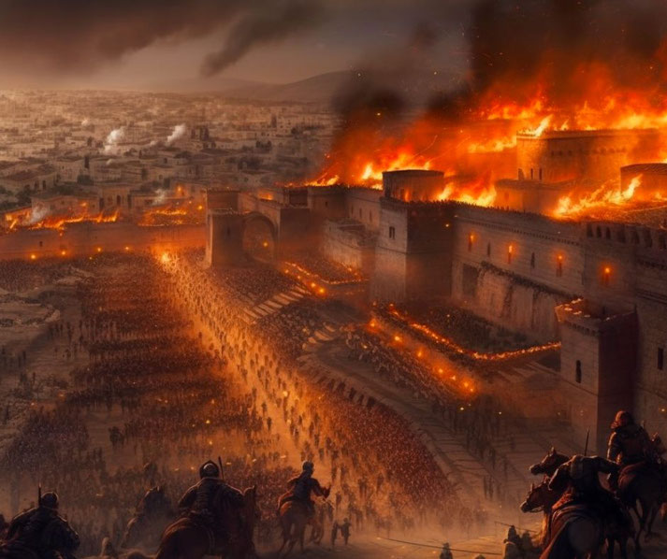
The Judgment of a Fallen Nation is Certain!
by Pastor Fee Soliven
Nahum 3:1-5
Sunday Afternoon
July 28, 2024

Slide 85
Nahum 3:1-5
1 Woe to the bloody city! It is all full of lies and robbery. Its victim never departs. 2 The noise of a whip And the noise of rattling wheels, Of galloping horses, Of clattering chariots! 3 Horsemen charge with bright sword and glittering spear. There is a multitude of slain, A great number of bodies, Countless corpses--They stumble over the corpses—

Slide 86
4 Because of the multitude of harlotries of the seductive harlot, The mistress of sorceries, Who sells nations through her harlotries, And families through her sorceries. 5 "Behold, I am against you," says the LORD of hosts…

Slide 87
Nahum 2:13
"Behold, I am against you," says the LORD of hosts, "I will burn your chariots in smoke, and the sword shall devour your young lions; I will cut off your prey from the earth, and the voice of your messengers shall be heard no more."

Slide 88
Nahum 3:1
“Woe to the city of blood, full of lies, full of plunder, never without victims!”

Slide 89
Nahum 3:19
“Who has not felt your endless cruelty?”

Slide 90
Nahum 3:8
“Do you think you’re superior to Egyptian Thebes, proudly invincible on the River Nile, Protected by the great River, walled in by the River, secure?”

Slide 91
Matthew 26:52
“For all who take the sword will perish by the sword”

Slide 92
Nahum 1:15
15 Behold, on the mountains The feet of him who brings good tidings, Who proclaims peace! O Judah, keep your appointed feasts, Perform your vows. For the wicked one shall no more pass through you; He is utterly cut off.

Slide 93
Nahum 3:15-19
15 There the fire will devour you, The sword will cut you off; It will eat you up like a locust. Make yourself many--like the locust! Make yourself many--like the swarming locusts! 16 You have multiplied your merchants more than the stars of heaven. The locust plunders and flies away.

Slide 94
17 Your commanders are like swarming locusts, And your generals like great grasshoppers, Which camp in the hedges on a cold day; When the sun rises they flee away, And the place where they are is not known. 18 Your shepherds slumber, O king of Assyria; Your nobles rest in the dust. Your people are scattered on the mountains, And no one gathers them.

Slide 95
19 Your injury has no healing, Your wound is severe. All who hear news of you Will clap their hands over you, For upon whom has not your wickedness passed continually?

Slide 96
Jonah 1:1-2
1 Now the word of the LORD came to Jonah the son of Amittai, saying, 2 "Arise, go to Nineveh, that great city, and cry out against it; for their wickedness has come up before Me."

Slide 97
Jonah 3:1-4
1 Now the word of the LORD came to Jonah the second time, saying, 2 "Arise, go to Nineveh, that great city, and preach to it the message that I tell you." 3 So Jonah arose and went to Nineveh, according to the word of the LORD. Now Nineveh was an exceedingly great city, a three-day journey in extent.

Slide 98
4 And Jonah began to enter the city on the first day's walk. Then he cried out and said, "Yet forty days, and Nineveh shall be overthrown!"

Slide 99
Jonah 3:5-10
5 So the people of Nineveh believed God, proclaimed a fast, and put on sackcloth, from the greatest to the least of them. 6 Then word came to the king of Nineveh; and he arose from his throne and laid aside his robe, covered himself with sackcloth and sat in ashes.

Slide 100
7 And he caused it to be proclaimed and published throughout Nineveh by the decree of the king and his nobles, saying, Let neither man nor beast, herd nor flock, taste anything; do not let them eat, or drink water. 8 But let man and beast be covered with sackcloth, and cry mightily to God; yes, let every one turn from his evil way and from the violence that is in his hands.

Slide 101
9 Who can tell if God will turn and relent, and turn away from His fierce anger, so that we may not perish? 10 Then God saw their works, that they turned from their evil way; and God relented from the disaster that He had said He would bring upon them, and He did not do it.

Slide 102
America the Modern City of Nineveh?

Slide 103
Jonah 1:2
"Arise, go to Nineveh, that great city, and cry out against it; for their wickedness has come up before Me."

Slide 104
1. Since Roe V. Wade in 1973 America has slaughtered, butchered and murdered 70,000,000 human babies through abortion!

Slide 105
Exodus 20:13
"You shall not murder”

Slide 106
2. On June 26, 2015 Obama spearheaded the movement of the homosexual agenda and the Supreme Court ruled 5-4 in favor of all 50 states in our nation to allow same sex marriage. This ruling over ruled the people’s right to vote on this matter!

Slide 107
Leviticus 20:13
“If a man lies with a male as he lies with a woman, both of them have committed an abomination. They shall surely be put to death. Their blood shall be upon them.”

Slide 108
Romans 1:26-28
26 For this reason God gave them up to vile passions. For even their women exchanged the natural use for what is against nature. 27 Likewise also the men, leaving the natural use of the woman, burned in their lust for one another, men with men committing what is shameful, and receiving in themselves the penalty of their error which was due.

Slide 109
3. Lawlessness and Civil Unrest

Slide 110
1 Timothy 1:9-11
9 knowing this: that the law is not made for a righteous person, but for the lawless and insubordinate, for the ungodly and for sinners, for the unholy and profane, for murderers of fathers and murderers of mothers, for manslayers,

Slide 111
10 for fornicators, for sodomites, for kidnappers, for liars, for perjurers, and if there is any other thing that is contrary to sound doctrine, 11 according to the glorious gospel of the blessed God which was committed to my trust.

Slide 112
Romans 1:21
because, although they knew God, they did not glorify Him as God, nor were thankful, but became futile in their thoughts, and their foolish hearts were darkened.

Slide 113
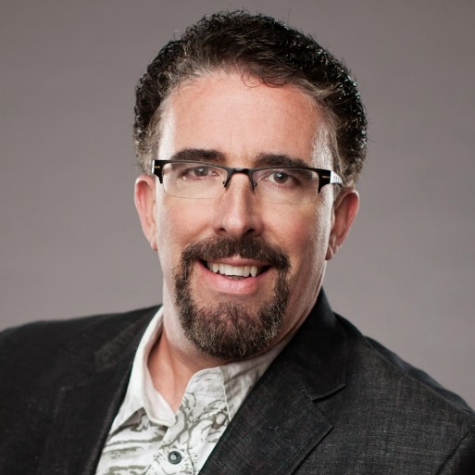
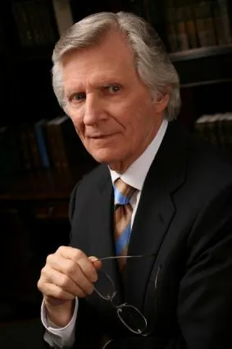
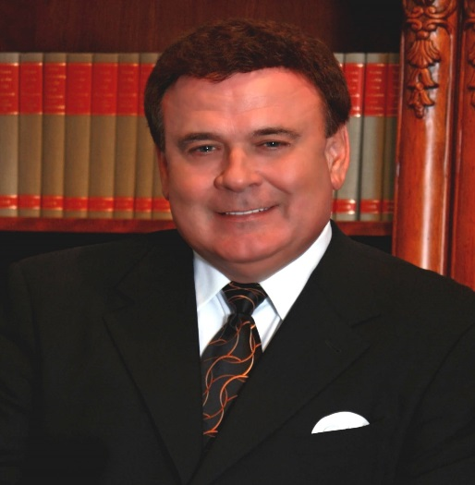
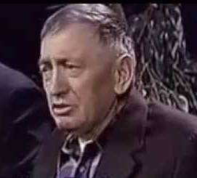
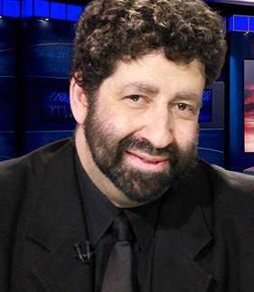
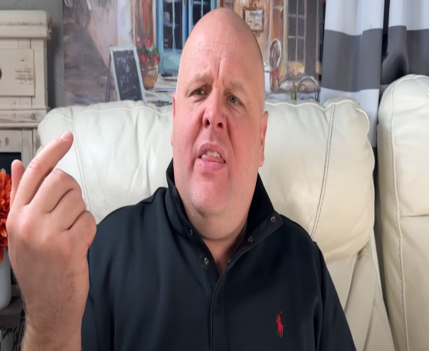
Perry Stone David Wilkerson John Kilpatrick
Modern Day Prophetic Voices
Dimitru Dudeman Jonathan Cahn Brandon Biggs

Slide 114
Psalm 124
1 "If it had not been the LORD who was on our side," Let Israel now say--2 "If it had not been the LORD who was on our side, When men rose up against us, 3 Then they would have swallowed us alive, When their wrath was kindled against us;

Slide 115
4 Then the waters would have overwhelmed us, The stream would have gone over our soul; 5 Then the swollen waters Would have gone over our soul." 6 Blessed be the LORD, Who has not given us as prey to their teeth. 7 Our soul has escaped as a bird from the snare of the fowlers; The snare is broken, and we have escaped. 8 Our help is in the name of the LORD, Who made heaven and earth.

Slide 116
1. A Nation Forgets God

Slide 117
2. An Enemy is Raised Up

Slide 118
3. A Trap is Set

Slide 119
4. The Nation who has forgotten God flies blindly into the trap and is ensnared. There is no escape.

Slide 120
5. The fowler (the enemy) comes at some point in the future…not necessarily on the day the trap is laid…and seizes their prey…and completely devours that nation.

Slide 121
6. That nation is swept away by the flood of God’s judgment. It is swallowed alive and whole.

Slide 122
7. It’s destruction is Certain

Slide 123
1 Thessalonians 4:13-18
13 But I do not want you to be ignorant, brethren, concerning those who have fallen asleep, lest you sorrow as others who have no hope. 14 For if we believe that Jesus died and rose again, even so God will bring with Him those who sleep in Jesus.

Slide 124
15 For this we say to you by the word of the Lord, that we who are alive and remain until the coming of the Lord will by no means precede those who are asleep. 16 For the Lord Himself will descend from heaven with a shout, with the voice of an archangel, and with the trumpet of God. And the dead in Christ will rise first.

Slide 125
17 Then we who are alive and remain shall be caught up together with them in the clouds to meet the Lord in the air. And thus we shall always be with the Lord. 18 Therefore comfort one another with these words.

Slide 126
1 Corinthians 15:50-54
50 Now this I say, brethren, that flesh and blood cannot inherit the kingdom of God; nor does corruption inherit incorruption. 51 Behold, I tell you a mystery: We shall not all sleep, but we shall all be changed-- 52 in a moment, in the twinkling of an eye, at the last trumpet. For the trumpet will sound, and the dead will be raised incorruptible, and we shall be changed.

Slide 127
53 For this corruptible must put on incorruption, and this mortal must put on immortality. 54 So when this corruptible has put on incorruption, and this mortal has put on immortality, then shall be brought to pass the saying that is written: "Death is swallowed up in victory."

Slide 128
20 Again, when a righteous man turns from his righteousness and commits iniquity, and I lay a stumbling block before him, he shall die; because you did not give him warning, he shall die in his sin, and his righteousness which he has done shall not be remembered; but his blood I will require at your hand.

Slide 129
Acts 2:38-39
38 Then Peter said to them, "Repent, and let every one of you be baptized in the name of Jesus Christ for the remission of sins; and you shall receive the gift of the Holy Spirit. 39 For the promise is to you and to your children, and to all who are afar off, as many as the Lord our God will call."

Slide 130
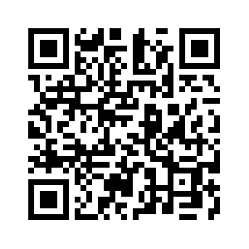
Donate with our QR code app to
Amazing Grace Christian Fellowship
Donations are Deeply Appreciated!

