Slide 2
“This is Amazing Grace”
(Phil Wickham)

Slide 3
Who breaks the power of sin and darkness. Who’s love is mighty and so much stronger. The King of

Slide 4
glory ,the king above all kings. Who shakes the whole earth with holy thunder. And leaves us

Slide 5
in awe and wonder? The King of Glory, the King above all Kings. This is amazing grace. This is

Slide 6
unfailing love. That you would would take my place. That you would bear my cross. You laid down your

Slide 7
life. That I would be set free. Oh, Jesus I sing for all that you’ve done for me. Who brings our chaos back

Slide 8
into order. Who makes the orphans a son and daughter. The King of Glory, The King of Glory

Slide 9
into order. Who makes the orphans a son and daughter. The King of Glory, The King of Glory

Slide 10
Who rules the nation. With truth and justice.Shines like the sun in all of his brilliance. The King of Glory

Slide 11
The King above all Kings. This is Amazing Grace. This is unfailing love. That you would take my place.

Slide 12
That you would bear my cross. You laid down your life. That I would be set free. Oh, Jesus, I sing for

Slide 13
All that you,ve done for me. Worthy is the Lamb who was slain. Worthy is the King who conquered the

Slide 14
grave. Worthy is the Lamb who was slain. Worthy is the King who conquered the grave. Worthy is the

Slide 15
Lamb who was slain. Worthy, Worthy,Worthy. This is Amazing Grace. This is unfailing love. That you

Slide 16
would take my place. That you would bear my cross. You laid down your life. That I would be set free

Slide 17
Oh, Jesus I sing for. All that you’ve done for me.

Slide 18
”Waymaker”
(Tasha Cobbs )

Slide 19
[Verse 1] You are here, moving in our midst I worship You, I worship You You are here,

Slide 20
working in this place I worship You, I worship You
You are here, moving in our midst I worship You, I

Slide 21
worship You You are here, working in this place
I worship You, I worship You [Chorus] You are

Slide 22
Waymaker, miracle worker Promise keeper, light in the darkness My God, that is who You are You are

Slide 23
Waymaker, miracle worker Promise keeper, light in the darkness My God, that is who You are [Verse 2]

Slide 24
You are here, touching every heart I worship You, I worship You You are here, healing every heart I

Slide 25
worship You, I worship You [Verse 3] You are here, turning lives around I worship You, I worship You You

Slide 26
are here, mending every heart I worship You, yeah, I worship You, Lord [Chorus] And You are Waymaker,

Slide 27
miracle worker Promise keeper, light in the darkness
My God, that is who You are Yeah, You are the

Slide 28
waymaker Waymaker, miracle worker Promise keeper, light in the darkness My God, that is who

Slide 29
You are Yeah, sing it again You are, yeah Waymaker, miracle worker Promise keeper, light in the darkness

Slide 30
My God, that is who You are Oh, it's who You are, Jesus, yeah Waymaker, miracle worker Promise

Slide 31
keeper, light in the darkness My God, that is who You are You might also like Way Maker [Refrain]

Slide 32
Sing that is who You are Oh, that is who You are

Slide 33
(That is who You are) Oh, and that is who You are (That is who You are) My Jesus, that is who You are

Slide 34
(That is who You are) Oh, we lift You up, that is who You are (That is who You are) My Jesus [Chorus]

Slide 35
Waymaker, miracle worker Promise keeper, light in the darkness My God, that is who You are Yes it is,

Slide 36
that is who You are Waymaker, miracle worker Promise keeper, light in the darkness My God, that is

Slide 37
who You are [Bridge] Let's sing this together, even when I don't see it Come on, even when Even when

Slide 38
I don't see it, You're working Even when I don't feel it, You're working You never stop, You never stop

Slide 39
working You never stop, You never stop working Come on And even when I don't see it, You’re

Slide 40
working Even when I don't feel it, You're working You never stop, You never stop working You never stop,

Slide 41
You never stop working Oh-oh Even when I don't see it, You're working Even when I don't feel it, You’re

Slide 42
working You never stop, You never stop working You never stop, You never stop working Even when I

Slide 43
don't see it, You're working Even when I don't feel it, You're working You never stop, You never stop

Slide 44
working You never stop, You never stop working
[Chorus] You are the way maker, yeah Waymaker,

Slide 45
miracle worker Promise keeper, light in the darkness
My God, that is who You are Waymaker, miracle

Slide 46
worker Promise keeper, light in the darkness My God, that is who You are

Slide 47
“Great are you Lord”
(All Sons and Daughters)

Slide 48
You give life, You are love. You bring light in the darkness. You give hope, You restore

Slide 49
Every heart that is broken. And great are you Lord. It’s your breath in our lungs so we

Slide 50
Pour out our praise. We pour out our praise.
It’s your breath in our lungs. So we pour out

Slide 51
Our praise to you only. You give life, you are love. You bring light to the darkness. You

Slide 52
Give hope, You restore. Every heart that is broken. Great are you Lord. It’s your breath

Slide 53
In our lungs. So we pour out our praise we pour out our praise. It’s your breath in our

Slide 54
Lungs so we pour out our praise to you only. It’s your breath in our lungs. So we

Slide 55
Pour out our praise we pour out our praise. It’s your breath in our lungs. So we pour out

Slide 56
Our praise to you only. And all the earth will shout your praise. Our hearts will cry, these

Slide 57
Bones will sing. Great are You, Lord. And all the earth will shout your praise. Our hearts

Slide 58
Will cry these bones will sing. Great are you,Lord. And all the earth will shout your

Slide 59
Praise Our hearts will cry these bones will sing. Great are you, Lord. It’s your breath in

Slide 60
Our Lungs. So we pour out our praise. We pour out our praise. It’s your breath in our

Slide 61
Lungs so we pour out our praise to you only. Great are you, Lord. It’s your breath in

Slide 62
Our lungs so we pour out our praise. Pour out our praise. It’s your breath in our lungs

Slide 63
So we pour out our praise to you only. Great are you , Lord.

Slide 64
“Worthy Of It All”
(Bethel Music)

Slide 65
All the saints and angels. They bow before the throne. All the elders cast their crowns before the

Slide 66
Lamb of God and sing. All the saints and angels. They bow before your throne. All the elders cast their

Slide 67
Crowns before the lamb of God and sing. You are worthy of it all. You are worthy of it all. For from you

Slide 68
All. For from you are all things and to you are all things. You deserve the glory. Day and night, night

Slide 69
Night and day. Let incense arise. Day and night, night and day. Let incense arise. Day and night, night

Slide 70
And day let incense arise. Day and night night and day. You are worthy of it all. You are worthy of it all

Slide 71
For from you are al things. And to you are all things. You deserve the glory. You are worthy of it all. You

Slide 72
Are worthy of it all. For from you are all things and to you are all things. You deserve the glory. We exalt

Slide 73
Thee. We exalt thee. We exalt thee, Oh, Lord.
We exalt thee. We exalt thee, We exalt thee, Oh

Slide 74
Nothing Else
(Cody Carnes)

Slide 75
wanna leave Oh, I'm not here for blessings Jesus, You don't owe me anything More than anything that

Slide 76
You can do I just want You I'm sorry when I've just gone through the motions I'm sorry when I just sang

Slide 77
another song Take me back to where we started I open up my heart to You I'm sorry when I've come

Slide 78
with my agenda I'm sorry when I forgot that You're enough Take me back to where we started I open up

Slide 79
my heart to You I'm caught up in Your presence I just want to sit here at Your feet I'm caught up in this holy

Slide 80
moment I never wanna leave Oh, I'm not here for blessings Jesus, You don't owe me anything And

Slide 81
more than anything that You can do I just want You
I just want You Nothing else, nothing else Nothing

Slide 82
else will do I just want You Nothing else, nothing else
Nothing else will do I just want You Nothing else,

Slide 83
nothing else Nothing else will do I just want You Nothing else, nothing else, Jesus Nothing else will do

Slide 84
I just want You Nothing else, nothing else Nothing else will do I just want You Nothing else, nothing

Slide 85
else, Jesus Nothing else will do I'm coming back to where we started I'm coming back to where we

Slide 86
started When I first felt Your love You're all that matters, Jesus You're all that matters I'm coming

Slide 87
back to what really matters Just Your heart I just wanna bless Your heart, Jesus I'm caught up in

Slide 88
Your presence I just want to sit here at Your feet I'm caught up in this holy moment I never wanna leave

Slide 89
And oh, I'm not here for blessings Jesus, You don't owe me anything More than anything that You can

Slide 90
do Oh, I just want You

Slide 93
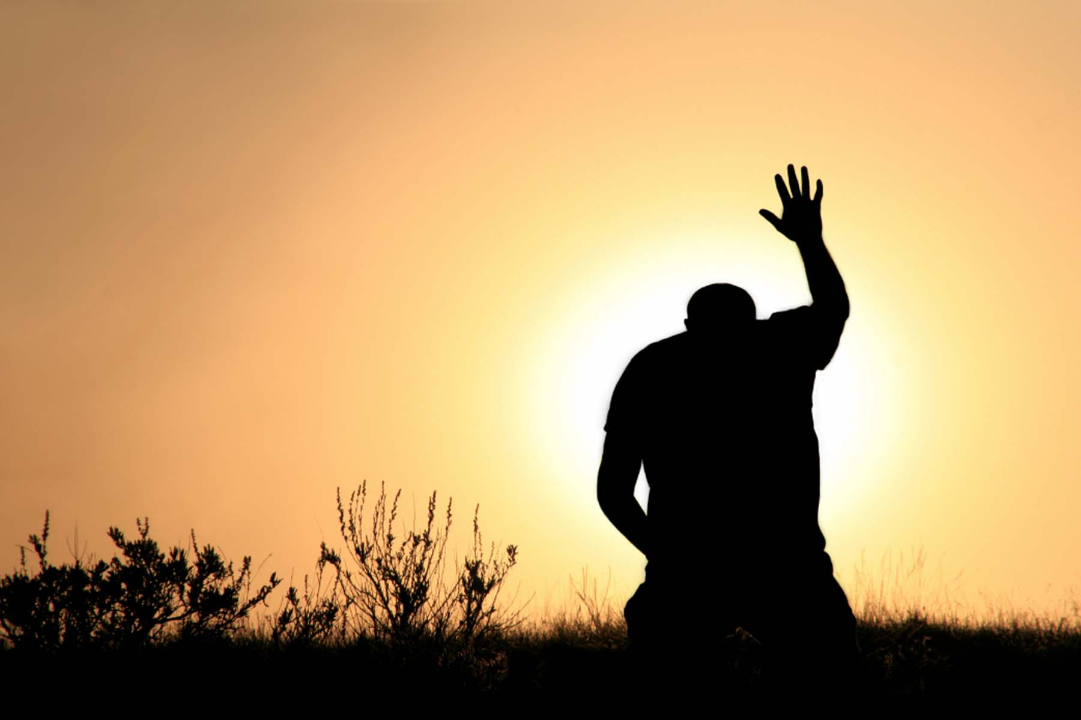
The Lord God is Faithful
Pastor Fee Soliven
Lamentations 3:19-26
Sunday Afternoon
August 18, 2024

Slide 94
Lamentations 3:19-26
19 Remember my affliction and roaming, The wormwood and the gall. 20 My soul still remembers And sinks within me. 21 This I recall to my mind, Therefore I have hope. 22 Through the LORD's mercies we are not consumed, Because His compassions fail not.

Slide 95
23 They are new every morning; Great is Your faithfulness. 24 "The LORD is my portion," says my soul, "Therefore I hope in Him!" 25 The LORD is good to those who wait for Him, To the soul who seeks Him. 26 It is good that one should hope and wait quietly For the salvation of the LORD.

Slide 96
Genesis 17:15-17
15 Then God said to Abraham, "As for Sarai your wife, you shall not call her name Sarai, but Sarah shall be her name. 16 And I will bless her and also give you a son by her; then I will bless her, and she shall be a mother of nations; kings of peoples shall be from her."

Slide 97
17 Then Abraham fell on his face and laughed, and said in his heart, "Shall a child be born to a man who is one hundred years old? And shall Sarah, who is ninety years old, bear a child?"

Slide 98
Genesis 18:11-14
11 Now Abraham and Sarah were old, well advanced in age; and Sarah had passed the age of childbearing. 12 Therefore Sarah laughed within herself, saying, "After I have grown old, shall I have pleasure, my lord being old also?"

Slide 99
13 And the LORD said to Abraham, "Why did Sarah laugh, saying, 'Shall I surely bear a child, since I am old?' 14 "Is anything too hard for the LORD? At the appointed time I will return to you, according to the time of life, and Sarah shall have a son."

Slide 100
Romans 4:19-22
19 And not being weak in faith, he did not consider his own body, already dead (since he was about a hundred years old), and the deadness of Sarah's womb. 20 He did not waver at the promise of God through unbelief, but was strengthened in faith, giving glory to God,

Slide 101
21 and being fully convinced that what He had promised He was also able to perform. 22 And therefore "it was accounted to him for righteousness."

Slide 102
Hebrews 11:11
11 By faith Sarah herself also received strength to conceive seed, and she bore a child when she was past the age, because she judged Him faithful who had promised.

Slide 103
Genesis 21:1-3
1 And the LORD visited Sarah as He had said, and the LORD did for Sarah as He had spoken. 2 For Sarah conceived and bore Abraham a son in his old age, at the set time of which God had spoken to him. 3 And Abraham called the name of his son who was born to him--whom Sarah bore to him--Isaac.

Slide 104
1. The Explanation of God’s Faithfulness

Slide 105
Numbers 23:19
"God is not a man, that He should lie, Nor a son of man, that He should repent. Has He said, and will He not do? Or has He spoken, and will He not make it good?

Slide 106
Romans 3:4
Certainly not! Indeed, let God be true but every man a liar. As it is written: "That You may be justified in Your words, And may overcome when You are judged."

Slide 107
Isaiah 25:1
O LORD, You are my God. I will exalt You, I will praise Your name, For You have done wonderful things; Your counsels of old are faithfulness and truth.

Slide 108
2. Great Is God’s Faithfulness

Slide 109
Revelations 3:14
"And to the angel of the church of the Laodiceans write, 'These things says the Amen, the Faithful and True Witness, the Beginning of the creation of God:

Slide 110
Revelations 19:11
Now I saw heaven opened, and behold, a white horse. And He who sat on him was called Faithful and True, and in righteousness He judges and makes war.

Slide 111
Revelation 21:5
Then He who sat on the throne said, "Behold, I make all things new." And He said to me, "Write, for these words are true and faithful."

Slide 112
Revelations 22:6
Then he said to me, "These words are faithful and true." And the Lord God of the holy prophets sent His angel to show His servants the things which must shortly take place.

Slide 113
Psalms 89:8
O LORD God of hosts, Who is mighty like You, O LORD? Your faithfulness also surrounds You.

Slide 114
Psalm 119:89-90
89 Forever, O LORD, Your word is settled in heaven. 90 Your faithfulness endures to all generations;

Slide 115
3. The Extent of God’s Faithfulness

Slide 116
1 Corinthians 1:7-9
7 so that you come short in no gift, eagerly waiting for the revelation of our Lord Jesus Christ, 8 who will also confirm you to the end, that you may be blameless in the day of our Lord Jesus Christ. 9 God is faithful, by whom you were called into the fellowship of His Son, Jesus Christ our Lord.

Slide 117
1 Thessalonians 5:23-28
23 Now may the God of peace Himself sanctify you completely; and may your whole spirit, soul, and body be preserved blameless at the coming of our Lord Jesus Christ. 24 He who calls you is faithful, who also will do it.

Slide 118
25 Brethren, pray for us. 26 Greet all the brethren with a holy kiss. 27 I charge you by the Lord that this epistle be read to all the holy brethren. 28 The grace of our Lord Jesus Christ be with you. Amen.

Slide 119
Romans 8:29-30
29 For whom He foreknew, He also predestined to be conformed to the image of His Son, that He might be the firstborn among many brethren. 30 Moreover whom He predestined, these He also called; whom He called, these He also justified; and whom He justified, these He also glorified.

Slide 120
1 Corinthians 10:12-13
13 No temptation has overtaken you except such as is common to man; but God is faithful, who will not allow you to be tempted beyond what you are able, but with the temptation will also make the way of escape, that you may be able to bear it.

Slide 121
2 Thessalonians 3:3
But the Lord is faithful, who will establish you and guard you from the evil one.

Slide 122
4. The Encouragement of God’s Faithfulness

Slide 123
Hebrews 10:23
Let us hold fast the confession of our hope without wavering, for He who promised is faithful.

Slide 124
2 Corinthians 1:20-22
20 For all the promises of God in Him are Yes, and in Him Amen, to the glory of God through us. 21 Now He who establishes us with you in Christ and has anointed us is God, 22 who also has sealed us and given us the Spirit in our hearts as a guarantee.

Slide 125
2 Timothy 2:11-16
11 This is a faithful saying: For if we died with Him, We shall also live with Him. 12 If we endure, We shall also reign with Him. If we deny Him, He also will deny us. 13 If we are faithless, He remains faithful; He cannot deny Himself.

Slide 126
14 Remind them of these things, charging them before the Lord not to strive about words to no profit, to the ruin of the hearers. 15 Be diligent to present yourself approved to God, a worker who does not need to be ashamed, rightly dividing the word of truth.

Slide 127
1 Thessalonians 4:13-18
13 But I do not want you to be ignorant, brethren, concerning those who have fallen asleep, lest you sorrow as others who have no hope. 14 For if we believe that Jesus died and rose again, even so God will bring with Him those who sleep in Jesus.

Slide 128
15 For this we say to you by the word of the Lord, that we who are alive and remain until the coming of the Lord will by no means precede those who are asleep. 16 For the Lord Himself will descend from heaven with a shout, with the voice of an archangel, and with the trumpet of God. And the dead in Christ will rise first.

Slide 129
17 Then we who are alive and remain shall be caught up together with them in the clouds to meet the Lord in the air. And thus we shall always be with the Lord. 18 Therefore comfort one another with these words.

Slide 130
1 Corinthians 15:50-54
50 Now this I say, brethren, that flesh and blood cannot inherit the kingdom of God; nor does corruption inherit incorruption. 51 Behold, I tell you a mystery: We shall not all sleep, but we shall all be changed-- 52 in a moment, in the twinkling of an eye, at the last trumpet. For the trumpet will sound, and the dead will be raised incorruptible, and we shall be changed.

Slide 131
53 For this corruptible must put on incorruption, and this mortal must put on immortality. 54 So when this corruptible has put on incorruption, and this mortal has put on immortality, then shall be brought to pass the saying that is written: "Death is swallowed up in victory."

Slide 132
20 Again, when a righteous man turns from his righteousness and commits iniquity, and I lay a stumbling block before him, he shall die; because you did not give him warning, he shall die in his sin, and his righteousness which he has done shall not be remembered; but his blood I will require at your hand.

Slide 133
Acts 2:38-39
38 Then Peter said to them, "Repent, and let every one of you be baptized in the name of Jesus Christ for the remission of sins; and you shall receive the gift of the Holy Spirit. 39 For the promise is to you and to your children, and to all who are afar off, as many as the Lord our God will call."

Slide 134
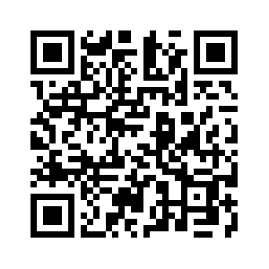
Donate with our QR code app to
Amazing Grace Christian Fellowship
Donations are Deeply Appreciated!

