Slide 3
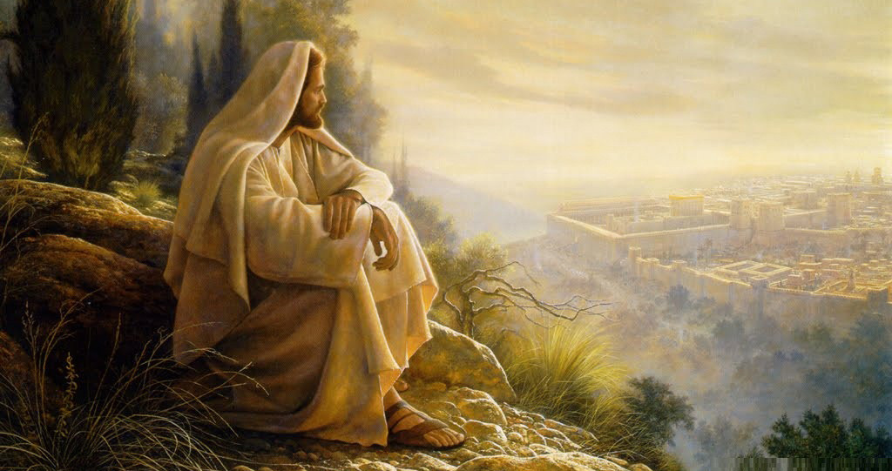
Being Alone with Jesus
By Pastor Fee Soliven
Matthew 14:22-27
Sunday Afternoon
September 1, 2024

Slide 4
Matthew 14:22-27
22 Immediately Jesus made His disciples get into the boat and go before Him to the other side, while He sent the multitudes away. 23 And when He had sent the multitudes away, He went up on the mountain by Himself to pray. Now when evening came, He was alone there. 24 But the boat was now in the middle of the sea, tossed by the waves, for the wind was contrary.

Slide 5
25 Now in the fourth watch of the night Jesus went to them, walking on the sea. 26 And when the disciples saw Him walking on the sea, they were troubled, saying, "It is a ghost!" And they cried out for fear. 27 But immediately Jesus spoke to them, saying, "Be of good cheer! It is I; do not be afraid."

Slide 6
Stress is a killer, but we can’t escape it since we’re surrounded by distressing situations of all kinds

Slide 7
How are we going to handle it?

Slide 8
Philippians 4:6-7
6 Be anxious for nothing, but in everything by prayer and supplication, with thanksgiving, let your requests be made known to God; 7 and the peace of God, which surpasses all understanding, will guard your hearts and minds through Christ Jesus.

Slide 9
Jesus also experienced stress, but He knew exactly how to handle it

Slide 10
Matthew 14:22-23
22 Immediately Jesus made His disciples get into the boat and go before Him to the other side, while He sent the multitudes away. 23 And when He had sent the multitudes away, He went up on the mountain by Himself to pray. Now when evening came, He was alone there.

Slide 11
Galatians 1:15-17
15 But then something happened! For even before I was born, God had chosen me to be his and called me-what kindness and grace- 16 to reveal his Son within me so that I could go to the Gentiles and show them the Good News about Jesus. When all this happened to me I didn't go at once and talk it over with anyone else;

Slide 12
17 I didn't go up to Jerusalem to consult with those who were apostles before I was. No, I went away into the deserts of Arabia and then came back to the city of Damascus.

Slide 13
1. The Practice of Solitude

Slide 14
Psalm 51:1-13
1 Have mercy upon me, O God, According to Your lovingkindness; According to the multitude of Your tender mercies, Blot out my transgressions. 2 Wash me thoroughly from my iniquity, And cleanse me from my sin.

Slide 15
3 For I acknowledge my transgressions, And my sin is always before me. 4 Against You, You only, have I sinned, And done this evil in Your sight--That You may be found just when You speak, And blameless when You judge.

Slide 16
5 Behold, I was brought forth in iniquity, And in sin my mother conceived me. 6 Behold, You desire truth in the inward parts, And in the hidden part You will make me to know wisdom.

Slide 17
7 Purge me with hyssop, and I shall be clean; Wash me, and I shall be whiter than snow. 8 Make me to hear joy and gladness, That the bones You have broken may rejoice. 9 Hide Your face from my sins, And blot out all my iniquities.

Slide 18
10 Create in me a clean heart, O God, And renew a steadfast spirit within me. 11 Do not cast me away from Your presence, And do not take Your Holy Spirit from me. 12 Restore to me the joy of Your salvation, And uphold me by Your generous Spirit. 13 Then I will teach transgressors Your ways, And sinners shall be converted to You.

Slide 19
2. Reasons for Solitude

Slide 20
For a Relationship

Slide 21
Genesis 1:26
26 Then God said, "Let Us make man in Our image, according to Our likeness; let them have dominion over the fish of the sea, over the birds of the air, and over the cattle, over all the earth and over every creeping thing that creeps on the earth."

Slide 22
Romans 5:7-8
7 For scarcely for a righteous man will one die; yet perhaps for a good man someone would even dare to die. 8 But God demonstrates His own love toward us, in that while we were still sinners, Christ died for us.

Slide 23
For Preparation

Slide 24
Experiencing Solitude

Slide 25
By opening God’s Word to focus on Him

Slide 26
Joshua 1:8
“This Book of the Law shall not depart from your mouth, but you shall meditate in it day and night, that you may observe to do according to all that is written in it. For then you will make your way prosperous, and then you will have good success”

Slide 27
Psalm 16:11
“You will show me the path of life; In Your presence is fullness of joy; At Your right hand are pleasures forevermore.”

Slide 28
By Eliminating Distractions

Slide 29
2 Corinthians 10:4-6
4 For the weapons of our warfare are not carnal but mighty in God for pulling down strongholds, 5 casting down arguments and every high thing that exalts itself against the knowledge of God, bringing every thought into captivity to the obedience of Christ, 6 and being ready to punish all disobedience when your obedience is fulfilled.

Slide 30
Benefits of Solitude

Slide 31
1. Makes our Busy Days More Fruitful

Slide 32
Colossians 1:10
“that you may have a walk worthy of the Lord, fully pleasing Him, being fruitful in every good work and increasing in the knowledge of God”

Slide 33
2. Repairs Damage

Slide 34
Acts 3:19
“Repent therefore and be converted, that your sins may be blotted out, so that times of refreshing may come from the presence of the Lord”

Slide 35
3. Equips us to Face the Tough Days

Slide 36
4. Creates Surprising Moments

Slide 37
5. Strips us of Pride

Slide 38
6. Protects Health

Slide 39
7. Makes a Difference in Relationships

Slide 40
8. Gives Peace and Joy

Slide 41
9. Gives Greater Strength from the Lord

Slide 42
10. Produces Greater Trust in God

Slide 43
11. Develops a Deeper Relationship with the Lord

Slide 44
1. How do you normally handle stress in your life?

Slide 45
2. In what way is solitude different from another form of stress relief you’ve experienced?

Slide 46
3. Have you ever practiced solitude with God as a solution to stress?

Slide 47
4. What benefits have become evident from your practice of solitude?

Slide 48
5. Would you recommend it to others who are dealing with stress?

Slide 49
1 Thessalonians 4:13-18
13 But I do not want you to be ignorant, brethren, concerning those who have fallen asleep, lest you sorrow as others who have no hope. 14 For if we believe that Jesus died and rose again, even so God will bring with Him those who sleep in Jesus.

Slide 50
15 For this we say to you by the word of the Lord, that we who are alive and remain until the coming of the Lord will by no means precede those who are asleep. 16 For the Lord Himself will descend from heaven with a shout, with the voice of an archangel, and with the trumpet of God. And the dead in Christ will rise first.

Slide 51
17 Then we who are alive and remain shall be caught up together with them in the clouds to meet the Lord in the air. And thus we shall always be with the Lord. 18 Therefore comfort one another with these words.

Slide 52
1 Corinthians 15:50-54
50 Now this I say, brethren, that flesh and blood cannot inherit the kingdom of God; nor does corruption inherit incorruption. 51 Behold, I tell you a mystery: We shall not all sleep, but we shall all be changed-- 52 in a moment, in the twinkling of an eye, at the last trumpet. For the trumpet will sound, and the dead will be raised incorruptible, and we shall be changed.

Slide 53
53 For this corruptible must put on incorruption, and this mortal must put on immortality. 54 So when this corruptible has put on incorruption, and this mortal has put on immortality, then shall be brought to pass the saying that is written: "Death is swallowed up in victory."

Slide 54
20 Again, when a righteous man turns from his righteousness and commits iniquity, and I lay a stumbling block before him, he shall die; because you did not give him warning, he shall die in his sin, and his righteousness which he has done shall not be remembered; but his blood I will require at your hand.

Slide 55
Acts 2:38-39
38 Then Peter said to them, "Repent, and let every one of you be baptized in the name of Jesus Christ for the remission of sins; and you shall receive the gift of the Holy Spirit. 39 For the promise is to you and to your children, and to all who are afar off, as many as the Lord our God will call."

Slide 56
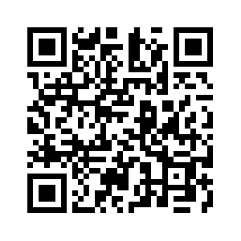
Donate with our QR code app to
Amazing Grace Christian Fellowship
Donations are Deeply Appreciated!

