Slide 3
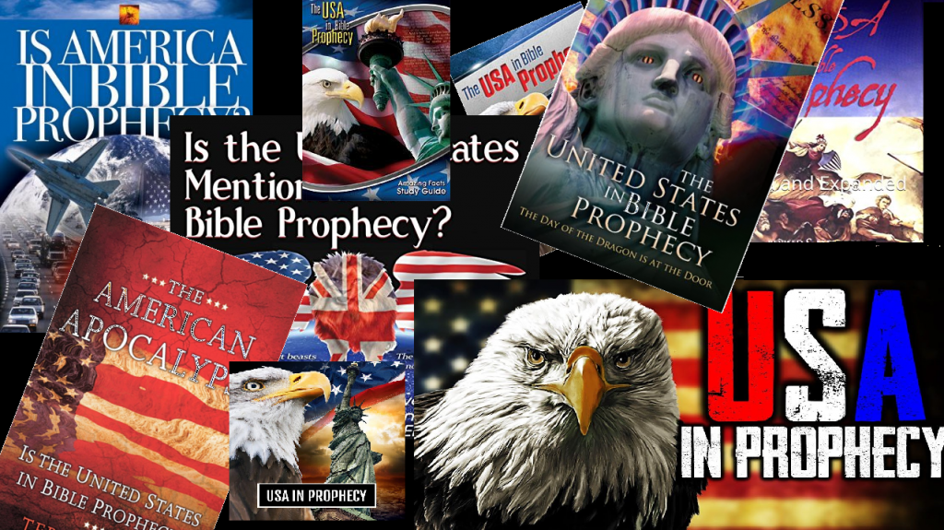
Mystery Babylon Part 1
by Pastor Fee Soliven
Revelation 18:1-24
Sunday Afternoon
September 8, 2024

Slide 4
Revelation 18:1-24
1 After these things I saw another angel coming down from heaven, having great authority, and the earth was illuminated with his glory. 2 And he cried mightily with a loud voice, saying, "Babylon the great is fallen, is fallen, and has become a dwelling place of demons, a prison for every foul spirit, and a cage for every unclean and hated bird!

Slide 5
3 For all the nations have drunk of the wine of the wrath of her fornication, the kings of the earth have committed fornication with her, and the merchants of the earth have become rich through the abundance of her luxury." 4 And I heard another voice from heaven saying, "Come out of her, my people, lest you share in her sins, and lest you receive of her plagues.

Slide 6
5 For her sins have reached to heaven, and God has remembered her iniquities. 6 Render to her just as she rendered to you, and repay her double according to her works; in the cup which she has mixed, mix double for her. 7 In the measure that she glorified herself and lived luxuriously, in the same measure give her torment and sorrow; for she says in her heart, 'I sit as queen, and am no widow, and will not see sorrow.'

Slide 7
8 "Therefore her plagues will come in one day--death and mourning and famine. And she will be utterly burned with fire, for strong is the Lord God who judges her. 9 "The kings of the earth who committed fornication and lived luxuriously with her will weep and lament for her, when they see the smoke of her burning,

Slide 8
10 standing at a distance for fear of her torment, saying, 'Alas, alas, that great city Babylon, that mighty city! For in one hour your judgment has come.' 11 "And the merchants of the earth will weep and mourn over her, for no one buys their merchandise anymore: 12 merchandise of gold and silver, precious stones and pearls, fine linen and purple, silk and scarlet, every kind of citron wood, every kind of object of ivory, every kind of object of most precious wood, bronze, iron, and marble;

Slide 9
13 and cinnamon and incense, fragrant oil and frankincense, wine and oil, fine flour and wheat, cattle and sheep, horses and chariots, and bodies and souls of men. 14 The fruit that your soul longed for has gone from you, and all the things which are rich and splendid have gone from you, and you shall find them no more at all. 15 The merchants of these things, who became rich by her, will stand at a distance for fear of her torment, weeping and wailing,

Slide 10
16 and saying, 'Alas, alas, that great city that was clothed in fine linen, purple, and scarlet, and adorned with gold and precious stones and pearls! 17 For in one hour such great riches came to nothing.' Every shipmaster, all who travel by ship, sailors, and as many as trade on the sea, stood at a distance 18 and cried out when they saw the smoke of her burning, saying, 'What is like this great city?'

Slide 11
19 "They threw dust on their heads and cried out, weeping and wailing, and saying, 'Alas, alas, that great city, in which all who had ships on the sea became rich by her wealth! For in one hour she is made desolate.' 20 "Rejoice over her, O heaven, and you holy apostles and prophets, for God has avenged you on her!"

Slide 12
21 Then a mighty angel took up a stone like a great millstone and threw it into the sea, saying, "Thus with violence the great city Babylon shall be thrown down, and shall not be found anymore. 22 The sound of harpists, musicians, flutists, and trumpeters shall not be heard in you anymore. No craftsman of any craft shall be found in you anymore, and the sound of a millstone shall not be heard in you anymore.

Slide 13
23 The light of a lamp shall not shine in you anymore, and the voice of bridegroom and bride shall not be heard in you anymore. For your merchants were the great men of the earth, for by your sorcery all the nations were deceived. 24 And in her was found the blood of prophets and saints, and of all who were slain on the earth."

Slide 14
Revelation 17:3
So he carried me away in the Spirit into the wilderness. And I saw a woman sitting on a scarlet beast which was full of names of blasphemy, having seven heads and ten horns.

Slide 15
Daniel 12:4
“seal the book” for the mysteries of prophecy were appointed for the “time of the end” when “knowledge shall be increased”

Slide 16
John 16:13
However, when He, the Spirit of truth, has come, He will guide you into all truth; for He will not speak on His own authority, but whatever He hears He will speak; and He will tell you things to come.

Slide 17
Amos 3:7
Surely the Lord GOD does nothing, Unless He reveals His secret to His servants the prophets.

Slide 18
U.S. Providential Rise

Slide 19
1. Babylon Is Providentially Raised Up by God As A “Golden Cup In The Hand Of The Lord.”

Slide 20
Jeremiah 51:7
“Babylon hath been a golden cup in the LORD’s hand, that made all the earth drunken: the nations have drunken of her wine; therefore the nations are mad.”

Slide 21
2. Babylon Is The Seventh Of Eight Providential Nations.

Slide 22
Revelation 17:10-11
10 “They are also seven kings. Five have fallen, one is, the other has not yet come; but when he does come, he must remain for only a little while. 11 The beast who once was, and now is not, is an eighth king. He belongs to the seven and is going to his destruction.

Slide 23
3. Babylon Is A Mystery, Mysterion; A Secret Revealed To A Small Group Of People

Slide 24
The U.S. did not exist at the
time of the prophecies

Slide 25
Isaiah 47:7
And you said, 'I shall be a lady forever,' So that you did not take these things to heart, Nor remember the latter end of them.

Slide 26
Revelation 17:5
“And on her forehead a name was written: MYSTERY, BABYLON THE GREAT, THE MOTHER OF HARLOTS AND OF THE ABOMINATIONS OF THE EARTH”

Slide 27
Daniel 12:10
“Many shall be purified, made white, and refined, but the wicked shall do wickedly; and none of the wicked shall understand, but the wise shall understand”

Slide 28
Deuteronomy 29:29
"The secret things belong to the LORD our God, but those things which are revealed belong to us and to our children forever, that we may do all the words of this law”

Slide 29
4. Babylon Appears Before The Antichrist And The Ten Nations Emerge.

Slide 30
Revelation 17:10-12
10 There are also seven kings. Five have fallen, one is, and the other has not yet come. And when he comes, he must continue a short time. 11 And the beast that was, and is not, is himself also the eighth, and is of the seven, and is going to perdition. 12 The ten horns which you saw are ten kings who have received no kingdom as yet, but they receive authority for one hour as kings with the beast.

Slide 31
5. Babylon Is Recognized By The World With The Symbol Of A Woman

Slide 32
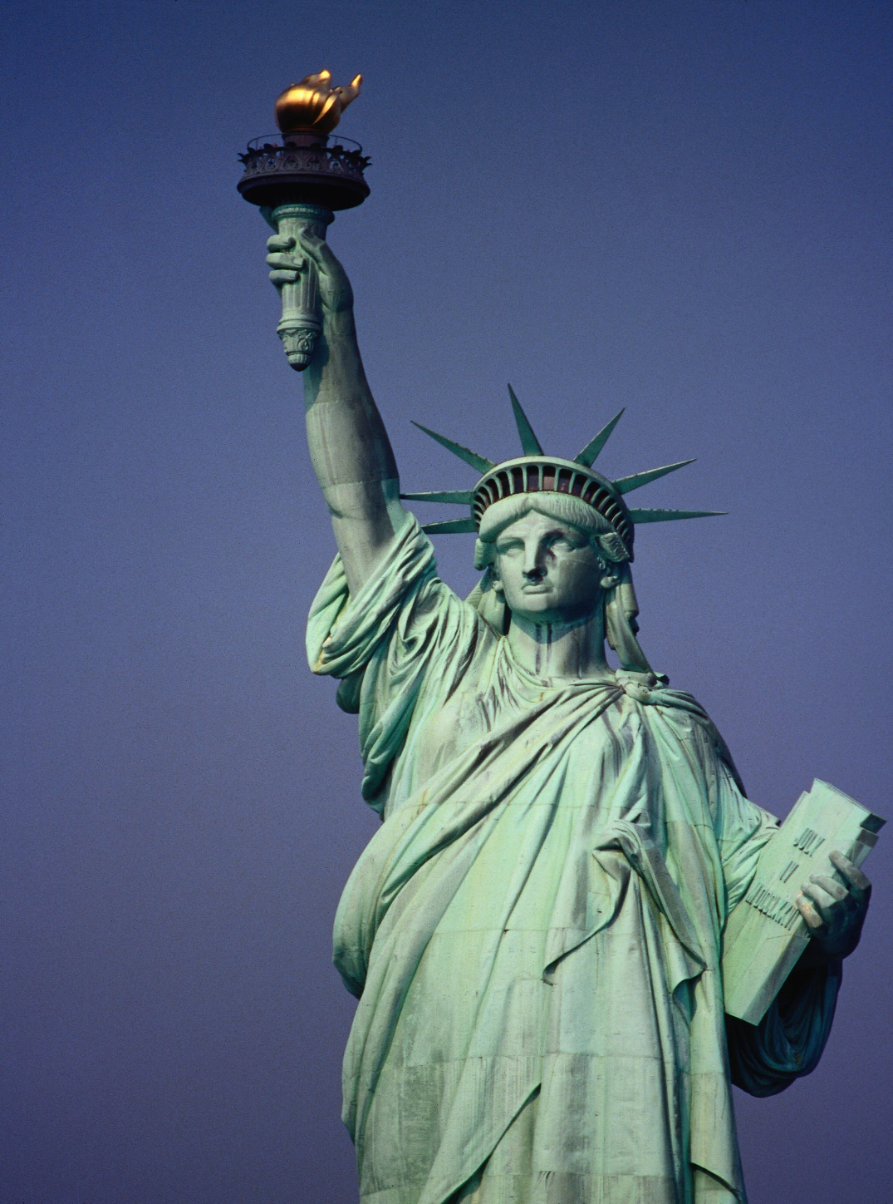
The global icon of the U.S. is Lady Liberty

Slide 33
Isaiah 47:5-7
5 "Sit in silence, and go into darkness, O daughter of the Chaldeans; For you shall no longer be called The Lady of Kingdoms. 6 I was angry with My people; I have profaned My inheritance, And given them into your hand. You showed them no mercy; On the elderly you laid your yoke very heavily. 7 And you said, 'I shall be a lady forever,' So that you did not take these things to heart, Nor remember the latter end of them.

Slide 34
Revelation 17:3
So he carried me away in the Spirit into the wilderness. And I saw a woman sitting on a scarlet beast which was full of names of blasphemy, having seven heads and ten horns.

Slide 35
Revelation 18:3
For all the nations have drunk of the wine of the wrath of her fornication, the kings of the earth have committed fornication with her, and the merchants of the earth have become rich through the abundance of her luxury."

Slide 36
6. Babylon Is The Wealthiest Of All Nations.

Slide 37
The U.S. has the highest GDP
in the world $ 25 Trillion
Gross Domestic Product

Slide 38
Revelation 18:3-4
3 For all the nations have drunk of the wine of the wrath of her fornication, the kings of the earth have committed fornication with her, and the merchants of the earth have become rich through the abundance of her luxury."

Slide 39
4 And I heard another voice from heaven saying, "Come out of her, my people, lest you share in her sins, and lest you receive of her plagues.

Slide 40
Revelation 18:16
and saying, 'Alas, alas, that great city that was clothed in fine linen, purple, and scarlet, and adorned with gold and precious stones and pearls!

Slide 41
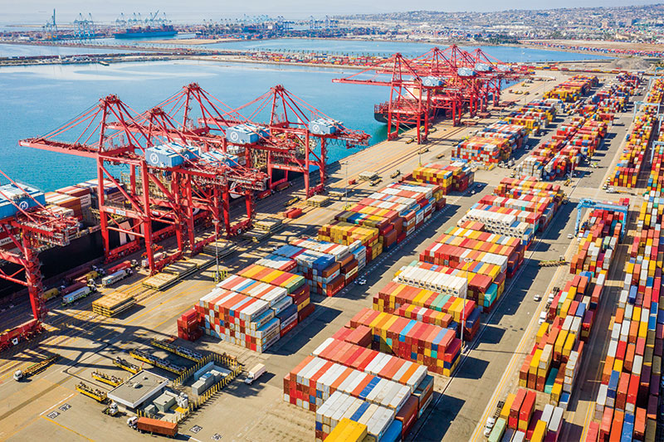
7. Babylon Trades With Merchants At Her Deep-Water Ports.

Slide 42
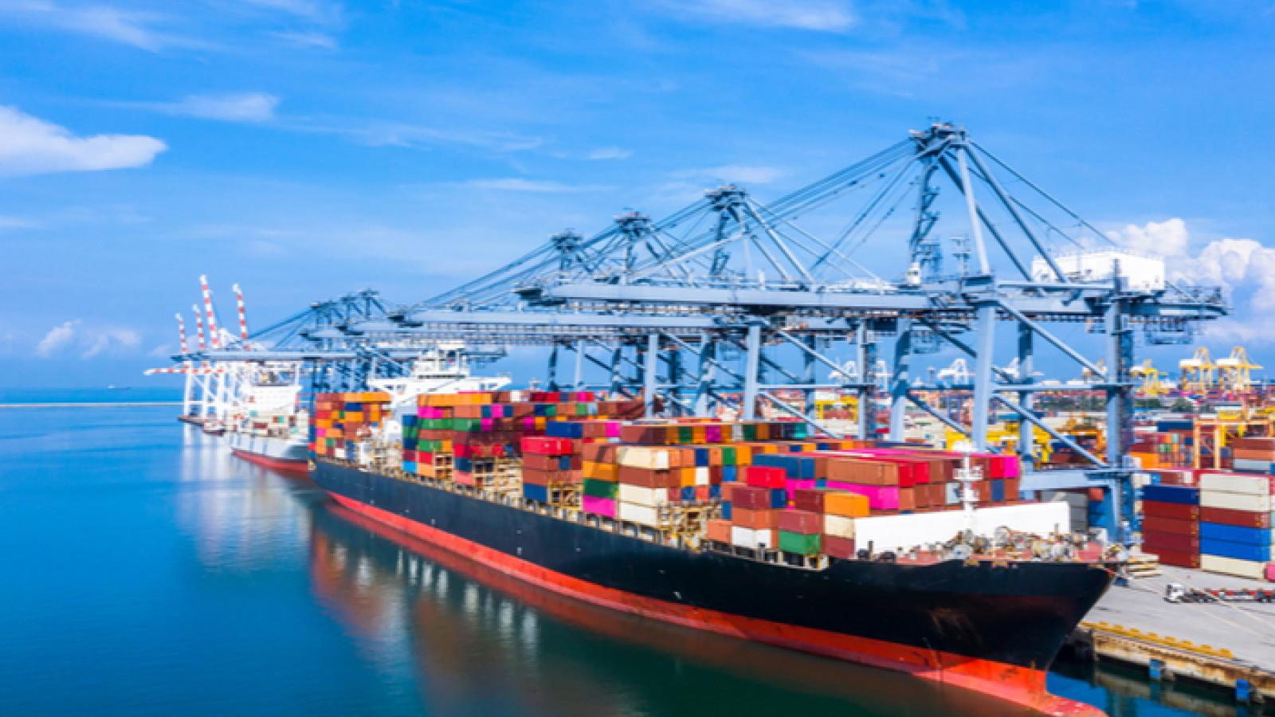
The U.S. has 40% of the worlds deep water ports

Slide 43
Revelation 18:17-19
17 For in one hour such great riches came to nothing.' Every shipmaster, all who travel by ship, sailors, and as many as trade on the sea, stood at a distance 18 and cried out when they saw the smoke of her burning, saying, 'What is like this great city?'

Slide 44
19 "They threw dust on their heads and cried out, weeping and wailing, and saying, 'Alas, alas, that great city, in which all who had ships on the sea became rich by her wealth! For in one hour she is made desolate.'

Slide 45
8. Babylon Trades All Twenty• Seven Products Listed In Scripture

Slide 46
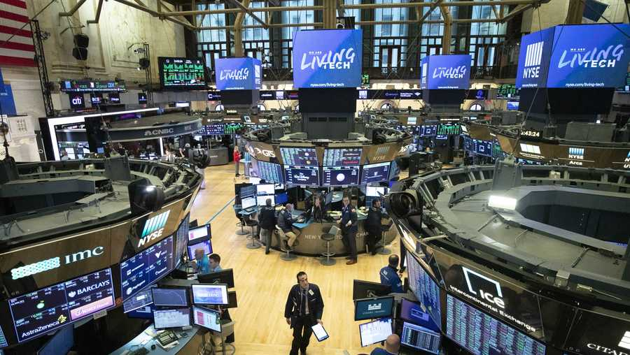
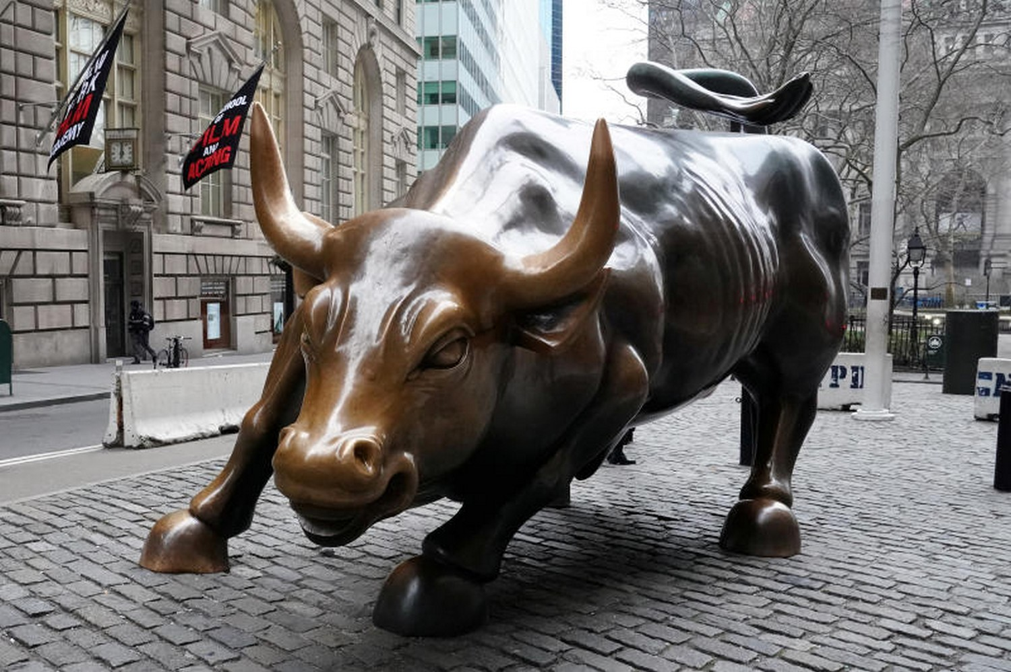
The NYSE is the world's largest stock exchange

Slide 47
Revelation 18:12-13
12 merchandise of gold and silver, precious stones and pearls, fine linen and purple, silk and scarlet, every kind of citron wood, every kind of object of ivory, every kind of object of most precious wood, bronze, iron, and marble; 13 and cinnamon and incense, fragrant oil and frankincense, wine and oil, fine flour and wheat, cattle and sheep, horses and chariots, and bodies and souls of men.

Slide 48
9. Babylon Has Traded in
"Slaves and Souls Of Men."

Slide 49
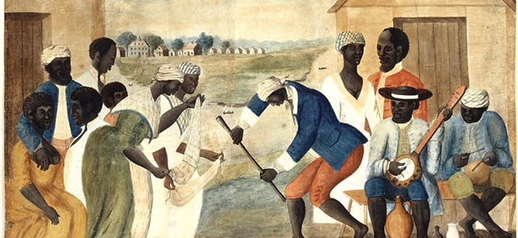
The U.S. practiced slavery until 1865

Slide 50
Revelation 18:13
and cinnamon and incense, fragrant oil and frankincense, wine and oil, fine flour and wheat, cattle and sheep, horses and chariots, and bodies and souls of men.

Slide 51
10. Babylon Makes Merchants of The Earth Rich Through the Abundance of Her Delicacies.

Slide 52
The U.S. is the largest importer of
goods in the world

Slide 53
Revelation 18:19
"They threw dust on their heads and cried out, weeping and wailing, and saying, 'Alas, alas, that great city, in which all who had ships on the sea became rich by her wealth! For in one hour she is made desolate.'

Slide 54
Revelation 18:15
The merchants of these things, who became rich by her, will stand at a distance for fear of her torment, weeping and wailing…

Slide 55
11. BABYLON HAS A WORLD CURRENCY THAT DOMINATES THE 7 MOUNTAINS CONTINENTS OF THE EARTH.

Slide 56
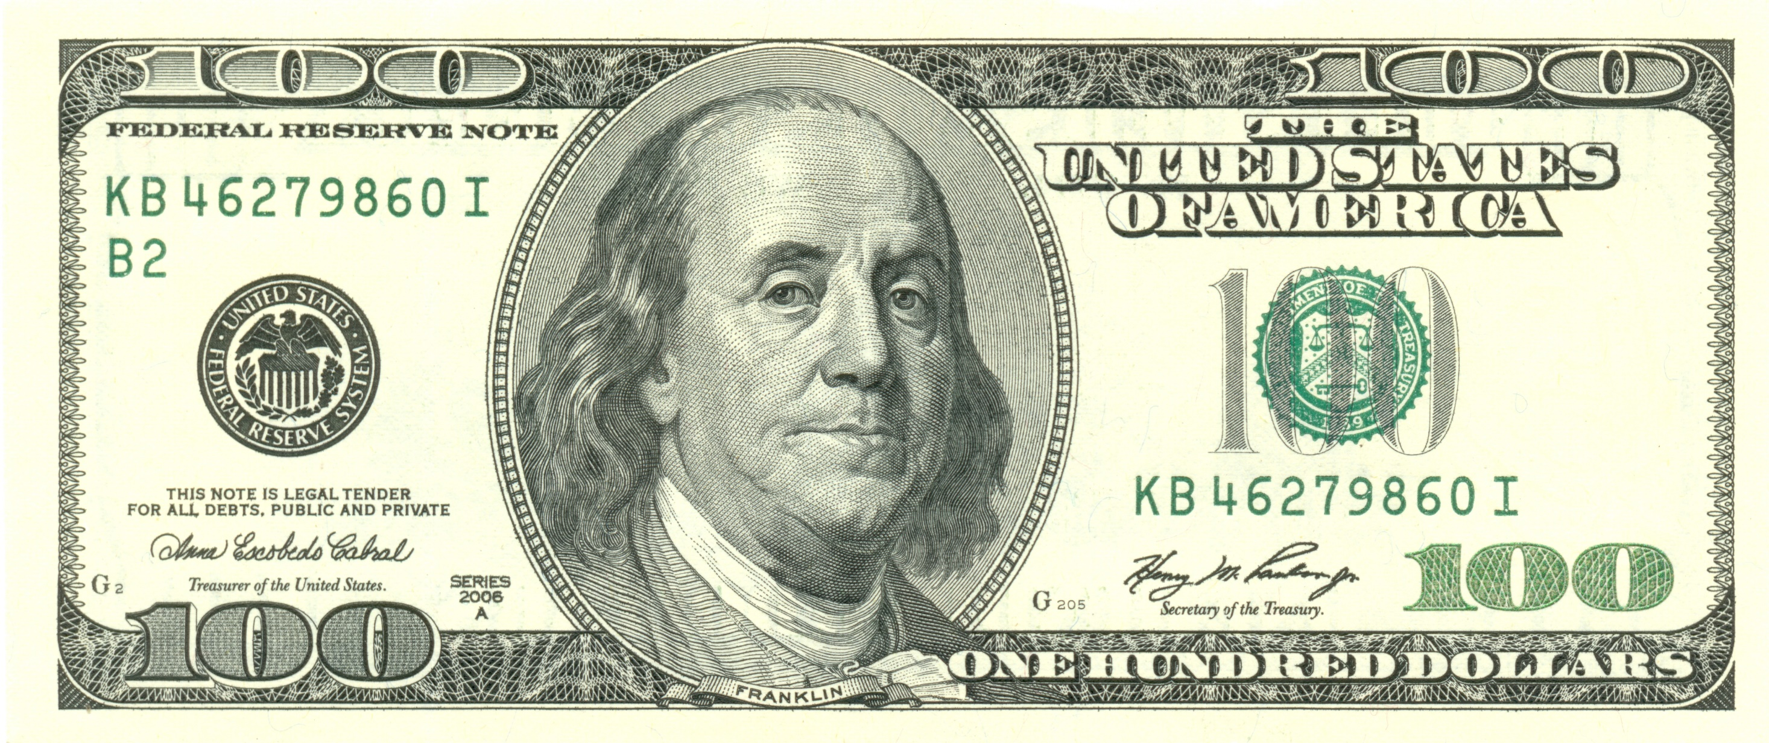
The U.S. dollar has been the world currency since 1944 Britton woods agreement

Slide 57
Revelation 17:9
“Here is the mind which has wisdom: The seven heads are seven mountains on which the woman sits”

Slide 58
Revelation 17:18
And the woman whom you saw is that great city which reigns over the kings of the earth."

Slide 59
Revelation 18:9
"The kings of the earth who committed fornication and lived luxuriously with her will weep and lament for her, when they see the smoke of her burning…

Slide 60
Revelation 18:15
The merchants of these things, who became rich by her, will stand at a distance for fear of her torment, weeping and wailing…

Slide 61
U.S. Providential Blessings

Slide 62
12. Babylon has the Greatest Military Force in The World

Slide 63
The U.S. spends more annually on military than the next 4 leading countries combined

Slide 64
Revelation 17:9
“Here is the mind which has wisdom: The seven heads are seven mountains on which the woman sits”

Slide 65
Revelation 17:18
And the woman whom you saw is that great city which reigns over the kings of the earth."

Slide 66
13. Babylon Uses Her Military to “Police” or “Rule Over” The Seven Mountains of the Earth.

Slide 67
Revelation 17:3
So he carried me away in the Spirit into the wilderness. And I saw a woman sitting on a scarlet beast which was full of names of blasphemy, having seven heads and ten horns.

Slide 68
1 Thessalonians 4:13-18
13 But I do not want you to be ignorant, brethren, concerning those who have fallen asleep, lest you sorrow as others who have no hope. 14 For if we believe that Jesus died and rose again, even so God will bring with Him those who sleep in Jesus.

Slide 69
15 For this we say to you by the word of the Lord, that we who are alive and remain until the coming of the Lord will by no means precede those who are asleep. 16 For the Lord Himself will descend from heaven with a shout, with the voice of an archangel, and with the trumpet of God. And the dead in Christ will rise first.

Slide 70
17 Then we who are alive and remain shall be caught up together with them in the clouds to meet the Lord in the air. And thus we shall always be with the Lord. 18 Therefore comfort one another with these words.

Slide 71
1 Corinthians 15:50-54
50 Now this I say, brethren, that flesh and blood cannot inherit the kingdom of God; nor does corruption inherit incorruption. 51 Behold, I tell you a mystery: We shall not all sleep, but we shall all be changed-- 52 in a moment, in the twinkling of an eye, at the last trumpet. For the trumpet will sound, and the dead will be raised incorruptible, and we shall be changed.

Slide 72
53 For this corruptible must put on incorruption, and this mortal must put on immortality. 54 So when this corruptible has put on incorruption, and this mortal has put on immortality, then shall be brought to pass the saying that is written: "Death is swallowed up in victory."

Slide 73
20 Again, when a righteous man turns from his righteousness and commits iniquity, and I lay a stumbling block before him, he shall die; because you did not give him warning, he shall die in his sin, and his righteousness which he has done shall not be remembered; but his blood I will require at your hand.

Slide 74
Acts 2:38-39
38 Then Peter said to them, "Repent, and let every one of you be baptized in the name of Jesus Christ for the remission of sins; and you shall receive the gift of the Holy Spirit. 39 For the promise is to you and to your children, and to all who are afar off, as many as the Lord our God will call."

Slide 75
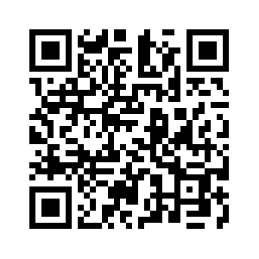
Donate with our QR code app to
Amazing Grace Christian Fellowship
Donations are Deeply Appreciated!

Slide 76
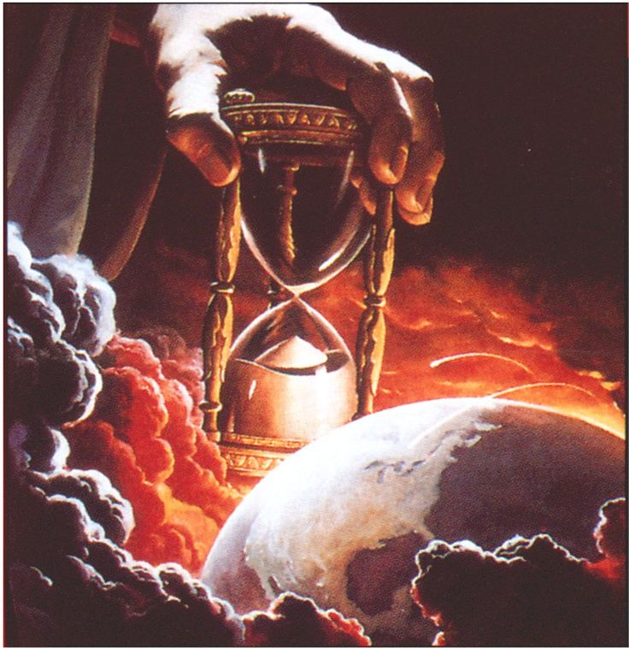
The Message
Jesus is Returning Soon!
We are living on Bowered Time!
Are You Ready To Meet King Jesus?

