Slide 2
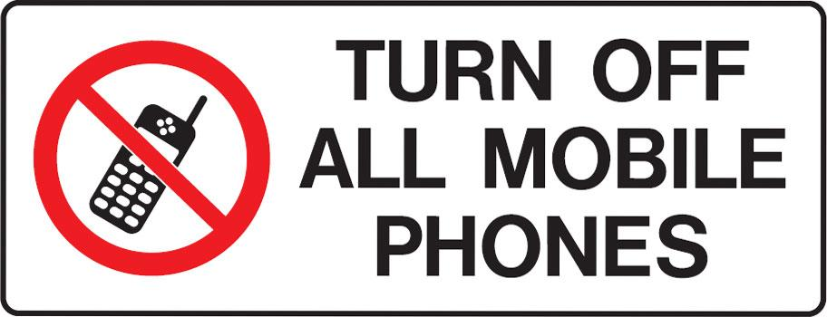

Slide 3
"Behold, I lay in Zion a Stumbling Stone”
by Pastor Fee Soliven
Romans 9:27-33
Thursday Evening
October 10, 2024

Slide 4
Romans 9:27-33
27 Isaiah also cries out concerning Israel: "Though the number of the children of Israel be as the sand of the sea, The remnant will be saved. 28 For He will finish the work and cut it short in righteousness, Because the LORD will make a short work upon the earth."

Slide 5
29 And as Isaiah said before: "Unless the LORD of Sabaoth had left us a seed, We would have become like Sodom, and we would have been made like Gomorrah." 30 What shall we say then? That Gentiles, who did not pursue righteousness, have attained to righteousness, even the righteousness of faith;

Slide 6
31 but Israel, pursuing the law of righteousness, has not attained to the law of righteousness. 32 Why? Because they did not seek it by faith, but as it were, by the works of the law. For they stumbled at that stumbling stone.

Slide 7
33 As it is written: "Behold, I lay in Zion a stumbling stone and rock of offense, And whoever believes on Him will not be put to shame."

Slide 8
27 Isaiah also cries out concerning Israel: "Though the number of the children of Israel be as the sand of the sea, The remnant will be saved.

Slide 9
Isaiah 10:23
For the Lord GOD of hosts Will make a determined end In the midst of all the land.

Slide 10
28 For He will finish the work and cut it short in righteousness, Because the LORD will make a short work upon the earth."

Slide 11
Genesis 19:24-29
24 Then the LORD rained brimstone and fire on Sodom and Gomorrah, from the LORD out of the heavens. 25 So He overthrew those cities, all the plain, all the inhabitants of the cities, and what grew on the ground. 26 But his wife looked back behind him, and she became a pillar of salt.

Slide 12
27 And Abraham went early in the morning to the place where he had stood before the LORD. 28 Then he looked toward Sodom and Gomorrah, and toward all the land of the plain; and he saw, and behold, the smoke of the land which went up like the smoke of a furnace.

Slide 13
29 And it came to pass, when God destroyed the cities of the plain, that God remembered Abraham, and sent Lot out of the midst of the overthrow, when He overthrew the cities in which Lot had dwelt.

Slide 14
Isaiah 1:9
Unless the LORD of hosts Had left to us a very small remnant, We would have become like Sodom, We would have been made like Gomorrah.

Slide 15
29 And as Isaiah said before: "Unless the LORD of Sabaoth had left us a seed, We would have become like Sodom, and we would have been made like Gomorrah."

Slide 16
Genesis 19:23-26
23 The sun had risen upon the earth when Lot entered Zoar. 24 Then the LORD rained brimstone and fire on Sodom and Gomorrah, from the LORD out of the heavens. 25 So He overthrew those cities, all the plain, all the inhabitants of the cities, and what grew on the ground. 26 But his wife looked back behind him, and she became a pillar of salt.

Slide 17
30 What shall we say then? That Gentiles, who did not pursue righteousness, have attained to righteousness, even the righteousness of faith;

Slide 18
Galatians 2:16-18
16 knowing that a man is not justified by the works of the law but by faith in Jesus Christ, even we have believed in Christ Jesus, that we might be justified by faith in Christ and not by the works of the law; for by the works of the law no flesh shall be justified.

Slide 19
17 But if, while we seek to be justified by Christ, we ourselves also are found sinners, is Christ therefore a minister of sin? Certainly not! 18 For if I build again those things which I destroyed, I make myself a transgressor.

Slide 20
31 but Israel, pursuing the law of righteousness, has not attained to the law of righteousness.

Slide 21
Titus 3:3-7
3 For we ourselves were also once foolish, disobedient, deceived, serving various lusts and pleasures, living in malice and envy, hateful and hating one another. 4 But when the kindness and the love of God our Savior toward man appeared,

Slide 22
5 not by works of righteousness which we have done, but according to His mercy He saved us, through the washing of regeneration and renewing of the Holy Spirit, 6 whom He poured out on us abundantly through Jesus Christ our Savior, 7 that having been justified by His grace we should become heirs according to the hope of eternal life.

Slide 23
2 Peter 2:4-8
4 For if God did not spare the angels who sinned, but cast them down to hell and delivered them into chains of darkness, to be reserved for judgment; 5 and did not spare the ancient world, but saved Noah, one of eight people, a preacher of righteousness, bringing in the flood on the world of the ungodly;

Slide 24
6 and turning the cities of Sodom and Gomorrah into ashes, condemned them to destruction, making them an example to those who afterward would live ungodly; 7 and delivered righteous Lot, who was oppressed by the filthy conduct of the wicked

Slide 25
8(for that righteous man, dwelling among them, tormented his righteous soul from day to day by seeing and hearing their lawless deeds)

Slide 26
32 Why? Because they did not seek it by faith, but as it were, by the works of the law. For they stumbled at that stumbling stone.

Slide 27
Galatians 2:14-18
14 But when I saw that they were not straightforward about the truth of the gospel, I said to Peter before them all, "If you, being a Jew, live in the manner of Gentiles and not as the Jews, why do you compel Gentiles to live as Jews?

Slide 28
15 We who are Jews by nature, and not sinners of the Gentiles, 16 knowing that a man is not justified by the works of the law but by faith in Jesus Christ, even we have believed in Christ Jesus, that we might be justified by faith in Christ and not by the works of the law; for by the works of the law no flesh shall be justified.

Slide 29
17 But if, while we seek to be justified by Christ, we ourselves also are found sinners, is Christ therefore a minister of sin? Certainly not! 18 For if I build again those things which I destroyed, I make myself a transgressor.

Slide 30
33 As it is written: "Behold, I lay in Zion a stumbling stone and rock of offense, And whoever believes on Him will not be put to shame."

Slide 31
1 Peter 2:6-10
6 Therefore it is also contained in the Scripture, "Behold, I lay in Zion A chief cornerstone, elect, precious, And he who believes on Him will by no means be put to shame."

Slide 32
7 Therefore, to you who believe, He is precious; but to those who are disobedient, "The stone which the builders rejected Has become the chief cornerstone," 8 and "A stone of stumbling And a rock of offense." They stumble, being disobedient to the word, to which they also were appointed.

Slide 33
9 But you are a chosen generation, a royal priesthood, a holy nation, His own special people, that you may proclaim the praises of Him who called you out of darkness into His marvelous light; 10 who once were not a people but are now the people of God, who had not obtained mercy but now have obtained mercy.

Slide 34
1 Thessalonians 4:13-18
13 But I do not want you to be ignorant, brethren, concerning those who have fallen asleep, lest you sorrow as others who have no hope. 14 For if we believe that Jesus died and rose again, even so God will bring with Him those who sleep in Jesus.

Slide 35
15 For this we say to you by the word of the Lord, that we who are alive and remain until the coming of the Lord will by no means precede those who are asleep. 16 For the Lord Himself will descend from heaven with a shout, with the voice of an archangel, and with the trumpet of God. And the dead in Christ will rise first.

Slide 36
17 Then we who are alive and remain shall be caught up together with them in the clouds to meet the Lord in the air. And thus we shall always be with the Lord. 18 Therefore comfort one another with these words.

Slide 37
1 Corinthians 15:50-54
50 Now this I say, brethren, that flesh and blood cannot inherit the kingdom of God; nor does corruption inherit incorruption. 51 Behold, I tell you a mystery: We shall not all sleep, but we shall all be changed-- 52 in a moment, in the twinkling of an eye, at the last trumpet. For the trumpet will sound, and the dead will be raised incorruptible, and we shall be changed.

Slide 38
53 For this corruptible must put on incorruption, and this mortal must put on immortality. 54 So when this corruptible has put on incorruption, and this mortal has put on immortality, then shall be brought to pass the saying that is written: "Death is swallowed up in victory."

Slide 39
20 Again, when a righteous man turns from his righteousness and commits iniquity, and I lay a stumbling block before him, he shall die; because you did not give him warning, he shall die in his sin, and his righteousness which he has done shall not be remembered; but his blood I will require at your hand.

Slide 40
Acts 2:38-39
38 Then Peter said to them, "Repent, and let every one of you be baptized in the name of Jesus Christ for the remission of sins; and you shall receive the gift of the Holy Spirit. 39 For the promise is to you and to your children, and to all who are afar off, as many as the Lord our God will call."

Slide 41
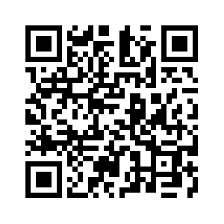
Donate with our QR code app to
Amazing Grace Christian Fellowship
Donations are Deeply Appreciated!

