Slide 3
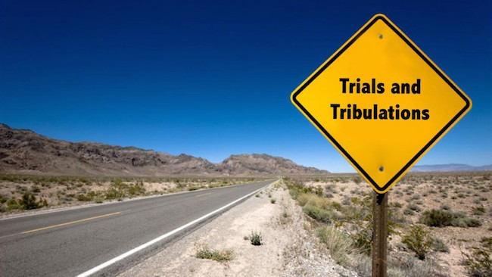
Jesus Help Us Through This Life
by Pastor Fee Soliven
1 Peter 1:3-7
Sunday Morning
November 3, 2024

Slide 4
1 Peter 1:3-7
3 Blessed be the God and Father of our Lord Jesus Christ, who according to His abundant mercy has begotten us again to a living hope through the resurrection of Jesus Christ from the dead,

Slide 5
4 to an inheritance incorruptible and undefiled and that does not fade away, reserved in heaven for you, 5 who are kept by the power of God through faith for salvation ready to be revealed in the last time. 6 In this you greatly rejoice, though now for a little while, if need be, you have been grieved by various trials,

Slide 6
7 that the genuineness of your faith, being much more precious than gold that perishes, though it is tested by fire, may be found to praise, honor, and glory at the revelation of Jesus Christ...

Slide 7
Throughout the World,
People are Hurting

Slide 8
“Where’s God in all this?”

Slide 9
1 Peter 1:4-5
4 to an inheritance incorruptible and undefiled and that does not fade away, reserved in heaven for you, 5 who are kept by the power of God through faith for salvation ready to be revealed in the last time.

Slide 10
Although our pain and trouble may seem pointless to us, God has a divine purpose for everything He allows into our lives

Slide 11
Romans 8:28-30
28 And we know that all things work together for good to those who love God, to those who are the called according to His purpose. 29 For whom He foreknew, He also predestined to be conformed to the image of His Son, that He might be the firstborn among many brethren.

Slide 12
30 Moreover whom He predestined, these He also called; whom He called, these He also justified; and whom He justified, these He also glorified.

Slide 13
2 Timothy 1:8-9
8 Therefore do not be ashamed of the testimony of our Lord, nor of me His prisoner, but share with me in the sufferings for the gospel according to the power of God, 9 who has saved us and called us with a holy calling, not according to our works, but according to His own purpose and grace which was given to us in Christ Jesus before time began...

Slide 14
God uses life’s trials to accomplish
His secondary purposes

Slide 15
To Surface Whatever is
Detrimental in our Lives

Slide 16
Psalms 51:1-4
1 Have mercy upon me, O God, According to Your lovingkindness; According to the multitude of Your tender mercies, Blot out my transgressions. 2 Wash me thoroughly from my iniquity, And cleanse me from my sin.

Slide 17
3 For I acknowledge my transgressions, And my sin is always before me. 4 Against You, You only, have I sinned, And done this evil in Your sight--That You may be found just when You speak, And blameless when You judge.

Slide 18
Psalm 51:5-11
5 Behold, I was brought forth in iniquity, And in sin my mother conceived me. 6 Behold, You desire truth in the inward parts, And in the hidden part You will make me to know wisdom. 7 Purge me with hyssop, and I shall be clean; Wash me, and I shall be whiter than snow.

Slide 19
8 Make me to hear joy and gladness, That the bones You have broken may rejoice. 9 Hide Your face from my sins, And blot out all my iniquities. 10 Create in me a clean heart, O God, And renew a steadfast spirit within me. 11 Do not cast me away from Your presence, And do not take Your Holy Spirit from me.

Slide 20
Psalm 51:17
"The sacrifices of God are a broken spirit, A broken and a contrite heart--These, O God, You will not despise."

Slide 21
2. To Test Our Faith

Slide 22
God uses Life’s Trials to accomplish His Secondary Purposes

Slide 23
1 Peter 1:7
"that the genuineness of your faith, being much more precious than gold that perishes, though it is tested by fire, may be found to praise, honor, and glory at the revelation of Jesus Christ..."

Slide 24
Romans 1:17
"For in it the righteousness of God is revealed from faith to faith; as it is written, "The just shall live by faith."

Slide 25
3. To Test our Devotion to God

Slide 26
Philippians 4:13
"I can do all things through Christ who strengthens me."

Slide 27
Luke 22:39-43
39 Coming out, He went to the Mount of Olives, as He was accustomed, and His disciples also followed Him. 40 When He came to the place, He said to them, "Pray that you may not enter into temptation."

Slide 28
41 And He was withdrawn from them about a stone's throw, and He knelt down and prayed, 42 saying, "Father, if it is Your will, take this cup away from Me; nevertheless not My will, but Yours, be done."

Slide 29
2 Corinthians 12:7-10
7 And lest I should be exalted above measure by the abundance of the revelations, a thorn in the flesh was given to me, a messenger of Satan to buffet me, lest I be exalted above measure.

Slide 30
8 Concerning this thing I pleaded with the Lord three times that it might depart from me. 9 And He said to me, "My grace is sufficient for you, for My strength is made perfect in weakness." Therefore most gladly I will rather boast in my infirmities, that the power of Christ may rest upon me.

Slide 31
10 Therefore I take pleasure in infirmities, in reproaches, in needs, in persecutions, in distresses, for Christ's sake. For when I am weak, then I am strong.

Slide 32
The Lord’s Primary Purpose is to conform us to the Image of His Son

Slide 33
Romans 8:29
29 For whom He foreknew, He also predestined to be conformed to the image of His Son, that He might be the firstborn among many brethren.

Slide 34
Romans 8:31
"What then shall we say to these things? If God is for us, who can be against us?"

Slide 35
God has a process for developing Christlike Character

Slide 36
1. He Controls Every Trial

Slide 37
1 Corinthians 10:13
"No temptation has overtaken you except such as is common to man; but God is faithful, who will not allow you to be tempted beyond what you are able, but with the temptation will also make the way of escape, that you may be able to bear it."

Slide 38
2. He Designs Trials to Fit Us

Slide 39
James 1:2-4
2 My brethren, count it all joy when you fall into various trials, 3 knowing that the testing of your faith produces patience. 4 But let patience have its perfect work, that you may be perfect and complete, lacking nothing.

Slide 40
3. He Uses Chastisement
\

Slide 41
Hebrews 12:5-6
5 And you have forgotten the exhortation which speaks to you as to sons: "My son, do not despise the chastening of the LORD, Nor be discouraged when you are rebuked by Him; 6 For whom the LORD loves He chastens, And scourges every son whom He receives."

Slide 42
4. He Uses Afflictions

Slide 43
2 Corinthians 4:7-9
7 But we have this treasure in earthen vessels, that the excellence of the power may be of God and not of us. 8 We are hard pressed on every side, yet not crushed; we are perplexed, but not in despair; 9 persecuted, but not forsaken; struck down, but not destroyed...

Slide 44
5. God’s Trials are Progressive

Slide 45
2 Peter 3:18
"but grow in the grace and knowledge of our Lord and Savior Jesus Christ. To Him be the glory both now and forever. Amen."

Slide 46
Our Response to Trials Determines the Outcome

Slide 47
1 Peter 1:6-9
6 In this you greatly rejoice, though now for a little while, if need be, you have been grieved by various trials, 7 that the genuineness of your faith, being much more precious than gold that perishes, though it is tested by fire, may be found to praise, honor, and glory at the revelation of Jesus Christ,

Slide 48
8 whom having not seen you love. Though now you do not see Him, yet believing, you rejoice with joy inexpressible and full of glory, 9 receiving the end of your faith--the salvation of your souls.

Slide 49
1 Thessalonians 4:13-18
13 But I do not want you to be ignorant, brethren, concerning those who have fallen asleep, lest you sorrow as others who have no hope. 14 For if we believe that Jesus died and rose again, even so God will bring with Him those who sleep in Jesus.

Slide 50
15 For this we say to you by the word of the Lord, that we who are alive and remain until the coming of the Lord will by no means precede those who are asleep. 16 For the Lord Himself will descend from heaven with a shout, with the voice of an archangel, and with the trumpet of God. And the dead in Christ will rise first.

Slide 51
17 Then we who are alive and remain shall be caught up together with them in the clouds to meet the Lord in the air. And thus we shall always be with the Lord. 18 Therefore comfort one another with these words.

Slide 52
1 Corinthians 15:50-54
50 Now this I say, brethren, that flesh and blood cannot inherit the kingdom of God; nor does corruption inherit incorruption. 51 Behold, I tell you a mystery: We shall not all sleep, but we shall all be changed-- 52 in a moment, in the twinkling of an eye, at the last trumpet. For the trumpet will sound, and the dead will be raised incorruptible, and we shall be changed.

Slide 53
53 For this corruptible must put on incorruption, and this mortal must put on immortality. 54 So when this corruptible has put on incorruption, and this mortal has put on immortality, then shall be brought to pass the saying that is written: "Death is swallowed up in victory."

Slide 54
20 Again, when a righteous man turns from his righteousness and commits iniquity, and I lay a stumbling block before him, he shall die; because you did not give him warning, he shall die in his sin, and his righteousness which he has done shall not be remembered; but his blood I will require at your hand.

Slide 55
Acts 2:38-39
38 Then Peter said to them, "Repent, and let every one of you be baptized in the name of Jesus Christ for the remission of sins; and you shall receive the gift of the Holy Spirit. 39 For the promise is to you and to your children, and to all who are afar off, as many as the Lord our God will call."

Slide 56
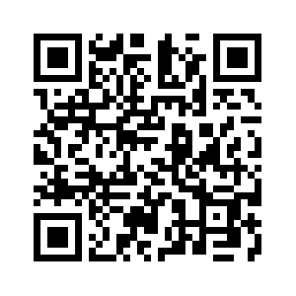
Donate with our QR code app to
Amazing Grace Christian Fellowship
Donations are Deeply Appreciated!

