Slide 3
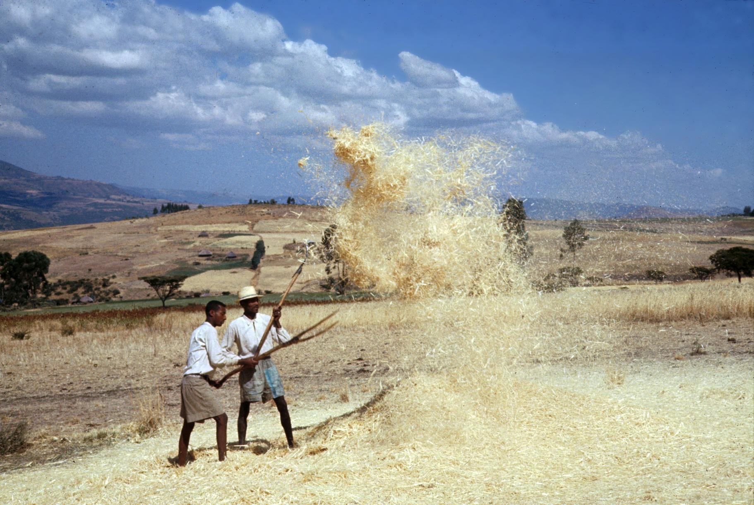
Being Sifted Like Wheat
By Pastor Fee Soliven
Luke 22:24-34
Sunday Morning
February 16, 2025

Slide 4
Luke 22:24-34
24 Then they began to argue among themselves about who would be the greatest among them. 25 Jesus told them, “In this world the kings and great men lord it over their people, yet they are called ‘friends of the people.’ 26 But among you it will be different. Those who are the greatest among you should take the lowest rank, and the leader should be like a servant.

Slide 5
27 Who is more important, the one who sits at the table or the one who serves? The one who sits at the table, of course. But not here! For I am among you as one who serves. 28 “You have stayed with me in my time of trial. 29 And just as my Father has granted me a Kingdom, I now grant you the right 30 to eat and drink at my table in my Kingdom. And you will sit on thrones, judging the twelve tribes of Israel.

Slide 6
31 “Simon, Simon, Satan has asked to sift each of you like wheat. 32 But I have pleaded in prayer for you, Simon, that your faith should not fail. So when you have repented and turned to me again, strengthen your brothers.” 33 Peter said, “Lord, I am ready to go to prison with you, and even to die with you.” 34 But Jesus said, “Peter, let me tell you something. Before the rooster crows tomorrow morning, you will deny three times that you even know me.”

Slide 7
Why does God allow us to be sifted, or tested, through hardship and
challenges in life?

Slide 8
1. He has a purpose behind every heartache

Slide 9
2. God desires for us to become available vessels through which He can do His work

Slide 10
3. God's purpose for each person who is saved is to serve Him

Slide 11
Ephesians 2:8-10
8 For by grace you have been saved through faith, and that not of yourselves; it is the gift of God, 9 not of works, lest anyone should boast. 10 For we are His workmanship, created in Christ Jesus for good works, which God prepared beforehand that we should walk in them.

Slide 12
Why does God want us to serve Him?

Slide 13
Mark 16:14-18
14 Later He appeared to the eleven as they sat at the table; and He rebuked their unbelief and hardness of heart, because they did not believe those who had seen Him after He had risen. 15 And He said to them, "Go into all the world and preach the gospel to every creature. 16 He who believes and is baptized will be saved; but he who does not believe will be condemned.

Slide 14
17 And these signs will follow those who believe: In My name they will cast out demons; they will speak with new tongues; 18 they will take up serpents; and if they drink anything deadly, it will by no means hurt them; they will lay hands on the sick, and they will recover."

Slide 15
Looking into God’s Word on how we are Rewarded!

Slide 16
Luke 6:22-23
22 Blessed are you when men hate you, And when they exclude you, And revile you, and cast out your name as evil, For the Son of Man's sake. 23 Rejoice in that day and leap for joy! For indeed your reward is great in heaven, For in like manner their fathers did to the prophets.

Slide 17
Luke 6:35-36
35 But love your enemies, do good, and lend, hoping for nothing in return; and your reward will be great, and you will be sons of the Most High. For He is kind to the unthankful and evil. 36 Therefore be merciful, just as your Father also is merciful.

Slide 18
Colossians 3:23-25
23 And whatever you do, do it heartily, as to the Lord and not to men, 24 knowing that from the Lord you will receive the reward of the inheritance; for you serve the Lord Christ. 25 But he who does wrong will be repaid for what he has done, and there is no partiality.

Slide 19
Daniel 12:3
3 Those who are wise shall shine Like the brightness of the firmament, And those who turn many to righteousness Like the stars forever and ever.

Slide 20
Proverbs 11:30
The fruit of the righteous is a tree of life, And he who wins souls is wise.

Slide 21
God uses our failure to draw us
closer to Him

Slide 22
2 Timothy 1:7
“For God has not given us a spirit of fear, but of power and of love and of a sound mind”

Slide 23
No matter how you sinned, God can use you again if you repent!

Slide 24
John 10:10-11
10 The thief does not come except to steal, and to kill, and to destroy. I have come that they may have life, and that they may have it more abundantly. 11 I am the good shepherd. The good shepherd gives His life for the sheep.

Slide 25
John 8:44
44 You are of your father the devil, and the desires of your father you want to do. He was a murderer from the beginning, and does not stand in the truth, because there is no truth in him. When he speaks a lie, he speaks from his own resources, for he is a liar and the father of it.

Slide 26
Know that Satan can't touch a child of God without His permission!

Slide 27
Luke 22:31-32
31 “Simon, Simon, Satan has asked to sift each of you like wheat. 32 But I have pleaded in prayer for you, Simon, that your faith should not fail. So when you have repented and turned to me again, strengthen your brothers.”

Slide 28
Job 1:6-12
6 Now there was a day when the sons of God came to present themselves before the LORD, and Satan also came among them. 7 And the LORD said to Satan, "From where do you come?" So Satan answered the LORD and said, "From going to and fro on the earth, and from walking back and forth on it."

Slide 29
8 Then the LORD said to Satan, "Have you considered My servant Job, that there is none like him on the earth, a blameless and upright man, one who fears God and shuns evil?" 9 So Satan answered the LORD and said, "Does Job fear God for nothing? 10 Have You not made a hedge around him, around his household, and around all that he has on every side? You have blessed the work of his hands, and his possessions have increased in the land.

Slide 30
11 But now, stretch out Your hand and touch all that he has, and he will surely curse You to Your face!" 12 So the LORD said to Satan, "Behold, all that he has is in your power; only do not lay a hand on his person." So Satan went out from the presence of the LORD.

Slide 31
Sifting defined:
the process of removing the inedible parts of the wheat from the part used to make flour. When the mixture was thrown into the air, the wheat would fall to the ground and the chaff would fly away.

Slide 32
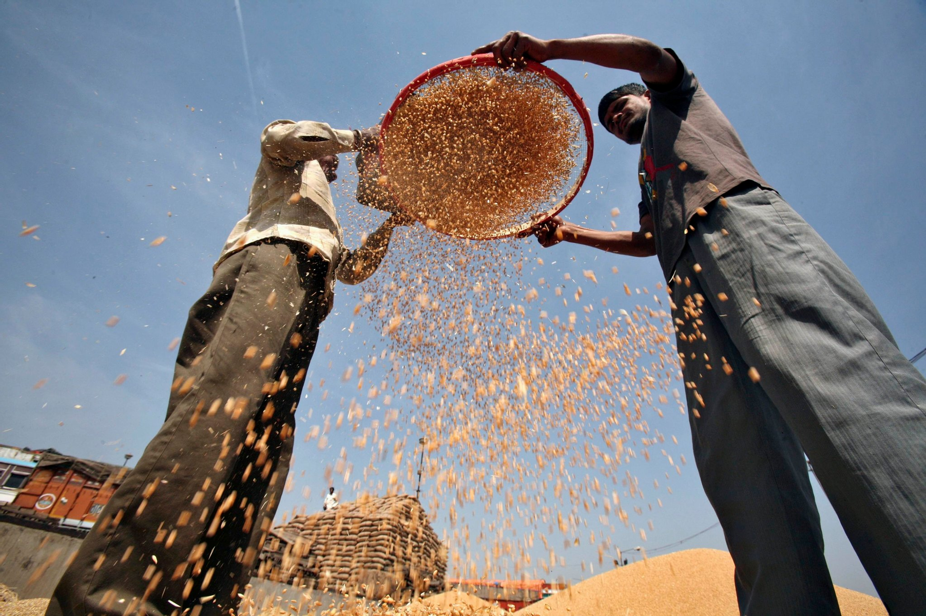
Photo Slide>>>>>>>>

Slide 33
Shake
Sometimes God has to shake us to get our attention if we've tried to excuse ourselves from being used by Him.

Slide 34
Hebrews 12:25-29
25 See that you do not refuse Him who speaks. For if they did not escape who refused Him who spoke on earth, much more shall we not escape if we turn away from Him who speaks from heaven,

Slide 35
26 whose voice then shook the earth; but now He has promised, saying, "Yet once more I shake not only the earth, but also heaven." 27 Now this, "Yet once more," indicates the removal of those things that are being shaken, as of things that are made, that the things which cannot be shaken may remain.

Slide 36
28 Therefore, since we are receiving a kingdom which cannot be shaken, let us have grace, by which we may serve God acceptably with reverence and godly fear. 29 For our God is a consuming fire.

Slide 37
Shock
God is willing to let something into your life that will shock you into realizing that He has a call on your life.

Slide 38
Romans 8:28-29
8 And we know that all things work together for good to those who love God, to those who are the called according to His purpose. 29 For whom He foreknew, He also predestined to be conformed to the image of His Son, that He might be the firstborn among many brethren.

Slide 39
Silent
Sometimes God works deep within us, and no growth is obvious on the surface. Almost a type of a silent restlessness until we discover how to abide in Christ.

Slide 40
John 15:4-6
4 Abide in Me, and I in you. As the branch cannot bear fruit of itself, unless it abides in the vine, neither can you, unless you abide in Me. 5 I am the vine, you are the branches. He who abides in Me, and I in him, bears much fruit; for without Me you can do nothing.

Slide 41
Searching
God searches our hearts and minds to reveal sinful patterns that aren't part of who we are as His children.

Slide 42
Jeremiah 17:9-10
9 "The heart is deceitful above all things, And desperately wicked; Who can know it? 10 I, the LORD, search the heart, I test the mind, Even to give every man according to his ways, According to the fruit of his doings.

Slide 43
Separating
God separates us from sin. His call can also mean we have to leave friends and family that will corrupt you.

Slide 44
1 Corinthians 15:33-34
33 Do not be deceived: "Evil company corrupts good habits." 34 Awake to righteousness, and do not sin; for some do not have the knowledge of God. I speak this to your shame.

Slide 45
Sterilizing
If we confess our sins, He is faithful to forgive them

Slide 46
1 John 1:9-10
9 If we confess our sins, He is faithful and just to forgive us our sins and to cleanse us from all unrighteousness. 10 If we say that we have not sinned, we make Him a liar, and His word is not in us.

Slide 47
God allows Satan to sift us

Slide 48
"Lord, are You using this in my life to get me ready to be used by You?"

Slide 49
1 Thessalonians 4:13-18
13 But I do not want you to be ignorant, brethren, concerning those who have fallen asleep, lest you sorrow as others who have no hope. 14 For if we believe that Jesus died and rose again, even so God will bring with Him those who sleep in Jesus.

Slide 50
15 For this we say to you by the word of the Lord, that we who are alive and remain until the coming of the Lord will by no means precede those who are asleep. 16 For the Lord Himself will descend from heaven with a shout, with the voice of an archangel, and with the trumpet of God. And the dead in Christ will rise first.

Slide 51
17 Then we who are alive and remain shall be caught up together with them in the clouds to meet the Lord in the air. And thus we shall always be with the Lord. 18 Therefore comfort one another with these words.

Slide 52
1 Corinthians 15:50-54
50 Now this I say, brethren, that flesh and blood cannot inherit the kingdom of God; nor does corruption inherit incorruption. 51 Behold, I tell you a mystery: We shall not all sleep, but we shall all be changed-- 52 in a moment, in the twinkling of an eye, at the last trumpet. For the trumpet will sound, and the dead will be raised incorruptible, and we shall be changed.

Slide 53
53 For this corruptible must put on incorruption, and this mortal must put on immortality. 54 So when this corruptible has put on incorruption, and this mortal has put on immortality, then shall be brought to pass the saying that is written: "Death is swallowed up in victory."

Slide 54
20 Again, when a righteous man turns from his righteousness and commits iniquity, and I lay a stumbling block before him, he shall die; because you did not give him warning, he shall die in his sin, and his righteousness which he has done shall not be remembered; but his blood I will require at your hand.

Slide 55
Acts 2:38-39
38 Then Peter said to them, "Repent, and let every one of you be baptized in the name of Jesus Christ for the remission of sins; and you shall receive the gift of the Holy Spirit. 39 For the promise is to you and to your children, and to all who are afar off, as many as the Lord our God will call."

Slide 56
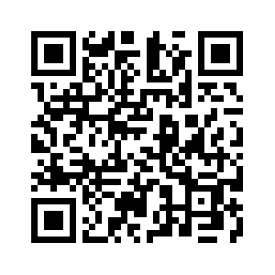
Donate with our QR code app to
Amazing Grace Christian Fellowship
Donations are Deeply Appreciated!

