Slide 3
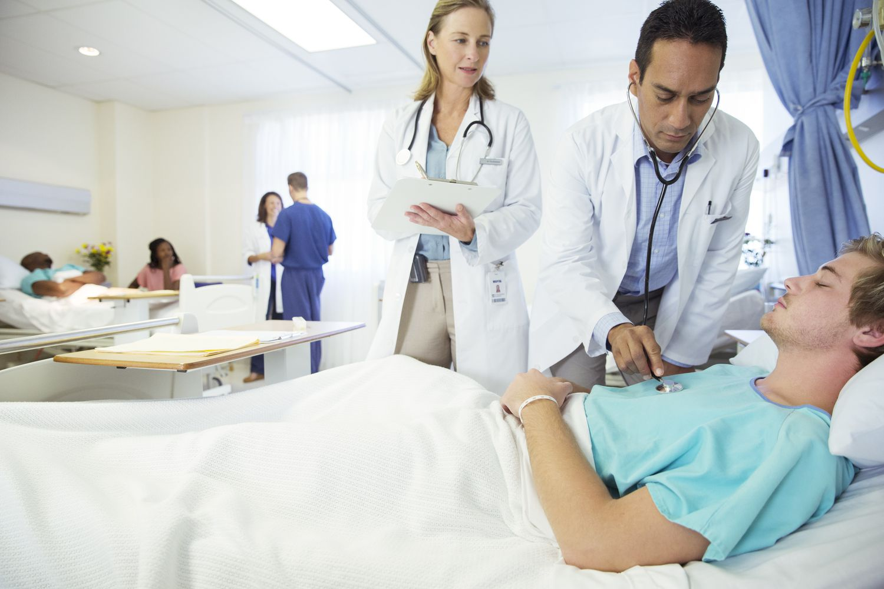
Is Anyone Among You Sick
by Pastor Fee Soliven
James 5:13-20
Sunday Morning
February 9, 2025

Slide 4
James 5:13-20
13 Is anyone among you suffering? Let him pray. Is anyone cheerful? Let him sing psalms. 14 Is anyone among you sick? Let him call for the elders of the church, and let them pray over him, anointing him with oil in the name of the Lord. 15 And the prayer of faith will save the sick, and the Lord will raise him up. And if he has committed sins, he will be forgiven.

Slide 5
16 Confess your trespasses to one another, and pray for one another, that you may be healed. The effective, fervent prayer of a righteous man avails much. 17 Elijah was a man with a nature like ours, and he prayed earnestly that it would not rain; and it did not rain on the land for three years and six months. 18 And he prayed again, and the heaven gave rain, and the earth produced its fruit.

Slide 6
19 Brethren, if anyone among you wanders from the truth, and someone turns him back, 20 let him know that he who turns a sinner from the error of his way will save a soul from death and cover a multitude of sins.

Slide 7
1 Corinthians 6:19-20
19 Or do you not know that your body is the temple of the Holy Spirit who is in you, whom you have from God, and you are not your own? 20 For you were bought at a price; therefore glorify God in your body and in your spirit, which are God's.

Slide 8
1. Is sickness a result of sin?

Slide 9
Romans 5:12
"Therefore, just as through one man sin entered the world, and death through sin, and thus death spread to all men, because all sinned--"

Slide 10
2. Is it the Lord’s will to heal everyone?

Slide 11
Psalm 103:1-3
1 Bless the LORD, O my soul; And all that is within me, bless His holy name! 2 Bless the LORD, O my soul, And forget not all His benefits: 3 Who forgives all your iniquities, Who heals all your diseases...

Slide 12
3. What role do physicians play?

Slide 13
Colossians 4:14
"Luke the beloved physician and Demas greet you"

Slide 14
4. How should we respond when the lord doesn’t heal us?

Slide 15
Romans 8:28
"And we know that all things work together for good to those who love God, to those who are the called according to His purpose"

Slide 16
5. Can unbelievers expect God to answer their prayers for healing?

Slide 17
Romans 10:11-12
11 For the Scripture says, "Whoever believes on Him will not be put to shame." 12 For there is no distinction between Jew and Greek, for the same Lord over all is rich to all who call upon Him. 13 For "whoever calls on the name of the LORD shall be saved."

Slide 18
6. Can sickness in the life of a believer be profitable?

Slide 19
Psalm 119:71
It is good for me that I have been afflicted, That I may learn Your statutes.

Slide 20
Romans 8:29
"For whom He foreknew, He also predestined to be conformed to the image of His Son, that He might be the firstborn among many brethren"

Slide 21
7. Whoever wants to receive prayer for healing must be willing to ask for it

Slide 22
Acts 20:28
"Therefore take heed to yourselves and to all the flock, among which the Holy Spirit has made you overseers, to shepherd the church of God which He purchased with His own blood"

Slide 23
8. The elders should pray, anointing him or her with oil

Slide 24
Psalm 133:1-2
1 Behold, how good and how pleasant it is For brethren to dwell together in unity! 2 It is like the precious oil upon the head, Running down on the beard, The beard of Aaron, Running down on the edge of his garments.

Slide 25
9. It should all be done in the Name of the Lord Jesus

Slide 26
Colossians 3:17
"And whatever you do in word or deed, do all in the name of the Lord Jesus, giving thanks to God the Father through Him"

Slide 27
10. Hearts of Faith

Slide 28
1 Peter 1:6-7
6 In this you greatly rejoice, though now for a little while, if need be, you have been grieved by various trials, 7 that the genuineness of your faith, being much more precious than gold that perishes, though it is tested by fire, may be found to praise, honor, and glory at the revelation of Jesus Christ

Slide 29
11. Pure Hearts

Slide 30
Matthew 5:8
"Blessed are the pure in heart, For they shall see God"

Slide 31
12. Righteous lifestyles

Slide 32
Why don’t Christians always follow this pattern?

Slide 33
13. They think this pattern only applied to the First Century Church

Slide 34
2 Timothy 3:16-17
16 All Scripture is given by inspiration of God, and is profitable for doctrine, for reproof, for correction, for instruction in righteousness, 17 that the man of God may be complete, thoroughly equipped for every good work.

Slide 35
14. They don’t believe it works today

Slide 36
Hebrews 13:8-9
8 Jesus Christ is the same yesterday, today, and forever. 9 Do not be carried about with various and strange doctrines. For it is good that the heart be established by grace, not with foods which have not profited those who have been occupied with them.

Slide 37
15. They’re too embarrassed to admit that they need help

Slide 38
Romans 1:16-17
16 For I am not ashamed of the gospel of Christ, for it is the power of God to salvation for everyone who believes, for the Jew first and also for the Greek. 17 For in it the righteousness of God is revealed from faith to faith; as it is written, "The just shall live by faith."

Slide 39
16. They’re too Proud to ask for help

Slide 40
Proverbs 16:18-19
18 Pride goes before destruction, And a haughty spirit before a fall. 19 Better to be of a humble spirit with the lowly, Than to divide the spoil with the proud.

Slide 41
17. They’re afraid to pray for others because their prayers might not be answered.

Slide 42
James 1:5-8
5 If any of you lacks wisdom, let him ask of God, who gives to all liberally and without reproach, and it will be given to him. 6 But let him ask in faith, with no doubting, for he who doubts is like a wave of the sea driven and tossed by the wind. 7 For let not that man suppose that he will receive anything from the Lord; 8 he is a double-minded man, unstable in all his ways.

Slide 43
18. They’re too embarrassed to confess their sins to someone else

Slide 44
James 5:15
Confess your trespasses to one another, and pray for one another, that you may be healed. The effective, fervent prayer of a righteous man avails much.

Slide 45
19. They’re consumed with their own needs and believe they don’t have time to sympathize with or pray for others

Slide 46
Is Anyone Among You Sick

Slide 47
Romans 15:1-4
1 We then who are strong ought to bear with the scruples of the weak, and not to please ourselves. 2 Let each of us please his neighbor for his good, leading to edification. 3 For even Christ did not please Himself; but as it is written, "The reproaches of those who reproached You fell on Me."

Slide 48
4 For whatever things were written before were written for our learning, that we through the patience and comfort of the Scriptures might have hope.
.

Slide 49
20. They have sin in their lives and doubt that God can heal

Slide 50
1 John 1:7-10
7 But if we walk in the light as He is in the light, we have fellowship with one another, and the blood of Jesus Christ His Son cleanses us from all sin. 8 If we say that we have no sin, we deceive ourselves, and the truth is not in us.

Slide 51
9 If we confess our sins, He is faithful and just to forgive us our sins and to cleanse us from all unrighteousness. 10 If we say that we have not sinned, we make Him a liar, and His word is not in us.

Slide 52
21. They don’t feel worthy to be used
by the Lord

Slide 53
Philippians 4:13
"I can do all things through Christ who strengthens me"

Slide 54
1 Thessalonians 4:13-18
13 But I do not want you to be ignorant, brethren, concerning those who have fallen asleep, lest you sorrow as others who have no hope. 14 For if we believe that Jesus died and rose again, even so God will bring with Him those who sleep in Jesus.

Slide 55
15 For this we say to you by the word of the Lord, that we who are alive and remain until the coming of the Lord will by no means precede those who are asleep. 16 For the Lord Himself will descend from heaven with a shout, with the voice of an archangel, and with the trumpet of God. And the dead in Christ will rise first.

Slide 56
17 Then we who are alive and remain shall be caught up together with them in the clouds to meet the Lord in the air. And thus we shall always be with the Lord. 18 Therefore comfort one another with these words.

Slide 57
1 Corinthians 15:50-54
50 Now this I say, brethren, that flesh and blood cannot inherit the kingdom of God; nor does corruption inherit incorruption. 51 Behold, I tell you a mystery: We shall not all sleep, but we shall all be changed-- 52 in a moment, in the twinkling of an eye, at the last trumpet. For the trumpet will sound, and the dead will be raised incorruptible, and we shall be changed.

Slide 58
53 For this corruptible must put on incorruption, and this mortal must put on immortality. 54 So when this corruptible has put on incorruption, and this mortal has put on immortality, then shall be brought to pass the saying that is written: "Death is swallowed up in victory."

Slide 59
20 Again, when a righteous man turns from his righteousness and commits iniquity, and I lay a stumbling block before him, he shall die; because you did not give him warning, he shall die in his sin, and his righteousness which he has done shall not be remembered; but his blood I will require at your hand.

Slide 60
Acts 2:38-39
38 Then Peter said to them, "Repent, and let every one of you be baptized in the name of Jesus Christ for the remission of sins; and you shall receive the gift of the Holy Spirit. 39 For the promise is to you and to your children, and to all who are afar off, as many as the Lord our God will call."

Slide 61
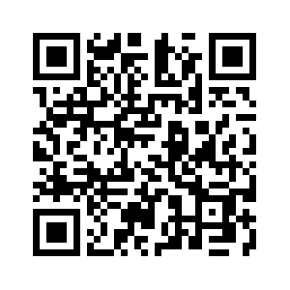
Donate with our QR code app to
Amazing Grace Christian Fellowship
Donations are Deeply Appreciated!

